Slide 1
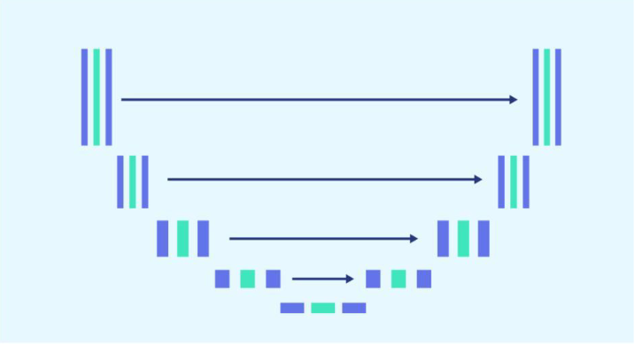
<Cancer Chaimpain>
Sezan Prudence Hessou
<Xiwu Dai>
<Sezan P Hessou>
<Wassam qayytum>
<Dennis Z Shen>
<Oliver Tabibzadeh>

Slide 2
The Problem
What is the problem?
X-ray Image – Chest --→ Cancerous?
Who has this problem?
Diagnostic Imaging
Why should this problem be solved?
Reduce Cost
How will I know this problem has been solved?
Accuracy Analysis

Slide 3
Background Information
Use Image Dataset To Train A U-Net Model
Dataset:
- https://www.kaggle.com/datasets/newra008/lung-mask-image-dataset
Model:
- U-Net
Reference:
- https://paperswithcode.com/method/u-net
- https://www.geeksforgeeks.org/u-net-architecture-explained/
- https://www.kaggle.com/datasets/newra008/lung-mask-image-dataset
- https://www.openai.com/chatgpt

Slide 4
Workable Solutions
Plan A
U-Net Model
Dataset:
Plan B #1
Plan B #2
Pretrainded Lung ResNet50 KD
Dataset:
Build from Scrach
https://www.kaggle.com/
datasets/newra008/
lung-mask-image-dataset
Dataset:
Build from Scrach
https://www.kaggle.com/
datasets/andrewmvd/
lung-and-colon-cancer histopathological-images
https://www.kaggle.com/
datasets/andrewmvd/
lung-and-colon-cancer-histopathological-images
Introduce pretrained
CNN Model
Reduced Input Size
Reduced Input Size
Reduced Input Size
Add on Interface

Slide 5
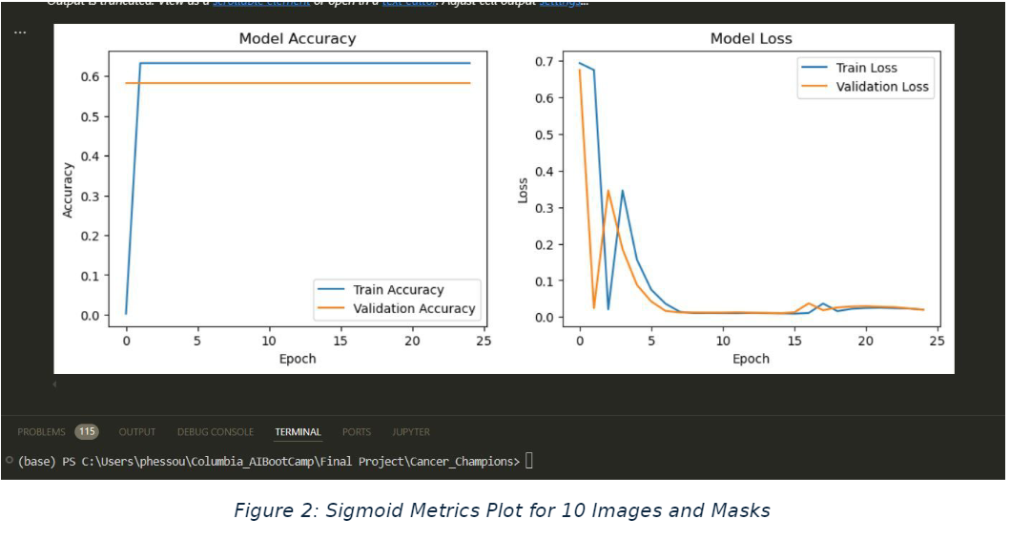
U-Net Model Result

Slide 6
U-Net Model Result

Slide 7
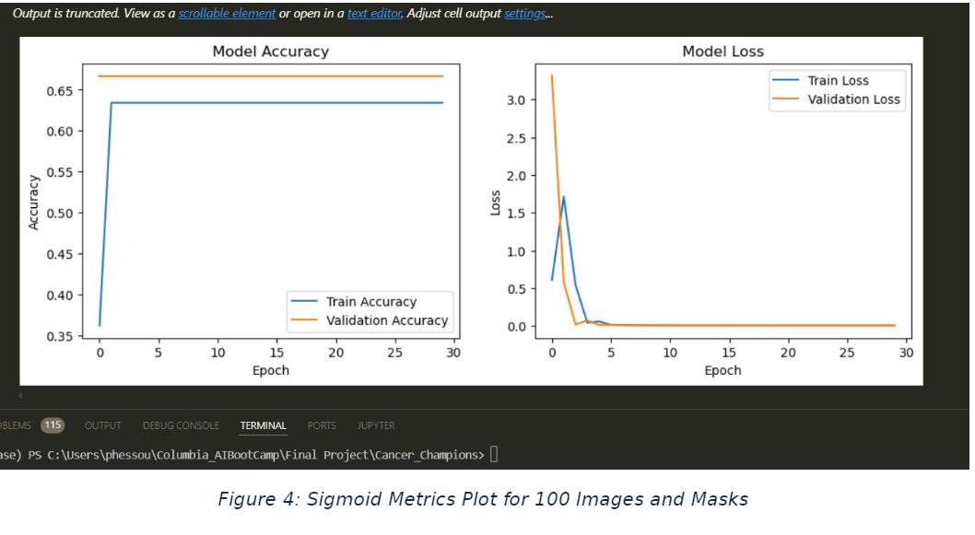
U-Net Model Result

Slide 8
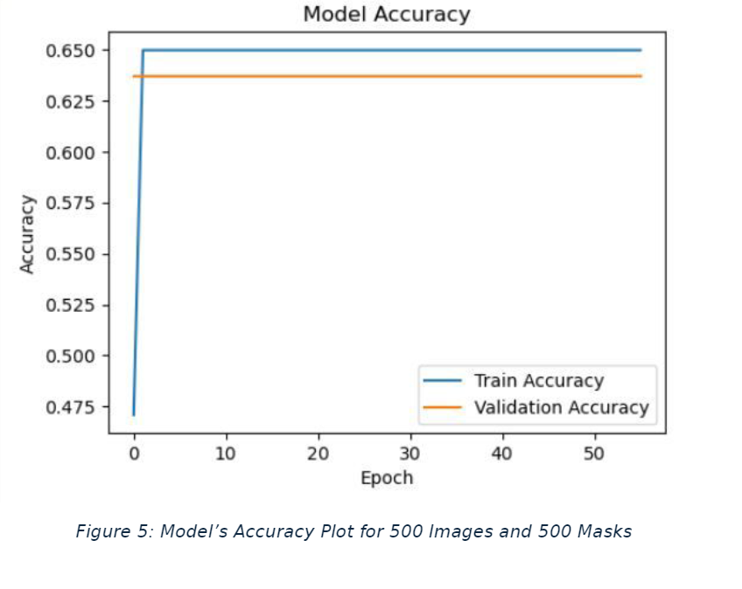
U-Net Model Result

Slide 9
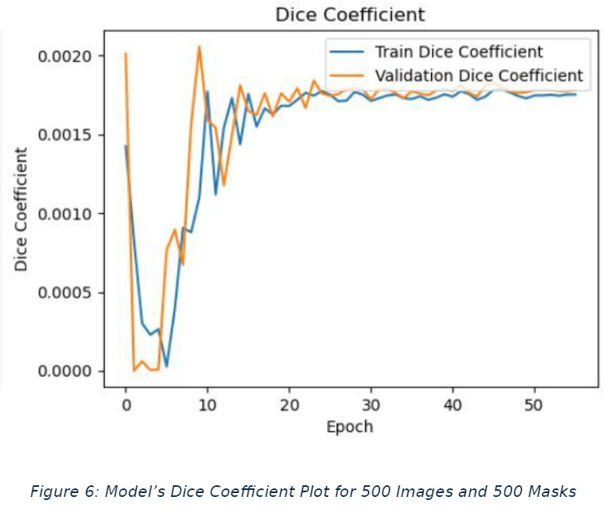
U-Net Model Result

Slide 10
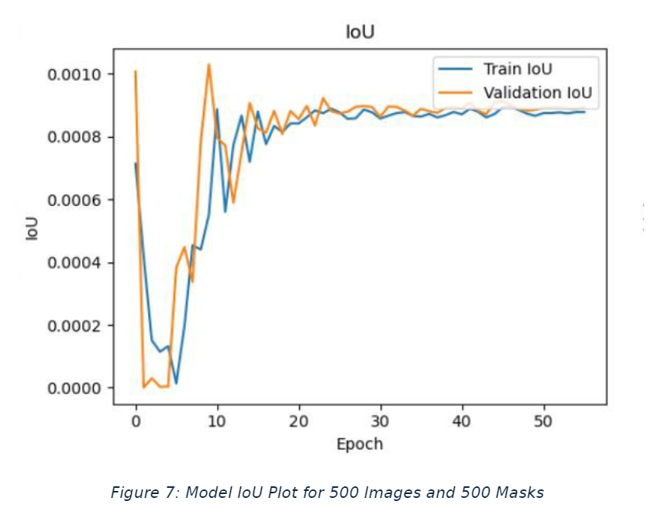
U-Net Model Result

Slide 11
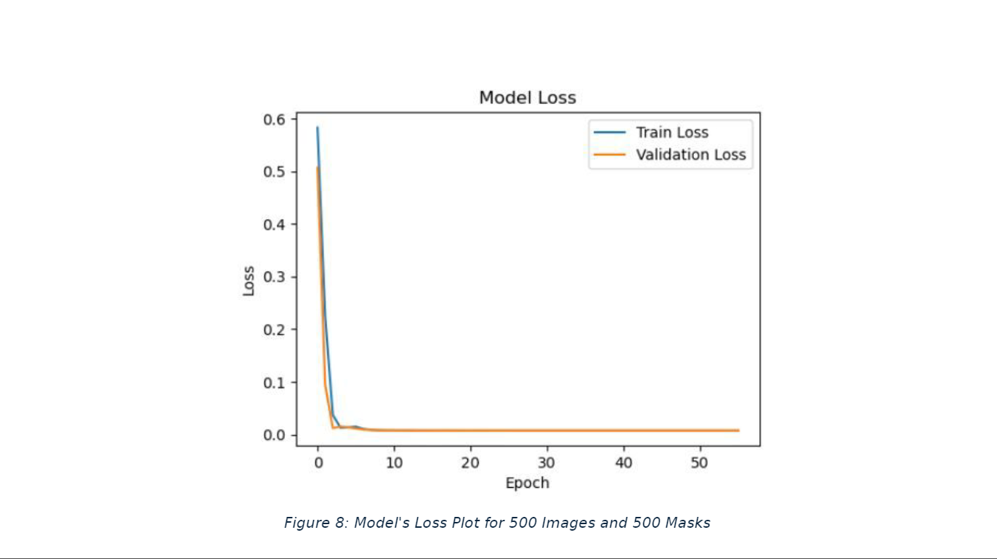
U-Net Model Result

Slide 12
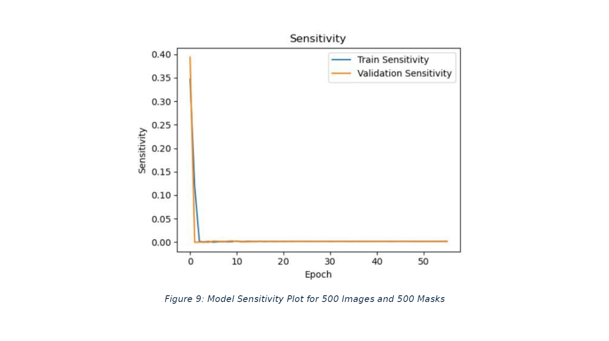
U-Net Model Result

Slide 13
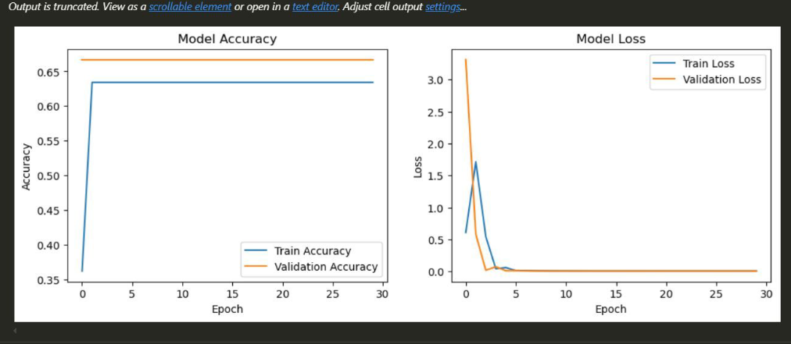
U-Net Model Result

Slide 14
Conclusion
We successfully built a U-Net Model from Scrach
We faced and overcame the unexpected challenges as a team
The project will be used in future work

Slide 15
discussion
How U-Net Works
U-Net Pros and Cons
Dataset and Model Selection

Slide 16
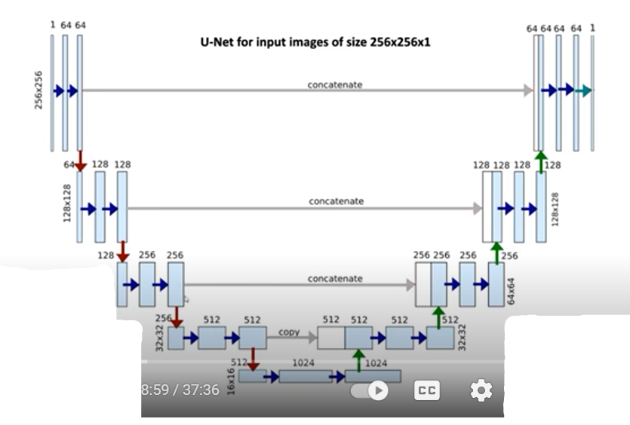

Slide 17
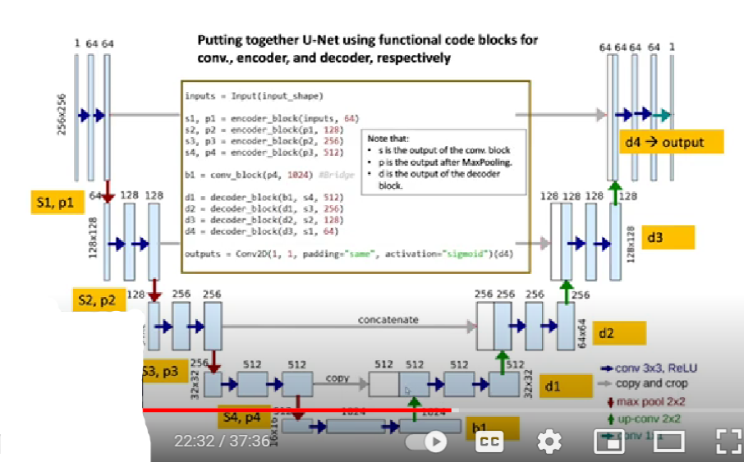
U-Net Model Result

Slide 18
Suggestions For Future Work:
Hyperparameters tuning for better accuracy and lower loss
Batch size manipulation to attain optimal results
Learning rate and epoch manipulation to achieve better outcome

