Slide 1
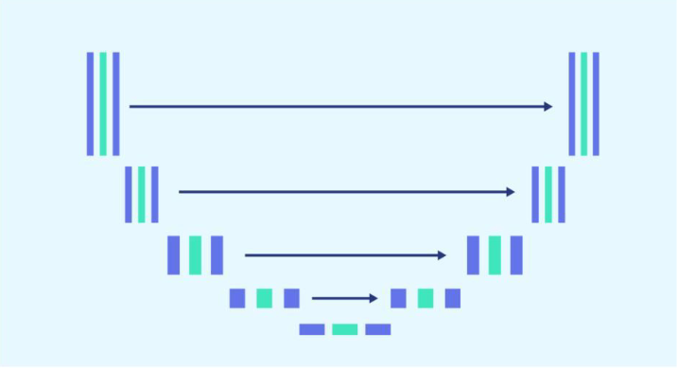
<Cancer ChampiOnS>
Sezan Prudence Hessou
Xiwu Dai
Sezan P Hessou
Wassam qayYum
Dennis Z Shen
Oliver Tabibzadeh

Slide 2
Background Information
Introduction
Problem Statement
Solution

Slide 3
The Problem
Issue
X-ray Image – Chest --→ Cancerous?
Stakeholders
Biomedical Imagery Professionals + Cancer Patients
Why should this problem be solved?
Efficiency, Cost, Resolution
Metrics
Accuracy, Loss, Dice Coefficient, IoU

Slide 4
Workable Solutions
Initial Plan
Plan A
Pre-trained U-Net Model/FAILURE
Plan B
Dataset:
https://www.kaggle.com/
datasets/andrewmvd/
lung-and-colon-cancer-histopathological-images
Introduce pretrained
Pre-trained CNN Model
Reduced Input Size
Pre-trained Lung ResNet50 KD
Dataset:
https://www.kaggle.com/
datasets/andrewmvd/
lung-and-colon-cancer histopathological-images
Reduced Input Size
Build from Scrach
Add on Interface
Dataset:
https://www.kaggle.com/
datasets/newra008/
lung-mask-image-dataset
Reduced Input Size
U-Net Model from Scratch/SUCCESS

Slide 5
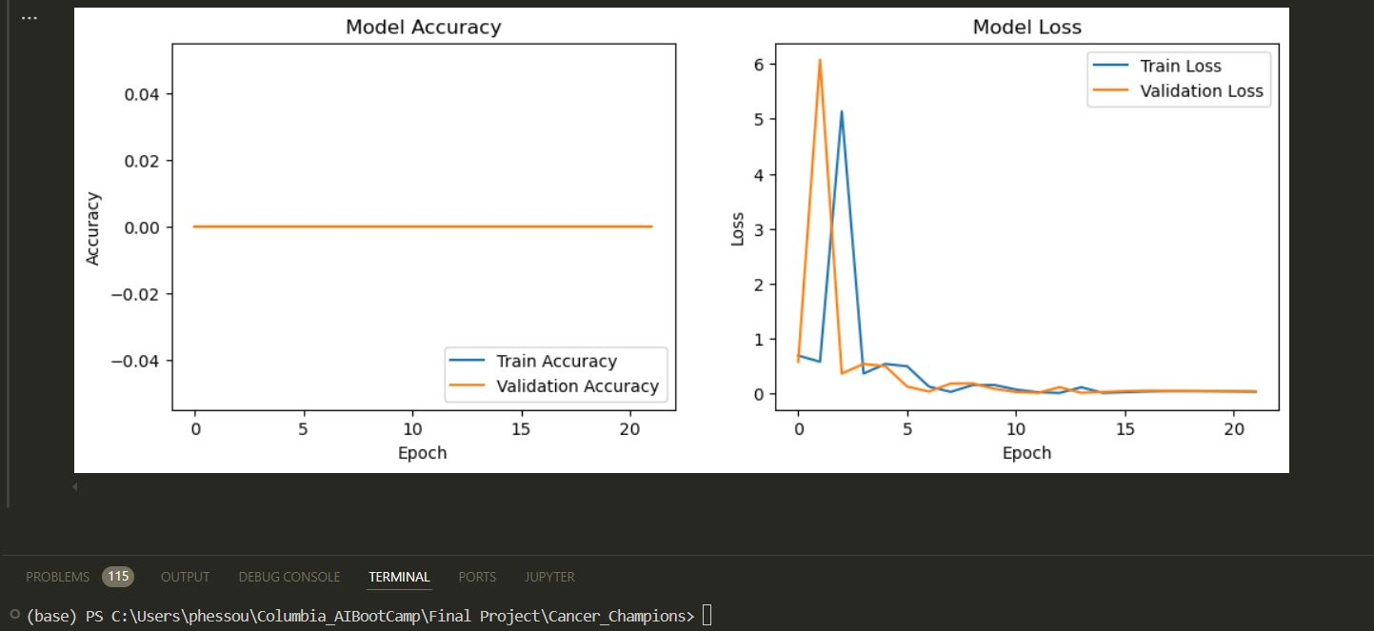
U-Net Model Result
Figure 1: Softmax Metrics Plot for 10 Images and Masks

Slide 6
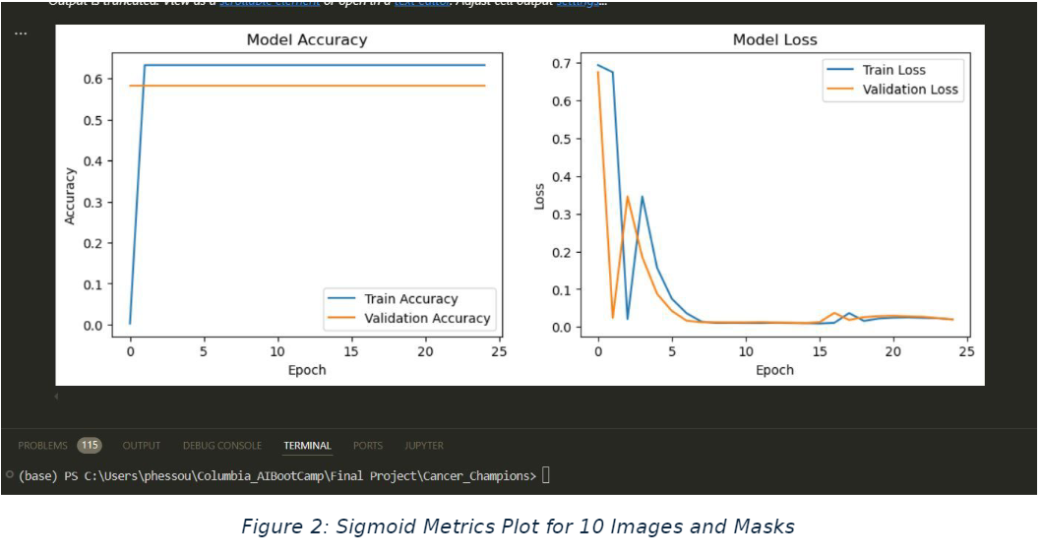
U-Net Model Result

Slide 7
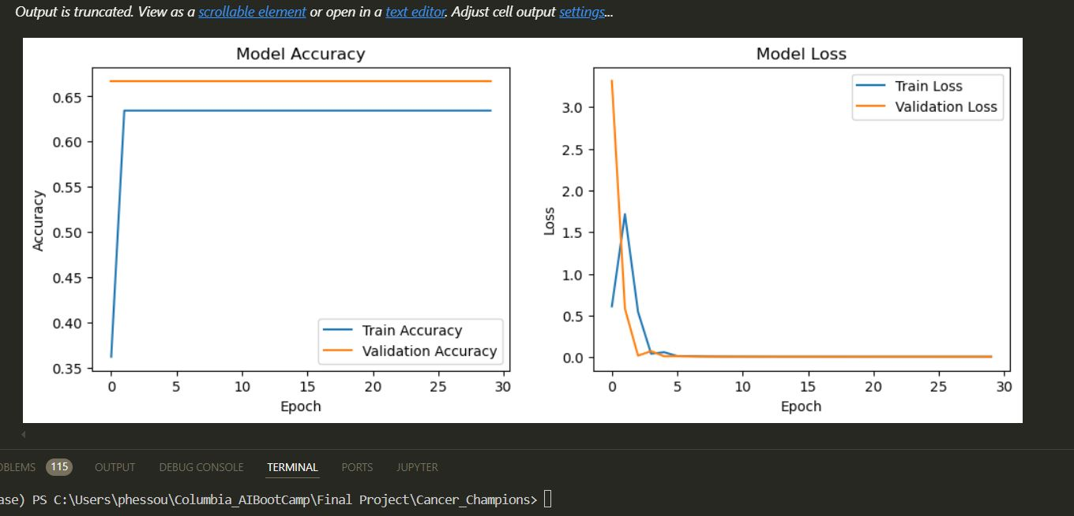
U-Net Model Result
Figure 3: Sigmoid Metrics Plot for 100 Images and Masks

Slide 8
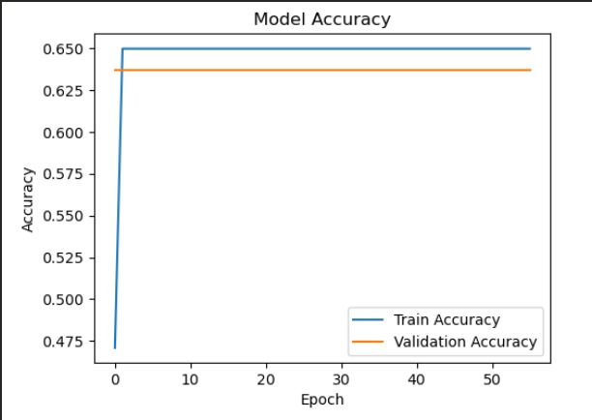
U-Net Model Result
Figure 4: Model’s Accuracy Plot for 500 Images and 500 Masks

Slide 9
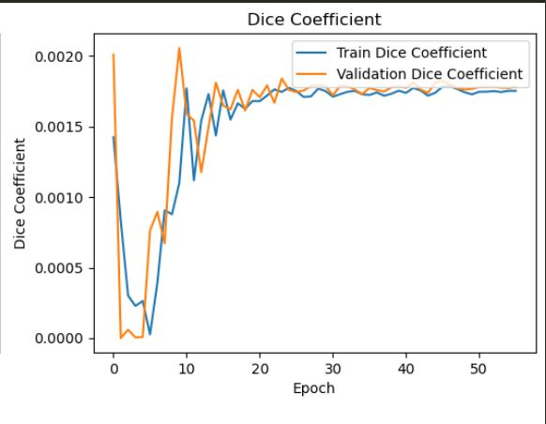
U-Net Model Result
Figure 5: Model’s Dice Coefficient Plot for 500 Images and 500 Masks

Slide 10
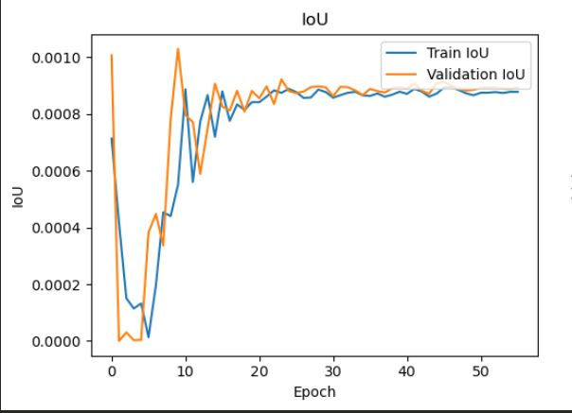
U-Net Model Result
Figure 7: Model IoU Plot for 500 Images and 500 Masks

Slide 11
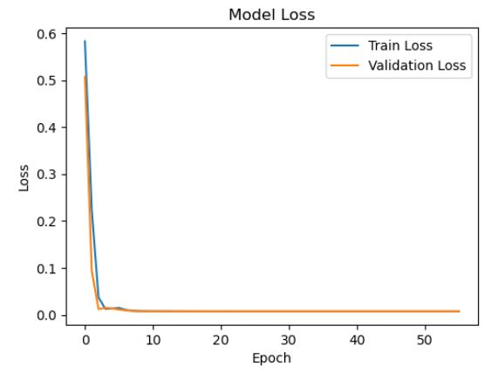
U-Net Model Result
Figure 7: Model's Loss Plot for 500 Images and 500 Masks

Slide 12
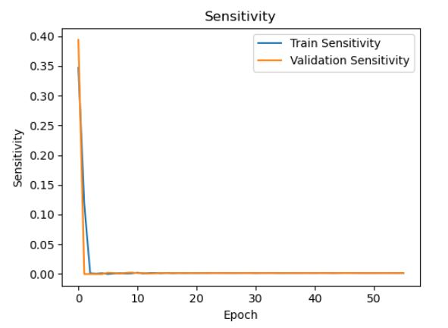
U-Net Model Result
Figure 8: Model Sensitivity Plot for 500 Images and 500 Masks

Slide 13
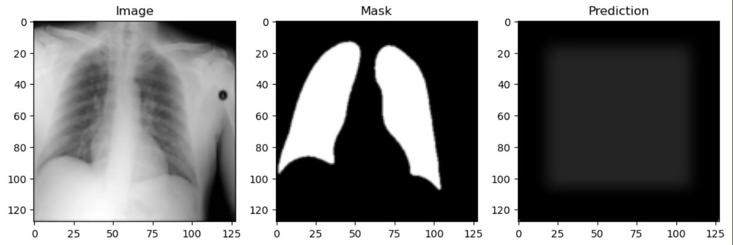
U-Net Model Result
Figure 9: Image-Mask-Prediction

Slide 14
discussion
How U-Net Works?
U-Net Pros and Cons
Dataset and Model Selection

Slide 15
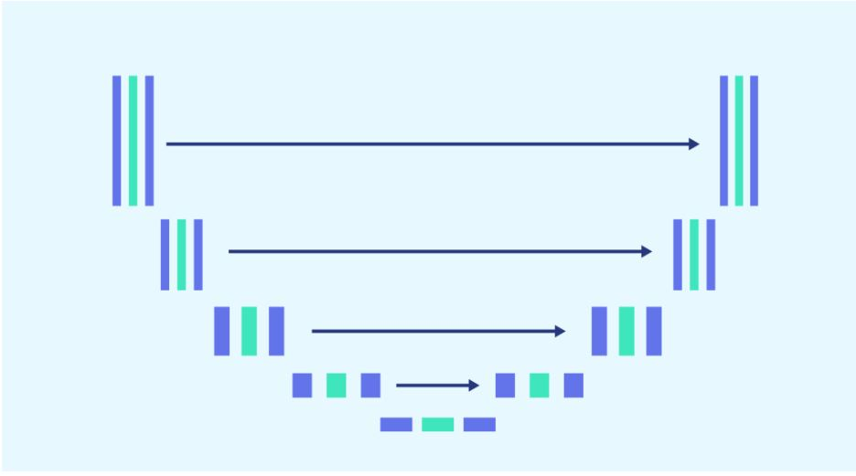
Figure 12: U-Net Model Architecture (U-shape)

Slide 16
Conclusion
Successfully U-Net Model from Scratch
Challenges

Slide 17
Compliance & Ethics
HIPAA & GDPR
Bias Removal/Anonymity
Responsible Use

Slide 18
Future Work
Hyperparameters tuning for better accuracy and lower loss
Batch size manipulation to attain optimal results
Learning rate and epoch manipulation to achieve better outcome

Slide 19
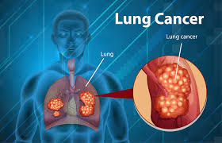
Q & A

