Slide 1
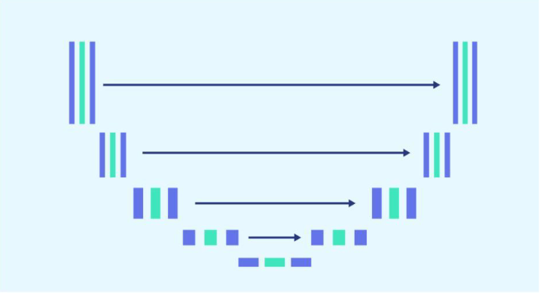
<Cancer ChampiOnS>
Sezan Prudence Hessou
<Xiwu Dai>
<Sezan P Hessou>
<Wassam qayYum>
<Dennis Z Shen>
<Oliver Tabibzadeh>

Slide 2
Background Information
Introduction
Problem Statement
Solution

Slide 3
The Problem
Issue
X-ray Image – Chest --→ Cancerous?
Stakeholders
Biomedical Imagery
Why should this problem be solved?
Efficiency & Cost
Metrics
Accuracy Analysis

Slide 4
Workable Solutions
Initial Plan
Plan A
Pre-trained U-Net Model/FAILURE
Plan B
Dataset:
https://www.kaggle.com/
datasets/andrewmvd/
lung-and-colon-cancer-histopathological-images
Introduce pretrained
Pre-trained CNN Model
Reduced Input Size
Pre-trained Lung ResNet50 KD
Dataset:
https://www.kaggle.com/
datasets/andrewmvd/
lung-and-colon-cancer histopathological-images
Reduced Input Size
Build from Scrach
Add on Interface
Dataset:
https://www.kaggle.com/
datasets/newra008/
lung-mask-image-dataset
Reduced Input Size
U-Net Model from Scratch/SUCCESS

Slide 5
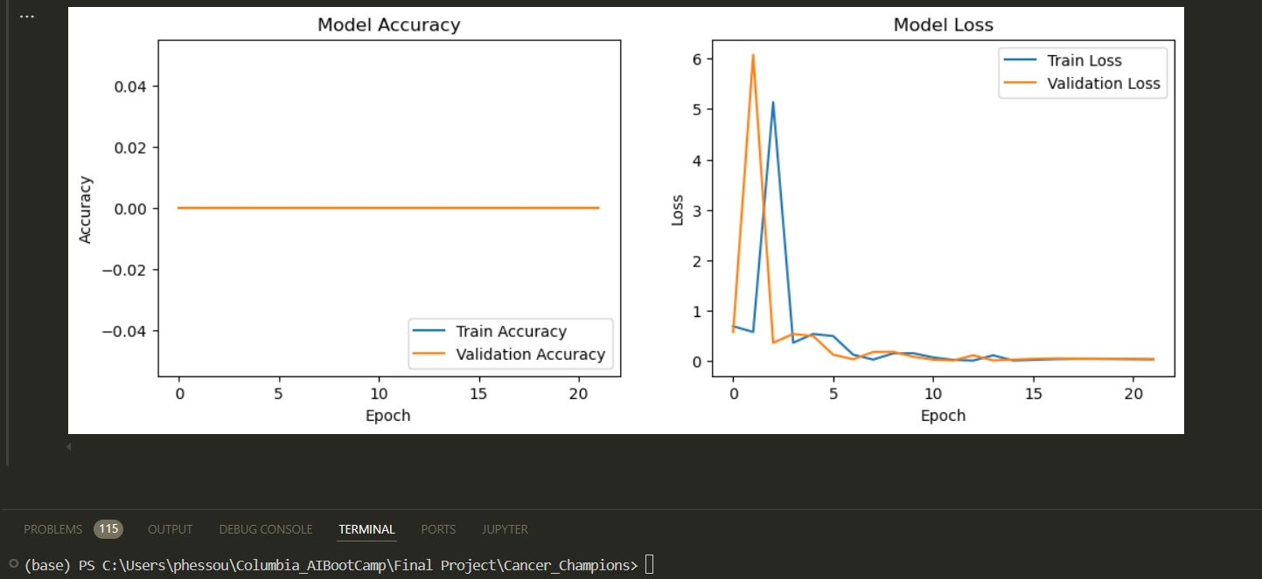
U-Net Model Result
Figure 3: Softmax Metrics Plot for 10 Images and Masks

Slide 6
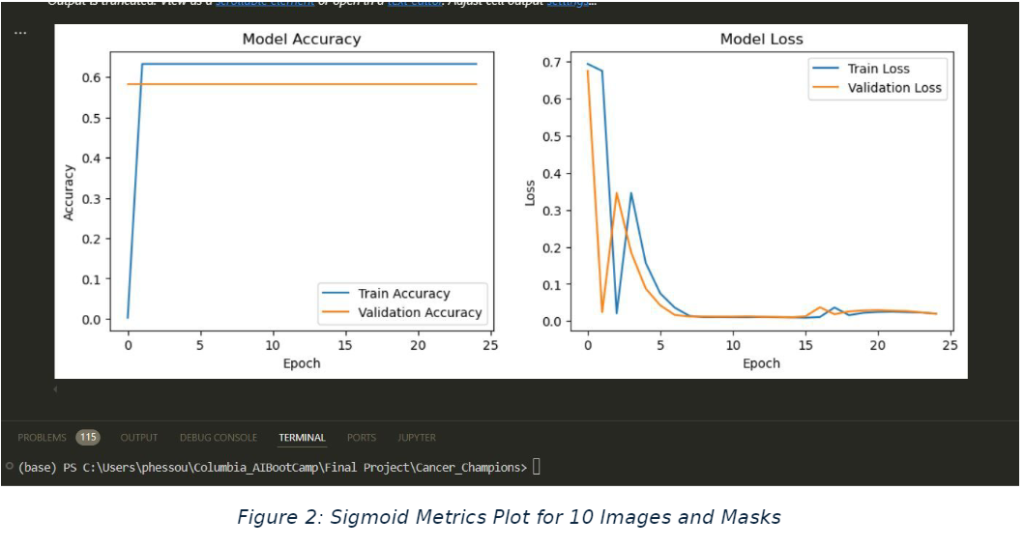
U-Net Model Result

Slide 7
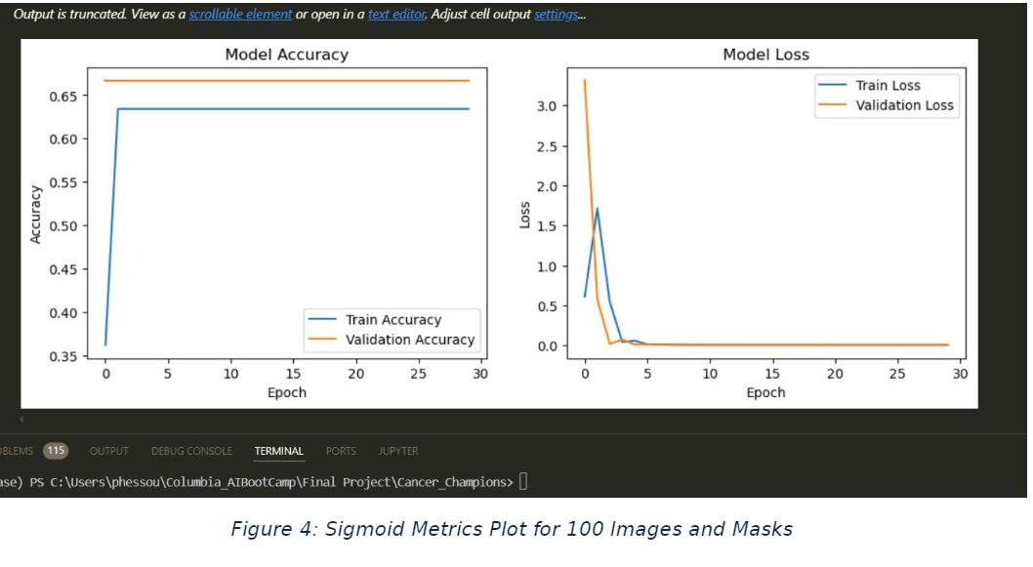
U-Net Model Result

Slide 8
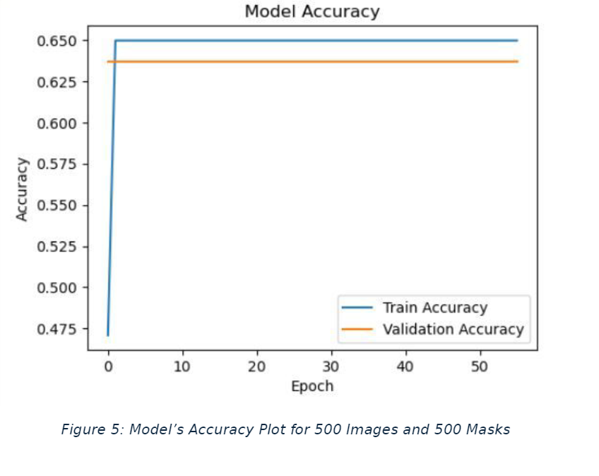
U-Net Model Result

Slide 9
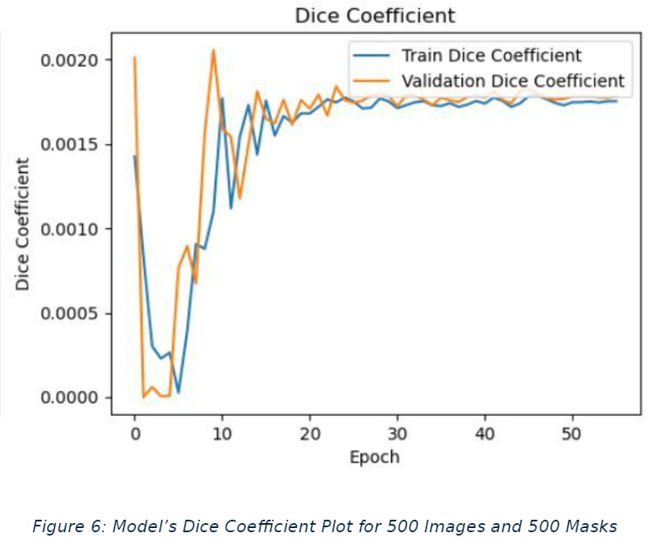
U-Net Model Result

Slide 10
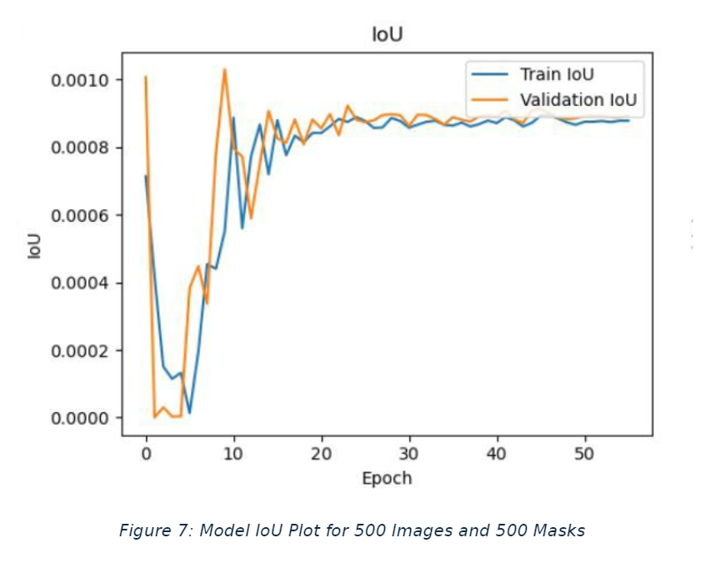
U-Net Model Result

Slide 11
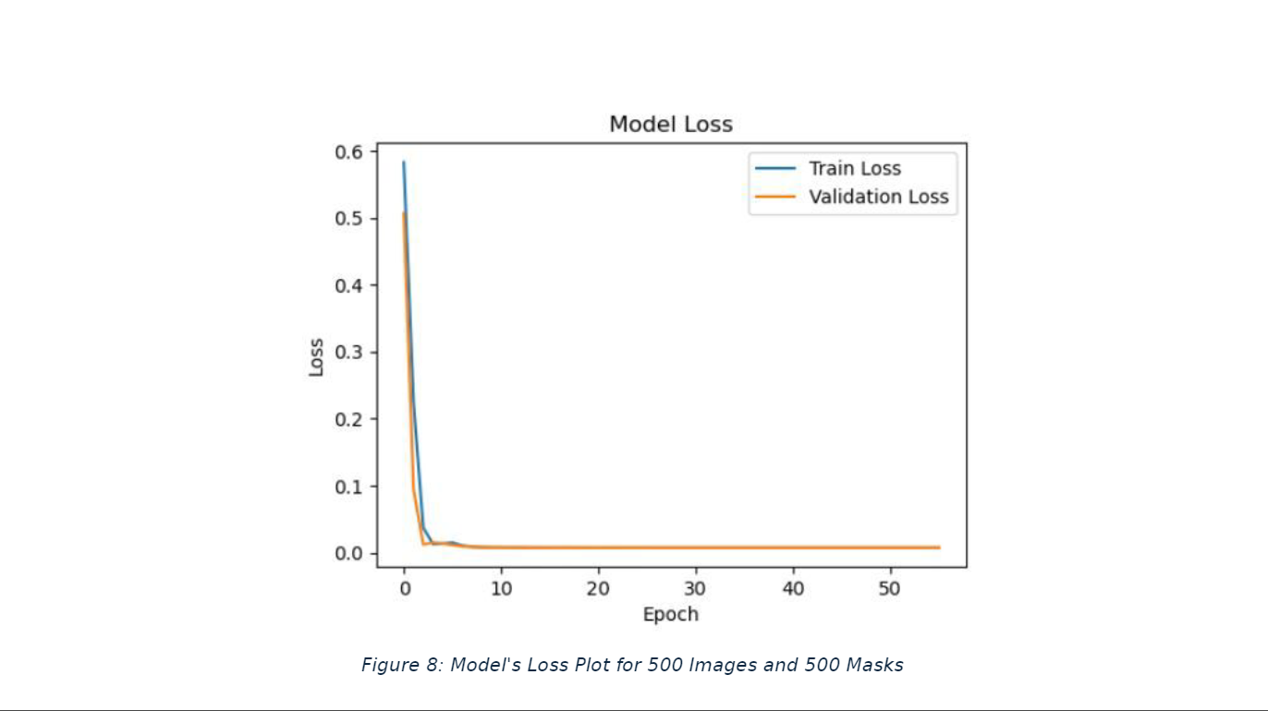
U-Net Model Result

Slide 12
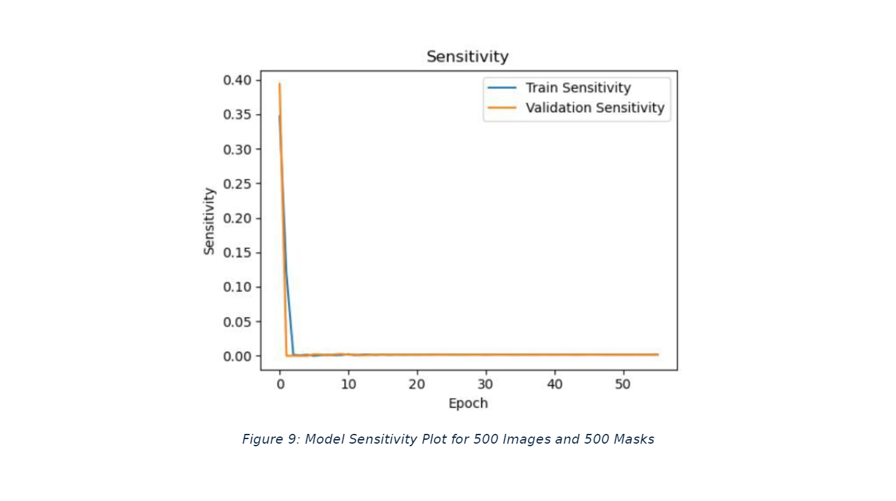
U-Net Model Result

Slide 13
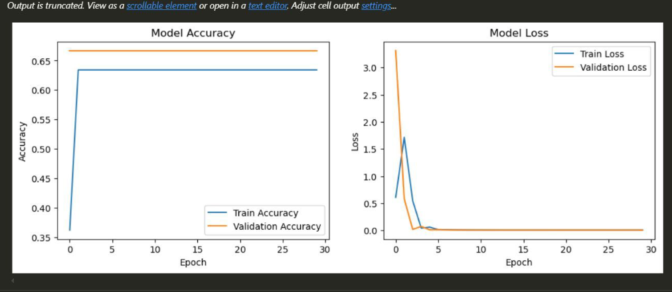
U-Net Model Result

Slide 14
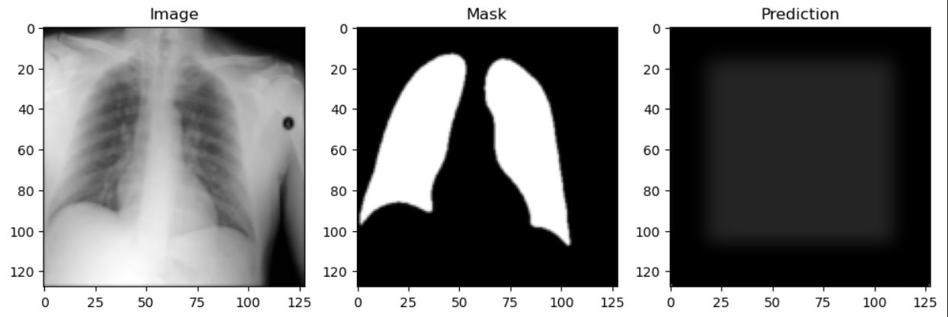
U-Net Model Result

Slide 15
discussion
How U-Net Works?
U-Net Pros and Cons
Dataset and Model Selection

Slide 16
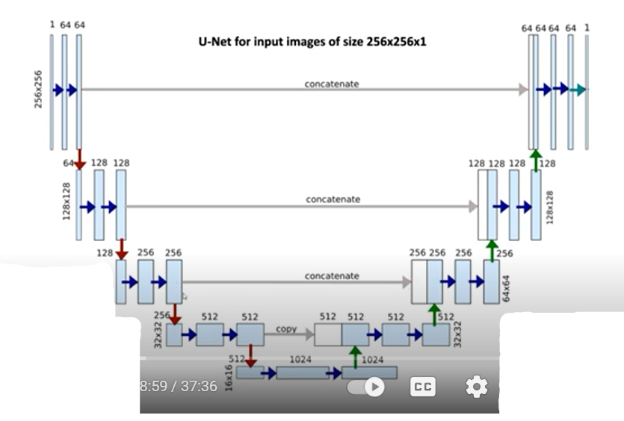

Slide 17
Conclusion
Successfully U-Net Model from Scratch
Team Challenges

Slide 18
Suggestions For Future Work
Hyperparameters tuning for better accuracy and lower loss
Batch size manipulation to attain optimal results
Learning rate and epoch manipulation to achieve better outcome

