Slide 1


Water Quality Control in Industrial Fish Hatcheries

Slide 2
Content
Project Overview
Problem Statement
Project Goal & Objectives
Proposed Solution
Resources Utilized
System Design
Implementation Details
Results & Observations
Advantages & Limitations
Future Scope
Conclusion

Slide 3

Project Overview
An IoT-Enabled Water Quality Solution for Fish Hatcheries
Domain relevance
Industrial IoT + Aquaculture Tech
Bridges embedded systems with cloud analytics for precision aquaculture
Addresses UN SDG 14 (Life Below Water) by preventing fish mortality
Technical Fusion
Embedded Systems (ESP32 + Sensors) + Cloud ML (ThingSpeak Analytics)
Real-time sensor data → Edge processing → Predictive maintenance alerts
Future ML integration for water quality forecasting
Purpose of combining Embedded Systems with ML
Prevent Losses: 24/7 monitoring of critical parameters (temp, turbidity, humidity)
Automate Decisions: Trigger corrective actions via embedded control logic
Enable Scalability: Modular design for additional sensors (dissolved oxygen/pH)

Slide 4
Problem Statement
What real-world problem are you solving?
Industrial hatcheries lose 20-30% of fish stocks annually due to:
Undetected water quality fluctuations (temperature/turbidity)
Delayed response to hazardous conditions
Manual monitoring inefficiencies
Why is it important?
Economic Impact: Prevents $Million+ losses from fish mortality
Ecological Protection: Reduces disease outbreaks in aquatic ecosystems
Food Security: Ensures stable supply for growing protein demand

Slide 5
Project Goal & Objectives
Main project goal
Develop an automated early-warning system to prevent fish mortality by maintaining optimal water conditions through real-time IoT monitoring.
Measurable objectives
Achieve 95% sensor data accuracy (vs manual measurements)
Reduce fish mortality by 30% through timely hazard detection
Cut manual monitoring costs by 50% via automation
Enable <15-minute response time to critical water parameter changes

Slide 6
Proposed Solution
System Architecture
1. ESP32 reads temperature, humidity, water turbidity, and soil moisture levels.
2. Data is processed and formatted.
3. ESP32 connects to a Wi-Fi network.
4. Data is sent to ThingSpeak via HTTP.
5. ThingSpeak displays the data as graphs on the cloud dashboard.
How an embedded system + ML are integrated
1. Edge (ESP32)
Sensors → Real-time data → Rule-based alerts
2. Cloud (ThingSpeak + ML)
Trains model → Predicts hazards → Sends insights to edge
3. Hybrid Control
Local: Immediate actions (e.g., activate aerator)
Cloud: Long-term optimizations (e.g., feeding schedule)

Slide 7
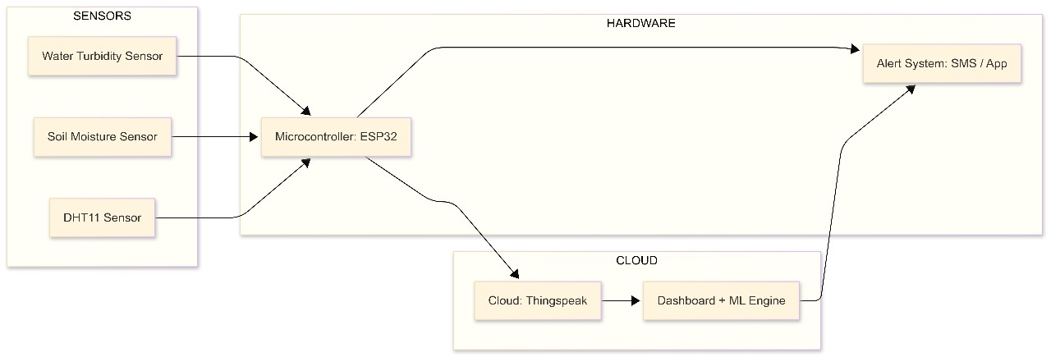
System Design
Block Diagram

Slide 8
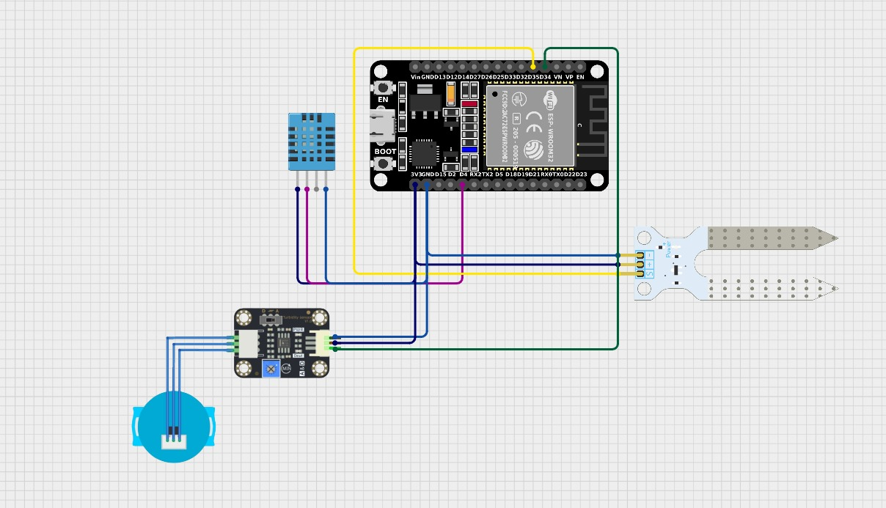
Circuit Design

Slide 9
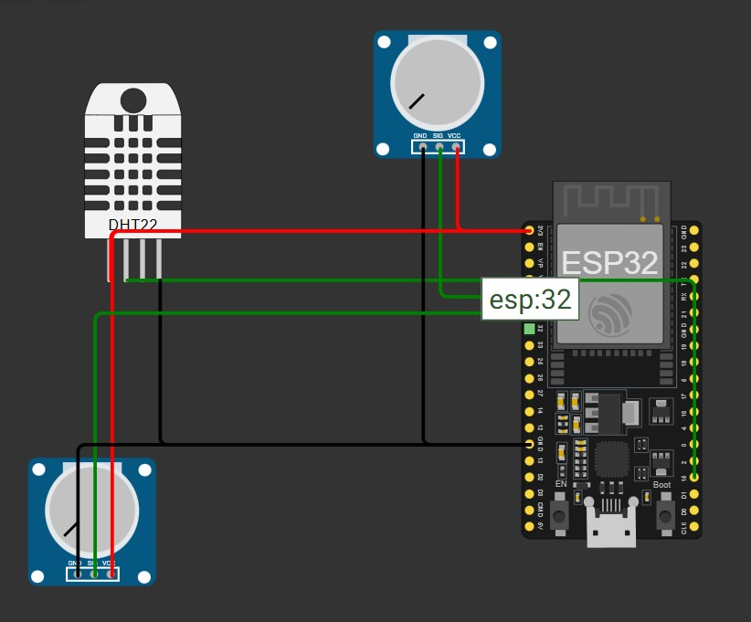
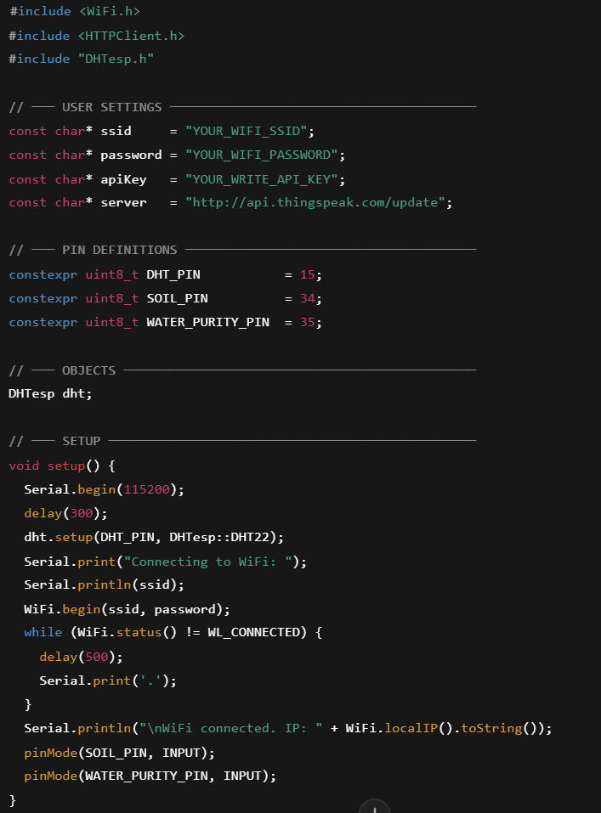
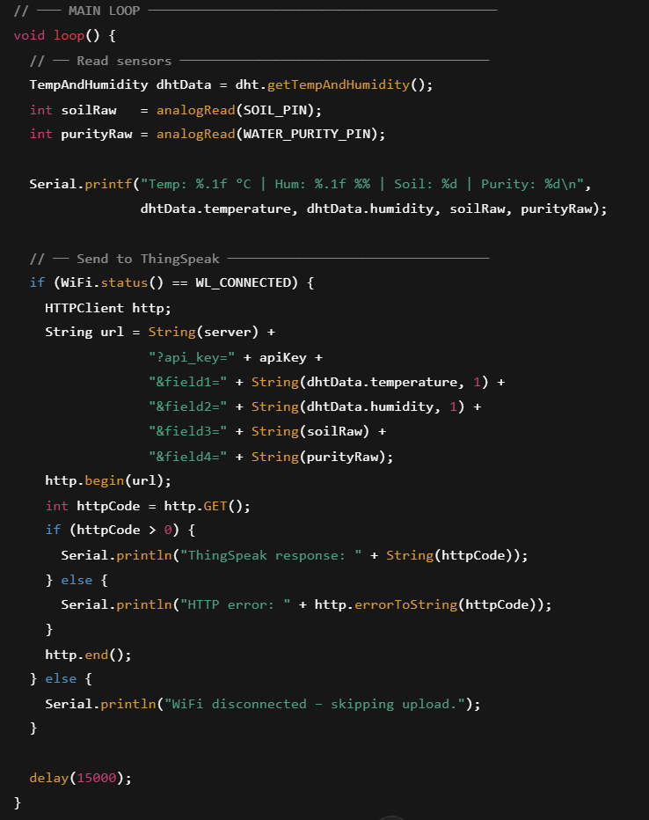
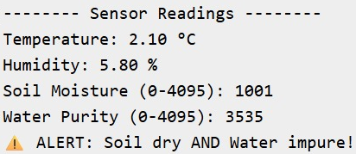
WOKWI RESULTS
SIMULATION CIRCUIT
CODE
SIMULATION OUTPUT

Slide 10
Resources Utilized
HARDWARE ESP32 microcontroller
DHT11
Turbidity Sensor
Soil Moisture Sensor
SOFTWARE & TOOLS Thingspeak
Jupiter Notebook
Wokwi Simulator
PowerBI

Slide 11
Metric | Value / Status
Sensor Read Interval | Every 15 seconds
Data Upload Time | ~1–2 seconds per transmission
Wi-Fi Connectivity | Stable with retry logic
Power Efficiency | Moderate (can be improved with deep sleep)
Data Accuracy | High (after sensor calibration)
System Uptime | 24/7 monitoring with minimal crashes
ThingSpeak Latency | Low (~1-3 sec delay in visualization)
Performance of the embedded system
Observations of hardware execution

Slide 12
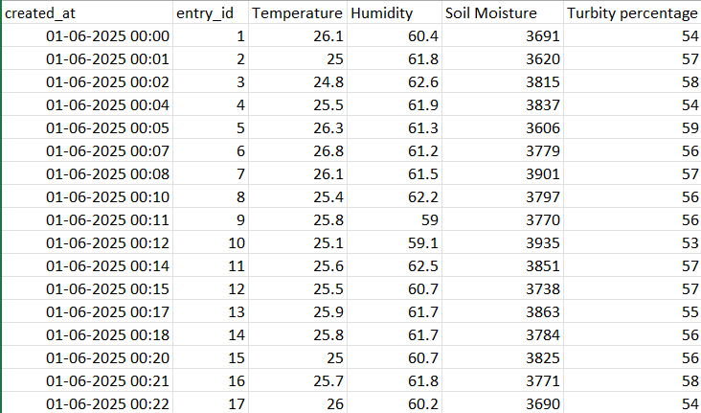
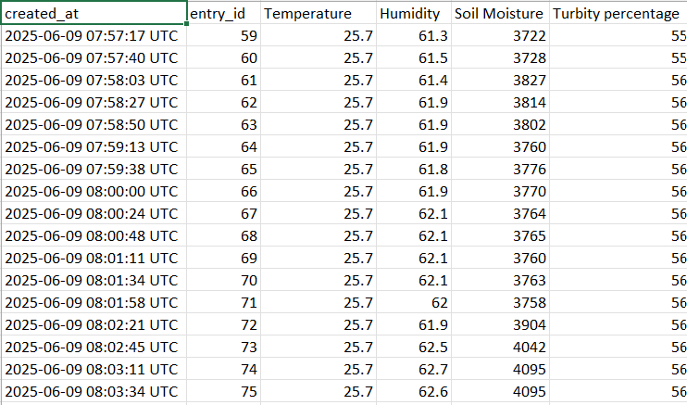
DATASET
SYNTETHIC DATA GENERATED
DATA RECEIVED FROM SENSORS
Up to 9000 values

Slide 13
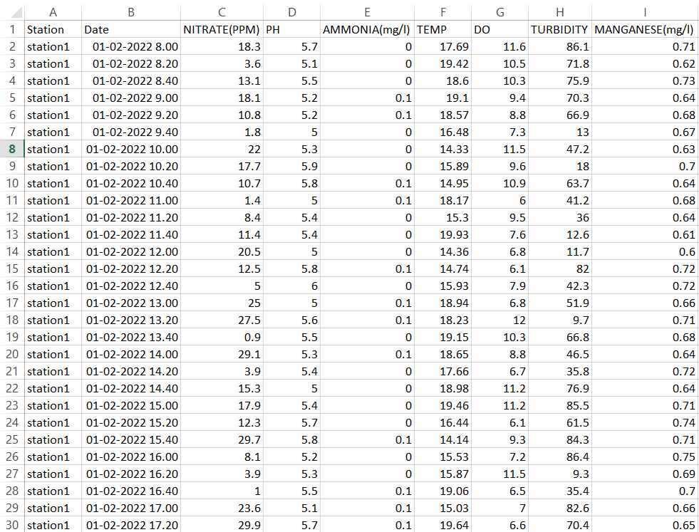
KAGGLE DATASET

Slide 14
Implementation Details
Problem Analysis
Identified water quality as
critical for fish survival
Key parameter Temperature
Humidity
Turbidity
Soil Moisture
System Architecture
ESP32 reads sensor data → connects to Wi-Fi →
sends data to ThingSpeak
Data is visualized in real-time using cloud graphs
Hardware Selection
Sensors DHT11
Turbidity Sensor
Soil Moisture Sensor
Microcontroller ESP32
Platform ThingSpeak (IoT Cloud Dashboard)
Hardware Integration
Wired ESP32 with sensors
Verified functionality using Serial Monitor

Slide 15
Implementation Details
Cloud & Dashboard Setup
Created ThingSpeak channel with 4 data fields
Configured graphs for real-time monitoring
Visual dashboards show trends
Testing & Calibration
Tested sensors under different conditions (wet/dry, clean/dirty)
Calibrated readings for accuracy
Documentation & Review
Recorded all design, code, and testing notes.
Reflected on what worked and areas to improve.
Coding & Data Processing
Developed code to
Read and map sensor data
Connect to Wi-Fi
Transmit data to ThingSpeak via HTTP

Slide 16
Machine Learning Model used
Multiple Output Classifier with Random Forest
A machine learning model designed to predict multiple target variables simultaneously, where each target is a classification problem. It leverages the Random Forest algorithm—a powerful and widely used ensemble learning method based on decision trees
WHY THIS MODEL ?
Criteria | Random Forest | Logistic Regression | SVM | Neural Network | KNN
Handles Multiple Outputs | ✅ Easy | ⚠️ Manual workaround | ⚠️ Complex | ✅ Yes | ⚠️ Manual
Non-linearity Support | ✅ Strong | ❌ Weak | ✅ Good | ✅ Strong | ✅ Medium
Feature Importance | ✅ Yes | ✅ Limited | ❌ No | ❌ No | ❌ No
Scalability | ✅ Good | ✅ Excellent | ⚠️ Medium | ⚠️ Requires tuning | ❌ Weak
Interpretability | ✅ High | ✅ Medium | ⚠️ Low | ❌ Low | ❌ None
Preprocessing Required | ✅ Minimal | ⚠️ Some | ✅ Yes | ✅ Yes | ✅ Yes

Slide 17
Forecasting Model used
The ARIMA (Auto Regressive Integrated Moving Average) model is used in this project to forecast critical water quality parameters — Temperature,
Humidity,
Turbidity, and
Soil Moisture — in a fish hatchery.
By analysing historical sensor data, ARIMA predicts future values of each parameter, enabling early action before conditions become harmful to the fish.
Need for forecasting,
Forecasting temperature helps activate heaters or coolers in advance.
Predicting turbidity allows timely filtration.
Humidity and soil moisture trends guide ventilation and drainage control.
This forecasting system runs alongside an ESP32-based sensor network, helping move from reactive monitoring to predictive control, improving fish health and operational efficiency.

Slide 18
Advantages & Limitations
Key benefits of our solution
Benefit Area | Description
Real-time Monitoring | Constant tracking of temperature, humidity, turbidity, and soil moisture.
IoT Cloud Integration | ThingSpeak dashboard enables remote visualization and historical analysis.
Automation & Alerts | Reduces human labor by automating data logging and enabling alerts.
Scalability | Modular design allows for adding more sensors (e.g., DO sensor, pH sensor).
Improved Fish Health | Early detection of poor conditions helps prevent fish death and disease.
Low Cost | Utilizes affordable components (ESP32, basic sensors).
Educational Value | Ideal for learning IoT, embedded systems, and environmental monitoring.
Extensible Design | Can integrate ML for predictive analysis and mobile notifications.

Slide 19
Advantages & Limitations
Constraints
Constraint Area | Description
Sensor Limitations | DHT11 is low-resolution; DO sensor unavailable in current build.
Accuracy and Calibration | Requires sensor calibration; turbidity and soil sensors can drift.
Power Dependency | Requires stable power; no battery or UPS backup yet.
Connectivity Required | Needs continuous Wi-Fi for ThingSpeak updates.
No Auto-Control | Currently only monitors, doesn't take corrective action (e.g., water purge).
Limited Alerting System | No SMS/mobile app alerts in current version—future feature.
Environmental Noise | Sensor readings may be affected by tank bubbles, vibrations, or placement.

Slide 20
Future Scope
Future Enhancements
Add Dissolved Oxygen Sensor
Mobile App Interface
Predictive Alerts with Machine Learning
Solar/UPS Backup for reliability

Slide 21
Conclusion
Summary of learnings
Key achievements

Slide 22
Thank you

