Slide 1
Group A
Keith Barker
Tiffany Devlin-Drye
Michael Howerter
Yeikel Valdes Santana

Slide 2
Project Overview
WebApps@UF Student Team Portal is in need of a web app to support the Teams at UF. The web app is a communication tool between the teams and a customer. This web app will be an all inclusive stop in order to stream-line management of the team.
This app will show up-to-date feedback between customer and team.
This app will allow an easier time for non-technical customers to get a better product from the team at UF.

Slide 3
Project Overview
The scope of the project focuses on a few main points:
Profile Management of the Team
Email tool between customer and team members
Project Management tools to check on status updates, read comments and a place for the customer to approve functionality of the project
Documentation stored in a central location

Slide 4
Features
Front-end:
Made changes after initial meeting of Wireframes
After further study of notes and communication with customer, further changes were made.
Began work on WebApps@UF Student Team Portal web app with making scaffold and stock pages.

Slide 5
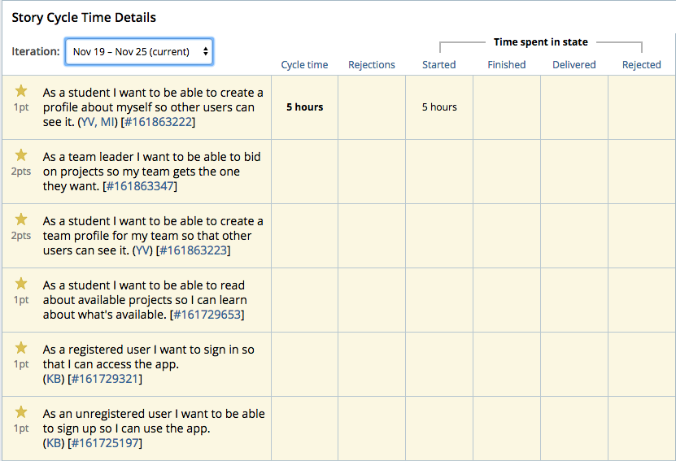
Snapshot of Sprint #2

Slide 6
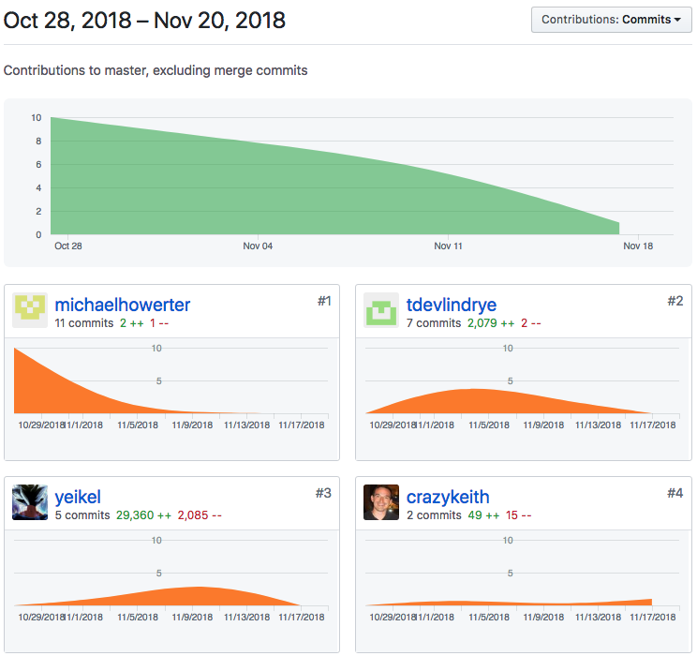
Github Snapshot

Slide 7
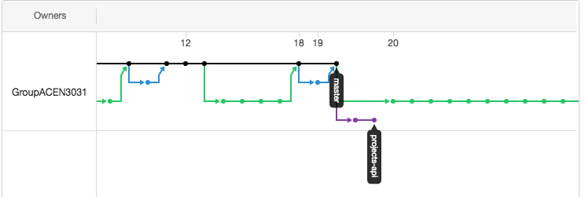
GitHub Activity:

