Slide 1


Group Project 4
Group Members: Issa Habeeb, Ali Algahim, Emran Ali, George Ebaugh, Munassar Shariff, Nadia Aktar, Rasheed Kareem

Slide 2
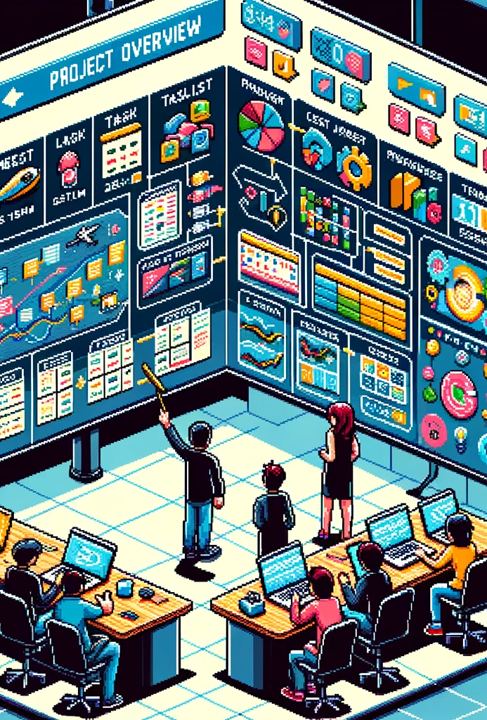
Project Overview
Added new Features to the Employee Tracker app that was created for project 3

Slide 3

Software
vHTML- The structure, and elements (such as header, body, footer) of the website.
vCSS- Styling for the elements.
vVS code- Text editor.
vPython- Programming language used to write the code.
vTkinter- Graphical user interface.
vPylint- Checked Code and Followed Requirements.
vPyinstaller- Made it into an exe

Slide 4

Website and tech Demo

Slide 5
Why Choose us?
showcasing expertise in building robust applications with user-friendly interfaces.
Our team excels in writing clean, appealing HTML and CSS styles from previous successful projects.
Our team has diverse skills, including graphic design, UX design, and programming.

Slide 6
Future Improvements
Adding a search feature and filters for quicker employee access.
Strengthen the app's security with user authentication and access levels.
ensure mobile responsiveness for easy access on various devices.

Slide 7

Questions?

