Slide 1


Group Project 4
Group Members: Issa Habeeb, Ali Algahim, Emran Ali, George Ebaugh, Munassar Shariff, Nadia Aktar, Rasheed Kareem

Slide 2
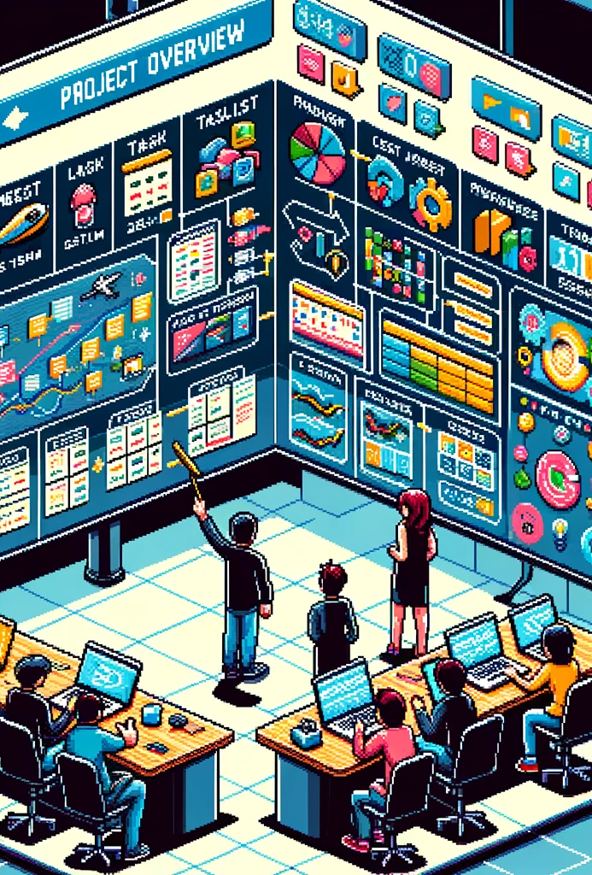
Project Overview
The employee tracker app kicks off with a screen displaying roles like software engineers or HR, each with its own image. Users can pick a role, leading them to a detailed page showing the current employee count and individual info. The app simplifies management by allowing users to easily add or remove employees in the selected role, making workforce tracking straightforward.

Slide 3

Software
vHTML- The structure, and elements (such as header, body, footer) of the website.
vCSS- Styling for the elements.
vVS code- Text editor.
vPython- Programming language used to write the code.
vTkinter- Graphical user interface.
vPylint- Checked Code and Followed Requirements.
vPyinstaller- Made it into an exe

Slide 4

Website and tech Demo

Slide 5
Why Choose us?
showcasing expertise in building robust applications with user-friendly interfaces.
Our team excels in writing clean, appealing HTML and CSS styles from previous successful projects.
Our team has diverse skills, including graphic design, UX design, and programming.

Slide 6
Future Improvements
Adding a search feature and filters for quicker employee access.
Strengthen the app's security with user authentication and access levels.
ensure mobile responsiveness for easy access on various devices.

Slide 7

Questions?

