Slide 1
CALIBER

Slide 2
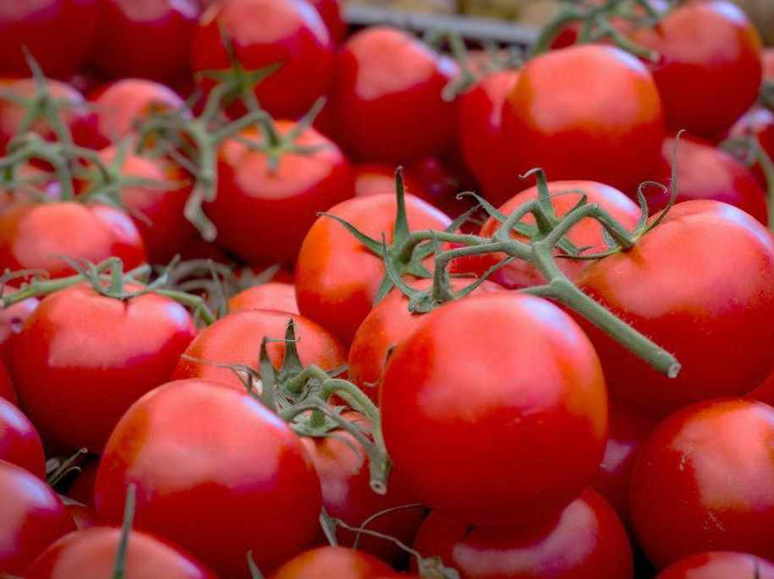
Asia’s Best Tomatoes
from SriLanka
But ranked 80th in the global market for tomato products

Slide 3
Reasons
Inefficient manpower
Reduction in quality
Lower demand in the world market

Slide 4
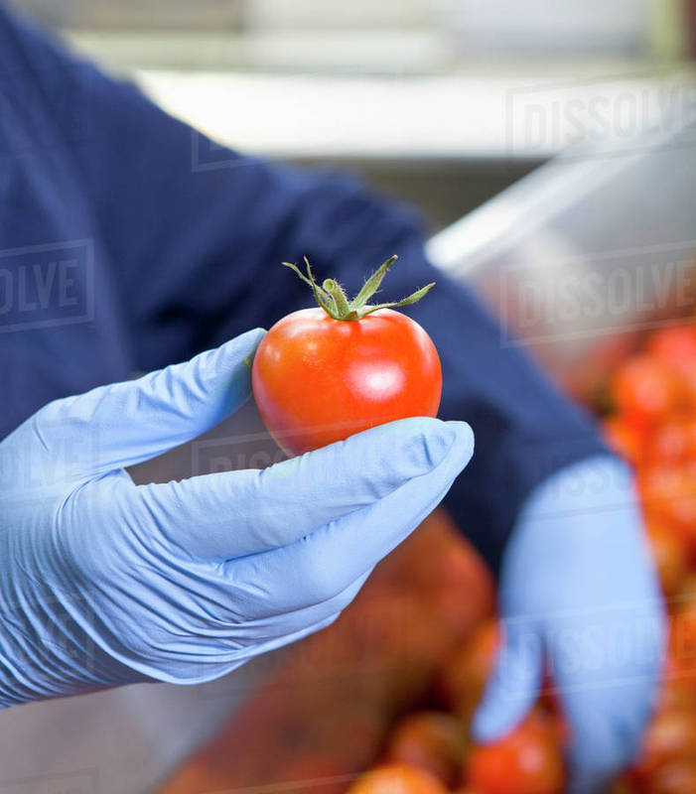
Current method of quality check

Slide 5
Proposed technical solution
Detecting damaged / spoilt tomatoes by image processing and using automated system for quality inspection.

Slide 6
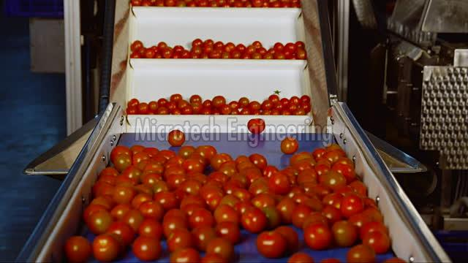
Deliverable in Hackathon
Identifying the damaged/spoilt tomatoes positioned on the conveyer belt.

Slide 7

Benefits
Increases product quality &
production rate
Reduces manpower cost
Economical development of country
Further improved for fruits like
Mango
Banana

Slide 8
Questions?

Slide 9
THANK YOU!

