Slide 1
IoT Project
Paper Sharing
Xiao Ding
December 7 2018

Slide 2
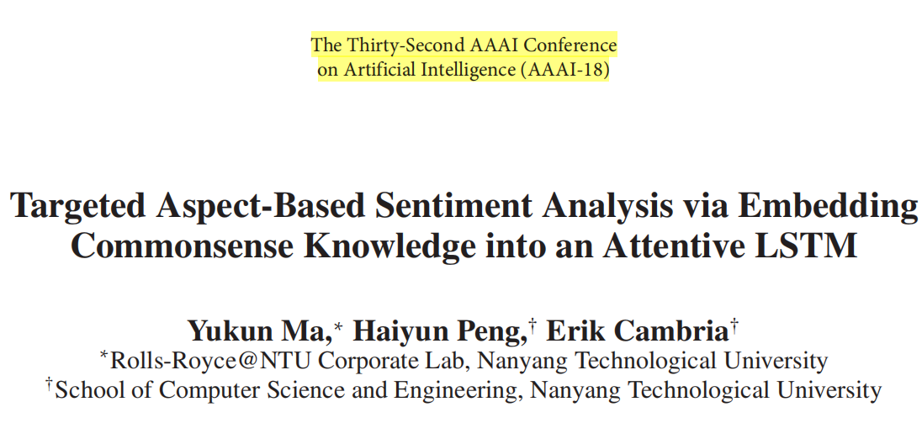
Paper Sharing

Slide 3
Related Work
Aspect-Based Sentiment Analysis
Targeted Sentiment Analysis
Targeted Aspect-Based Sentiment Analysis
Incorporating External Knowledge

Slide 4
Limitation of Current Work
1. A given target might consist of multiple instances (mentions of the same target) or multiple words in a sentence, existing research assumes all instances are of equal importance and simply computes an average vector over such instances. This oversimplification conflicts with the fact that one or more instances of the target are often more tightly tied with sentiment than others.
2. Hierarchical attention exploited by existing methods only implicitly models the process of inferring the sentiment-bearing words related to the given target and aspect as black-box.
3. Existing research falls short in effectively incorporating into the deep neural network external knowledge.
4. Without any constraints, moreover, the global attention model might tend to encode task-irrelevant information

Slide 5
Contributions
1. We propose a hierarchical attention model that explicitly attends to first the targets and then the whole sentence.
2. We extend the classic LSTM cell with components accounting for integration with external knowledge.
3. We incorporate affective commonsense knowledge into a deep neural network.

Slide 6
Task Definition
e.g. “I live in [West London] for years. I like it and it is safe to live in much of [west London]. Except [Brent] maybe.”
Objective：detecting the aspects and classify the sentiment polarity.
Outputs: output for [WestLondon] is [‘general’:positive; ‘safety’:positive], while output for [Brent] should be [‘general’: negative; ‘safety’:negative].

Slide 7
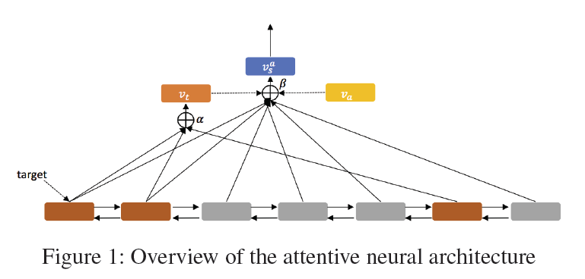
Overview

Slide 8
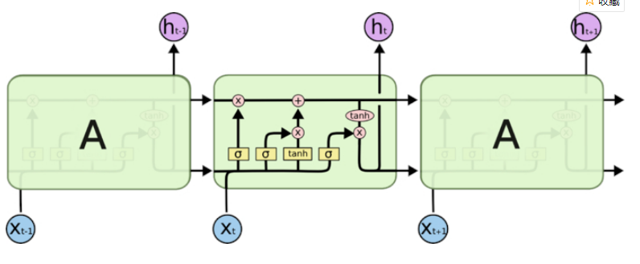
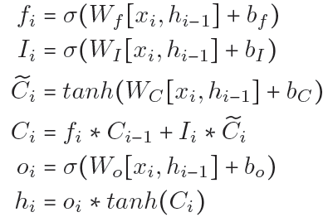
LSTM

Slide 9
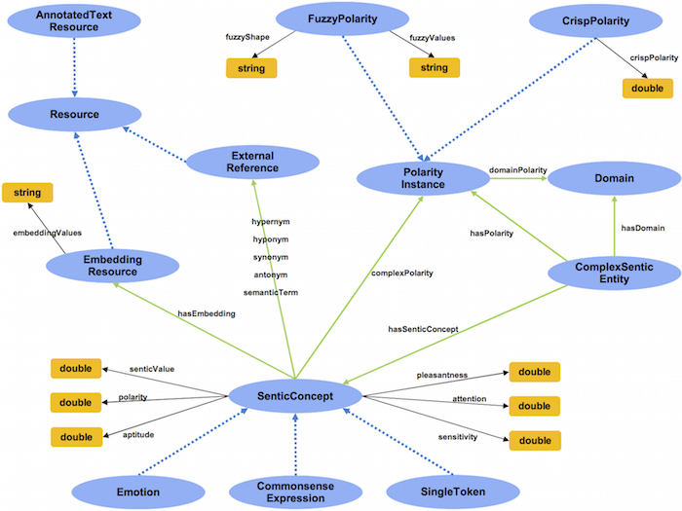
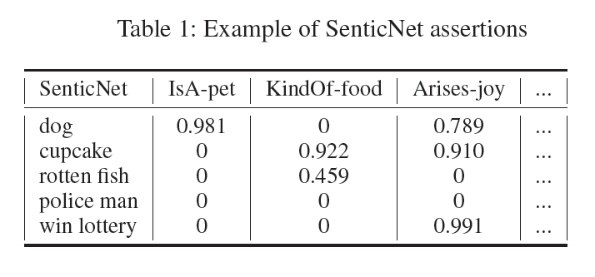
Commonsense Knowledge
SenticNet
AffectiveSpace
has been built to map the concepts of SenticNet to continuous low-dimensional embeddings without losing the semantic and affective relatedness of the original space.

Slide 10
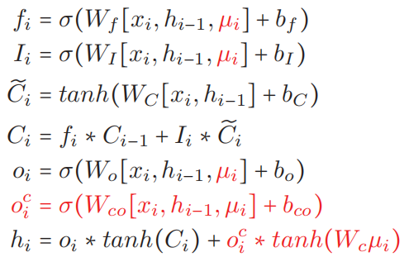
Sentic LSTM

Slide 11

Experiments
Datasets
Sentihood (Saeidi et al. 2016)
Semeval 2015
Experiment Setting
aspect categorization
aspect-based sentiment classification
Metrics
Strict Accuracy
Macro-F1
Micro-F1

Slide 12
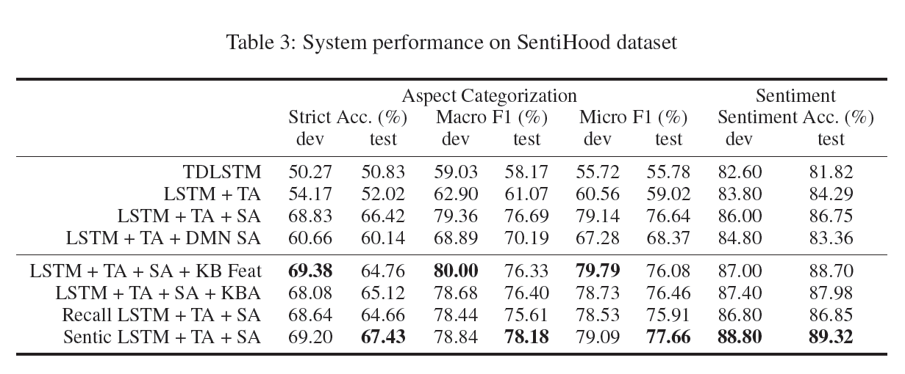
Experiments
Results

Slide 13
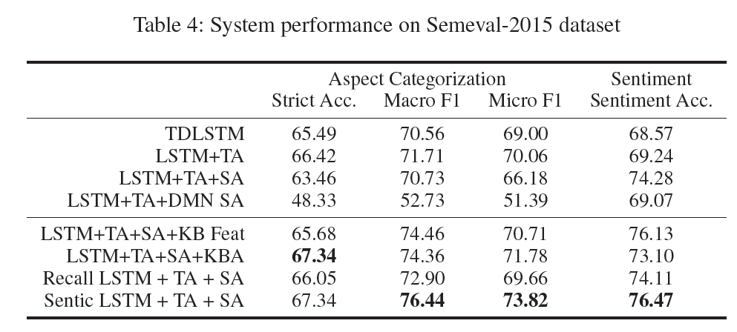
Experiments
Results

Slide 14
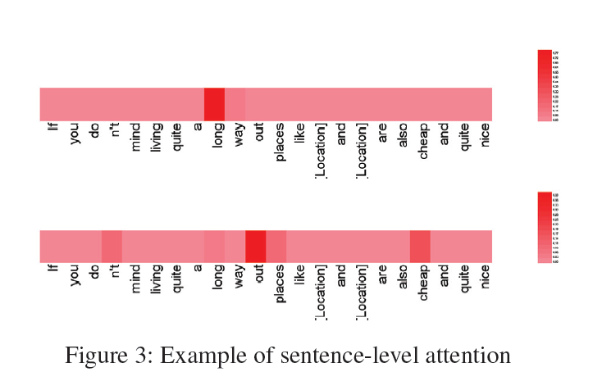
Experiments
Examples

