Slide 1
Lin Y, Shen S, Liu Z, et al. Neural relation extraction with selective attention over instances[C].2016.
潘皓
2018/11/8

Slide 2
Basic knowledge
实体关系抽取（Relation Extraction）
关系抽取（Relation Extraction）或关系分类（Relation classification）是信息抽取的子任务之一，目的是从自然语言文本中抽取出命名实体对之间的关系。如经典的例句“Bill Gates is the founder of Microsoft Inc.”中包含一个实体对(Bill Gates, Microsoft Inc.)，这两个实体对之间的关系为Founder。

Slide 3
Basic knowledge
远程监督（Distant Supervision）
如果有一个精确定义的知识库规定了一个实体对之间的关系R，那就假设所有其它句子中出现的这个实体对都蕴含了同样的关系R。如在选取的知识库中“Bill Gates is the founder of Microsoft Inc.”中实体对(Bill Gates, Microsoft Inc.) 关系为Founder。 那么从其它地方找来句子中如： “Bill Gates is now going to Microsoft Inc.” “Bill Gates regretted to found Microsoft Inc.”
(Bill Gates, Microsoft Inc.) 关系都被标记为Founder。
Mintz M, Bills S, Snow R, et al. Distant supervision for relation extraction without labeled data[C].2009.

Slide 4
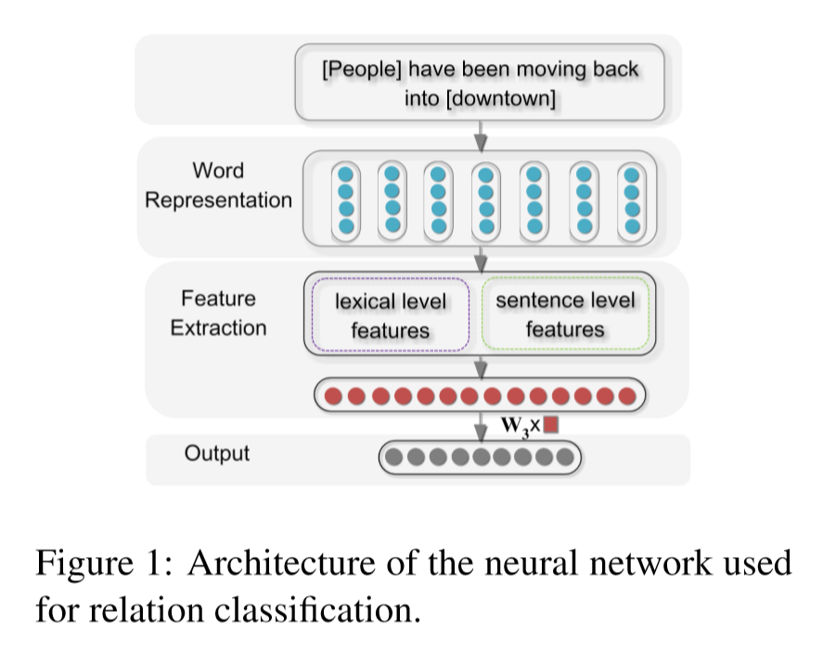
CNN in RE
Zeng D, Liu K, Lai S, et al. Relation classification via convolutional deep neural network[C].2014.

Slide 5
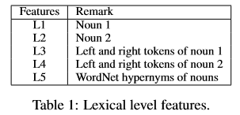
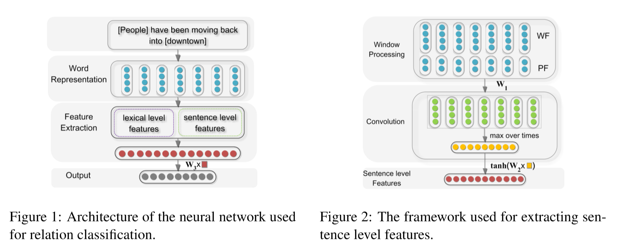
CNN in RE
Zeng D, Liu K, Lai S, et al. Relation classification via convolutional deep neural network[C].2014.

Slide 6
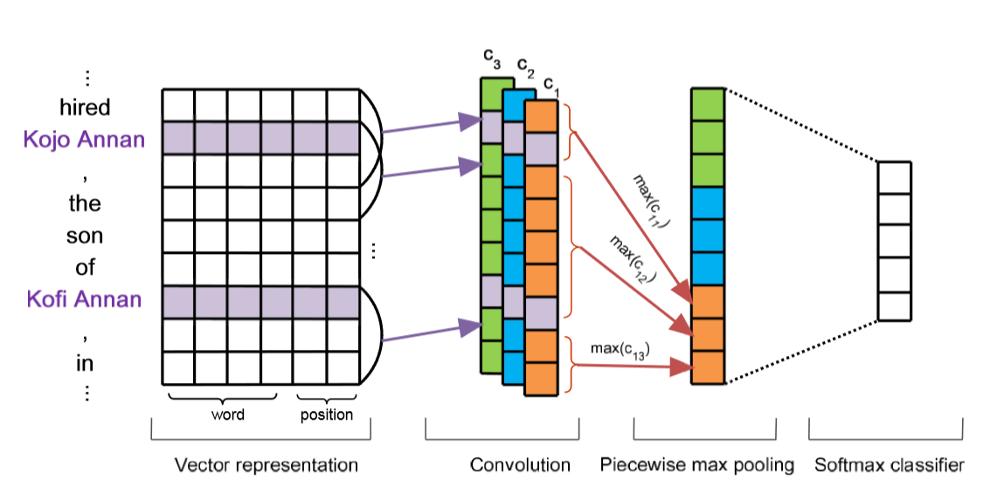

PCNN in RE
最后的损失函数使用多示例学习MIL方法计算（BP-MIL）。
Zeng D, Liu K, Chen Y, et al. Distant supervision for relation extraction via piecewise convolutional neural networks[C].2015.

Slide 7
PCNN in RE
多示例学习（Multiple instance learning）
由医学问题引出，用于训练的是instance打包成的bag。如果一个bag 里面存在至少一个instance被分类器判定标签为+（或者1）的示例，则该包为正包；如果一个bag里面所有的instance都被分类器判定标签为-，则该包为负包。
Zeng D, Liu K, Chen Y, et al. Distant supervision for relation extraction via piecewise convolutional neural networks[C].2015.

Slide 8
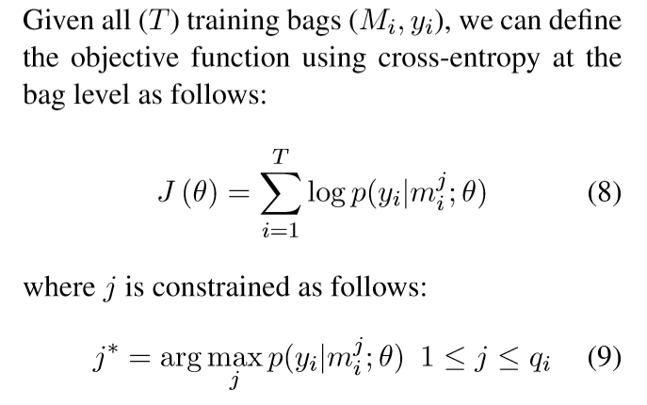
PCNN in RE
Zeng D, Liu K, Chen Y, et al. Distant supervision for relation extraction via piecewise convolutional neural networks[C].2015.

Slide 9

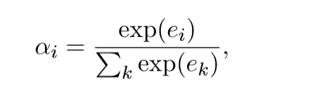
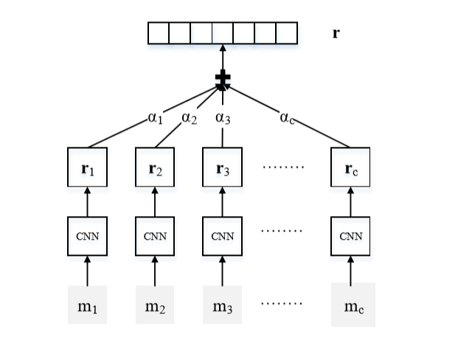
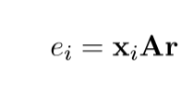
APCNN in RE
X_{i} 是经过CNN提取的句子表示
A 是一个确定权重的对角阵
r 是代表关系的向量
Lin Y, Shen S, Liu Z, et al. Neural relation extraction with selective attention over instances[C].2016.

Slide 10
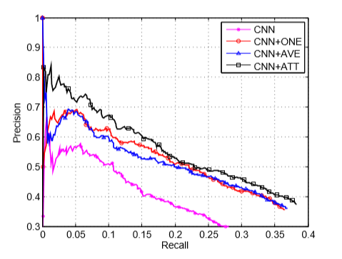
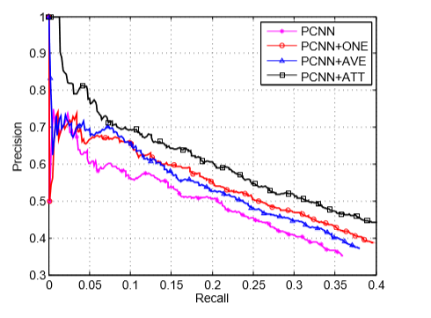
APCNN in RE
Lin Y, Shen S, Liu Z, et al. Neural relation extraction with selective attention over instances[C].2016.

Slide 11
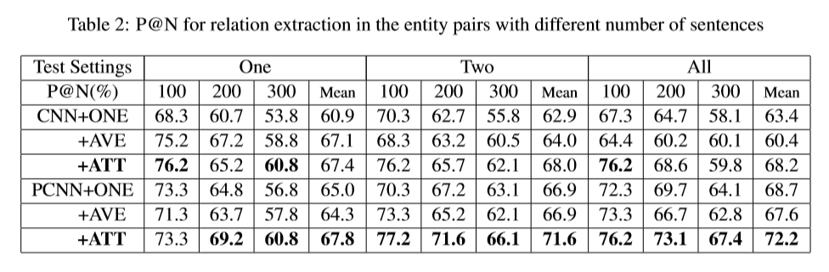
APCNN in RE
Lin Y, Shen S, Liu Z, et al. Neural relation extraction with selective attention over instances[C].2016.

Slide 12
Further work： Try to improve PCNN/APCNN in RE

Slide 13
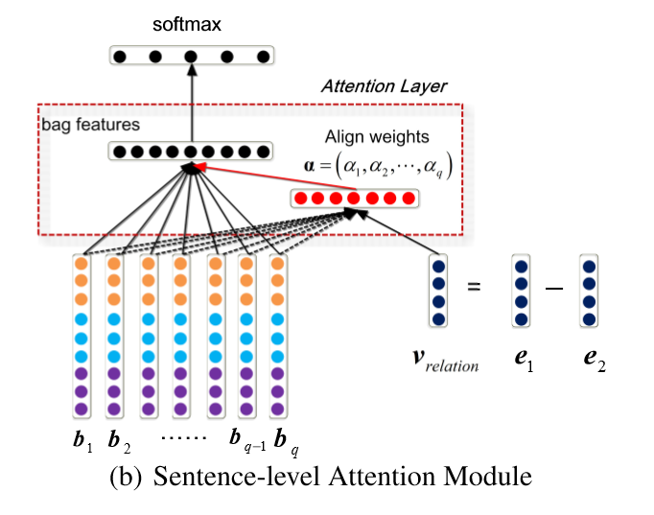
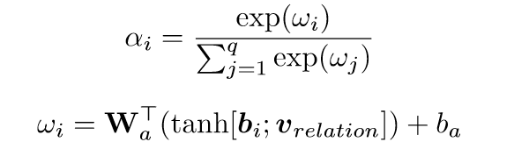

APCNN+D in RE
Distant Supervision for Relation Extraction with Sentence-Level Attention and Entity Descriptions[C].2017.

Slide 14


APCNN+D in RE
e 是实体的词向量
d 是把实体的词向量和描述的词向量连 接起来后，经过一个独立的CNN输出的与e维度相同的“描述向量”。
Distant Supervision for Relation Extraction with Sentence-Level Attention and Entity Descriptions[C].2017.

Slide 15
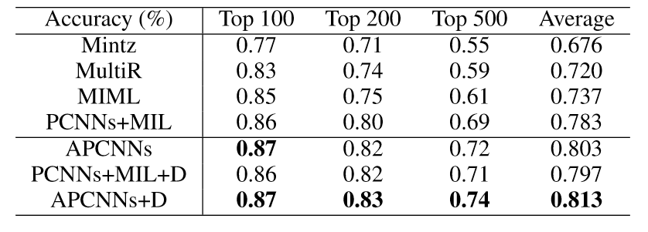
APCNN+D in RE
Distant Supervision for Relation Extraction with Sentence-Level Attention and Entity Descriptions[C].2017.

Slide 16
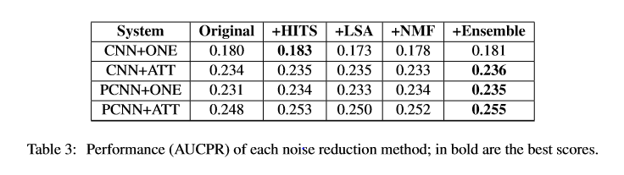
APCNN+seed_selection in RE
这篇文章通过对远程监督数据集降噪来提高关系抽取的性能：
分别采用了：
HITS(Hypertext-induced topic search)
LSA(Latent semantic analysis)
NMF(Non-negative matrix factorization)
保留了90%的语料，效果不大。
Phi V T, Santoso J, Shimbo M, et al. Ranking-Based Automatic Seed Selection and Noise Reduction for Weakly Supervised Relation Extraction[C].2017.

Slide 17
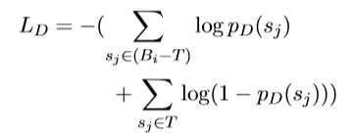

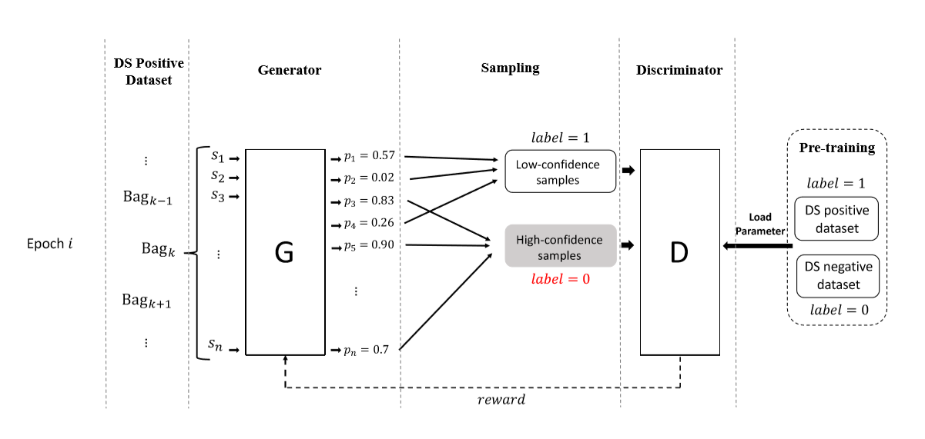



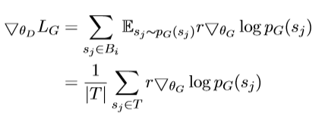
APCNN+DSGAN in RE
Qin P, Xu W, Wang W Y. DSGAN: Generative Adversarial Training for Distant Supervision Relation Extraction[J].2018.

Slide 18
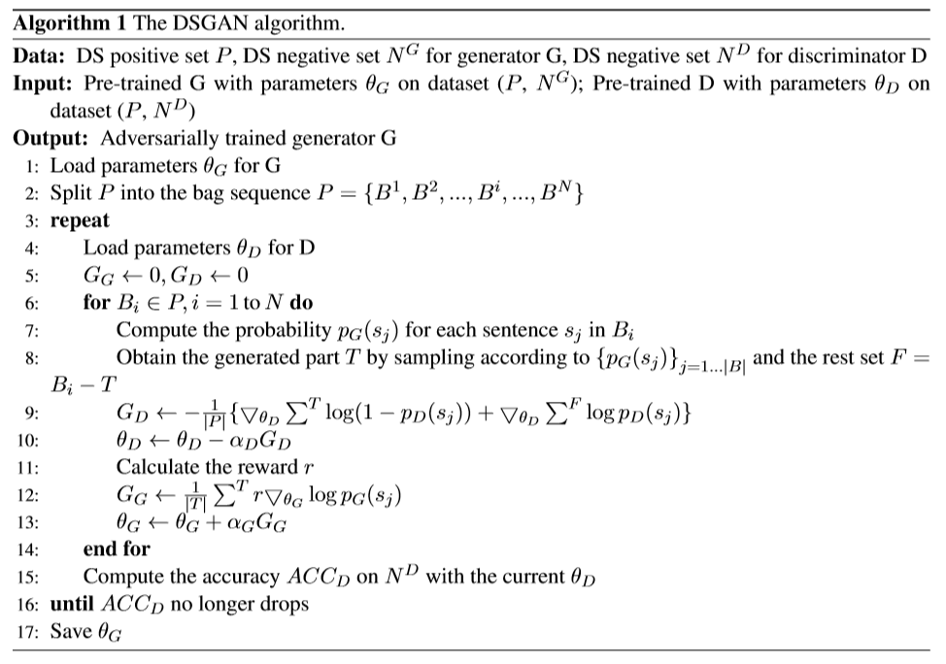
APCNN+DSGAN in RE
Qin P, Xu W, Wang W Y. DSGAN: Generative Adversarial Training for Distant Supervision Relation Extraction[J].2018.

Slide 19
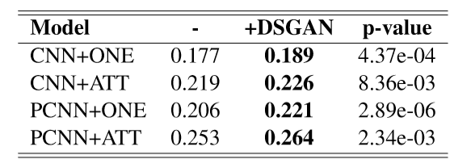
APCNN+DSGAN in RE
Qin P, Xu W, Wang W Y. DSGAN: Generative Adversarial Training for Distant Supervision Relation Extraction[J].2018.

