Slide 1
TouchShare
“An easy way to stay connected”
Notes:
Open with scenario about staying connected with new people

Slide 2
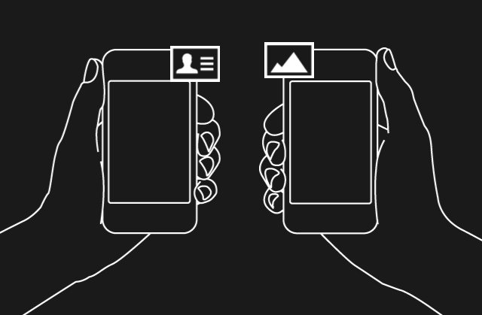
Our Product
Mobile Application utilizing “touch” based software
An easy way to share contact information & Social Media
Notes:
Talk about functionality and how to use the application (After downloading, open to create a profile and add information you’d like to share)

Slide 3
The Problem
Difficulty staying connected with someone new
Finding someone online can be a chore
Sharing information can be a long process
Carrying around cumbersome documents and resumes

Slide 4
Our Solution
Our application instantly allows sharing information across multiple platforms
Information shared can be accessed all in one place
Instantly shared with a single touch of two phones

Slide 5
Our Team
Christopher “Jacob” Miller – Software
Kyler Cain – Software
Arthur Bjontegard – Operations and Logistics
Justin Deaton – Financial Planning
Qingxiong Cai – Marketing
Jack Cross – Customer Relations

Slide 6








Social Media Supported
Notes:
Add social media logos

Slide 7
The Market
Industry: Technology
Market: Worldwide
Customer: People seeking to make lasting connections with the ability to connect across social media platforms

Slide 8
Competitive advantage
Differentiation: No mobile application that allows users to share social media information easily by proximity and physical touch
Access: Downloaded with a mobile device through supported application platforms such as Android Marketplace and Apple Store, in addition to a website to edit profile information

Slide 9

Position in value chain
We’re a customer-centric mobile technology product providing users the service to connect across multiple social media platforms

Slide 10


Revenue Source
Advertisement revenue accompanied by an eventual large userbase
Deals with social media platforms for promotion purposes
Paid-for feature to permanently disable advertisements

Slide 11
Financial Needs
Google play store application listing fee: $25
Apple store application listing fee: $99/year
Website registration $12/year
Web/database hosting: $5+/month
Advertisement: $1000 for services such as Google AdMob and Facebook Ads Manager
Notes:
Biggest idea: Growing the userbase, ease of creation and development experience in group (already in early stages of dev)

Slide 12
To Summarize…
Our product is a mobile application utilizing proximity-based software to allow users to easily share media information and create lasting relationships
With very low startup costs compared to traditional brick and mortar and manufacturing businesses, our development will be done by part of our founding team with expertise in software creation
With the popularity of social media, the userbase will continue to grow exponentially
Notes:
Research ad revenue (job fairs, social media hosts, etc)

