Slide 1
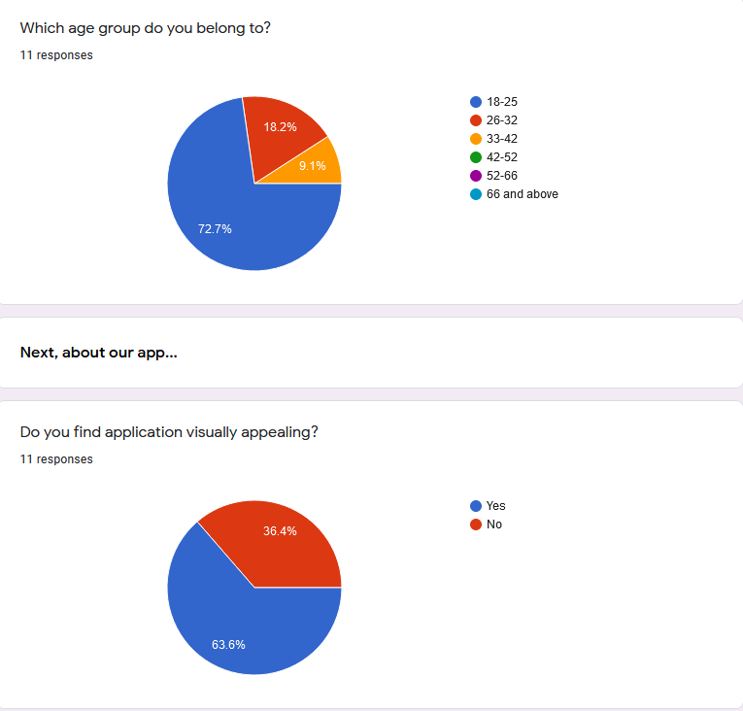
Survey Report

Slide 2
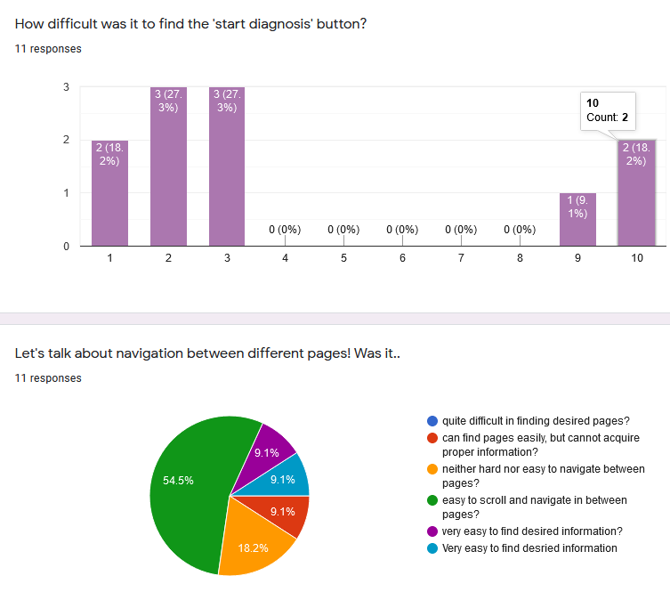
Survey Report

Slide 3
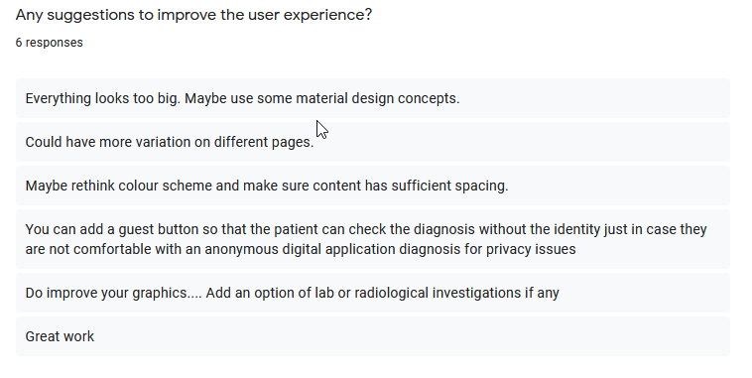
Feedback

Slide 4
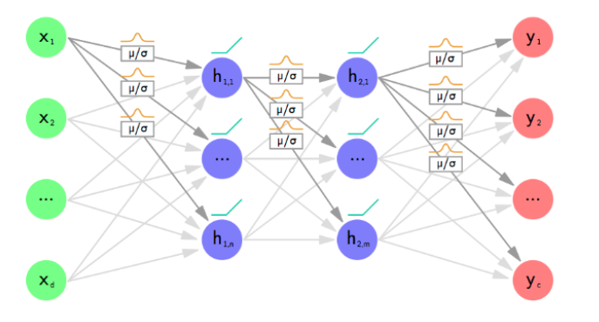
Distribution of weights in Bayesian + CNN network

Slide 5
Backlog
Integration of Django framework with NN model

Slide 6
Next Week Task
Work on Backlogs
Complete Interim report
Starting model training with different hyperparameters
Preparing test cases for the code written so far

