Slide 1
Pixel Art Editor in C Group 07 Nujhat Neha 2421313642 Sadia Afrin Sharmi 2423019642 Arifa Akter Mim 2422852642 Md Mahabubul Alam 2422388042
Department of Electrical and
Computer Science
North South University

Slide 2
Project analysis slide 2
Project At a Glance
METHODOLOGY
ANALYSIS
PIXEL
ART EDITOR
IN C
IMPLEMENTATION
BUGS AND ISSUES
TESTING
RESULTS

Slide 3





Project analysis slide 3
METHODOLOGY
Modular Structure:
Programming Language
Compiler and IDE
Operating System
Core Data Structure
The program features a modular design with key functions like initializeGrid(), displayGrid(), and fillColor(), supporting pixel-based operations such as drawing and flood-filling.
The program was developed in C, utilizing standard input/output libraries and basic control structures for simplicity and efficiency.
Compiled using GCC, known for robust debugging tools, and developed in Code::Blocks, an IDE ideal for writing, testing, and debugging code.
Development and testing were performed on Windows 10, ensuring compatibility with a widely-used environment.
Utilizes a 2D char grid[ROWS][COLS] array for pixel storage and updates, enabling efficient memory usage and fast access for grid-based tasks.

Slide 4
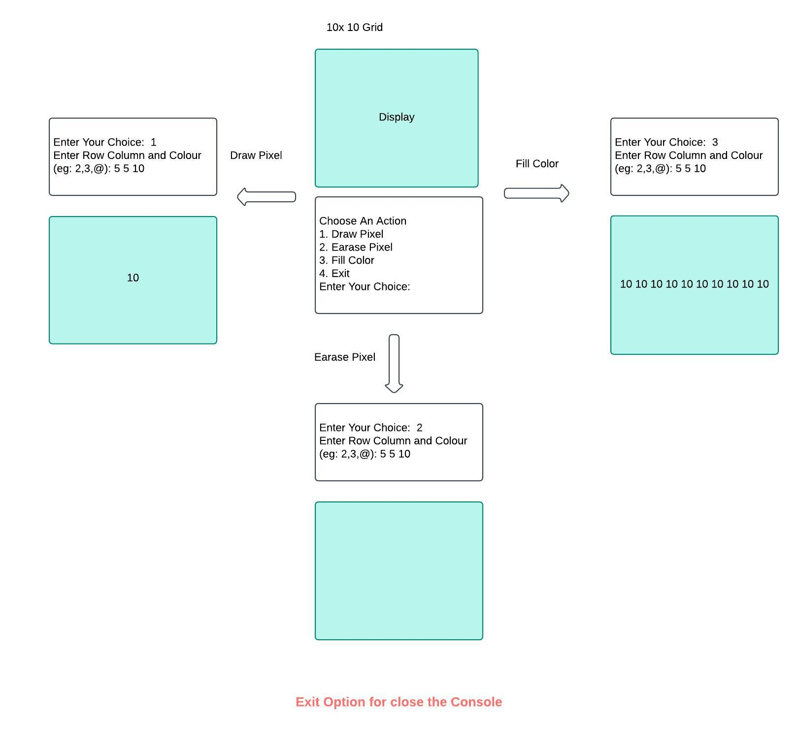
Project analysis slide 4
IMPLEMENTATION
initializeGrid(): displayGrid(): drawPixel(): erasePixel(): fillColor(): handleUserInput():
Tasks
Functions
Project Objectives
Implementation Plan
Schedules
Resources

Slide 5
Project analysis slide 6
FUNCTIONS
Sets up the grid by initializing all elements to blank spaces, creating a clean canvas.
Outputs the grid to the console with borders, displaying its current state.
Modifies a specific cell to represent a drawn pixel, provided the coordinates are valid.
initializeGrid()
displayGrid()
drawPixel()
erasePixel()
fillColor()
handleUser
Input()
Resets a cell to its blank state, effectively erasing any modifications.
Implements a recursive flood-fill algorithm to change connected cells of a target color to a new color.
Manages user commands via an interactive menu, triggering appropriate grid manipulation functions.

Slide 6

Project analysis slide 8
BUGS AND ISSUES
Out-of-Bounds Input
Stack Overflow in fillColor()
Validate coordinates before processing to prevent accessing invalid grid areas.
Replace the recursive approach with an iterative method to avoid excessive memory usage.
Lack of Input Validation
Infinite Loop Risks
Add checks in pixel operations and sanitize user inputs to prevent crashes.
Introduce explicit exit conditions for loops to avoid unintended infinite iterations.

Slide 7

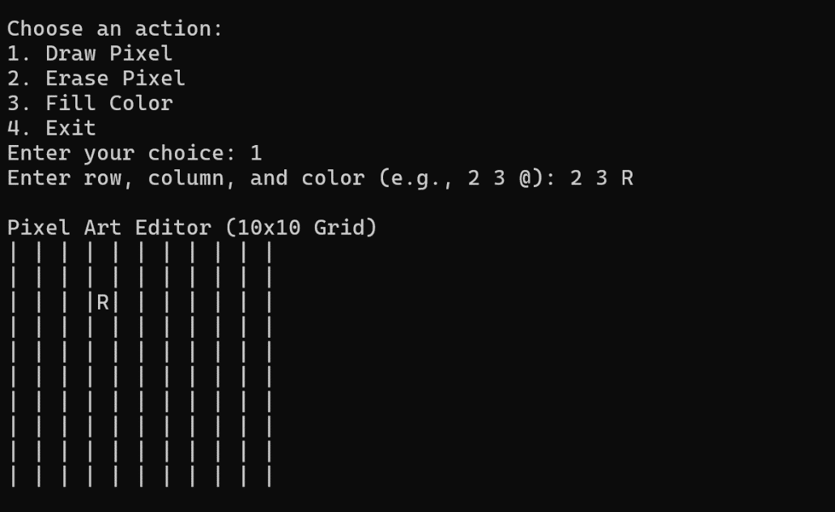
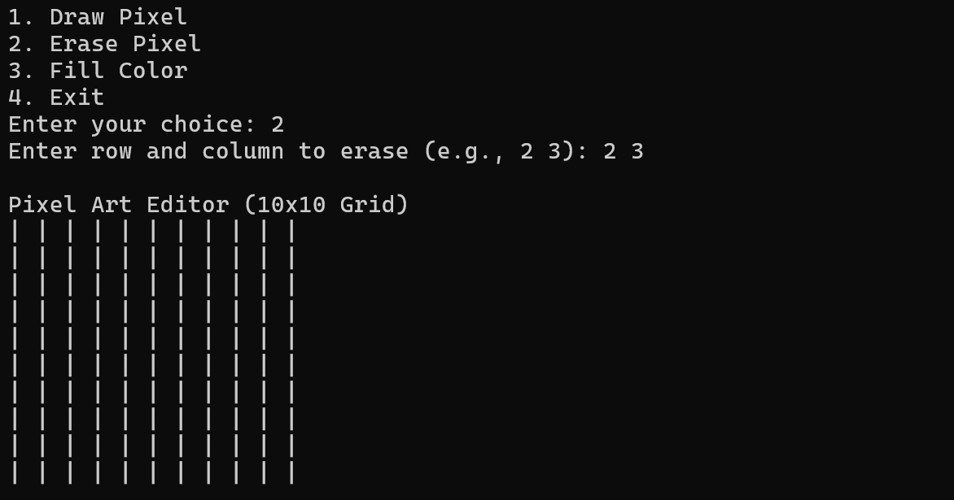
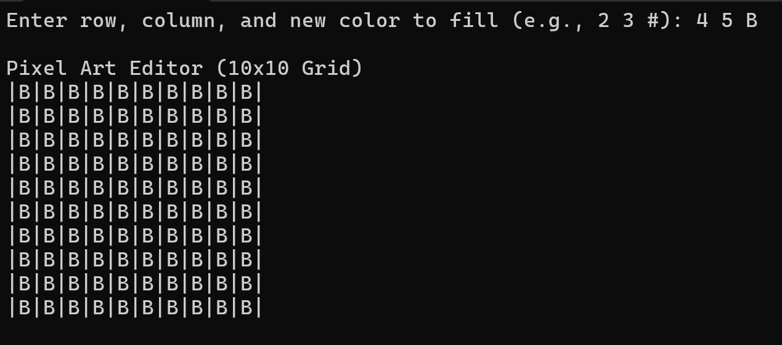
Project analysis slide 10
RESULTS AND TESTING
All test cases produced expected results
Output Console
Test Data:
Drawing a pixel at (2, 3) with color 'R' successfully updated the grid.
Erasing the pixel at (2, 3) reset it to blank.
Flood-filling from (4, 5) with color 'B' correctly filled all connected pixels of the same initial color.
Boundary conditions like invalid coordinates were handled gracefully.
The program’s static grid size ensures predictable performance and constant memory usage.
Operations were efficient, completing in constant or linear time depending on the task.

Slide 8

Project analysis slide 10
ANALYSIS
The pixel art editor efficiently uses 2D arrays for grid operations.
It applies a recursive flood-fill algorithm but faces:
Stack overflow risks.
Boundary issues
The console-based interface:
Is functional but has limitations in usability and interactivity.
Highlights the need for:
Enhanced error handling.
Input validation.
A potential transition to a graphical interface.

Slide 9
Thank You

