Slide 1
Tethered 6U CubeSat
Tether range, relative attitude, heritage and 3D imaging
CUBICS 2026 · Stream 1 · Team meeting, October 2026
Notes:
Goal of the meeting: agree on tether length, attitude sensors and the imaging claim before writing the proposal. All numbers assume two 4 kg halves at 550 km.

Slide 2




Four answers for today
SUMMARY
Tether range
Relative attitude
Vertical only. 500 m to 1 km is feasible: 3.6 to 7.2 mN of tension and about 3.5 h to deploy.
IMUs alone drift within minutes. Add a star tracker on each half and dual GNSS; use the stowed zero only to calibrate.
State of the art
3D photos
Tethers have flown since 1966. Most failures happen during deployment.
Not with a 0.5 to 1 km baseline: errors of 0.8 to 1.7 km. Yes with fore/aft camera pointing: about 3.5 m.
Notes:
One card per question raised for this meeting. The rest of the deck backs each card with numbers.

Slide 3
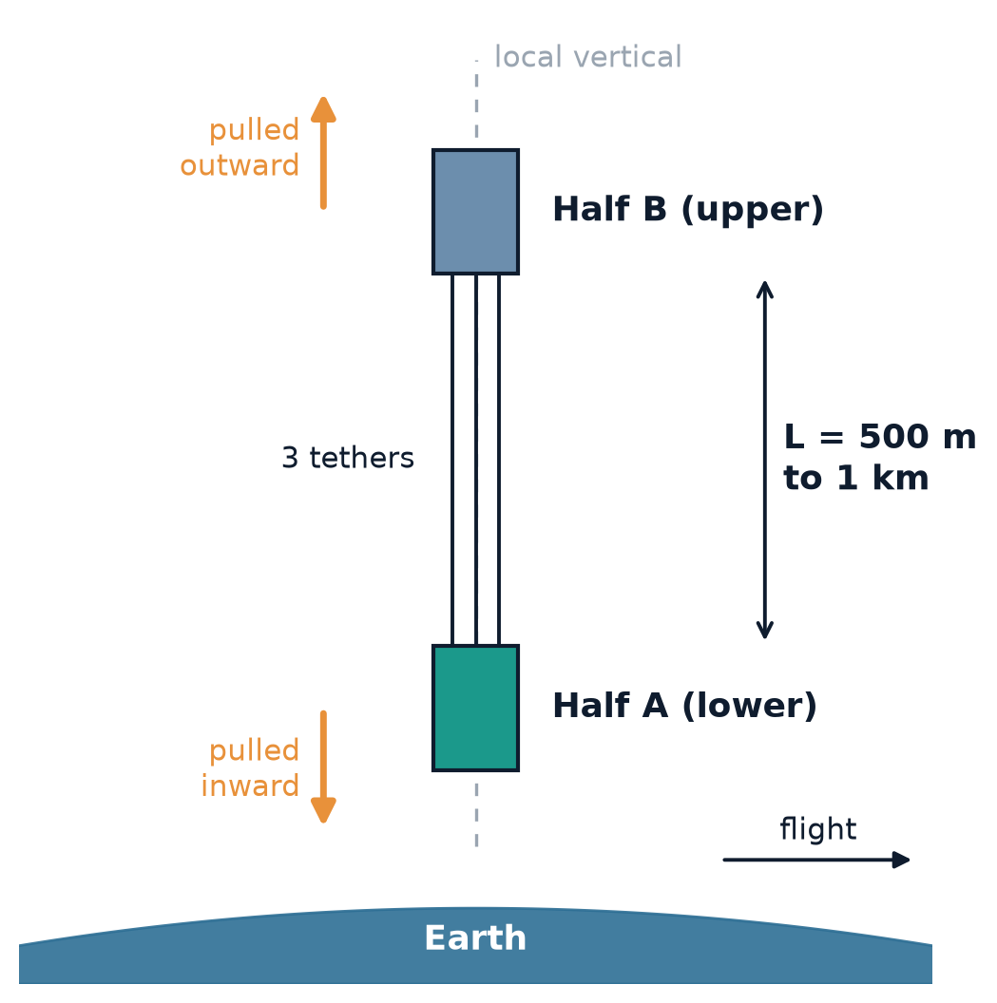
Only a vertical tether stays taut
1 · TETHER RANGE AND ORIENTATION
Gravity pulls the lower half a little more and the upper half a little less.
That difference keeps the three tethers taut, with no power.
The pair settles along the local vertical by itself.
T = 3 n² m_eq L
n = orbital rate at 550 km, m_eq = 2 kg, L = separation. Tension grows linearly with the tether length.
Notes:
Gravity gradient: below the orbit centre gravity exceeds what circular motion needs, above it falls short. The tether supplies the difference. This only works radially; along-track gives zero tension and cross-track pushes the halves together.

Slide 4
500 m to 1 km: the key numbers
1 · TETHER RANGE AND ORIENTATION
Quantity | L = 500 m | L = 1 km
Total tension | 3.6 mN | 7.2 mN
Tension per tether (3 tethers) | 1.2 mN | 2.4 mN
Deployment time, controlled | 3.2 h | 3.5 h
Free deployment, no brake | 75 min, ends at 0.95 m/s | 81 min, ends at 1.9 m/s
Tether mass (3 × 0.2 mm) | 66 g | 132 g
Elastic stretch at full tension | 0.2 mm | 0.8 mm
Thermal length change (±100 K) | 0.15 to 0.5 m | 0.3 to 1.0 m
Tether frontal area (drag) | 0.30 m² | 0.60 m²
Orbit life at 550 km, deployed | ≈ 1.2 years | ≈ 0.6 years
Two 4 kg halves, three 0.2 mm tethers, 550 km. Orbit life uses a simple drag model with mean solar activity; the formal analysis is still to do.
Notes:
Controlled deployment: tether paid out exponentially at half the orbital rate, which keeps libration bounded. Orbit life: the tethers themselves add 0.3 to 0.6 square metres of drag area, more than the satellites. That shortens the mission but helps the 5-year deorbit rule.

Slide 5
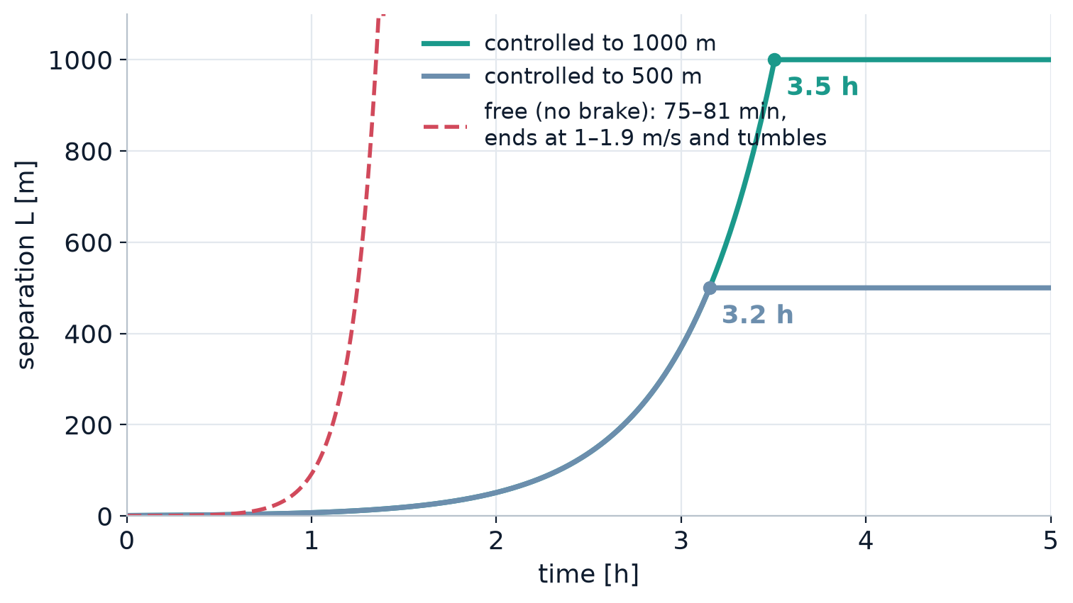
Slow deployment keeps the tether vertical
1 · TETHER RANGE AND ORIENTATION
3.2–3.5 h
controlled deployment to 500 m or 1 km
< 30°
libration during a controlled deployment
1.9 m/s
end speed of a free 1 km deployment: the tether tumbles
Notes:
The winch pays the tether out slowly. Too fast and the Coriolis effect tips the tether towards horizontal. The free curve is the textbook cosh solution, which ignores libration.

Slide 6
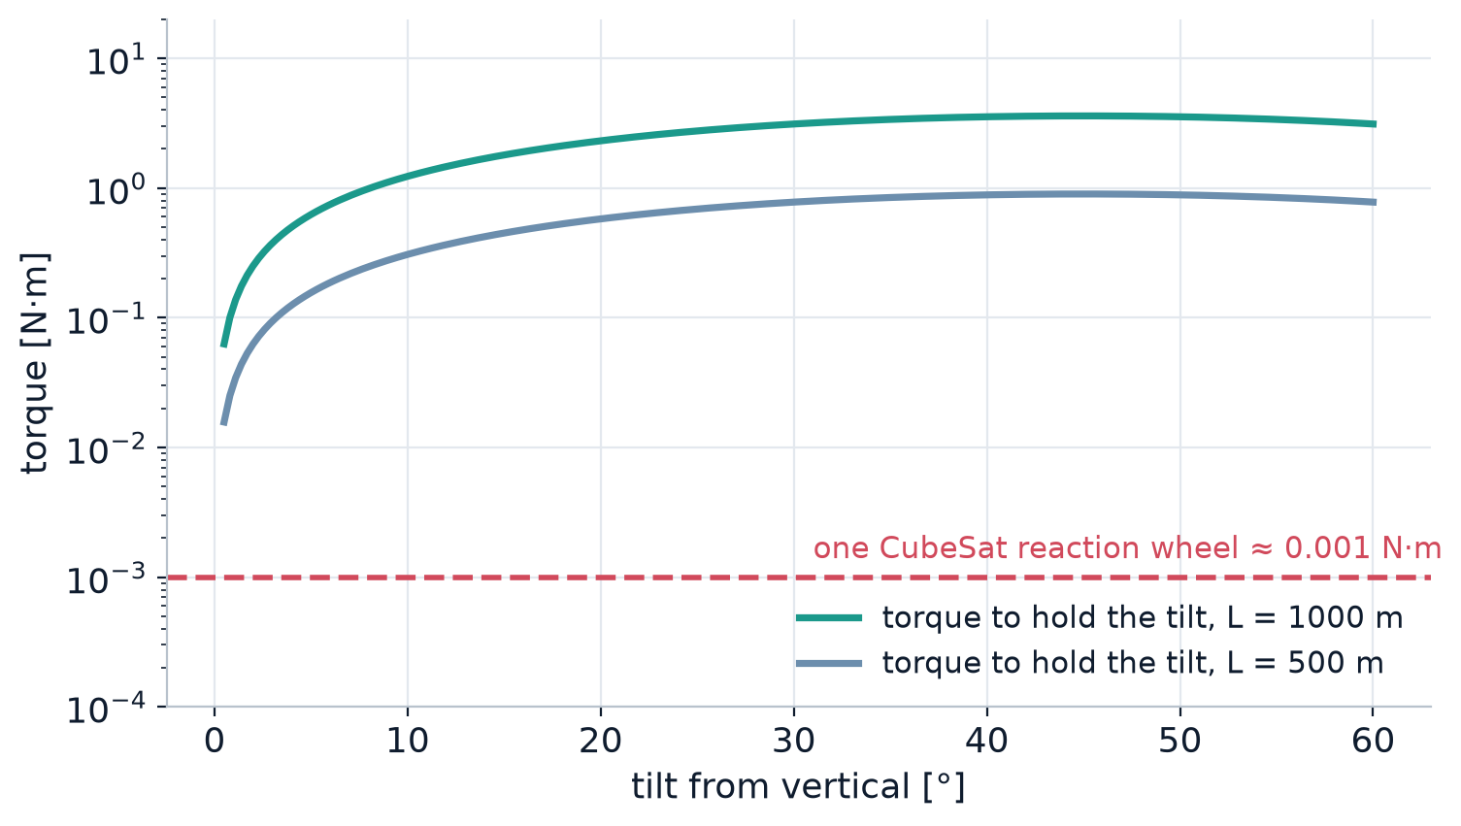
A diagonal tether cannot be held
1 · TETHER RANGE AND ORIENTATION
Gravity always pulls the pair back to vertical; a tilt becomes a 55-minute swing.
Holding 30° at 1 km would need 3.1 N·m, about 3,000 times a reaction wheel.
A tilted tether also carries less tension: cos² of the angle.
Diagonal is a swing, not a configuration
Notes:
Static tension at angle phi is 3 n^2 m_eq L cos^2 phi, and the gravity-gradient torque 3 n^2 I sin phi cos phi always pushes back to vertical. Only wheels could hold the angle and they are three orders of magnitude too weak.

Slide 7



Once deployed, the length stays fixed
1 · TETHER RANGE AND ORIENTATION
The winch sets the length. More tension does not lengthen the tether; it only pulls it tighter.
< 1 mm
up to 1 m
55 min
elastic stretch at full tension, even at 1 km
length change between sun and shadow: the winch must compensate
period of the natural swing around vertical
Paying out faster only adds swing and braking load; it does not give a longer or tighter tether.
Notes:
Answer to the idea that the tether keeps separating as speed or tension grows: tension rises linearly with length (3.6 mN at 500 m, 7.2 mN at 1 km) but the stretch is below a millimetre. The real length change is thermal, up to a metre at 1 km for polyethylene fibre, which is why active winch compensation matters.

Slide 8
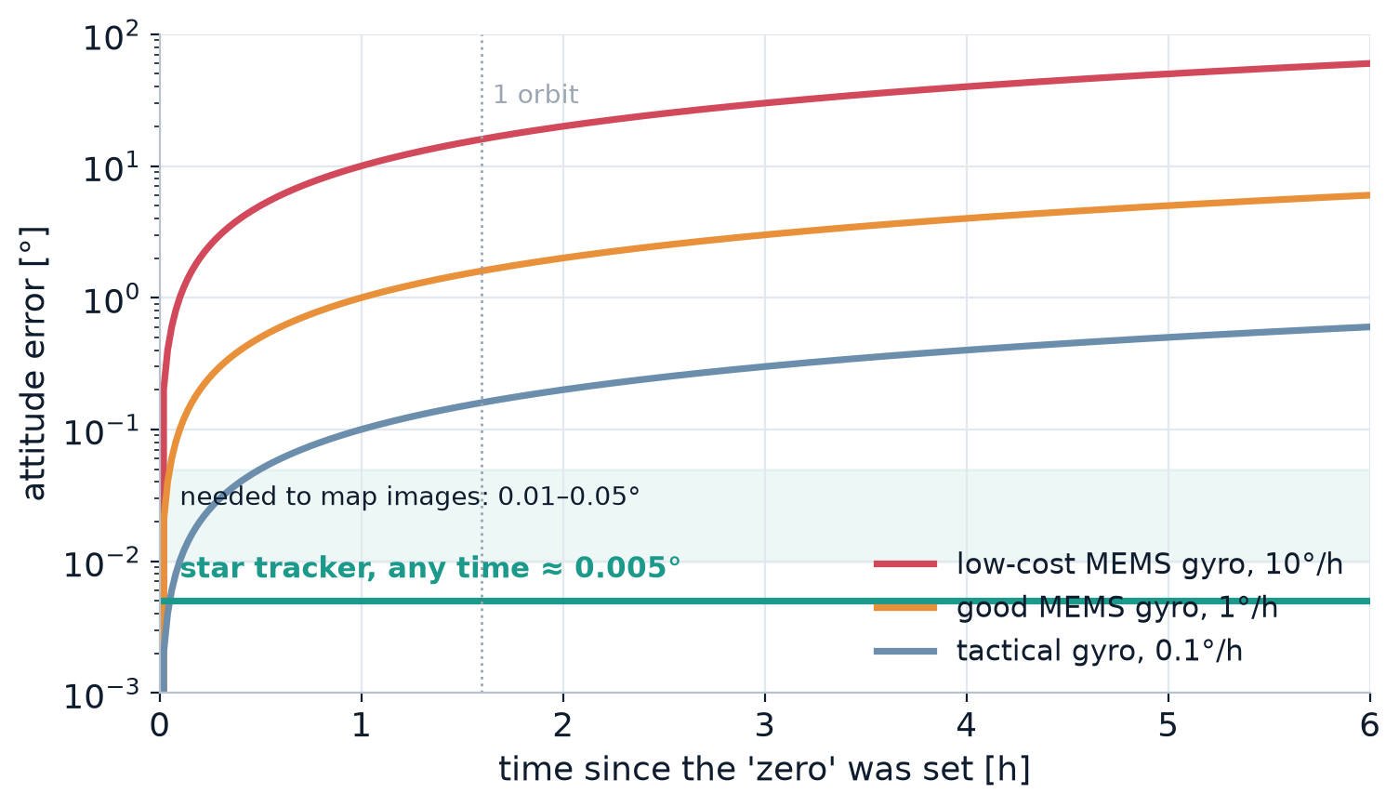
IMUs alone lose the zero within minutes
2 · RELATIVE ATTITUDE
Gyros measure rotation rate, so small errors add up over time.
A good 1°/h MEMS gyro is off by 1.6° after one orbit.
Accelerometers cannot sense attitude in free fall.
Mapping images needs 0.01 to 0.05°: only an absolute sensor holds that.
Notes:
Setting both IMUs to zero while the halves are joined is a good calibration step, but it does not survive. The error grows with time and cannot be reset without an external reference.

Slide 9


Recommended sensors for relative attitude
2 · RELATIVE ATTITUDE
Star tracker on each half
Absolute attitude of each half to about 0.005°, at any time.
GNSS receiver on each half
Relative position at centimetre level: tether direction to about 0.001° at 1 km.
Tether direction encoders
Angle of the tether at each anchor, measured directly.
IMU
Fast rates between updates and during manoeuvres.
Stowed zero: use the joined state to calibrate the mounting offset between both halves, not as the reference for the whole mission.
Notes:
Relative attitude = attitude of B minus attitude of A, each from its own star tracker. Dual GNSS gives the baseline vector, i.e. the tether direction. Encoders give a third, independent check.

Slide 10
Tether heritage: deployment is the main risk
3 · STATE OF THE ART
Mission | Year | Length | What happened
Gemini XI | 1966 | 30 m | First tether test between two spacecraft
SEDS-1 | 1993 | 20 km | Full deployment; end mass deorbited
SEDS-2 | 1994 | 19.7 km | Closed-loop braking law validated
TSS-1R | 1996 | 19.7 km | Tether broke by an electrical arc
TiPS | 1996 | 4 km | Libration damped from 40° to 7.5°
ATEx | 1999 | 22 m of 6.2 km | Tether went slack after a thermal transient
YES2 | 2007 | 31.7 km | Longest structure deployed in orbit
TEPCE | 2019 | 1 km | Two CubeSat halves split by a stacer spring at 4 m/s
Notes:
Failures cluster in deployment: friction, slack and electrical issues. ATEx is the closest warning for us: the tether went slack after sunrise. TEPCE is the closest architecture: a CubeSat split in two by a spring.

Slide 11
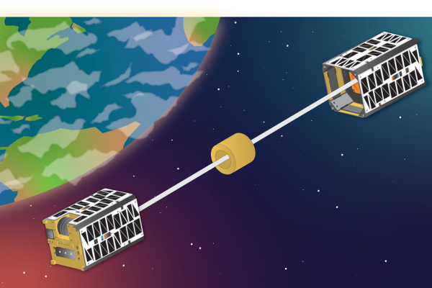
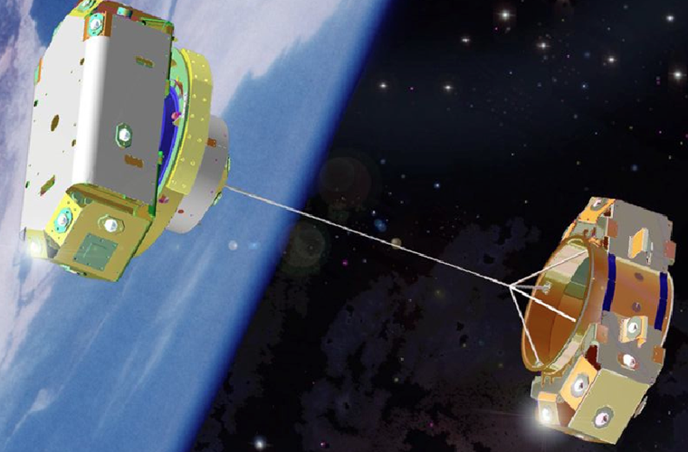
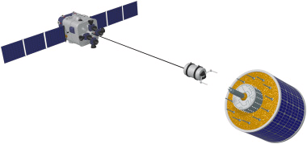
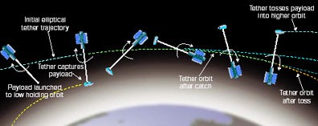
Previous tethered systems
3 · STATE OF THE ART
Two CubeSats joined by a tether
Two end bodies joined by a tether with a three-line bridle
Tether between a spacecraft and a target body
Momentum-exchange tether: catch and toss of a payload
Notes:
Images provided by the team from previous tether work. Confirm the original mission and source of each image before citing them in the proposal.

Slide 12


Where our proposal fits
3 · STATE OF THE ART
Already demonstrated
New in this proposal
Splitting a CubeSat in two with a spring (TEPCE, 2019)
Three tethers between the same two bodies
Kilometre-class deployment with braking (SEDS-2, TiPS)
Active thermal compensation of length (the ATEx failure)
Gravity-gradient stabilisation along the vertical
Tether direction measured at the anchors
Libration damping with the winch
Earth imaging from both halves
Notes:
The novelty is not deploying a tether, which is well proven, but controlling three tethers and their thermal length change at CubeSat scale.

Slide 13
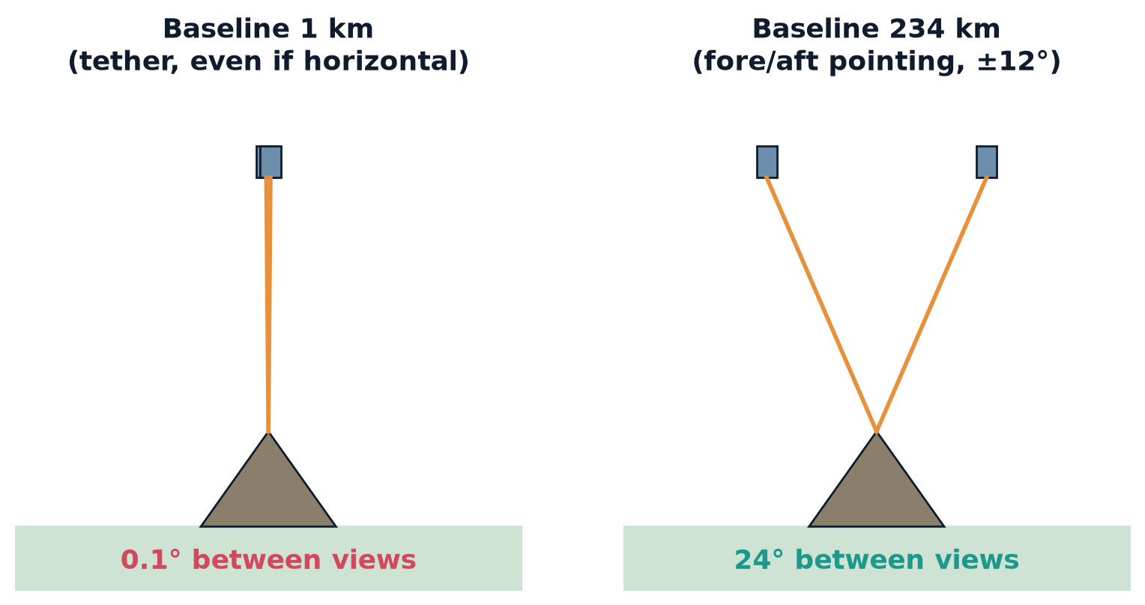
3D needs two very different viewing angles
4 · 3D IMAGING
Notes:
Height comes from parallax: how much a summit shifts between two photos. The shift is proportional to the baseline divided by the altitude, B/H.

Slide 14
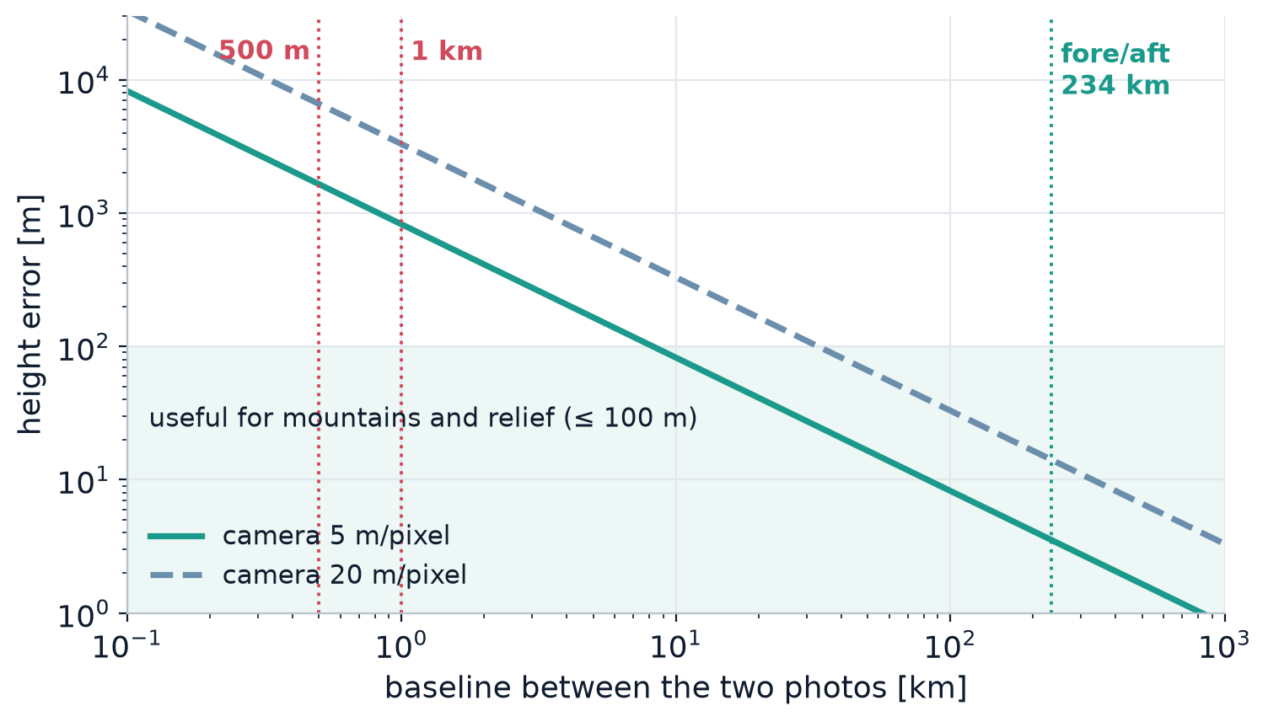
A 0.5–1 km baseline gives errors near 1 km
4 · 3D IMAGING
825 m
height error with a 1 km baseline, 5 m pixels
1.65 km
height error with a 500 m baseline
0.36 px
shift of a 1 km-high mountain between the two photos
And a vertical tether gives no stereo at all: both cameras look along the same line.
Notes:
Height error = matching error / (B/H). With 0.3 pixel matching at 5 m pixels, that is 1.5 m divided by B/H. Even a horizontal 1 km baseline gives B/H = 0.0018. Relief needs at least about 8 km of baseline for 100 m error.

Slide 15
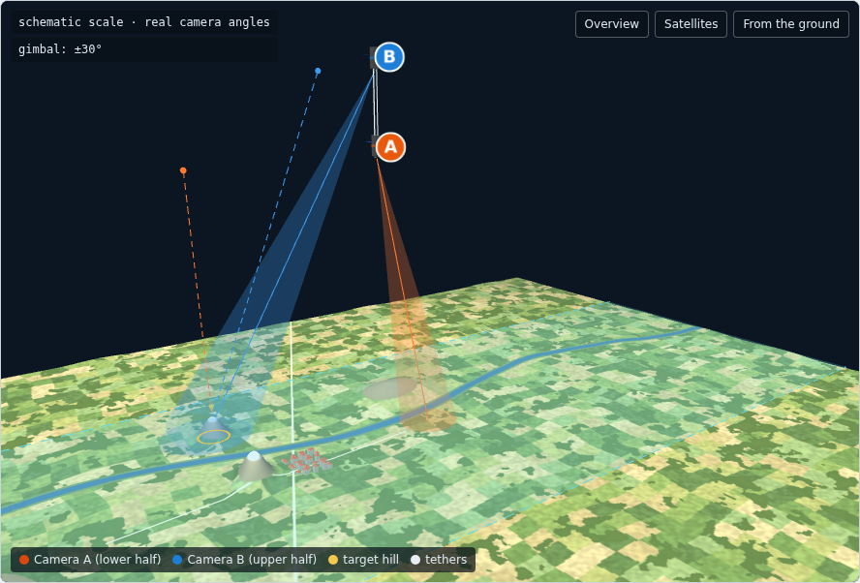
What works: pointing the cameras
4 · 3D IMAGING
Option | B/H | Height error 5 m / 20 m px | Notes
Fixed fore/aft cameras (A +12°, B −12°) | 0.43 | 3.5 m / 14 m | Simple; sites under the track
Gimbal ±30° on each half | 0.40 | 3.8 m / 15 m | Chosen sites; 2 to 4 day revisit
Tether baseline, 1 km | 0.0018 | 825 m / 3.3 km | Not usable
Simulator: both halves image the same hill 31 s apart
The 3D comes from the satellite moving along its orbit, not from the tether.
Notes:
Fore/aft: half A looks 12 degrees ahead, half B 12 degrees behind; 234 km of orbit between shots. The gimbal adds 635 km of reachable swath. Present 3D as a secondary objective; the tether's value is thermal compensation and metrology.

Slide 16



Going to 1 km adds new risks
5 · RISKS AND NEXT STEPS
Drag
Thermal
Debris
Mass
Tethers add 0.6 m² of drag area. Orbit life at 550 km falls to about 0.6 years.
Up to 1 m of length change per orbit. The winch needs that range and control.
A 1 km object has a larger collision cross-section. Confirm admissibility with CSA.
132 g of tether and larger drums inside two 3U halves.
Notes:
The drag point is the surprise: at 1 km the tethers dominate the drag. That helps deorbit compliance but may make the mission shorter than the operations plan. Run a formal lifetime analysis with STELA or DRAMA.

Slide 17
Decisions for the team
5 · RISKS AND NEXT STEPS
1
Tether length
500 m or 1 km, weighed against mission life (1.2 vs 0.6 years at 550 km).
2
Attitude sensors
Star tracker and GNSS on each half; IMU and encoders as support.
3
Imaging claim
Drop tether stereo; use fore/aft or gimbal cameras for 3D.
4
Questions to CSA by 9 Nov
Launch altitude, tether admissibility, deorbit case.
5
Analysis
Formal orbit-life study and thermal model of the tether.
Notes:
Close by agreeing owners and dates for each decision. Questions to CSA must go out before 9 November.

