Slide 1
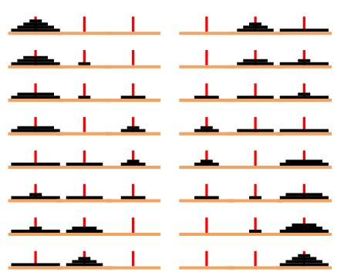
Towers of Hanoi
Tom Mulvey, Greg Quintanilla, Katy Chapman

Slide 2
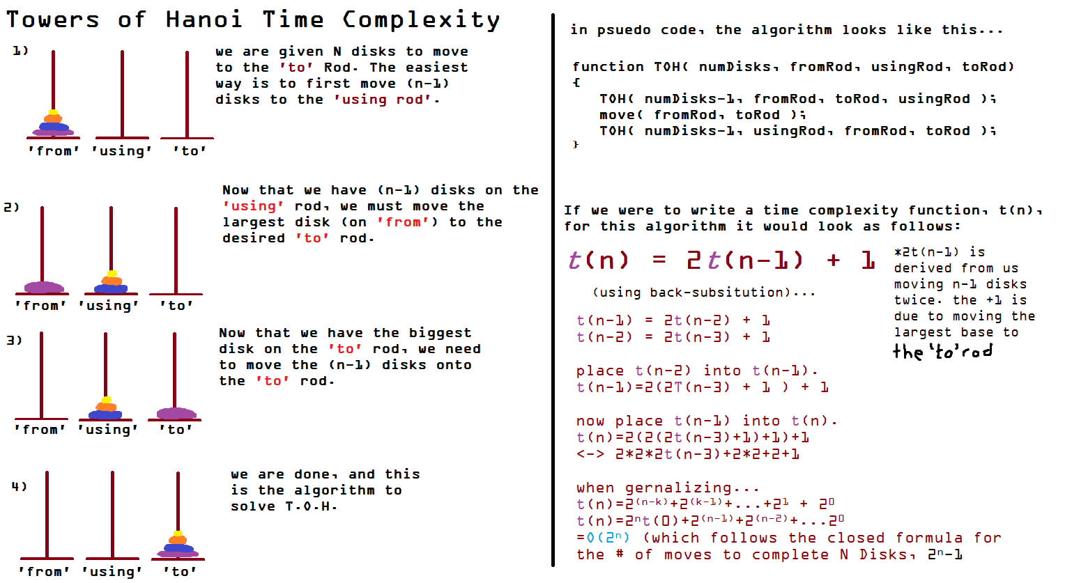
Towers of Hanoi and Time Complexity

Slide 3
Data Structures used
Stacks
Stacks of pairs of ints. First int was the size, second was the color associated with it.
Vectors
Holds the data from the text file. We used vectors <vectors <string> >.
Queues
We used Queues of vectors for the cheat mode. The vectors held the pegs to move from and to.
Bonus : We used fstream to have a login and score system within the program. It logs games played, total score, and user names + passwords. Lower scores are better, because it records the running total of moves over the minimum it takes to solve the game.

Slide 4
Headers, Implementation and Text Files
Header Files
login.h
Towers.h
Implementation Files
login.cpp
Towers.cpp
main.cpp
Text File
user.txt

Slide 5
Towers.h
class Towers
Public:
Constructors
Destructors
Accessors
Mutators
Functions
Public Data
Private:
Number of disks
Number of moves
#include <stack>
#include <string>
#include <vector>
#include <queue>

Slide 6
Towers.cpp
#include<iostream>
#include "Towers.h"
#include "login.h"
#include <stack>
#include <queue>
#include<windows.h>
#include <unistd.h>
#include <conio.h>
#include <math.h>
#include <vector>
#include <ctime>
#include <cstdlib>
using namespace std;
Solves towers of hanoi
Allows player to solve the towers of hanoi
Moves can be made by entering which location you would like to move a disk from
Then enter where you would like to move this disk
Auto solve is available if the player cannot figure out the solution
Uses login.cpp to update scores/games played
Must enter username and password to update your account scores
Also includes functions to show the disks moving
Allows game to be much more interactive and enjoyable

Slide 7
Important Functions Towers.cpp
Build Solution
Recursively moves and prints the pegs moving, like shown in the graphic on slide 2. Initializes array at 1.
Display
Recursive
Prints spaces and rod based off .top(). Then it pops then calls up display again. This time printing the next line. This process continues until each stack is empty. Then each of the recursive scopes pop, but before they pop they push back the values.

Slide 8
login.h
class login
Public:
Functions
string m_username
vector m_playerData
#include <vector>
#include <string>
#include "Towers.h"

Slide 9
login.cpp
#include <iostream>
#include <vector>
#include <fstream>
#include <conio.h>
#include <string>
#include <stdlib.h>
#include <sstream>
#include "login.h"
#include<windows.h>
#include "Towers.h"
Gives options to log in, sign up or exit
When you play the game, you can enter your username and password
this will update user.txt (number of games played and score)
When logging in, you must enter your username and password
Program will check whether or not your username and password are correct
If you choose to create a new account, the program will check the text file for the username you enter
If the username has already been taken, you will be asked to enter a new one

Slide 10
Important Functions login.cpp
Generate Vector
Checks if text file is open
While there are available lines in file:
Creates rows in vector form
Pushes data into row, then into vector
Insert Game Data
Finds username in structure
Index becomes username index
Replaces new strings with old within m_playerData
Places data into text file and closes text file
Also had a fun way to convert int -> char: string sc = static_cast<ostringstream*>( &(ostringstream() << new_score) )->str();

Slide 11
main.cpp
#include<iostream>
#include <stack>
#include<windows.h>
#include <cstdlib>
#include <unistd.h>
#include <ctime>
#include <cstdlib> #include "Towers.h"
#include "login.h"
using namespace std;
int main()
{
login test;
test.print_menu();
return 0;
}
Brings implementation files and header files together to run the game!

