Slide 1

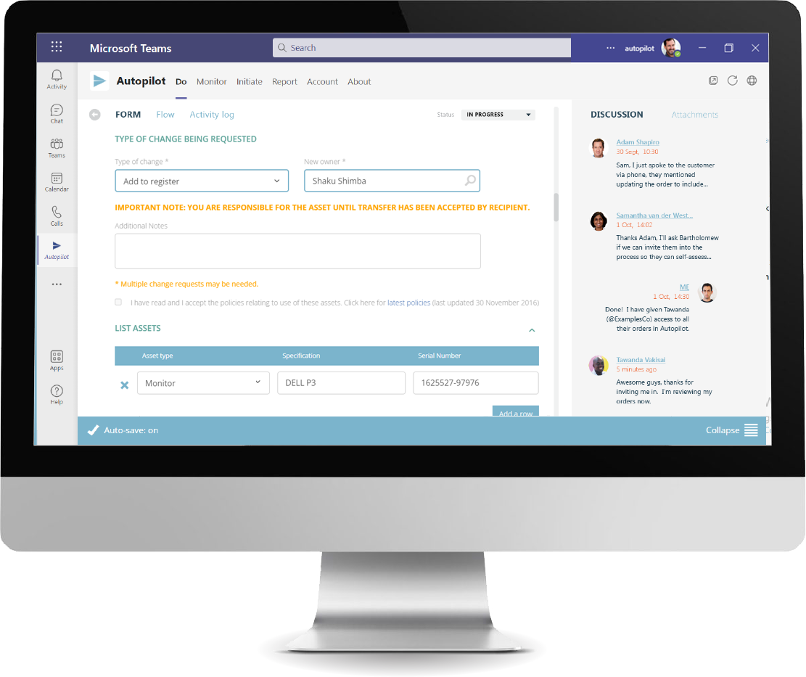
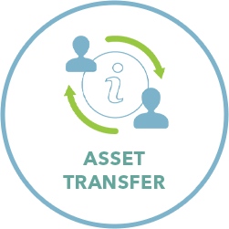
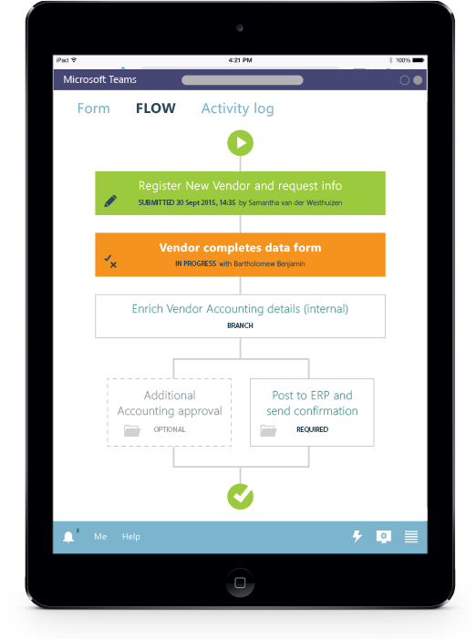





TEAMS PARTNER APP CASE STUDIES
The Cooperative Baptist Fellowship (CBF) uses Autopilot for Teams to handle key approval processes within the organization
The challenge
CBF is a Christian network of approximately 1,800 churches working together to spread the hope of Christ. It searched for ways to optimize its internal business processes and found Autopilot for Teams, a solution that fits seamlessly into its employees’ daily workflow by integrating with the same Microsoft 365 tools they’re already using.
The solution
The CBF team turned to Autopilot for a solution that met its unique workflow requirements and integrated directly into Microsoft Teams. Since Autopilot functions inside of the apps, such as Teams, that employees frequently use, CBF was able to roll it out within the organization very quickly. The system allows employees to get tasks approved efficiently while maintaining enterprise-standard controls.
“Using Autopilot has greatly improved our Personnel Changes approval process and allowed for our organization to create a system that works for us and increases efficiency. The team at Autopilot has been nothing short of amazing, responsive, and extremely helpful. “
Latoya Cross Human Resources Specialist
The results
CBF now has a complete workflow management solution built to work in Microsoft Teams. Autopilot’s seamless integration with Microsoft Teams means the application is readily available, allowing staff to easily submit leave applications; hire new staff; and create expense claims, training requests, IT support requests, staff transfers, and promotion requests.
CBF employees have rapidly adopted Autopilot. After an efficient rollout of the application, Autopilot has helped drive digital transformation by facilitating common workflow tasks in one familiar workspace.
Increasing the scope of applications available in the Teams environment and including functions (like leave applications and transfer requests) has increased CBF staff’s trust in the platform and helped to migrate them away from less integrated methods of working, in a positive way.
Highlights
Autopilot’s integration with Teams provides a single workspace for all digital workflows.
Each month, CBF employees automate several workflows with clarity and consistency, internally or with external partners.
CBF automated its leave process in just a few days.
About the partner
Autopilot allows you to rapidly replace any manual (or messy) business process with a seamless, automated solution that ensures compliance and mitigates risk. Implement reliable, consistent procedures every time.
Learn more: View Autopilot on AppSource

