Slide 1

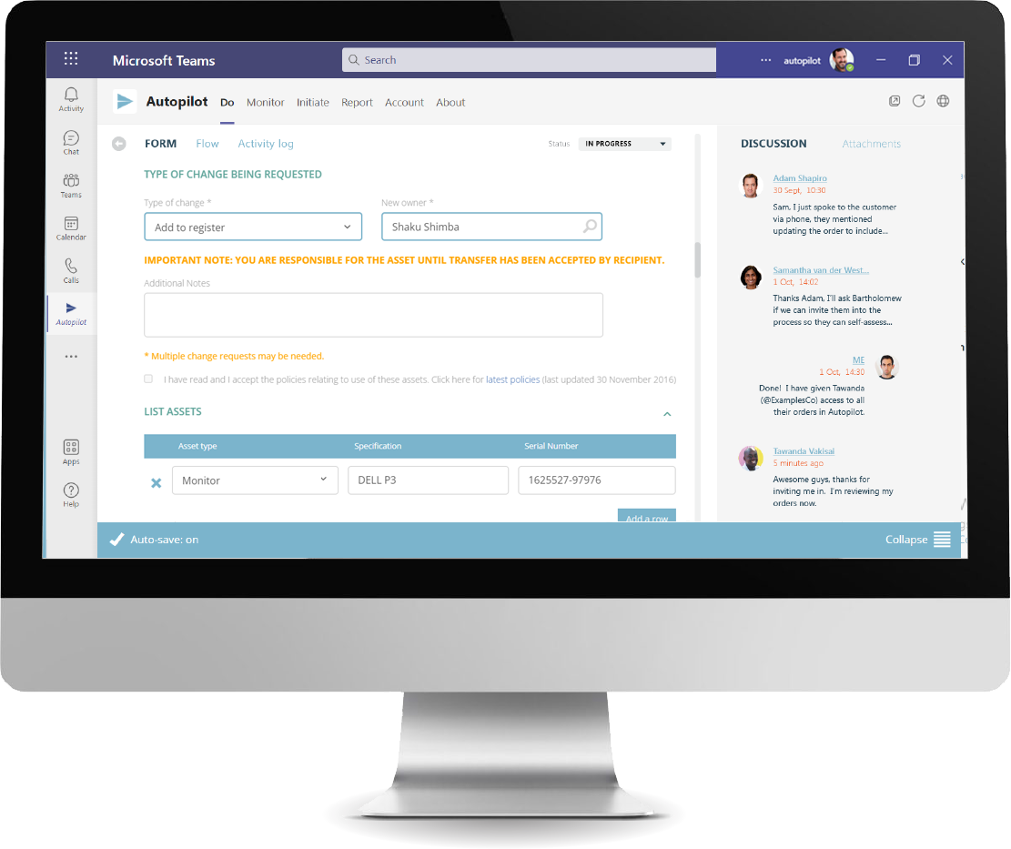
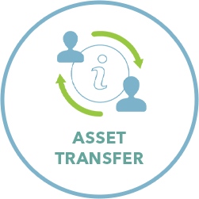
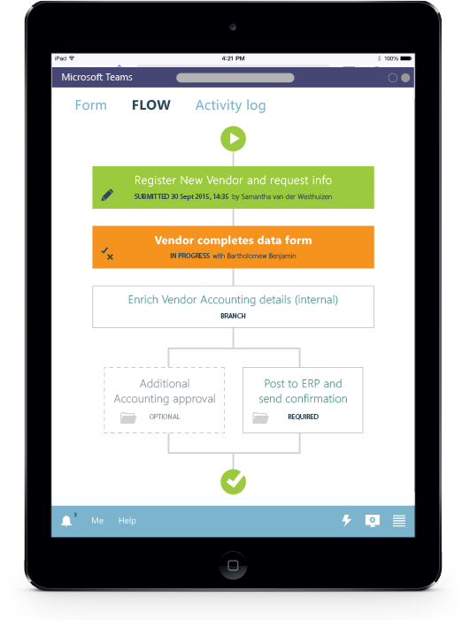





TEAMS PARTNER APP CASE STUDIES
RUBIQ uses Autopilot for Teams to handle its leave request processes within the organization
The challenge
RUBIQ, a South Africa-based compliance management company, was looking for ways to optimize its internal business processes. The company needed a solution that could fit seamlessly into its employees’ daily workflows by integrating with the same Microsoft 365 tools they were already using.
The solution
The RUBIQ team turned to Autopilot for a solution that met its unique workflow requirements and that integrated directly into Microsoft Teams. RUBIQ was able to roll out Autopilot organization-wide in just hours. The system allows employees to get tasks approved efficiently while maintaining enterprise-standard controls.
“We have begun using Autopilot within Microsoft Teams and it has brought in great convenience and easy access across our members. It functions smoothly and effortlessly. Great job on this expansion, Autopilot, nice to see you working toward making business processes work even better within a business.”
Sharley Caldwell Chief Operating Officer
The results
RUBIQ now has a leave-management solution built for Microsoft Teams. Autopilot’s seamless integration with Microsoft Teams means the application is readily available, allowing staff to easily submit leave applications.
RUBIQ employees have rapidly adopted Autopilot. After an efficient rollout of the application, Autopilot has helped drive digital transformation by facilitating common workflow tasks in one workspace.
Increasing the scope of applications available in the Teams environment and including functions (like leave applications) has increased RUBIQ staff’s trust in the platform and helped to migrate them away from less integrated methods of working, in a positive way.
Highlights
Autopilot’s integration with Teams provides a single workspace for all digital workflows.
Each month, RUBIQ employees automate workflows with clarity and consistency.
RUBIQ automated its leave process in just a few hours.
About the partner
Autopilot allows you to rapidly replace any manual (or messy) business process with a seamless, automated solution that ensures compliance and mitigates risk. Implement reliable, consistent procedures every time.
Learn more: View Autopilot on AppSource

