Slide 1
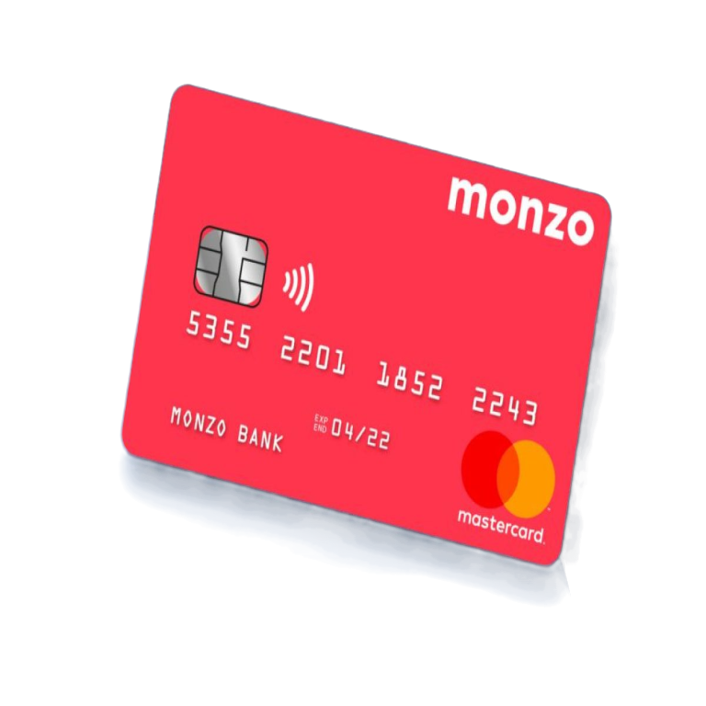

Monzo Spain
Competitive Analysis
Spain — March 2026

Slide 2
Content
01
Introduction to Spain
The main takeaways of the market
02
Personal Banking
Competitor selection, SWOT analysis, and deep-dive profiles
03
Business Banking Map
Competitor selection, SWOT analysis, and deep-dive profiles

Slide 3

Market
Why Banking in a New Market Is Fundamentally Different
When Spotify entered Spain, nobody had to cancel their radio. Salary Banking is a zero-sum game.
A Zero-Sum Market — Every Client Is Stolen
99.3%
Spain has near-total banking penetration. The average Spaniard holds 1.81 banking relationships (52% have 2+). The top 5 banks control 70–84% market share. Around 700.000 switch banks every year, but only 85,500 people do it through the “faulty” Switch Squeme — vs 1.2M in the UK (10x per capita), making switching much harder. Bizum has 30.6M users (70%+ adults), creating a network effect that locks customers into the incumbent ecosystem.
BANKED POPULATION
1 of 9
The Graveyard of Foreign Ambition
In 25 years, 9 licensed foreign banks tried Spain. Barclays (270 offices, sold to CaixaBank), Lloyds, Citibank, Deutsche Bank, Targobank — all exited or became niche. Only ING survived, entering in 1999 with 26 years of brand-building. The neobanks, although they have managed to get many signups and clients with low physical presence, they only win the periphery — the payroll stays at the incumbent.
FOREIGN BANKS SURVIVED
Cultural Fortress — Trust Is Inherited, Not Earned Online
86 vs 35
Spain scores 86 on Hofstede's Uncertainty Avoidance (UK: 35). "Mi banco de toda la vida" is a real expression — people inherit their bank like their football team. Only 16% have a positive perception of their bank, yet they stay. Banks pay promotions of €400–820 per salary/bizum (Monzo referral: €15). And Monzo's UK trust proof — 14M users, Blogs, Articles, Reddit — is invisible behind the language wall.
UNCERTAINTY AVOIDANCE
The thesis: Only 3 digital players cracked primary banking in Spain — ING (26 years), imagin (inherited CaixaBank's trust), Openbank (inherited Santander's). Monzo has neither option. It needs a third path: earning trust through a systematic, evidence-based acquisition engine.

Slide 4
Personal Banking

Slide 5
SECTION 01
Market & Gaps

Slide 6
Market & Gaps
Gap Analysis doc
Spain’s Product Gap Analysis: Lifecycle
Lifecycle Stage & "Job to be Done" | Revolut | N26 | Imagin | Bunq | Wise | Trade Republic
Account oppenings | 🟢 Excellent: A core strength. Fast, digital, and efficient onboarding. | 🟢 Excellent: A key acquisition driver. Known for its quick, paperless process. | 🟢 Excellent: Smooth digital onboarding, inheriting trust from CaixaBank. | 🟢 Excellent: Differentiates with its "no NIE needed" feature for expats, solving a major pain point. | 🟢 Excellent: Renowned for its simple and rapid onboarding process. | 🟢 Excellent: Fast, mobile-first onboarding designed for quick market entry.
🏛️ Local IBAN & SS/ Tax integratiosn | 🟡 Improving: Offers a Spanish IBAN. Bizum rollout has been phased and a source of user frustration. | 🟡 Improving: Now offers both a Spanish IBAN and Bizum, overcoming a major historical weakness. | 🟢 Excellent: A structural advantage. Offers seamless Spanish IBAN and Bizum integration from day one via CaixaBank. | 🟢 Excellent: Offers a Spanish IBAN and has integrated Bizum, showing a strong commitment to deep localization. | 🔴 Poor: Typically offers a non-Spanish IBAN for Euro accounts. No Bizum. A major barrier to being a primary bank. | 🟢 Excellent: A key differentiator. Offers a Spanish IBAN and Bizum, positioning it as a viable banking alternative, not just a broker.
💳Everyday spending | 🟢 Excellent: Great UX, fee-free card. Pain point: High third-party ATM fees in Spain. | 🟢 Excellent: App is consistently praised. Fee-free virtual card standard. | 🟢 Excellent: Good app and free card, with the powerful advantage of the free CaixaBank ATM network. | 🟡 Fair: Good app, but the free plan is more limited. Better suited for premium users. | 🟡 Fair: Functional card, but user reports of reliability issues in Spain are a concern. | 🟢 Excellent: Offers a Visa debit card with innovative rewards like "Saveback," effectively linking spending to investment.
💸 Budgeting & Savings Tools | 🟢 Excellent: A leader in this space. Features like "Pockets" and automated round-ups are very popular. | 🟢 Excellent: "Spaces" feature is a core and highly praised part of its product for goal-oriented savings. | 🟡 Fair: Offers basic savings "pots" but tools are less sophisticated than pure-play fintechs. | 🟢 Excellent: A major strength. Up to 25 sub-accounts with unique IBANs offer unparalleled organization. | 🟡 Fair: Provides "Jars" for separating money, but budgeting tools are less developed. | 🟢 Excellent: High-yield interest on cash (2.02% APR) and automated "Savings Plans" are central to its value proposition.
📈 Investing | 🟢 Excellent: Wide range of stocks, ETFs, and crypto with a very low barrier to entry. Key part of its "super-app" strategy. | 🟡 Fair: Integrated stock and ETF trading, but with a more limited offering than Revolut or Trade Republic. | 🔴 Poor: Critical weakness. Investment products are from CaixaBank and have uncompetitive high/hidden fees. | 🟡 Fair: Offers integrated stock/crypto investing, but it is not the brand's primary focus. | 🟡 Fair: Offers an "Assets" feature for investing in funds, but it's not a core product. | 🟢 Excellent: This is its core identity. Offers a massive range of assets with a simple, low-cost model (€1/trade) that is a key market differentiator.
🌍 International Use | 🟢 Excellent: A core brand pillar. Consistently rated as best-in-class for travel spending and currency exchange. | 🟢 Excellent: Strong travel functionality with fee-free payments abroad is a key part of its value proposition. | 🟡 Fair: Offers fee-free currency exchange but lacks the broader multi-currency holding capabilities of specialists. | 🟢 Excellent: ZeroFX and travel-focused features are central to its premium plans. Very strong for digital nomads. | 🟢 Excellent: The undisputed leader. The entire brand is built on cheap, transparent, and fast international money transfers. | 🟢 Excellent: Offers a competitive card for global use, a strong feature for an investment-led platform.
👨‍👩‍👧‍👦 Joint & Family Accounts | 🟡 Fair: Offers joint accounts and "Revolut <18". Functional, but not a cohesive "family finance" hub. | 🟡 Fair: Offers joint accounts but lacks a dedicated, well-developed offering for children. | 🟢 Excellent: A key strength. "imaginKids" and "imaginTeens" accounts are a powerful customer acquisition pipeline. | 🟢 Excellent: Provides strong joint account functionality and features for children's accounts. | 🔴 Poor: Joint accounts are available, but lacks any specific features for family finance. | 🔴 Poor: No specific offering for joint or family accounts. This is a clear product gap.
🏠 Credit / Mortgages | 🔴 Critical Failure: No mortgage offering in Spain. The biggest barrier to becoming a primary bank. | 🔴 Critical Failure: Does not offer mortgages in Spain. Forces users to maintain a traditional bank relationship. | 🟡 Fair: Can channel users to CaixaBank's mortgage products, but the experience is not natively integrated. | 🔴 Critical Failure: No mortgage product available in Spain. | 🔴 Critical Failure: Does not offer any credit products, including mortgages. | 🔴 Critical Failure: Does not offer mortgage products.
📞 Human Customer Support | 🔴 Critical Failure: The brand's Achilles' heel. Overwhelmingly cited as its greatest weakness. | 🔴 Critical Failure: A consistent and severe point of criticism. Support is described as robotic and ineffective. | 🔴 Critical Failure: A major pain point. Users complain of being caught in a loop between Imagin's digital support and CaixaBank's branches. | 🔴 Critical Failure: A significant weakness. User complaints about slow, unhelpful support are frequent and severe. | 🔴 Critical Failure: A primary source of negative reviews. Users report an inability to reach effective human support. | 🔴 Critical Failure: The most common and severe complaint. Support is described as non-existent and automated, a major risk.
Stage 1: Entry & Financial Independence (18-25)
Stage 2: Building & Budgeting (25-35)
Stage 3: Partnership & Family Life (30-45)

Slide 7
SECTION 02
Competitors & SWOT

Slide 8
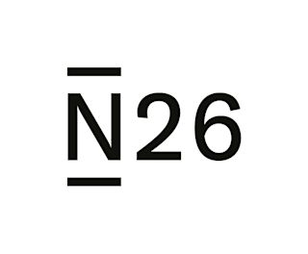












Competitors
Competitive Landscape: 14 Players Across 2 Categories
Neobanks & Fintechs
deep dive
deep dive
deep dive
deep dive
deep dive
Traditional & Digital-First Banks
deep dive
deep dive
deep dive
deep dive
9 Deep-dive profiles follow — Bankinter, N26, Imagin, ING, Revolut, Trade Republic, BBVA, Wise, Bunq

Slide 9
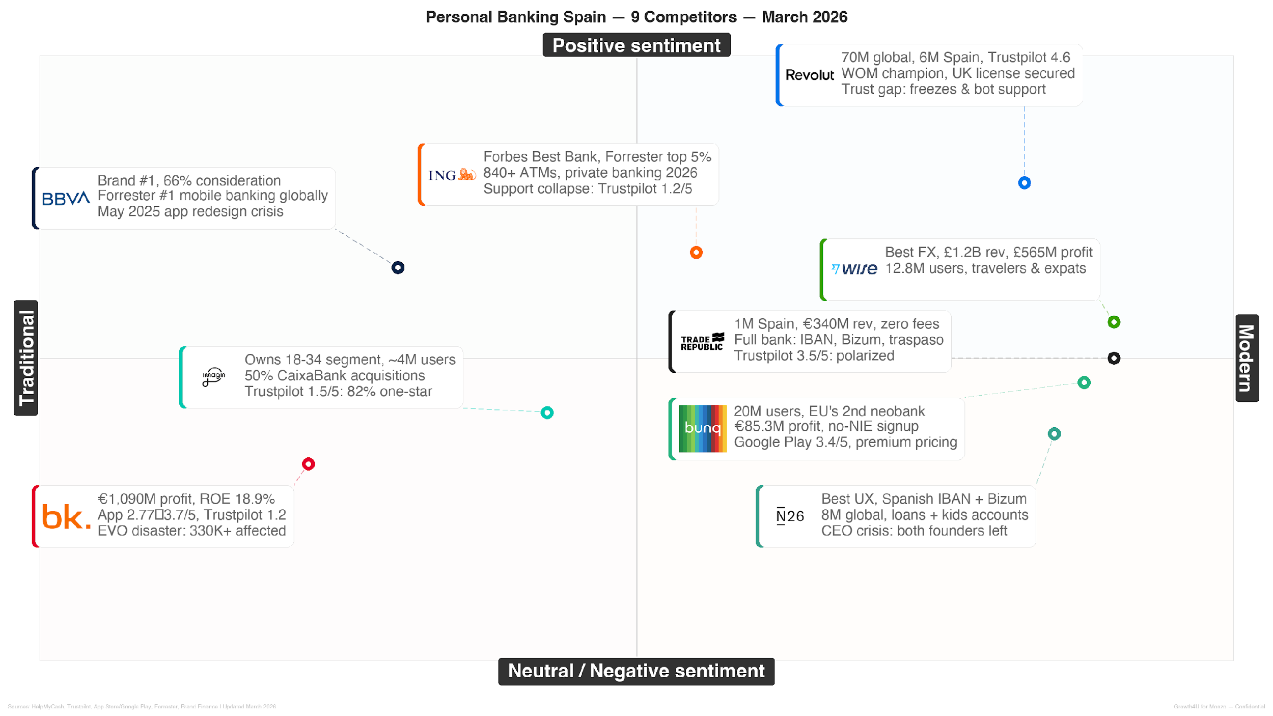
Competitors

Slide 10
Competitors & SWOT
SWOT analysis for Monzo in Spain
Superior UX & Mobile-First Design — Top-rated UK banking app (4.9★). Every competitor benchmarks against it.
Word-of-Mouth Engine & Loyal Community — 14M UK users. A referral culture that drove growth without paid acquisition.
Strong, Distinctive Brand & Gen Z Appeal — The coral card is instantly recognisable. Anti-bank personality resonates with 18-35s.
Product That Solves "Micro-Anxieties" — Pots, spending alerts, bill splitting — addresses emotional friction, not just functional needs.
"Fragile" Brand Outside UK — All trust proof (Trustpilot, Reddit, community) is in English. "Monzo opiniones" returns nothing.
No Physical Presence or Cash Services — Spain is 30%+ cash. No ATM deposits = automatic "second bank" perception.
Zero Brand Awareness in Spain — No press, no word-of-mouth. Starting cold in a market built on "mi banco de toda la vida."
STRENGTHS
WEAKNESSES
Systemic "Support Deficit" — Every competitor fails during crises (account freezes, fraud). Monzo wins by simply not failing.
"Free" Is Commoditised — All neobanks offer free accounts. Differentiation has shifted to value. Premium features can command €5–15/month.
Underserved "Person in Motion" Niche — 500K+ British expats + remote workers in Spain. Product already solves their needs.
Competitors' Opacity Creates a Trust Gap — Revolut hidden fees, N26 freezes, Trade Republic FX charges — all documented in Spanish social media.
High UX Bar Already Set — Revolut, N26, imagin, Openbank all offer excellent mobile UX. "Better app" no longer wins alone.
Incumbents' Structural Advantages — CaixaBank, Santander, BBVA have ATM networks, mortgages, and decades of brand trust.
Reputational Risk from Account Freezes — One viral incident in Spain can define the brand for years. Fatal before scale.
Price Wars Eroding Margins — 3.5% APY (Trade Republic), free Metal (Revolut). Unsustainable acquisition economics becoming the norm.
OPPORTUNITIES
THREATS
"Build in Public" — Spanish Edition — Spanish-language blog, open metrics, founder access. Turn UK story into local trust.
Target "Person in Motion" with Precision — Expat groups, nomad communities, British schools. Distribution is the only gap.
Own "Anti-Fair-Weather Friend" — Guarantee human support for freezes and fraud. Market it explicitly.
Build the Flywheel, Not the Funnel — 40% of UK growth came from referrals at near-zero cost. Replicate.
Leverage UK Reputation in Spanish PR — 14M users + Which? Best Bank = credibility for Spanish financial press.
Proactive Security Communication — Pre-empt account-freeze fear with radical transparency before it's needed.
Best-in-Class Spanish Support Hub — Human support in Spanish, peak hours. Digital done better than anyone.
Partnerships to Replace Physical Presence — Correos (cash), Bizum (P2P), employer salary programmes.
Spain-Calibrated AFC from Day One — Spanish fraud patterns differ from UK. False positives = viral horror stories.
Delay Complex Credit Products — Prove the core app works first. No mortgages or loans until trust is established.
SO
ST
WO
WT
Notes:
THREATS
STRATEGIES
SO — Offensive
"Build in Public" — Spanish Edition — Spanish-language blog, open metrics, founder access. Turn UK story into local trust.
Target "Person in Motion" with Precision — Expat groups, nomad communities, British schools. Distribution is the only gap.
Own "Anti-Fair-Weather Friend" — Guarantee human support for freezes and fraud. Market it explicitly.
ST — Re-orientation
Build the Flywheel, Not the Funnel — 40% of UK growth came from referrals at near-zero cost. Replicate.
Leverage UK Reputation in Spanish PR — 14M users + Which? Best Bank = credibility for Spanish financial press.
Proactive Security Communication — Pre-empt account-freeze fear with radical transparency before it's needed.
WO — Adaptive
Best-in-Class Spanish Support Hub — Human support in Spanish, peak hours. Digital done better than anyone.
Partnerships to Replace Physical Presence — Correos (cash), Bizum (P2P), employer salary programmes.
WT — Defensive
Spain-Calibrated AFC from Day One — Spanish fraud patterns differ from UK. False positives = viral horror stories.
Delay Complex Credit Products — Prove the core app works first. No mortgages or loans until trust is established.

Slide 11



Competitors
Bankinter docs
The “2-Speed” Bank, aggressive acquisition & tech shortcomings.
Bankinter's "Two-Speed Bank" model uses its strength in high-margin services to fund mass-market retail acquisition through attractive offers and authoritative content. However, its technologically deficient infrastructure, with an unstable mobile app and collapsed customer support, leads to a "Leaky Bucket" where newly acquired customers churn due to poor digital experience. The EVO Banco acquisition further exposed these weaknesses.
Potent Acquisition Engine: Highly effective at attracting new customers with aggressive offers like its "up to 5% APR" remunerated accounts.
Authoritative Content Marketing: Leverages its "Analysis Department" to produce expert financial content, building trust and generating high-quality organic traffic.
Pockets of Service Excellence: Personalized in-branch service and mortgage advisory receive high praise for professionalism and personal attention.
Users: ~1M active (709K nomina) (1)
Profit: €1,090M (2025) (2)
Market: 5–6.6% (3)
NPS: 49 (4)
Strengths
Positive reviews
Negative reviews
Service Excellence: "Personalized in-branch service and mortgage advisory receive high praise for professionalism."
Content Authority: "Expert financial analysis builds trust and generates high-quality organic traffic."
Support Collapse: "It is impossible to talk to anyone. The app is horribly bad, slow, unstable and obsolete."
EVO Migration: "The integration was a disaster — called 'fraud' by affected customers stranded without support."
Systemic Customer Support Failure: A critical trust deficit due to inaccessible support. Users report it is "impossible to talk to anyone" after trying multiple times.
Deficient Digital UX: The mobile app is a major liability — described as "horribly bad," "slow, unstable, and obsolete," reliant on outdated features like a coordinate card.
Reputational Damage from Migration: The EVO Banco integration was a "disaster" and "fraud" for 330K+ customers moved to an inferior service.
Weaknesses
★ 1.2/5
602
★ 4.1/5
12K
★ 3.7/5
23K

Slide 12

Competitors
imagin docs
Lifestyle with Golden Handcuffs, Leveraging Scale to Acquire and Retain Youth Through Community and Convenience
Imagin's core purpose is to protect CaixaBank's youth demographic rather than to innovate. It uses its vast existing customers and ATM network to offer a no-fee digital model combined with physical convenience, bypassing high CAC. It builds a youth-focused brand with age-segmented products and a lifestyle platform, retaining customers with high-friction, long-term promotions. However, its "mobile-only" strategy and broken customer service model lead to frustration.
Massive Scale: 48% market share among neobanks/fintechs. Over 5M users backed by CaixaBank's 11,000+ ATMs for free withdrawals.
"Cradle-to-Grave" Pipeline: Products like imaginKids (0-11) and imaginTeens (12-17) capture and build loyalty from early age.
Fee-Free Core: 100% online current account with no maintenance fees. Unique among neobanks: offers mortgages and loans.
Broad Product Portfolio: Comprehensive suite including investments, insurance, and sustainability products.
Users: ~4M (1)
Youth mkt: 48% neobank 18-34 (2)
Nomina: 36.8% mkt share (CaixaBank) (3)
NPS: 16 (CaixaBank, 2024) (4)
Strengths
Positive reviews
Negative reviews
Convenience: "Fee-free, Bizum, PFM tools work well. CaixaBank's ATM network gives unmatched physical convenience."
Youth Products: "Kids and Teens accounts are a great way to teach financial literacy from early age."
Support Loop: "You get bounced between Imagin and CaixaBank with no resolution. Impossible to get help."
Lock-in: "The 250 EUR bonus requires a 4-year commitment — golden handcuffs disguised as a benefit."
Systemic Service Failure: Most cited failure point — 1.8-star Trustpilot rating. Users bounced between Imagin and CaixaBank support.
Operational CaixaBank Dependency: Deep reliance on legacy systems creates bureaucratic maze for users.
"Mobile-Only" Limitation: No web portal creates single point of failure. Frustrates multi-platform users.
"Golden Handcuffs": The 250 EUR payroll bonus requires 48-month lock-in — contradicts digital flexibility promise.
Weaknesses
★ 1.5/5
203
★ 4.7/5
157K
★ 4.7/5
170K

Slide 13
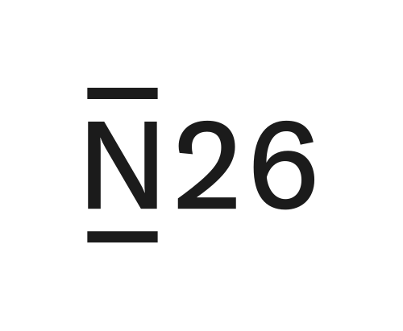
Competitors
N26 docs
Simplicity as a Trojan Horse, Minimalist Design Masks Flawed Internal Machinery
N26 uses a minimalist facade and emotional positioning to rapidly penetrate the market, driven by "Borrowed Trust" marketing via influencers. However, opaque account blocking and non-existent, robotic customer support lead to a "Broken Promise Backlash" that has made their push for becoming the main account not very successful at the moment, although this is changing rapidly.
Superior User Experience: Consistently praised for its "clean, clear, and ad-free" app, offering a seamless UX "much better than the apps of big banks."
Effective Customer Acquisition: A powerful engine built on a "freemium" model, clear value propositions for travelers, expats, and freelancers.
Expanding Ecosystem: Successfully integrated savings and investments, transforming the app into a financial "super-app."
Growing Legitimacy: Spanish IBAN + Bizum integration gives primary bank status. Both co-founders left in 2025; BaFin cap lifted Dec 2024.
Users: 8M+ global, >1.5M ES (1)
Revenue: ~€440M (2024) (2)
Market: 3.2% new accts ES (3)
Strengths
Positive reviews
Negative reviews
Superior UX: "The app is very easy to use and perfect for a modern bank. Much better than any big bank."
Modern Brand: "Strong brand identity that stands out with clean, minimalist aesthetic."
Account Freezes: "They blocked my account in the middle of a trip to Japan. Left without account or card."
Robot Support: "Customer service is a robot that solves nothing. Trapped in loops with no human escalation."
Critical Trust Deficit: Severe, recurring complaints about inaccessible and ineffective customer support.
Severe Reputational Risk: High volume of complaints about unexpected account freezes and funds held for weeks or months.
Regulatory Issues: Over-reliance on automated systems leads to "false positives" and multi-million euro BaFin fines.
Messaging Inconsistencies: Perceived "bait-and-switch" with unannounced rate cuts and new fees for previously free services.
Weaknesses
★ 4.1/5
40K
★ 4.8/5
58K
★ 3.7/5
110K

Slide 14
Competitors
ING docs
The Brittle Low-Cost Model, "No Fees" USP Meets Customer Support Collapse — The Perception Paradox
ING minimizes human support to offer "banking without fees." It acquires digitally comfortable, autonomous customers through its USP and a strong content ecosystem, weaponizing customer expectations as risk management. However, its significant vulnerability is a "Customer Service Collapse," leading to a "Perception Paradox" where it's seen as both an innovator and a source of intense frustration, failing as a "fair-weather friend" during complex issues like mortgages.
Users: 4.6M (Spain) (1)
Profit: €355M (ES+PT, 2025) (2)
Nomina: 2.7M accounts (3)
NPS: #1 in Spain (17yr) (4)
Strong Market Position: Spain's 6th largest bank by assets with a clear, problem-solution narrative as the antidote to traditional banking fees.
Innovative Acquisition: "Nomadas" campaign on Twitch reaches digitally native demographics. En Naranja blog builds organic authority.
Top-Rated Apps: 4.7 stars Google Play / 4.9 stars App Store — strong digital product that attracts autonomous users.
Strengths
Positive reviews
Negative reviews
Content Authority: "Building authority with educational content. Mortgage simulators are best-in-class tools."
Digital Product: "4.7/4.9 star app ratings — one of the best digital banking experiences in Spain."
Support Wall: "1.3/5 from 4,800 reviews. When you need real help with a mortgage, you're completely abandoned."
Fair-Weather Friend: "Great until something goes wrong. Then it's a wall of silence and automated responses."
Critical Service Failure: Dismal 1.3/5 on HelpMyCash from 4,800+ reviews. Creates a "support wall" for complex issues.
Non-Scalable Support: Low-cost model can't serve customers needing mortgage or complex product help — a sense of betrayal.
Digital-Only Limits: Limited physical presence becomes a weakness when human interaction is unavoidable.
Weaknesses
★ 1.2/5
2K
★ 4.8/5
154K
★ 4.8/5
268K

Slide 15
Competitors
Revolut docs
The Problem-First Bank, Utility Marketing and Feature Velocity Drive Growth, But Operational Flaws Create a Trust Chasm
Revolut's "Super App Flywheel" leverages free, high-performance tools and low-cost currency exchange to acquire "Global Nomad" customers. It then uses relentless feature velocity across various financial products to expand relationships. However, sudden and opaque account freezes, coupled with catastrophic, AI-run customer support, lead to a "Trust Chasm" where high average ratings mask severe one-star reviews, hindering users from trusting it as a primary bank.
Acquisition Engine: Dominates search with "utility marketing" — 6M+ Spanish users, 19.8% of new online bank accounts.
Superior UX + Feature Velocity: App described as "intuitive, fast, the best." Rapid deployment of innovative features like disposable virtual cards.
Full Localization: Spanish IBAN, payroll accounts, Bizum integration, and banking license (Jun 2024) converting users from "travel card" to primary bank.
Users: 50M+ global, 6M ES (1)
Revenue: $4B+ (2024) (2)
Market: 19.8% new accts ES (3)
Strengths
Positive reviews
Negative reviews
Superior UX: "The app is intuitive, fast, and the best I've used. Disposable virtual cards are brilliant."
Feature Velocity: "Rapid deployment of innovative features creates a best-in-class product experience."
Account Freezes: "Sudden freeze — locked out of my funds for 3 weeks with zero human communication."
AI Support Loop: "The AI chatbot loops you endlessly. No way to reach a human when your money is blocked."
Critical Trust Deficit: Customer service scores 2.9/5 on review sites. Turning operational issues into reputational crises.
Account Freeze Risk: Automated freezes without clear communication or human oversight — users locked out for weeks or months.
Brand Dissonance: Significant disconnect between aspirational, modern marketing and impersonal, robotic reality during crises.
Weaknesses
★ 4.7/5
366K reviews
★ 4.8/5
166K ratings
★ 4.4/5
3.3M ratings

Slide 16
Competitors
Trade Republic docs
The Irresistible Offer, Great Pricing Compels Users Despite Operational Weaknesses.
Trade Republic uses powerful financial incentives like market-leading interest rates (2.02% APR) and a flat 1 EUR trading fee, combined with hyper-localization, to attract "Aspirational Wealth Builders." However, it suffers from a "Systemic Operational Collapse" in customer service, leading to users being trapped in auto-generated response loops. This results in "Mercenary Loyalty" where customer allegiance is purely transactional and highly vulnerable to competitors.
Aggressive Hyper-Localized Offer: 2.02% APR on unlimited cash + Spanish IBAN + Bizum integration addresses key user needs directly.
Low Transparent Costs: Simple 1 EUR per trade and free savings plans democratize access to investing for new users.
Intuitive UX: Mobile app widely praised for simplicity, significantly lowering the barrier to entry for first-time investors.
Strong Regulatory Foundation: Licensed German bank under BaFin and ECB supervision provides legitimacy and security.
Users: 8M+ global, >1M ES (1)
Revenue: €272M (2024) (2)
Market: Emerging (Spain) (3)
Strengths
Positive reviews
Negative reviews
Value Offer: "2.02% APR, flat 1 EUR trades, Spanish IBAN with Bizum — unmatched combination for new investors."
Simplicity: "The app is incredibly simple. Lowered the barrier for me to start investing."
Worst Service: "The worst service in history. Trapped in automated loops with no human escalation."
Horror Stories: "Reddit is full of frozen fund horror stories. I'm scared to deposit more money."
Systematically Deficient Support: Most cited weakness — described as "the worst thing in the history of service."
High Reputational Risk: Large volume of "horror stories" on Reddit actively deter new users. Polarized brand sentiment.
Technical Failures: Frequent reports of frozen funds, failed transfers, and critical operational issues.
Vulnerable Business Model: Reliance on PFOF faces regulatory threat with potential EU ban.
Weaknesses
★ 3.3/5
33K
★ 4.8/5
53K
★ 2.2/5
107K

Slide 17
Competitors
BBVA docs
The Strategic Dual Identity, Global Institution and Digital Ally with a Superior App ( Now Its Biggest Liability)
BBVA operates as both a global institution for corporate audiences and a technological ally for digital-first customers. Its "Digital Welcome Package" — zero-fee online account, superior mobile app, and security features like the Aqua Card — drives acquisition. It employs a "Dual Funnel" blending direct marketing with brand building. However, its "Support Vacuum" and a disastrous app update have created a significant promise-reality gap.
Historic Digital Leadership: App recognized 5 consecutive years as best in Europe by Forrester. Built a powerful innovative brand image.
Powerful Acquisition Engine: 11M new customers in 2024 (66% digital). Strongest brand in Spain with "Aprendemos Juntos" (+1.8B views).
Proactive Cybersecurity: The area most consistently praised by users — fraud prevention builds deep institutional trust.
Users: 77M global, ~11M ES (1)
Profit ES: €4,180M (2025) (2)
Market: ~15–16% credit (3)
NPS: 32 (global) (4)
Strengths
Positive reviews
Negative reviews
Security: "They saved me from a cyberattack via SMS. In 5 minutes BBVA blocked my card and returned my money."
Professionalism: "The person managing my procedures has done an excellent, fast, and cordial job."
App Disaster: "How to ruin one of the best apps? Ask BBVA. Before it was wonderful, now the most horrendous."
Abandonment: "Blocking my money for 2 months for no reason, without explanations, without answers."
Abuse: "160 EUR/year for existing customers, 0 EUR for new ones. I'm literally switching banks."
Digital Experience Collapse: A disastrous app update turned its main asset into its biggest liability overnight.
Systemic Service Failure: Service across traditional and remote channels is perceived as inaccessible and ineffective.
Fee Erosion: Strong perception of "abusive" and non-transparent fees — the 40 EUR quarterly charge drives loyalty erosion.
Uncompetitive Savings: Interest-bearing savings products considered "ridiculous" and "insulting" by customers.
Weaknesses
★ 1.3/5
2.2K
★ 4.8/5
158K
★ 4.7/5
289K

Slide 18
Competitors
Wise docs
Radical Transparency and Cost Leadership, Consumer Advocacy in Cross-Border Finance with Efficient Acquisition
Wise's focus is cross-border finance, advocating for consumers by using the "real mid-market exchange rate." Its acquisition driver is proven cost leadership (8x cheaper) and efficient inbound marketing targeting "Persons in Motion" through hyper-localized SEO. However, a critical "Ghost Bank Nightmare" of no human support, account blocking and fund retention without recourse threatens its growth beyond the niche.
Aggressive Cost Leadership: Proven to be 8x cheaper for international transfers vs. major Spanish banks and fintech rivals like PayPal.
Transparent Value Prop: The "mid-market exchange rate" promise is a powerful, easy-to-understand differentiator that builds trust.
Strong Niche PMF: Integrated ecosystem perfectly meets the needs of expats, digital nomads, and auxiliares de conversacion.
Efficient Inbound Engine: 12.8M customers acquired at low cost through sophisticated SEO content strategy.
Users: 15.6M global (2025) (1)
Revenue: £1.2B (FY2025) (2)
Market: Leading intl. transfers (3)
Strengths
Positive reviews
Negative reviews
Savings: "Saved well over 60% on my usual monthly bank fees while living abroad."
Speed: "Super-fast transfers arrive in seconds. Smooth and fast transaction process."
Simplicity: "Simple, useful, and clear. Remarkably streamlined and easy to use."
Ghost Bank: "A ghost bank — blatant disregard for customers by blocking access to their funds."
Unreliable Card: "Card denied 80% of the time in Spain. Problems with contactless and ATM withdrawals."
Critical Support Failures: Significant gap between marketing promise of 24/7 support and user-reported reality of only automated responses.
Account Blocking: Recurring problem of frozen accounts without explanation or recourse — existential threat to user trust.
Product Gaps: No credit products (loans, mortgages) limits ability to serve as primary bank for long-term residents.
Card Reliability: Users report the Wise debit card is denied 80% of the time in Spain, contactless payments broken.
Weaknesses
★ 4.3/5
281K
★ 4.8/5
40K
★ 4.2/5
N/A

Slide 19
Competitors
Bunq docs
Surgical Strike on the Expat Niche, Frictionless Onboarding and Lifestyle Ecosystem for Expats and Digital Nomads
Bunq targets expats, digital nomads, and international students by eliminating bureaucratic pain points like the need for an NIE for account opening. Its acquisition is driven by frictionless onboarding and localization. Bunq maintains engagement through a sticky "All-in-One Lifestyle Ecosystem" with advanced budgeting, travel features, and ethical branding. However, severe support failures create a "Promise-Reality Gap" that contradicts its marketing.
Hyper-Focused Niche Strategy: Laser focus on expats, digital nomads, and international students allows for precise product and marketing.
Frictionless Onboarding: Account in minutes without NIE — passport only. A powerful competitive advantage in Spain.
Strong Localized PMF: Spanish IBAN + Bizum + multilingual support + 25 sub-accounts + ZeroFX travel features.
Ethical Branding: Tree planting and "Freedom of Choice" investment resonate with values-driven users.
Users: 20M+ global (2025) (1)
Revenue: €245M (2024) (2)
Market: Emerging in Spain (3)
Strengths
Positive reviews
Negative reviews
Empowerment: "I stopped stressing about finances. No longer worry about how to survive until the next salary."
Frictionless: "Spanish IBAN and functioning account in minutes without needing an NIE — why I chose Bunq."
Unsupported: "Extremely slow responses, unhelpful chatbot, issues that remain unresolved. Enormous frustration."
Instability: "Account suddenly frozen with no clear warning. Funds held for long periods without explanation."
Customer Support Issues: Stark contradiction between "24/7 support" promise and widespread complaints of slow, unhelpful responses.
Account Stability: Multiple reports of accounts suddenly frozen or closed with no clear warning or explanation.
Inconsistent UX: Vocal segment finds the app complex, "bloated," and confusing after the "V3" update.
Premium Pricing: Pro at 9.99/mo and Elite at 18.99/mo limits mass-market adoption potential.
Weaknesses
★ 4.2/5
21K
★ 4.6/5
3.8K
★ 3.4/5
26K

Slide 20
Business Banking

Slide 21
SECTION 01
Market & Gaps

Slide 22
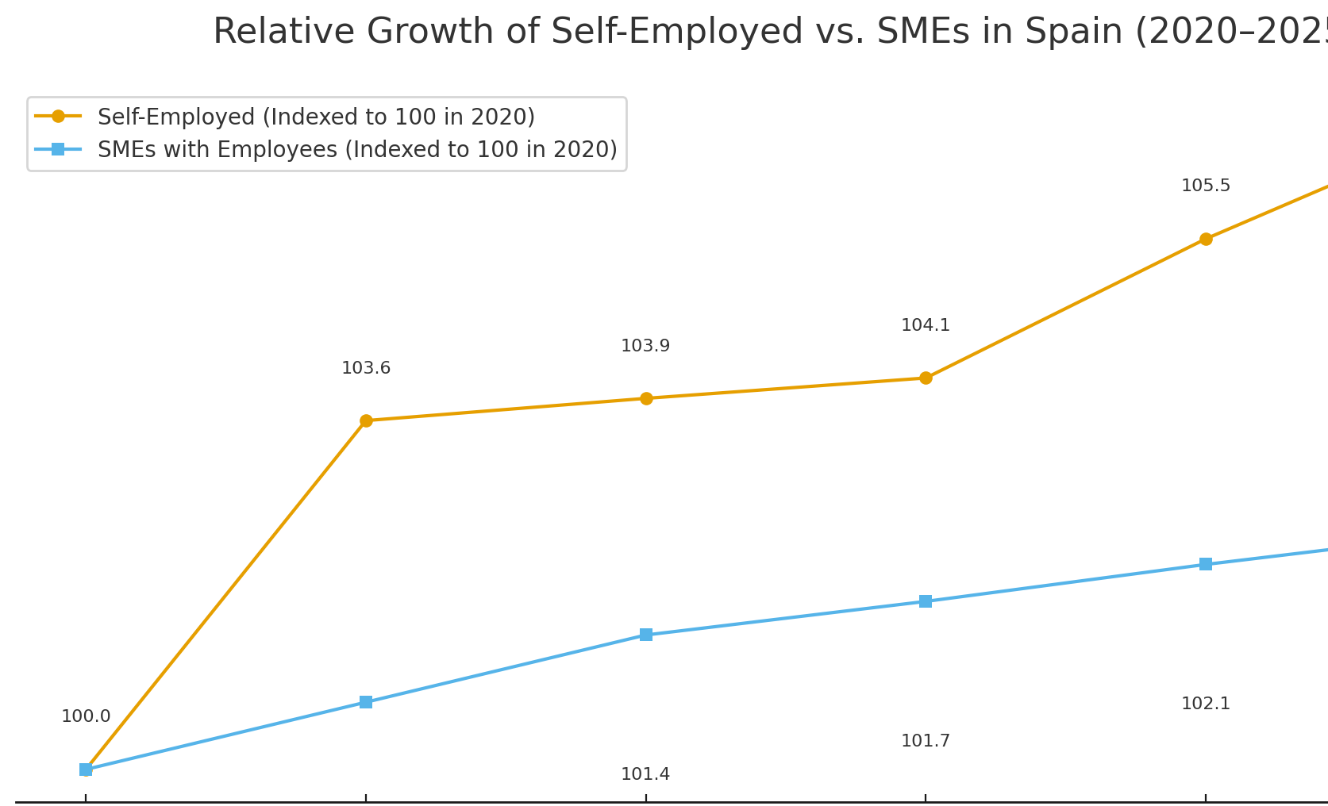
Market
Spain's BB Market: Underserved SMEs and Growing Autonomos
Four structural trends reshaping the competitive landscape for business banking in Spain
1
The SME Financing Gap
In 2024, 60% of SMEs seeking credit faced difficulties or rejections. Collateral-centric risk models are out of step with digital companies.
2
Bank-Fintech Collaboration
6x fintech growth since 2015. Relationship evolved from competitive to collaborative. Banks partner on innovative projects and integrate agile, customer-centric solutions.
3
Data-Driven Ecosystems
Market moving toward unified digital platforms over siloed products. BBVA's 'Sharing Knowledge' achieved 43.5M views by fostering a business community.
4
AI Adoption in Corporate Finance
20% of Spanish companies now use AI. BNP Paribas reduced loan processing time by 80%. AI shifting from experimental to core infrastructure.

Slide 23
Market & Gaps
Hacienda (AEAT) and Social Security (TGSS): The Integration Gap
Two separate regulatory integrations that determine whether a business account can be the sole account
Fintech
AEAT (Tax Agency)
TGSS (Social Security)
Veri*Factu
Can Be Sole Account?
N26
YES — direct AEAT payments
YES — TGSS collaborator (only neobank)
NO
YES — functionally complete for core admin
Qonto
YES — NRC code + direct debit + gateway (Oct 2024)
NO — not entidad colaboradora
YES — via Regate acquisition
NO — forces parallel bank for SS payments
Revolut
YES — AEAT collaborator (Mar 2025)
NO — stated future goal, not yet active
NO
NO — must maintain parallel bank for SS
Finom
NO — critical gap, cannot pay taxes
NO — no integration
NO
NO — relegated to secondary role
SumUp
PARTIAL — auto-fiscalization sends transactions
NO
YES — certified (Jan 2026)
NO — POS-first, not full business bank
Incumbents
YES — flawless native integration
YES — flawless native integration
VARIES
YES — but slow, expensive, poor UX
Monzo Opportunity: If Monzo achieves AEAT + TGSS + Veri*Factu + Digi. Certificada from launch = the only fintech with complete regulatory integration in Spain.

Slide 24
Market & Gaps
Gap Analysis doc
Spain’s Product Gap Analysis: Lifecycle
Lifecycle Stage & Key Need | BBVA | Santander | Sabadell | N26 | Qonto | Finom | Revolut | SumUp
🚀 Fast, Digital Account Opening | 🔴 Poor: Slow and bureaucratic processes.¹ | 🔴 Poor: Slow and bureaucratic processes.² | 🔴 Poor: Slow and bureaucratic processes.³ | 🟢 Excellent: Fast, paperwork-free opening in minutes.⁴ | 🟢 Excellent: Fast, digital registration process.⁵ | 🟢 Excellent: Fully online process in 24 hours.⁶ | 🟢 Excellent: Rapid digital onboarding.⁷ | 🟢 Excellent: Simple setup is a core strength.⁸
🏦 Professional Legitimacy (Spanish IBAN) | 🟢 Excellent: Standard offering.⁹ | 🟢 Excellent: Standard offering.⁹ | 🟢 Excellent: Standard offering.⁹ | 🟢 Excellent: A key feature for local payments.⁴ | 🟢 Excellent: A key feature of the account.⁵ | 🟢 Excellent: A key feature of the account.⁶ | 🟡 Good: Provides an IBAN, but local integration is weaker.⁷ | 🟢 Excellent: Provided with the free business account.⁸
💳 Accepting First Payments | 🟡 Good: Offers traditional POS terminals.¹ | 🟡 Good: Offers traditional POS terminals.² | 🟡 Good: Offers modern POS terminals.³ | N/A | 🟢 Excellent: Offers mobile terminals and "Tap to Pay".⁵ | N/A | 🟢 Excellent: Offers Revolut Reader and payment tools.⁷ | 🟢 Excellent: Core business model; low-cost hardware.⁸
🧾 Integrated Admin Tools (Invoicing, etc.) | 🟡 Fair: "One View" is powerful, but main app is a "catastrophic failure".¹ | 🟡 Fair: Tools exist but are clunky compared to fintechs.² | 🟡 Fair: Tools exist but are clunky compared to fintechs.³ | 🟡 Good: "Spaces" is a great tool, but less of an all-in-one platform.⁴ | 🟢 Excellent: Central to its identity; deep integration.⁵ | 🟢 Excellent: Designed as an "all-in-one" platform.⁶ | 🟢 Excellent: A "superapp" with many integrated tools.⁷ | 🟢 Excellent: "Super App" creates a sticky ecosystem.⁸
🇪🇸 Public Admin Integration (AEAT/SS) | 🟢 Excellent: Flawless, native integration.⁹ | 🟢 Excellent: Flawless, native integration.⁹ | 🟢 Excellent: Flawless, native integration.⁹ | 🟡 Fair: AEAT payments enabled, but no Social Security direct debit.⁴ | 🔴 Critical Failure: Cannot make payments to the Tax Agency.⁵ | 🔴 Critical Failure: Cannot pay taxes or direct debit from the Tax Agency.⁶ | 🔴 Poor: Lacks deep local administrative integration.⁷ | 🟡 Good: Automatic fiscalization sends transactions to the tax agency.⁸
🌍 Low-Cost International Payments | 🔴 Poor: Slow with high, opaque fees.⁹ | 🔴 Poor: Slow with high, opaque fees.⁹ | 🔴 Poor: Slow with high, opaque fees.⁹ | 🟢 Excellent: Partnership with Wise is a key selling point.⁴ | 🟡 Good: Supports SWIFT transfers in 25+ currencies.⁵ | 🟡 Good: Supports payments to 150+ countries.⁶ | 🟢 Excellent: A core strength with 35+ currencies at interbank rates.⁷ | N/A
💰 Access to Financing & Credit | 🟢 Excellent: Comprehensive offering, including Venture Debt.¹ | 🟢 Excellent: Comprehensive offering, including Venture Debt.² | 🟢 Excellent: Comprehensive offering, including equity investing.³ | 🔴 Poor: Very limited; no credit cards or long-term products.⁴ | 🟡 Fair: Limited "Pay Later" and partner loans after 6 months.⁵ | 🔴 Critical Failure: No credit or financing products mentioned.⁶ | 🔴 Critical Failure: Explicitly does not offer credit, loans, or overdrafts.⁷ | 🔴 Critical Failure: No credit or financing products mentioned.⁸
👥 Team Expense Management | 🟡 Fair: Offers corporate cards but lacks advanced controls.¹ | 🟡 Fair: Offers corporate cards but lacks advanced controls.² | 🟡 Fair: Offers corporate cards but lacks advanced controls.³ | 🟡 Fair: "Shared Spaces" is useful but less focused on team cards.⁴ | 🟢 Excellent: A key strength with comprehensive controls.⁵ | 🟢 Excellent: Offered in paid plans with multi-user access.⁶ | 🟢 Excellent: A key strength with custom spend controls.⁷ | N/A
📈 Specialized Advisory & Support | 🟢 Excellent: Strong, with units like BBVA Spark and CIB.¹ | 🟢 Excellent: Strong, with units like "Santander Startups".² | 🟢 Excellent: Core value prop with BStartup and industry hubs.³ | 🔴 Poor: Almost entirely absent; focus is on scalable tech.⁴ | 🔴 Poor: Almost entirely absent; focus is on scalable tech.⁵ | 🔴 Poor: Almost entirely absent; focus is on scalable tech.⁶ | 🔴 Poor: Almost entirely absent; focus is on scalable tech.⁷ | 🔴 Poor: Almost entirely absent; focus is on scalable tech.⁸
🆘 Human Support in a Crisis | 🔴 Poor: Consistently described as "ineffective" and "abysmal".¹ | 🔴 Poor: Consistently described as "inconsistent" and "unhelpful".² | 🔴 Poor: Described as "terrible" and "embarrassing".³ | 🔴 Critical Failure: "Brick wall of unhelpful customer service".⁴ | 🔴 Critical Failure: "Nonexistent technical support" in crises.⁵ | 🔴 Poor: Good for routine issues, but fails in high-stakes crises.⁶ | 🔴 Critical Failure: Its "weakest point"; "non-existent" and "frustrating".⁷ | 🔴 Critical Failure: "Unreturned calls," "hanging up on customers".⁸
Fee Transparency | 🔴 Poor: Notorious for "opaque" and "abusive" fees.¹ | 🔴 Poor: Notorious for "opaque" and "abusive" fees.² | 🔴 Poor: Notorious for "opaque" and "abusive" fees.³ | 🟡 Good: Core value prop is the "no-hidden-fees" model.⁴ | 🟡 Fair: Generally transparent, but some users feel it's expensive.⁵ | 🟡 Good: Strong value with the free plan; fees are generally clear.⁶ | 🟡 Fair: Undermined by "hidden costs" like weekend FX fees.⁷ | 🟢 Excellent: A core strength; "no hidden fees" is a primary driver.⁸
🙏 Peace of Mind & Trust | 🟡 Fair: Trusted for stability, but not to be fair or helpful.⁹ | 🟡 Fair: Trusted for stability, but not to be fair or helpful.⁹ | 🟡 Fair: Trusted for stability, but not to be fair or helpful.⁹ | 🔴 Poor: Deeply eroded by account blocking issues.⁴ | 🔴 Poor: Severely damaged by account freezes and support failures.⁵ | 🔴 Poor: Damaged by account blocking and inconsistent crisis support.⁶ | 🔴 Poor: Profound "trust deficit" from account freezes.⁷ | 🔴 Critical Failure: Critically damaged by fund retention issues.⁸
Stage 1: Inception & Launch
Stage 2: Day-to-Day Operations
Stage 3: Growth & Scaling
Overarching needs

Slide 25
SECTION 02
Competitors & SWOT

Slide 26



Competitors & SWOT
Competitive Landscape: 8 Deep-Dive Players Across 3 Categories
Neobanks & Fintechs
deep dive
deep dive
deep dive
deep dive
Traditional Banks
deep dive
deep dive
deep dive
POS & Payment Ecosystems
deep dive
8 Deep-dive profiles follow — Finom, Qonto, Revolut, SumUp, BBVA, Sabadell, Santander, N26

Slide 27
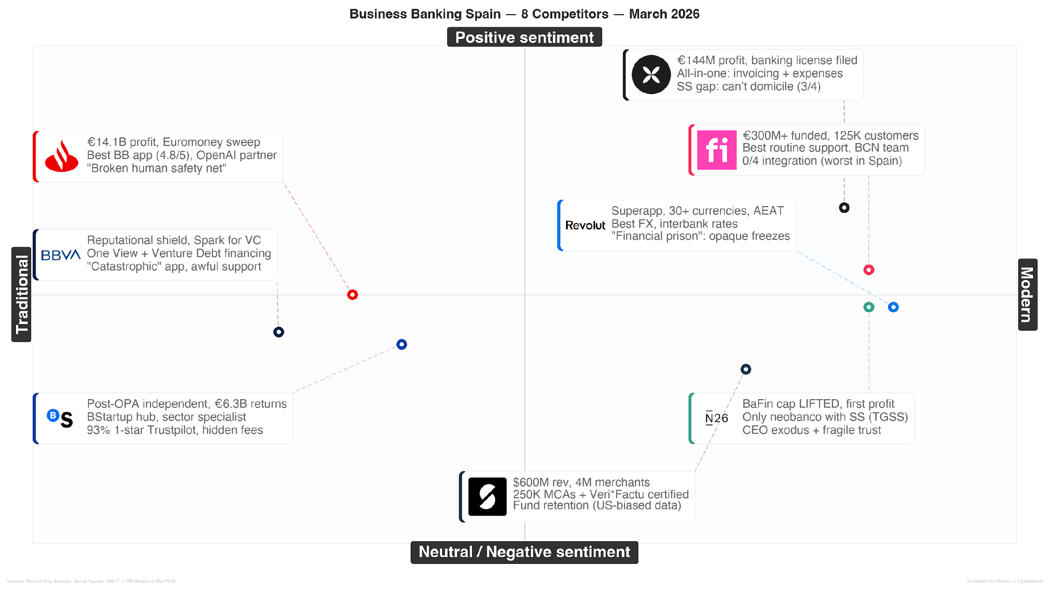
Competitors & SWOT

Slide 28
Competitors & SWOT
SWOT
STRENGTHS
Unique Tax Integration (Tax Pots) — Direct AEAT integration for automated VAT/tax; no competitor offers this. Solves #1 SME anxiety.
Superior Onboarding + Freemium — 10-min digital onboarding + only provider with robust free tier for Sole Traders & LTDs (vs. Qonto: no free tier).
Real Bank from Day 1 — Regulated bank with Spanish IBAN. Bypasses "foreign non-bank" perception that plagued early neobanks.
100% In-House Tech — Full stack ownership + proven UK community model. Integrated invoicing creates high switching costs.
Critical Feature Exclusions — No cash deposits, no multi-currency, no credit. Forces laser-focus on digitally-native newborn ICP.
Zero Brand Awareness — Starting from scratch in a market that values "mi banco de toda la vida." Needs "show, not tell" via partnerships & PLG.
Lack of Granular Planning — Annual target clear (6,021 customers), but no monthly KPIs defined. Hinders agile course correction.
WEAKNESSES
Systemic Trust Vacuum — ALL competitors fail on crisis support (account freezes, fund retention). First to offer human-led support for high-stakes issues wins.
Underserved Newborn Businesses — Highest pain (registration, anxiety), zero loyalty to incumbents. Monzo's offering is precision-engineered for this ICP.
"Second Bank" Phenomenon — Fintech customers maintain parallel traditional accounts due to integration gaps. Tax Pots + Spanish IBAN = path to primary account.
Integration Gap: No Competitor Covers 4/4 — VeriFactu + Digitalizacion Certificada + TGSS + AEAT. If Monzo achieves all 4, it's the only complete BB solution in Spain.
Cultural Inertia — Spain's uncertainty avoidance index: 86 (vs. UK 35). Only 25% SMBs switch banks in 5 years.
Neobank Reputational Contagion — Account freezes & fund retention tarnish category. But Qonto (€144M profit) & SumUp ($600M rev) are maturing dual threat.
Qonto Banking License (Jul 2025) — If granted: lending, savings, overdrafts, potentially TGSS. Narrows Monzo's competitive window significantly.
Post-OPA Incumbent Aggression — BBVA OPA failed (Oct 2025). Sabadell now independent, €6.3B shareholder returns — will compete aggressively for SME share.
Well-Funded Fintechs at Scale — Qonto €448.7M rev, SumUp pre-IPO $10-15B, Finom >€300M funded. No longer scrappy startups.
OPPORTUNITIES
THREATS
• Lead with "Tax Anxiety" — Center all messaging on automated tax management. Free invoice generator as "show, not tell" trust-builder.
• "Anti-Fair-Weather Friend" — Guarantee accessible human support for critical issues. Market explicitly as core differentiator.
• Pursue "4/4 Integration" — TGSS entidad colaboradora + VeriFactu + Digitalizacion Certificada + AEAT. "
ST
• "Borrow Trust" via Gestores — Partner with local accountants to circumvent cultural inertia. Co-branded materials + seamless referral process.
• Differentiate from Neobanks, Regulated bank status + crisis support quality + 4/4 integration. Nuanced: some neobanks maturing, so focus on specifics.
• Gaps → Niche Focus — No cash/multi-currency = feature for digital-native newborns. "Everything you need, nothing you don't."
• Community-Led Brand — Advisory board of 10-15 local business owners. Testimonials = launch campaign foundation. South Summit Madrid presence.
• High Switching Costs ASAP — Drive Tax Pots + invoicing adoption in first 6 months. Window narrowing with Qonto's banking license filing.
• Financial Discipline — CAC target ≤ €199. Prioritize efficient channels (partnerships, PLG). Avoid price wars with Qonto (€144M profit), SumUp ($600M).
SO
ST
WO
WT

Slide 29
Competitors
Finom docs
The Human-Centric Partner, B2B Banking Strategy for Freelancers and Solopreneurs
Finom combines high-tech efficiency (24h IBAN, 60s invoicing) with human-centric, localized service (Barcelona branch). Acquisition driven by low-barrier free plan with cashback. Primary churn catalyst: catastrophic failure in high-stakes scenarios (missing funds, account freezes) plus inability to pay Spanish taxes — undermining the 'all-in-one' promise.
Exceptional Routine Support: Consistently praised as "blazing fast" and "personalized" from "real people" — key differentiator vs. traditional banks.
All-in-One Platform: Consolidates business account, invoicing (20%+ faster payments), expense management, and accounting integrations in one dashboard.
Compelling Freemium + Incentives: Fully functional free Solo plan with up to 3% cashback on card expenses. 125K+ customers, >€300M funded.
Fast Onboarding: Fully online, local Spanish IBAN in 24 hours. Solaris BaaS partnership enables banking infrastructure.
Users: 125K+ businesses (1)
Revenue: ~$50M ARR (2)
Market: Niche SME neobank (3)
Strengths
Positive reviews
Negative reviews
Speed: Opened a business account for my BV within a few hours. At ING, I'm still waiting after 4 weeks.
Human Service: Customer service from Emma, Alain, Igor, Javi is exceptional. Having a human is a key differentiator.
Simplicity: Easy, intuitive, with real Cashback. Very complete. The app is very good, fast, and efficient.
Missing Funds: All the money in my account just disappeared. I've been waiting 3 months for them to return it.
Tax Gap: Warning: you can't make payments to Hacienda. Forces you to have another account just for that.
Bait-and-Switch: Abusive changes to terms. They tell you it's free, then after 30 minutes... hundreds of euros.
Critical AEAT Gap: Cannot pay taxes or handle direct debits from Agencia Tributaria — a major flaw undermining the "all-in-one" promise for Spanish businesses.
Crisis Support Failure: Routine support lauded but collapses during high-stakes issues: missing funds and "sporadically" responsive support in emergencies.
Lack of Core Banking: No cash/check deposits, ATM withdrawal limits. Not ideal for businesses needing full banking.
Account Freeze Risk: Abrupt account blocks with little explanation — leading to accusations of being a "scam."
Weaknesses
★ 4.6/5
12K
★ 4.7/5
164
★ 4.1/5
3.2K

Slide 30
Competitors
Qonto docs
Your Financial Partner Bank, Integrated Financial Management Platform — €144M Profit, 600K+ Customers, Banking License Filed
Qonto's strategy is to be an integrated financial management platform (invoicing, team management, accounting) creating big switching costs. Acquisition driven by promise of freeing SMEs from admin burdens. Now profitable (€144M in 2024, up from €71M) with 600K+ customers across 8 markets. Banking license formally filed July 2025 with French ACPR. However, the 'uh-oh moment' is when 'ultra-responsive support' collapses during crises.
Users: 600K+ businesses (1)
Revenue: €448.7M (2024) (2)
Market: Leading EU SME neobank (3)
NPS: 76 (4)
All-in-One B2B Platform: Business account + expense management + invoicing + accounting + Regate (€35.7M acquisition) for a complete financial OS.
Proven Profitability: €448.7M revenue (+44%), €144M profit (2x from 2023), €8.1B deposits. Strongest unit economics among B2B fintechs.
Superior UX + Brand: Trustpilot 4.8/5 (53K reviews), G2 4.7/5. Intuitive, modern interface praised by users. 70% revenue increase in Spain.
AEAT + Veri*Factu Leader: First fintech with AEAT collaboration (Oct 2024) + Veri*Factu compliance via Regate. Leads B2B regulatory integration.
Strengths
Positive reviews
Negative reviews
Efficiency: The best neobank in Europe. Simple, fast, transparent, with a UX on another level.
Integration: Quarterly accounting went from a chore to a pleasure. Accountant accesses everything.
Simplicity: Perfect bank for SMEs and startups. Very fast opening, intuitive and simple interface.
Abandonment: Impossible to talk to them. Account blocked 15+ days with money inside, only an irritating bot.
Fund Loss: They blocked our account, we lost €8,800, no explanation. Preparing a lawsuit.
Scam Accusations: CAREFUL — they block your funds at the slightest chance. Customer service solves nothing.
Critical Trust Deficit: Support collapses during crises: "non-existent" human escalation, automated responses, accounts blocked for 15+ days.
Account Freeze + Fund Retention: Most severe complaint: accounts blocked without reason, preventing fund access. Users preparing lawsuits (€8,800 case).
No Social Security Integration: NOT entidad colaboradora TGSS. Forces 50% of clients to maintain a parallel traditional bank account.
Inconsistent Price Perception: Despite transparency promise, some users report unexpected fees and "upselling" schemes.
Weaknesses
★ 4.8/5
53K
★ 4.7/5
1.2K
★ 4.3/5
25K

Slide 31
Competitors
Revolut Biz docs
The Borderless Promise, 20K+ New Businesses/Month — €4B Revenue, 6M+ Spanish Users, AEAT Collaborator
Revolut positions as a 'superapp' eliminating international operations friction, promising borderless money. Primary acquisition: significant cost savings (up to 6% on payments) and sleek UX with 20K+ new businesses monthly. Now €4B annual revenue (+72%), €1.4B profit, banking license Jun 2024. AEAT collaboration since Mar 2025. However, sudden and opaque account freezes due to automated processes create the critical 'uh-oh moment.'
"All-in-One" Global Platform: Multi-currency accounts, expense management, payments, treasury in one "superapp." 35+ currencies at interbank rates.
Superior UX + Automation: Consistently praised as "amazingly simple" — up to 88% faster than manual processes. 4.9/5 App Store.
Massive Cost Savings: Average 6% savings on payments vs. traditional banks. Primary acquisition driver for businesses with international operations.
Full Spanish Localization: AEAT collaborator (Mar 2025), Spanish IBAN, Bizum integration. GlobalHire EOR service launched 2025.
Users: 500K+ biz accts (2020) (1)
Revenue: Part of $4B+ total (2)
Market: Growing B2B segment (3)
NPS: 12 (group) (4)
Strengths
Positive reviews
Negative reviews
Low-Fees: The payment platform of the future... much cheaper per month than my bank.
Simplicity: Amazingly simple and reliable. I love brands that think big and dare to accelerate.
Cash Flow Crisis: If you don't want to risk a cash flow crisis for your business — DO NOT USE REVOLUT BUSINESS.
Blocked: They restricted my account and made me wait 19 days. Non-existent customer service.
Warning: Please stay away from Revolut Business.
Critical Support Failure: "Non-existent," "ineffective," "desperately frustrating" — the most significant weakness across all user feedback channels.
Account Freeze Risk: Opaque compliance freezes "without explanation" causing "cash flow crises" for businesses. Blocks lasting weeks or months.
No Credit Products: Does not offer credit lines, loans, overdrafts, or cash/check deposits. Cannot serve as sole bank for growth-stage businesses.
Deceptive Fee Structure: Weekend FX surcharges and limited free plans become "quickly insufficient" for active businesses.
Weaknesses
★ 4.7/5
366K
★ 4.8/5
166K
★ 4.4/5
3.3M

Slide 32
Competitors
SumUp docs
The Accelerated Growth Paradox, Land-and-Expand Model — $600M Revenue, 4M+ Merchants, Pre-IPO ($10-15B), VeriFactu Certified
SumUp's 'land and expand' model combines low-risk entry (pay-as-you-go, no contracts) with a sticky 'Super App' ecosystem that creates switching costs. $600M revenue, EBITDA positive since Dec 2022, 4M+ merchants across 37 markets, 1B+ annual transactions. Now includes Business Account (€1B+ deposits, 1.5M users) and 250K+ Merchant Cash Advances. Veri*Factu certified for Spain (Jan 2026). Pre-IPO at $10-15B.
Near-Zero Entry Barrier: Pay-as-you-go, no monthly fees or contracts. Solo Lite €39+VAT, Solo €79+VAT. Massively attracts micro-entrepreneurs.
Sticky "Super App" Ecosystem: POS + Business Account + Invoicing + Online Store creates high switching costs. €1B+ deposits, 1.5M active business account users.
Clear Niche Dominance: Absolute dominance in mobile merchants and temporary businesses (pop-ups, markets). 4M+ merchants globally.
Veri*Factu + Merchant Cash Advances: Spain-certified e-invoicing (Jan 2026). 250K+ MCAs issued — now offers lending alongside payments.
Merchants: 4M+ globally (1)
Revenue: ~€188M (2023) (2)
Market: Leading POS provider (3)
Strengths
Positive reviews
Negative reviews
Easy Start: Best alternative to a traditional bank. Set it up in half an hour, running same afternoon.
No Contracts: No monthly fees or abusive contracts. Just what you need when you're starting.
Freedom: Take payments anywhere, at fairs or at a client's home. Don't depend on any bank.
Black Hole: Waiting weeks for a response. It's a support black hole. Impossible to speak to a human.
Fund Theft: They blocked my account without warning and refuse to release my funds. They are thieves.
Broken Hardware: Card reader stopped working, solution: buy a new one. Marketing great, reality a disaster.
Systemic Support Collapse: "Non-existent," "terrible," "black hole" — most recurrent and damaging complaint across all review channels.
Critical Fund Retention: Severe recurring accusations of fund blocking and account freezes without explanation. Primary trust destroyer.
Fractured Brand Identity: Deep dissonance between empathetic marketing and customer experience of abandonment. "Scam" and "fraud" accusations.
Hardware Dependency: Card reader failures with no resolution except "buy a new one" — marketing great, reality a disaster.
Weaknesses
★ 4.1/5
40K
★ 4.5/5
1.4K
★ 3.9/5
119K

Slide 33
Competitors
BBVA Biz docs
Empresas: The Dual Path Strategist, Leveraging Scale and Segmentation for Reputational Shielding
BBVA employs a 'Duality and Reputational Shield' strategy — using scale and aspirational narratives to deflect operational failures. Segmented value propositions: financial hooks for mass market + Spark for high-growth tech (€1B committed, 1,700 customers). €10.5B profit 2025 (+4.5%), 1.2M new Spain customers. The OPA on Sabadell FAILED Oct 2025 (25.47% acceptance). Critical weakness: 'BBVA Empresas' app described as 'catastrophic failure.'
Users: 77M global, ~11M ES (1)
Profit ES: €4,180M (2025) (2)
SME mkt: Top 3 in Spain (3)
NPS: 32 (global) (4)
Corporate Reputation: Top 3 LinkedIn Employer in Spain. World leader in sustainability comms. Powerful 'reputational halo' effect.
Specialized Niche (Spark): BBVA Spark: €1B committed financing, 1,700 customers, 30+ deals in 2025. Unique Venture Debt for high-growth startups.
Advanced Digital Ecosystem: BBVA One View integrates accounts from 80+ external banks. Powerful for corporate treasury management.
Customer Acquisition Engine: 'Cuenta Negocios Bienvenida' (12 months commission-free). 1.2M new customers in Spain 2025.
Strengths
Positive reviews
Negative reviews
Spark Excellence: The ideal partner to accompany us on this journey." (A BBVA Spark client)
Security: They saved me from a cyberattack via SMS. In 5 minutes BBVA blocked my card and returned money.
Service Collapse: A real piece of garbage customer service for SMEs... days for them to answer, unfeasible for agile management.
App Disaster: The web doesn't work from almost any browser. The app works very badly, not intuitive at all.
Hidden Fees: They invent commissions and interest rates you didn't even know about.
Critical Trust Deficit: Service described as 'pesimo' (abysmal), 'desastre' (disaster). Trustpilot 1.3/5 from 2,141 reviews — 24x volume increase reinforces pattern.
"Empresas" App Disaster: New business app/portal described as 'horrible,' 'unreliable,' 'a mess' — transformed loyal users into vocal detractors.
Fee Opacity: Deep-seated perception of 'abusive commissions.' Consumer group recovered nearly €29,000 from client due to security failure.
OPA Failure Aftermath: Failed takeover of Sabadell (Oct 2025) consumed management attention. Sabadell now on offensive with €6.3B shareholder return.
Weaknesses
★ 1.3/5
2.2K
★ 4.8/5
158K
★ 4.7/5
289K

Slide 34

Competitors
Sabadell docs
The Trojan Horse Strategy, Post-OPA Victory — €6.3B Shareholder Return, TSB Sale to Santander (£2.65B), Now on Offensive
Sabadell emerged victorious from the BBVA OPA (failed Oct 2025, 25.47% acceptance). Now pivoting from defensive to offensive: €6.3B shareholder return program, €800M buyback (Feb 2026), TSB sale to Santander (£2.65B). Its 'Trojan Horse' strategy uses Sabadell Hub content to bypass negative mass-market perceptions. Churn catalyst: 'bait-and-switch' hidden fees discovered after promotional periods. Trustpilot 1.2/5 (93% one-star).
Powerful B2B Specialization: BStartup for startups, international business, tourism, agriculture. Customized sector solutions. Dedicated Business Managers.
Content-Led Thought Leadership: Sabadell Business Hub attracts high-value clients through webinars and expert content — not product offerings. Strong inbound.
Personalized High-Value Service: Dedicated Business Manager provides key differentiation vs. purely digital competitors for large accounts.
Post-OPA Offensive: €6.3B return program, €800M buyback, TSB sale proceeds. Significant resources for digital transformation.
Users: ~6.5M active (Spain) (1)
Profit: €1,775M (2025) (2)
NPS: 38–45 (PB) (3)
Strengths
Positive reviews
Negative reviews
Easy Onboarding: Signed up very quickly. The app isn't complex, it's user-friendly and simple.
Digital Utility: The app is very useful, solves many things without going to the bank.
Stability Perception: As one of Spain's major banks, some feel their money is in 'good hands.'
Betrayal: Going to another bank that's at least more transparent and loyal to its customers.
Incompetence: Terrible bank, terrible commissions, terrible service. My worst banking experience.
B2B Failure: If you're serious, with projects, forget about Sabadell.
Industrial-Scale Negativity: Trustpilot 1.2/5 with 93% one-star reviews (~2,000). Systemic, not isolated incidents.
Hidden Fees + Bait-and-Switch: Damaging reputation for 'hidden commissions' creating profound sense of disloyalty and deception.
Support Failure: Described as 'terrible,' 'embarrassing,' staffed by personnel who 'lie.' Unreliable and frustrating experience.
Severe Brand Dissonance: Acute gap between 'strategic partner' promise and operational reality. CNMC ruling: NOT irreplaceable in SMEs.
Weaknesses
★ 1.2/5
2K
★ 4.6/5
324K
★ 4.3/5
N/A

Slide 35
Competitors
Santander Biz docs
A Fragmented Digital Perception, 25% SME Market Share, €14.1B Record Profit 2025, 180M Customers, Euromoney World's Best Retail Bank
Santander's strategy revolves around global scale and non-financial value ecosystem (Santander X, Work Cafes) to create customer dependency. The 'Paradox of Quality': business-specific digital tools (Santander Empresas app 4.8/5) defy its negative consumer reputation. €14.1B record profit 2025, 180M customers, Euromoney 'World's Best Retail Bank' + 'Europe's Best Digital Bank for SMEs.' OpenAI partnership: €200M AI savings, 40% contact center AI-assisted.
Global Scale + Network: International operations leader. Export finance: 4th consecutive year (#1), 14.5% market share, $18.2B volume.
Comprehensive Product Suite: Full business lifecycle: Confirming, Factoring, Venture Debt, Cyber Insurance. Most complete product set.
Non-Financial Ecosystem: Santander X, Work Cafes, training platforms. Creates differentiation and loyalty beyond banking.
Best-in-Class Business App: Santander Empresas 4.8/5 App Store. 'Functional, fast, simple' — paradox vs. consumer brand perception.
Users: 8.84M active (Spain) (1)
Profit: €3,762M (Spain, 2024) (2)
SME mkt: 25% share (Spain) (3)
Strengths
Positive reviews
Negative reviews
Business App: The business app is functional, fast, easy. Intuitive, allows almost all transactions without going to the bank.
Scale: Global network positions it as natural leader for companies with international activity.
Service Incompetence: Business manager is incompetent and inefficient, doesn't respond to weeks of calls and emails.
Abuse: Charged our business account €49 for a €12 overdraft. They are thieves and scammers.
Vicious Circle: Trapped: manager unreachable, phone support says use website. Nothing gets resolved.
Systemic Service Failure: Unresponsive managers, inefficient phone support. Business clients trapped in 'vicious circle' between channels.
Consumer Brand Drag: Poor general app creates negative 'bandwagon effect' deterring new business clients who perceive technology as unreliable.
Fee Opacity + 'Zero Commission' Trap: Disconnect between promotional 'zero commission' offers and recurring 'abusive' fee complaints.
Operational Failures: Unexplained account freezes + ineffective problem-resolution. €49 charge on €12 overdraft cited as 'illegal practice.'
Weaknesses
★ 1.2/5
1.3K
★ 4.8/5
425K
★ 4.5/5
61K

Slide 36
Competitors
N26 Biz docs
Mastering the Freelancer and Expat Niches, Purpose-Built for Digitally-Native Professionals — BaFin Cap Lifted, TGSS Collaborator
N26's success lies in seamless digital UX targeting freelancers and expats with low-cost, paperwork-free banking. Product-market fit for 'Mobile-First Freelancer' and 'Expat/Digital Nomad' personas. €440M revenue (+40%), first profitable Q3 2024. BaFin growth cap lifted June 2024 with 200K+ signups/month post-lift. Both co-founders departed (Stalf Aug 2025, Tayenthal Dec 2025). The ONLY neobank with TGSS (Social Security) collaborator status — unique differentiator.
Superior Digital Experience: App praised as 'clean, clear, ad-free.' Benchmark for UX. Account opening in minutes, paperwork-free.
Unique AEAT + TGSS Integration: The ONLY neobank with Social Security collaborator status. Functionally complete for core admin — can be sole account for autonomos.
Aggressive Financial Incentives: Freemium model, up to 0.5% cashback, high-yield savings. Wise partnership for low-cost international transfers.
Agile Localization: Spanish IBAN + Bizum + 3 free ATM withdrawals/month. First neobank to integrate with Bizum. Personal loans launched Nov 2025.
Users: 8M+ global, >1.5M ES (1)
Revenue: ~€440M (2024) (2)
Market: 3.2% new accts ES (3)
Strengths
Positive reviews
Negative reviews
Superior UX: Best bank if tired of traditional banking. Super intuitive app, much better than 'big bank' apps.
Efficiency: Whole process to get your bank account is easy, fast, and agile. Everything FREE.
Clean App: Used N26 for years, always valued how clean, clear, and ad-free the app is. Fast and focused.
Incompetence: Worst customer service I have ever seen. Can never communicate if you have a problem. Lamentable.
Insecurity: This bank is a scam. On any day and at any time they will block your money.
Abandonment: They closed my account. 11 days and still haven't returned my money. Incredible.
Critical Support Failure: 'Non-existent' human support, especially non-premium users. 'Brick wall' that turns minor issues into financial crises.
Account Freeze Trust Deficit: Widespread accounts frozen with no explanation. Access to funds lost for weeks/months. 'Scam' accusations.
Leadership Crisis: Both co-founders departed 2025 (Stalf Aug, Tayenthal Dec). New BaFin compliance issues Dec 2025 (Netherlands mortgage halt).
Limited Product Ecosystem: No mortgages, no business loans, no credit cards (personal loans only as of Nov 2025). Secondary account for many users.
Weaknesses
★ 4.1/5
40K
★ 4.8/5
58K
★ 3.7/5
110K

Slide 37
Thank you

Slide 38
Market & Gaps
Spain's Product Gap Analysis
Gap Analysis doc
FEATURE
Revolut
N26
Imagin
Evobanco
Bunq
Trade
Republic
Wise
MONZO OPPORTUNITY
1. Localization (IBAN & Bizum)
4
4
4
4
4
4
2
Achieve parity with the best-in-class (Spanish IBAN + Bizum) to neutralize incumbents' advantage and surpass Wise.
2. Onboarding Friction
4
3
3
3
4
4
4
Replicate Bunq's frictionless 'no NIE' onboarding to dominate the high-value expat segment from day one.
3. App User Experience (UX)
4
4
3
2
4
4
4
Leverage Monzo's proven, award-winning UX to provide a superior, reliable experience, directly countering the app failures of Imagin and Evobanco.
4. Customer Support
2
2
2
2
3
2
2
The single greatest market opportunity. Provide reliable, empathetic human support to solve the market's biggest pain point and build a defensible moat based on trust.
5. Pricing & Fee Transparency
4
4
3
3
4
3
4
Architect a value-centric free tier that includes 'table stakes' plus unique family features to establish the best secondary account, creating a powerful acquisition funnel.
6. Savings & Investment Offering
4
3
2
3
3
4
2
Offer a competitive, transparent, and easy-to-use savings and investment product to match the leaders, integrated with superior budgeting tools.
7. International / Travel Features
4
4
3
3
4
3
4
Match the fee-free travel offerings of the leaders as a 'table stake' feature to be competitive, but do not rely on it as a primary differentiator.
8. Family / Joint Accounts
4
3
4
2
4
4
4
Dominate the underserved family segment by launching with a comprehensive, seamlessly integrated offering for joint and youth accounts, creating a sticky, multi-generational customer base.
9. Account Stability & Trust
3
3
4
3
3
3
4
Build the brand around the promise of account stability and trust to protect from the primary fear and source of distrust generated by all competitors.
OVERALL
3.7
3.3
3.1
2.8
3.7
3.4
3.3
Strong
Good
Mixed
1
Weak

Slide 39
OPE Canvas
Obvious Choice
Ideal Customer Profile (ICP)
Core problem
Primary Market Channels
(1) Combines the convenience of modern neobank features with the trustworthiness and stability of a traditional regulated bank
(2)Only bank offering a competitive savings rate with instant access for free, plus comprehensive family banking (joint accounts and free kids accounts)
(3)Fully localized with Bizum integration from day 1 and 24/7 human support in Spanish - addressing the key gaps of both incumbents and other neobanks
"Urban Optimizers" (20-35, 3.6M): digital-savvy singles/couples seeking simple money management & mid-term savings.
"Busy Nesters" (35-50, 2.4M): young families needing collaborative tools & affordable child-focused solutions.
"Trenders" (3.6M): digital finance influencers driving adoption.
Excluded: branch, multi-currency, cash.
Spanish consumers face fragmented finances between banks and neobanks, low literacy, and 42% worry about the future—demanding a trusted, simple solution that unifies banking and builds confidence.
Community & Word-of-Mouth
Educational Content/"Learn with Monzo"
PR & Earned Media
Digital Performance Marketing
Core Product
Geography
Free account with Bizum, Pots, instant savings, family features; optional Subscriptions with perks and local partnerships; in-app financial education; 24/7 Spanish support.
Phase 1: Spain launch (April/May 2026) via Irish banking license passporting
Moat 1: user experience
Moat 2: Differentiation
Moat 3: free pricing
Superior digital experience through 100% in-house technology and "MonzOS" platform, creating a "magically simple" interface that stands out against incumbents' poor apps (Trustpilot avg 1.3) and provides features like instant notifications, Pots, and seamless Bizum integration that competitors struggle to match.
Unique combination of being a fully regulated bank with Spanish IBANs while offering free competitive savings rates with instant access, comprehensive family banking features, and 24/7 human Spanish support - a feature set no competitor currently matches in Spain.
Freemium model removes adoption barriers with a robust free tier including features competitors charge for (savings interest, family accounts, Bizum), while the transparent pricing builds trust in a market frustrated by incumbents' hidden fees.
Endgame
Core values
Transition from valuable secondary account to become the primary bank for Spanish consumers, replicating UK's success where 75% of customers learn about Monzo through word-of-mouth. DUDA - Specific 3-5 year quantitative targets for market share or customer numbers not provided.
Customer Obsession and Trust
Transparency and Simplicity
Humanity and Relatability
Community & Word-of-Mouth
Data-Driven Experimentation
1- Year Picture
Quarterly Picture
Monthly picture
Acquire 49,783 personal banking customers (5x RBP target)
Achieve target CAC of €114 with €5.7M marketing budget
Successfully launch with full Bizum integration and Spanish tax authority connections
Build initial brand awareness and social proof in priority segments
Q1-Q2 2026: Complete Spanish license passporting and launch "Seed" phase waitlist campaign
Q2-Q3 2026: Execute "Activate" phase with PR and social proof building
Q3-Q4 2026: Full market launch ("Arrive" phase) with ATL Lite campaigns
No specific KPIs or metrics provided for Spanish market tracking. Based on UK precedent, likely to track: waitlist signups, customer acquisition numbers, activation rates, referral rates, and NPS scores
Core Capabilities:
100% in-house technology enabling rapid innovation
Global Banking Platform (MonzOS) hub-and-spoke localization model
24/7 multilingual human customer support
Industry-leading security features
Strong UK proof points (13M+ customers, 70+ NPS)
Strategy Choice
Product-Led Growth with Community Amplification - Focus on delivering exceptional value through the product itself to drive organic word-of-mouth (targeting UK's 66% organic acquisition rate), using a "show not tell" approach with demos and educational content to overcome Spain's high uncertainty avoidance and trust barriers.

Slide 40
Market & Gaps
The New Frontier: Transforming Cyclical Profitability into Structural Growth
Spanish banking faces a pivotal shift — from interest-rate dependency to innovation-driven growth
The Profitability Challenge
The AI Revolution
Open Banking Evolution
Strong ROE, but over-reliance on interest rates
AI shifting from internal tool to core value proposition. Spanish GenAI in Fintech market projected to grow significantly.
PSD3 and mandatory instant payments driving open banking from compliance exercise to competitive advantage.
ROE projected to moderate from 12.6% to ~11.4% in 2025 as interest rates fall
Cost-to-income ratio drastically improved, falling to <42% by late 2023
The Competitive Shift
The Sustainability Imperative
The Future of Payments
Traditional titans face innovative, agile challengers
Now a core pillar of financial strategy, with major banks aligning operations with EU goals.
Rapid shift towards instant and mobile solutions. Bizum dominates the Spanish market.
The five largest banks control ~84% of assets
Spanish fintech sector thriving, attracting 1/3 of all startup investment in 2024
16% of market now fintechs & digital incumbents

