Slide 1

RUMYPET(R U my pet?)
Team Groza
Kim Tae Hong (20132335)
(Presenter) Kim Chan Il (20150577)
Paeng Jin Wook (20154645)

Slide 2

Contents
Schedule & Progress
Problems & Solutions
Plans
Q&A

Slide 3

1. SCHEDULE & PROGRESS

Slide 4
SCHEDULE
Week |  | To-Do (can be changed)
Week 9 |  | Hold a meeting and make a Plan based on Midterm Demonstration.
Week 10 |  | Android : Image Upload Function. Server : Add a image data column in database and link with python code. Python : Link to the server
Week 11 |  | Android : E-mail Certification function. Server : link to python code completely and buy a server. Python : Find the way to save the feature template in database.
Week 12 |  | Android : Complete the detail function. (Edit Profile, etc...) Server : Divide the mode of the function in server. Python : Code refactoring and enhance the performance.
Week 13 |  | Android : Debugging and error fixing. Server : move the data to the database that we bought, and refactor. Python : Code refactoring and enhance the performance.
Week 14 |  | Android : Release the Beta Version and unit testing by users. Server : Error fixing, and managing the server. Python : Code refactoring and enhance the performance.
Week 15 |  | Final Demonstration
Week 16 |  | Final Examination
4
Notes:
This is the schedule later.

Slide 5
Role of this week
Week 10 | Android : Image Upload Function. Server : Add a image data column in database and link with python code. Python : Link to the server
Week 11 | Android : E-mail Certification function. Server : link to python code completely and buy a server. Python : Find the way to save the feature template in database.
5

Slide 6




Schedule & Progress – Kim Chan Il (Android)
“Success Uploading Images to Local Server”
6
Notes:
This is the UI Deisign we did last week.
Using this, Chan il Kim applied this into Android Studio.

Slide 7
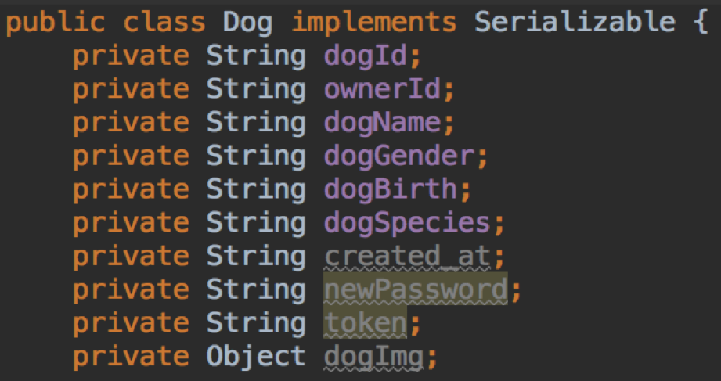

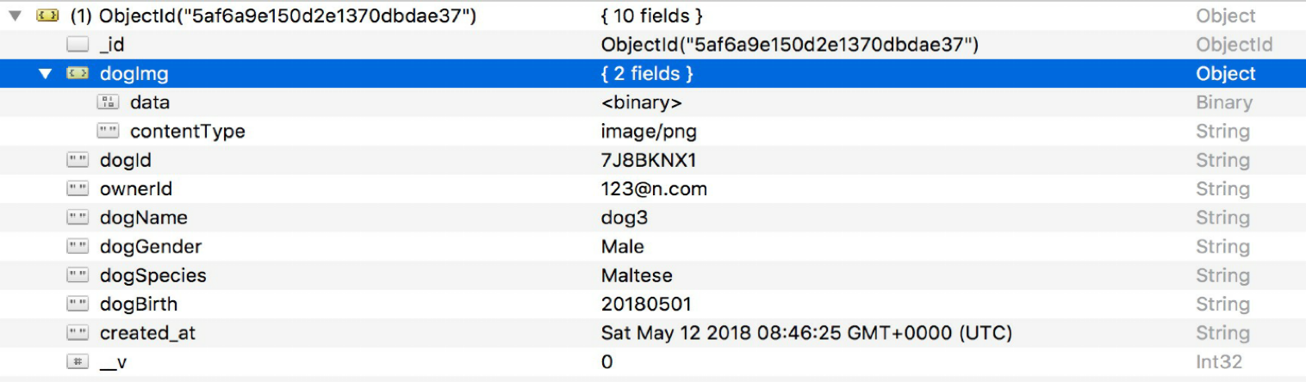
Schedule & Progress – Kim Chan Il (Android)
“Success Uploading Images to Local Server”
7
Notes:
This is the UI Deisign we did last week.
Using this, Chan il Kim applied this into Android Studio.

Slide 8
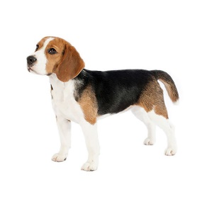

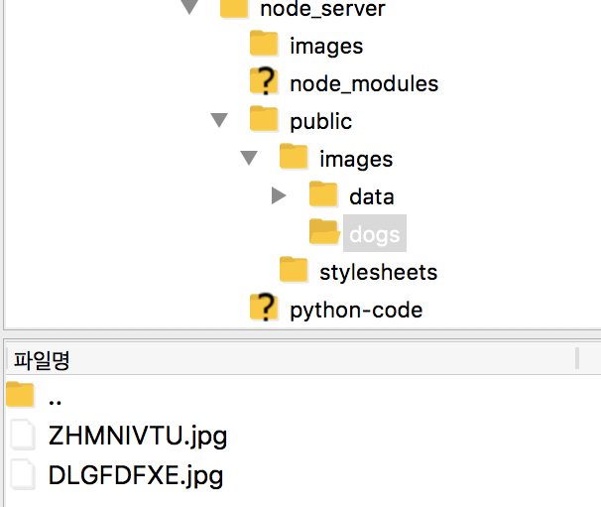
Schedule & Progress – Kim Chan Il (Android)
“Uploading Dog Image and Dog’s nose Image in Database”
Images/upload
POST
8
Notes:
This is the UI Deisign we did last week.
Using this, Chan il Kim applied this into Android Studio.

Slide 9
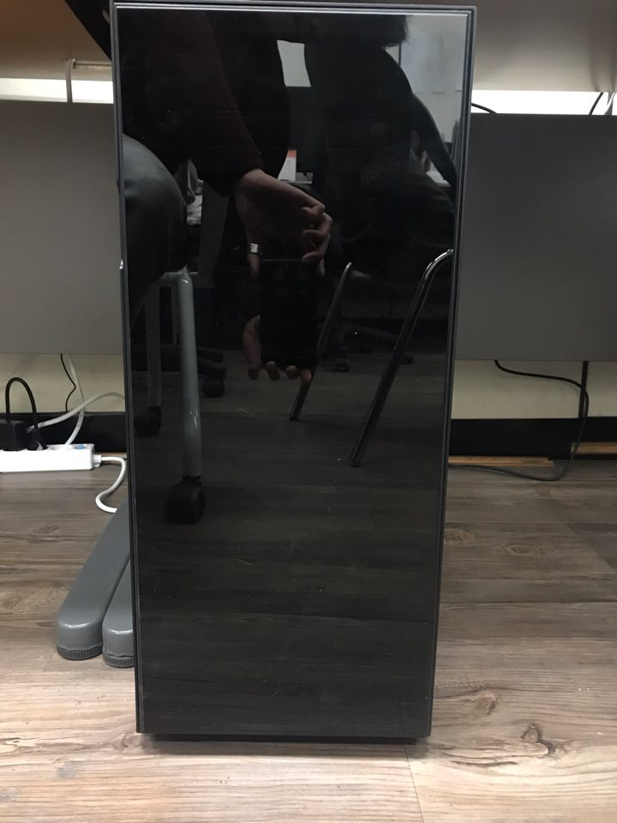

Schedule & Progress – Kim Tae Hong (Server)
“We Bought a Server Computer for Maintaining our Datas”
Expired Soon!
9
Notes:
Left one is the simple python code for testing
Right one is the return value that came from the python code. We get the string through the server using nodejs.

Slide 10

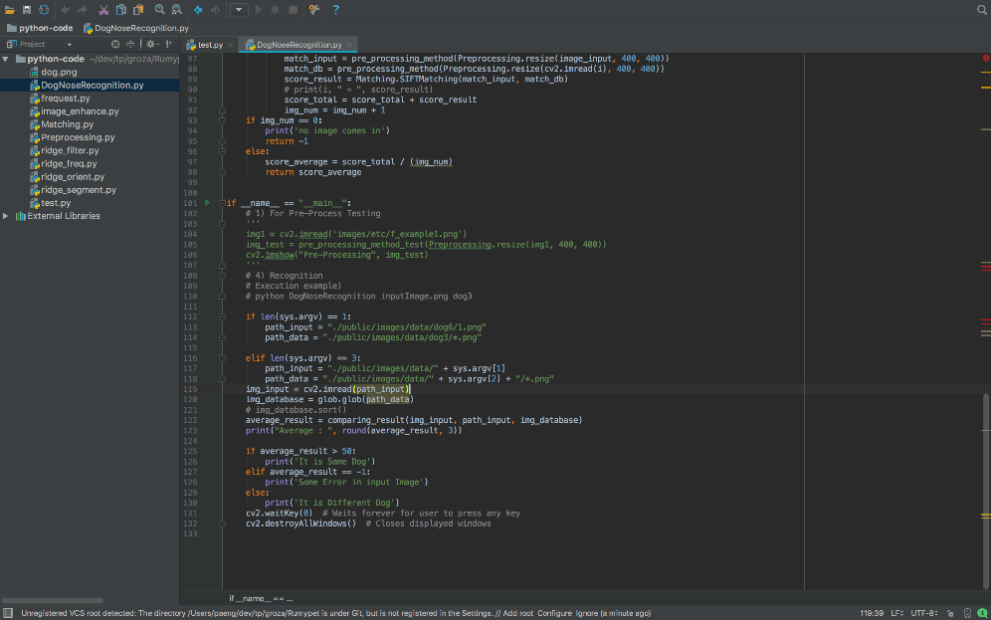

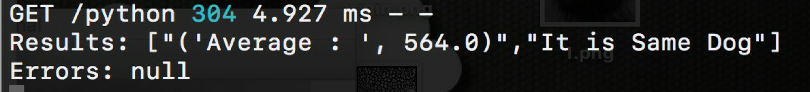
Schedule & Progress – Kim Tae Hong (Server)
“Python code succeeded in connecting to server”
Put A as one of the data in B and set the environment variables to A and B and then
connect to http://ec2-13-209-70-175.apnortheast-2.compute.amazonaws.com:8080/python
Returns the value. ( A is a image needed matching. B is data set in DB.)
10
Notes:
Left one is the simple python code for testing
Right one is the return value that came from the python code. We get the string through the server using nodejs.

Slide 11
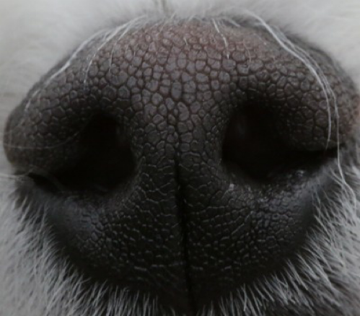
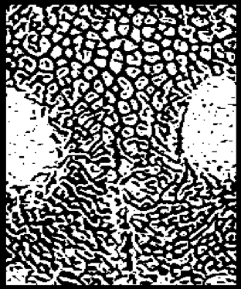
Schedule & Progress – Paeng Jin Wook (Python)
“Cut the image from the center to 7/8 in Height and to 3/4 in width.”
Then do another preprocessing.
This could further reduce the speed of execution.
11

Slide 12
Schedule & Progress – Paeng Jin Wook (Python)
“We applied a gabor filter that adjusts the threshold value considering the possibility that the result will vary depending on the surrounding environment (light, color, etc.) when shooting the camera.”
12

Slide 13
2. PROBLEMS & SOLUTION

Slide 14
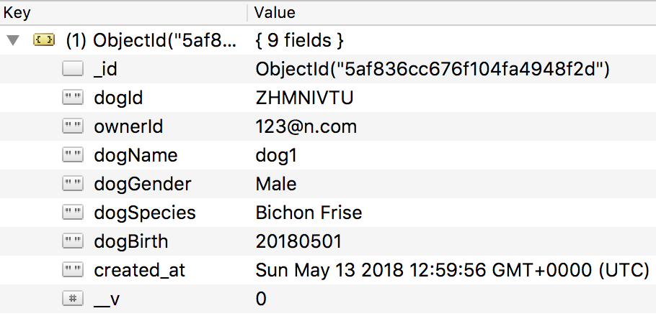
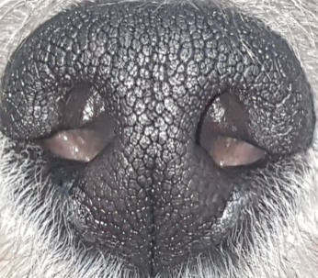


PROBLEMS & SOLUTIONS
Problem 1
When we upload a image in MongoDB as a column, We had some Problem...
Input Image
14
Notes:
--ppt reading--
Now, we have our own server!

Slide 15
PROBLEMS & SOLUTIONS
Solution 1
We Save it at the local path of the server so that we can later also use it in a python code.
Input Image
15
Notes:
--ppt reading--
Now, we have our own server!

Slide 16

3. PLANS

Slide 17
PLANS for next week
Week 12 | Android : Complete the detail function. (Edit Profile, etc...) Server : Divide the mode of the function in server. Python : Code refactoring and enhance the performance.
17
Notes:
ppt reading

Slide 18

Q&A

Slide 19
Thank you!

