Slide 1
Check this link to view the staging site:
https://www.jeromelalunio.tech/annie_client/

Slide 2
Annie: Anime Assistant Deep Learning AI

Slide 3
Purpose and description.
Annie is an Artificial Intelligence Virtual Assistant specifically made for anime fans.
This is meant to be a “Quality of life improvement” for anime fans.
Main reasons why we choose this project.
  Virtual Assistants are currently in demand.
  Anime is gaining more popularity. [Add surveys and data]

Slide 4
Purpose and description.
Features
  Reverse image search Anime recognition system.
  Anime recommendations.
  Anime Calendar.
  Kanji, hiragana and katakana Quiz.
  Discord Integration.
  MyAnimeList Integration.

Slide 5
Scope and limitation
Due to differences in image resolutions it will be near impossible to reach 100% similarity with the reverse image search.
The bot will struggle to recognize images that are edited, cropped, filtered or has really low resolution.
The kanji-kana quiz will only be a character recognition quiz and not a comprehensive language course.
The schedules will be synced with Japan release dates which may not be the same with international release dates since many international streaming sites have different release dates.

Slide 6
Objectives
To help anime fans recognize anime shows by analyzing screenshots of it through computer vision.
To help anime fans to find anime series that they love or to discover series they might enjoy through recommendations using data analysis.
To provide a calendar for seasonal animes that the users want to watch.
Help anime fans to learn more about kanji, hiragana and katakana.

Slide 7












Description of technologies.
(development)
Backend
  Python
  Typescript
  Nodejs
  PostGreSQL
Version control
  Version control system
    Git
  Remote repository
    Github
Frontend
    Web client
      Typescript
      Scss
    Android/IOS client
      Flutter
      Dart
    Windows Client
      C#
      .net Framework
    Linux Client
      Electron

Slide 8



Description of technologies.
(deployment)
Deployment
  Machine learning models, api and database: Microsoft Azure B1ls instance
  Discord Bot: Replit
  Webapp: Github Pages

Slide 9
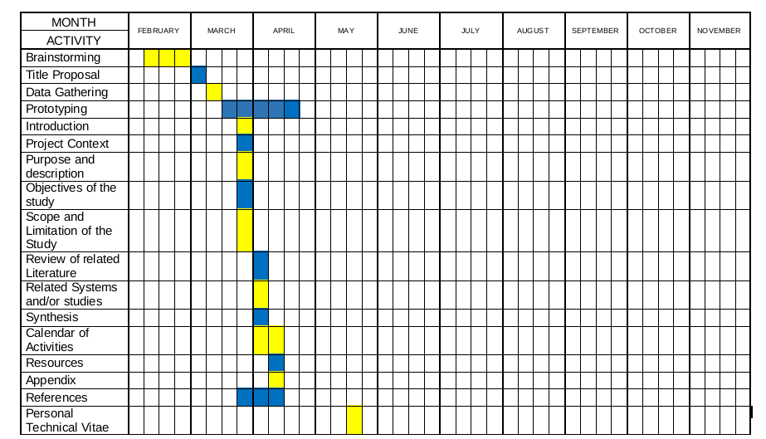
Gantt Chart of activities

