Slide 1

Annie: Anime Fan Assistant App
Members:
Jose Jerome V. Lalunio
Gerald A. Corpus
John Wendel L. Estrella

Slide 2

Purpose and description.
Annie is a Virtual Assistant App specifically made for anime fans.
This is meant to be a “Quality of life improvement” for anime fans.
Main reasons why we choose this project.
Virtual Assistants are currently in demand.
Anime is gaining more popularity.

Slide 3
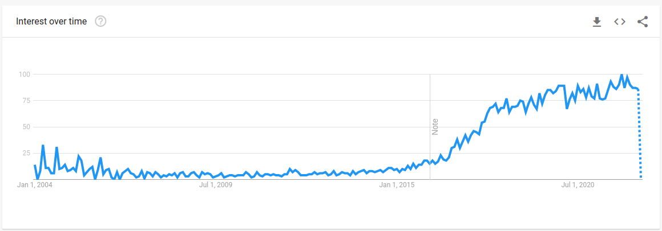

Interest overtime for Artificial Intelligence https://trends.google.com/trends/explore?date=all&q=artificial%20intelligence%20machine%20learning

Slide 4
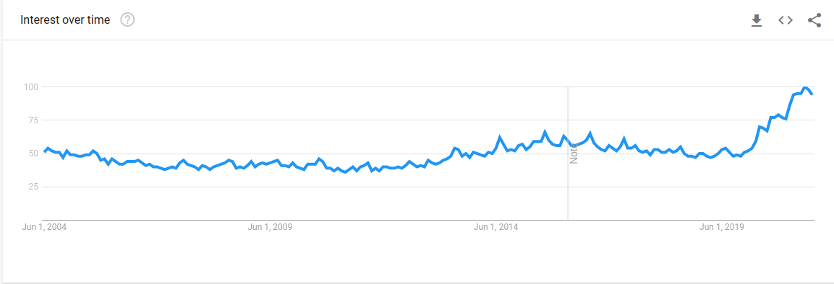
Interest overtime for Anime https://trends.google.com/trends/explore?date=today%205-y&q=anime

Slide 5
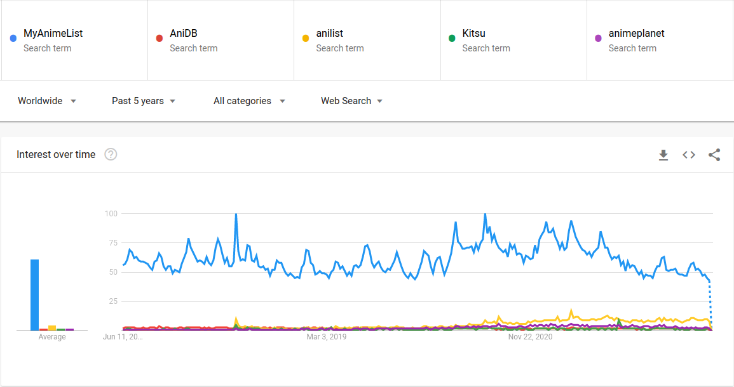

Slide 6








database
intention recognition model
Anime title recognition model(text)
discord bot
desktop client
Mobile App
web client
User

Slide 7
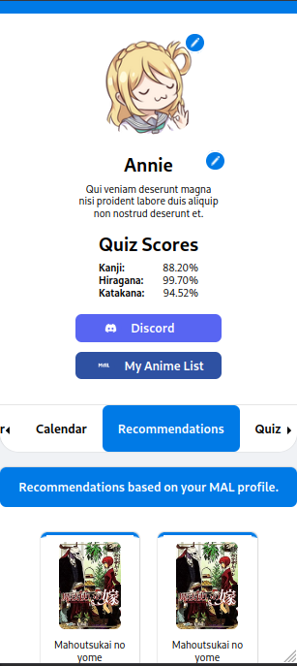
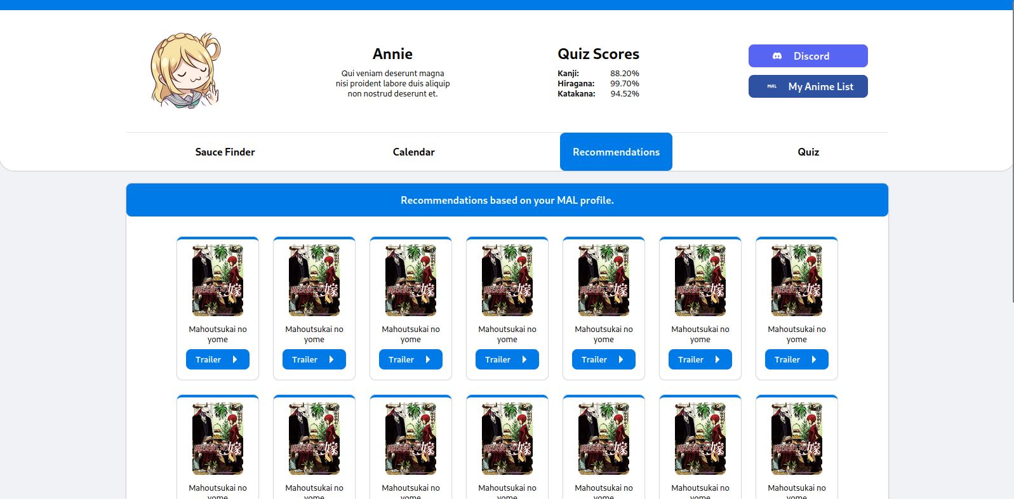
(not the final design) Sample of how the desktop and mobile and web clients would look like.

Slide 8
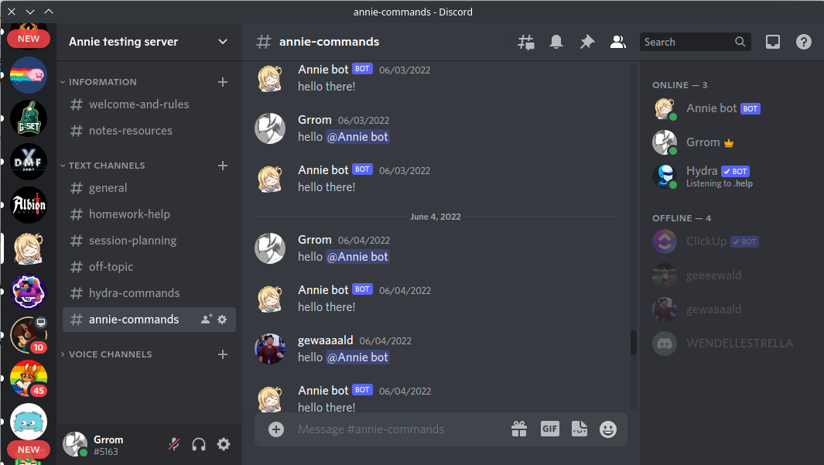
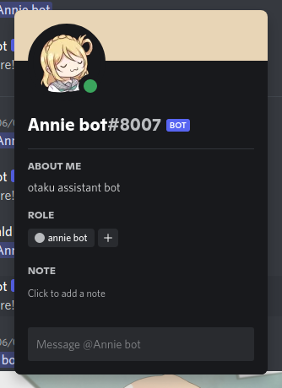
How the discord bot would look like.

Slide 9

Purpose and description.
Features
Reverse image search Anime recognition system.
Anime recommendations.
Anime Calendar.
Kanji, hiragana and katakana Quiz.
Discord Integration.
MyAnimeList Integration.

Slide 10
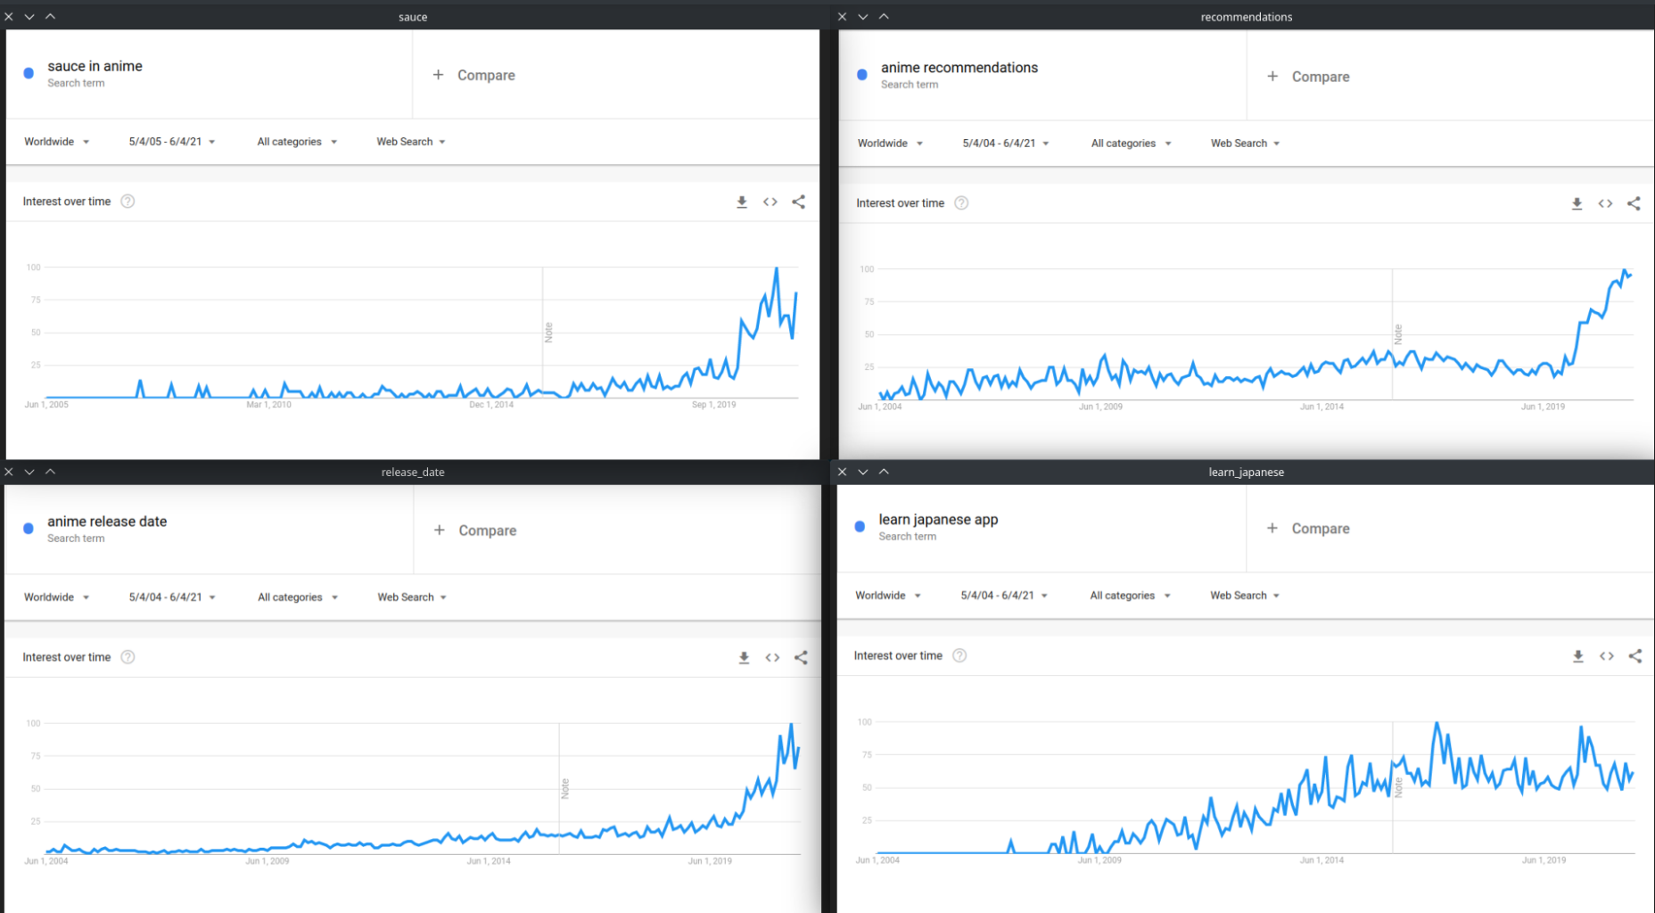

Slide 11

Scope and limitation
The proponents will train two supervised text classification models, an Anime title recognition model and an intention recognition model.
The data-sets for the Anime title recognition model will be a list of Anime titles and their alternative titles and will be collected from MyAnimeList.net.
The data-sets for the intention recognition model will be lists of phrases that users would normally use to interact with Annie and these phrases will be collected through an online survey.
The machine learning models that the proponents will develop will use a standard feed-forward approach with two hidden layers. The proponents will use NLTK to prepare the data and TensorFlow to train the models.
The system will have a genre classification feature and will use Multinomial Naive Bayes Algorithm to identify anime genres included in texts.

Slide 12
Scope and limitation
Due to differences in image resolutions it will be near impossible to reach 100% similarity with the reverse image search.
The bot will struggle to recognize images that are edited, cropped, filtered or has really low resolution.
The kanji-kana quiz will only be a character recognition quiz and not a comprehensive language course.
The kanji quiz will only include single kanji characters with on’yomi readings and up-to N3 level difficulty.
The schedules will be synced with Japan release dates which may not be the same with international release dates since many international streaming sites have different release dates.
The text recognition models will struggle to recognize inputs that have typographical errors.
Anime recommendation and Anime calendar feature will be limited for users that don’t link their MyAnimeList accounts.

Slide 13
Objectives
To help Anime fans recognize anime shows by analyzing screenshots of it.
To help anime fans to find Anime series that they love or to discover series they might enjoy through recommendations.
To provide a calendar for seasonal Animes that the users want to watch.
Help Anime fans to familiarize themselves with kanji, hiragana and katakana.

Slide 14













Description of technologies. (development)
Backend
Python
Typescript
Nodejs
PostGreSQL
TensorFlow
Version control
Version control system
Git
Remote repository
Github
Frontend
Web client
Typescript
Scss
Android/IOS client
Flutter
Dart
Windows Client
C#
.net Framework
Linux Client
Electron

Slide 15



Description of technologies. (deployment)
Deployment
Machine learning models, api and database: Microsoft Azure B1ls instance
Discord Bot: Replit
Webapp: Github Pages

Slide 16
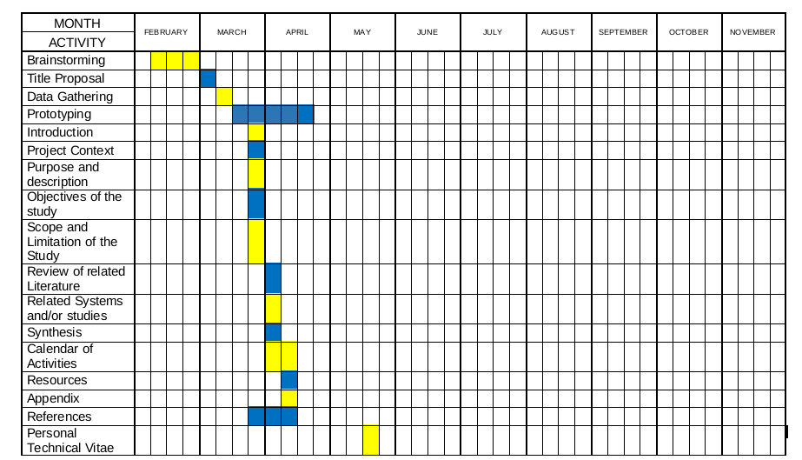
Gantt Chart of activities

