Slide 1

Annie: Anime Fan Assistant App

Slide 2





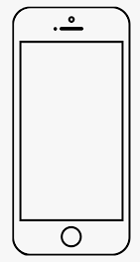


database
Anime title recognition model(text)
intention recognition model
discord bot
desktop client
web client
Mobile App
User

Slide 3
Genre Classification
(ranking genres by frequency)
Anime Recommendation
Kanji-Kana Quiz
Calendar Scheduler
Image Recognition API calls
MyAnimeList API calls

Slide 4
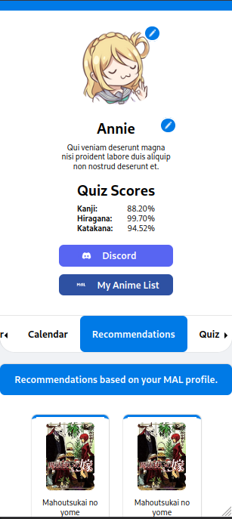
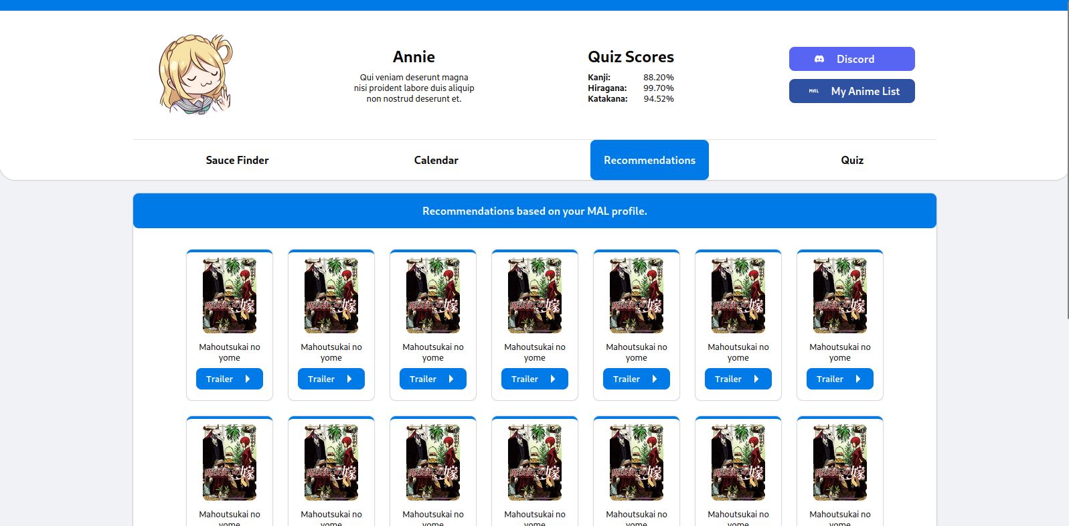
(not the final design) Sample of how the desktop, mobile and web clients would look like.

Slide 5
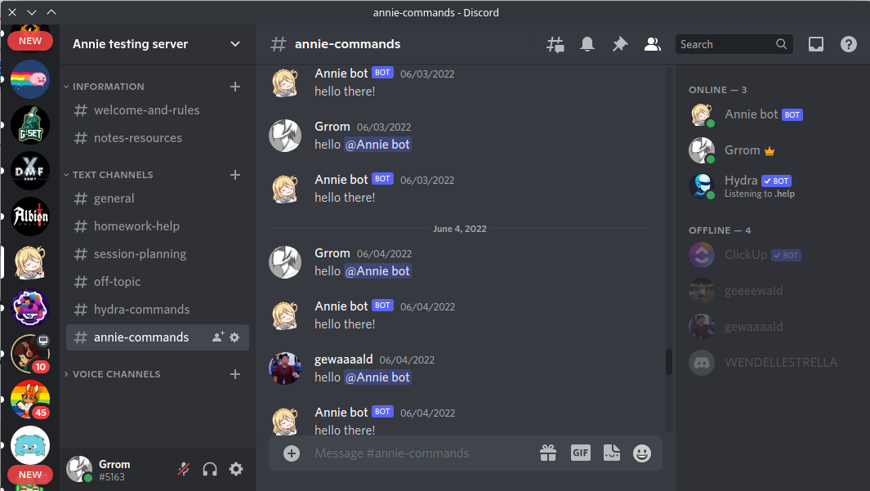
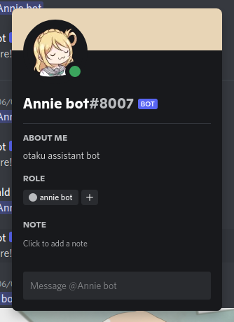
How the discord bot would look like.

Slide 6

Scope and limitation
The proponents will train two supervised text classification models, an Anime title recognition model and an intention recognition model.
The data-sets for the Anime title recognition model will be a list of Anime titles and their alternative titles and will be collected from MyAnimeList.net.
The data-sets for the intention recognition model will be lists of phrases that users would normally use to interact with Annie and these phrases will be collected through an online survey.
The machine learning models that the proponents will develop will use a standard feed-forward approach with two hidden layers. The proponents will use NLTK to prepare the data and TensorFlow to train the models.
The system will have a genre classification feature and will use Multinomial Naive Bayes Algorithm to classify and rank genres from the user’s watch history based on frequency.

Slide 7
Scope and limitation
The kanji quiz will only include single kanji characters with on’yomi readings and up-to N3 level difficulty.
Anime recommendation and Anime calendar feature will be limited for users that don’t link their MyAnimeList accounts.

