Slide 1
Retro Arcade
Nathan F, Nathan L

Slide 2
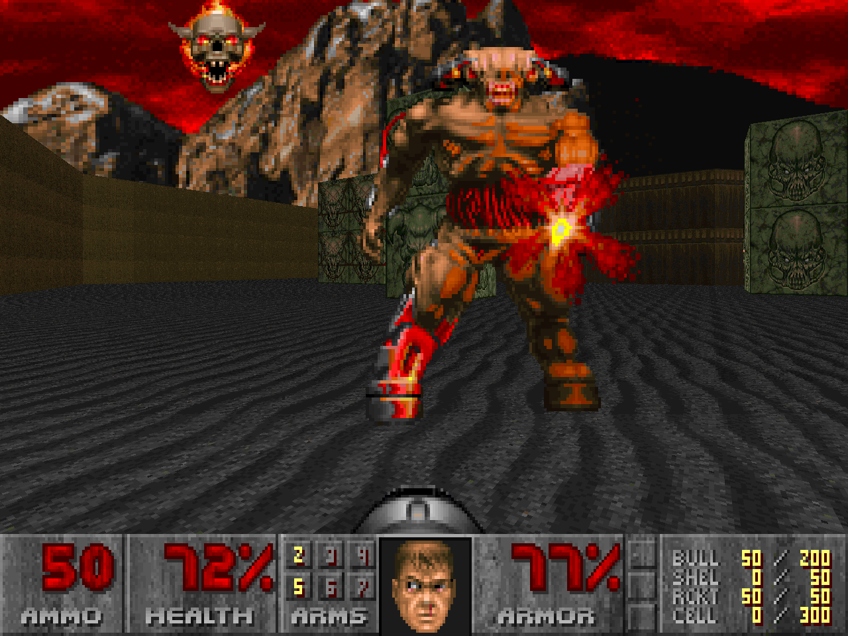
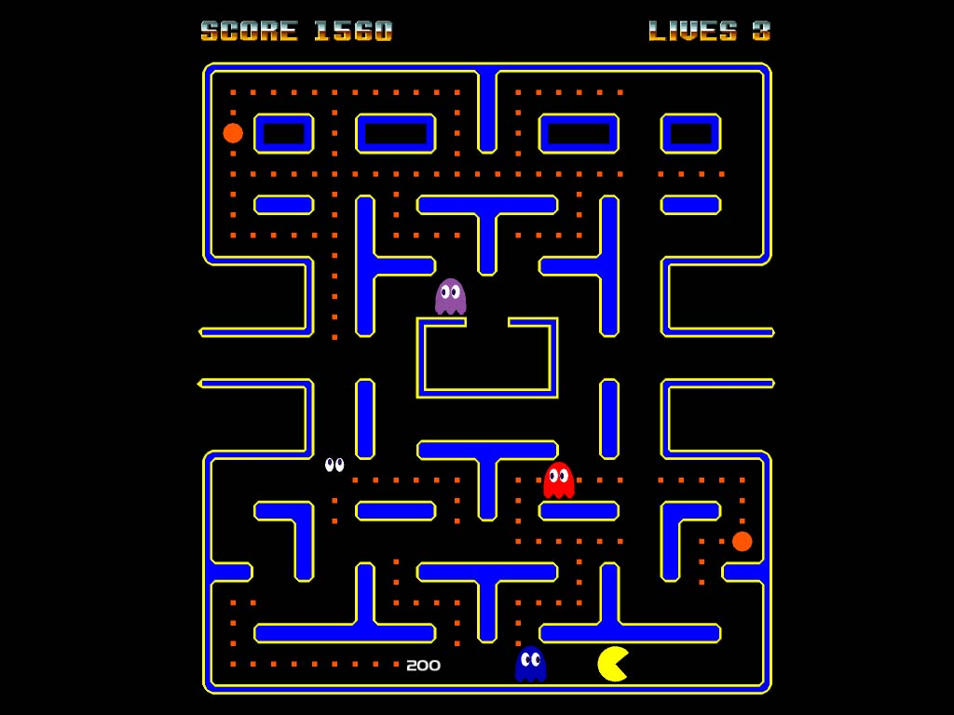
Objective
Build a small retro arcade to play old games
Learn about integration between raspberry pi and potentially Arduino to be able to use button and joystick controllers

Slide 3
Materials
1x Raspberry Pi with Retro pie installed
1x SD card (16GB)
1x Arudino
8x buttons
1 joystick
1x tiny screen (480 or 720 p)
various cables preferably male to female cables
A power supply strong enough to power everything

Slide 4
Links for extra materials
https://www.amazon.com/Case-Official-Raspberry-Touchscreen-Display/dp/B01HV97F64/ref=sr_1_4?s=pc&ie=UTF8&qid=1515616875&sr=1-4&keywords=raspberry+pi+monitor
https://www.amazon.com/WGCD-Button-Microswitch-Jamma-Mame-Arcade/dp/B072R1H185/ref=pd_sbs_200_1?_encoding=UTF8&pd_rd_i=B072R1H185&pd_rd_r=KBSS1CBS2CQ4DVPM13YR&pd_rd_w=IdnCj&pd_rd_wg=lNd7Y&psc=1&refRID=KBSS1CBS2CQ4DVPM13YR

Slide 5
Milestones
Feb 1: working with retropi, ensuring all of the libraries are set up with games running
Feb 15: Having working controllers either using Arduino or other meathod (not in game)
Feb 28: Debug controllers (not in game)
March 1: Begin mapping controllers in games
March 15: Build a case to hold the Arduino and buttons while also supporting the screen.

Slide 6
Milestones continued
March 30: Map a layout for the inside of the box
April 4: Put the components into the box with power
April 15: Debug the whole thing while it is together to see if there are any conflicts within the system
April 30: Be done and ready to present
All milestones are subject to modification depending on what happens during the process*

