Slide 1
Retro Arcade
Nathan F, Nathan L

Slide 2
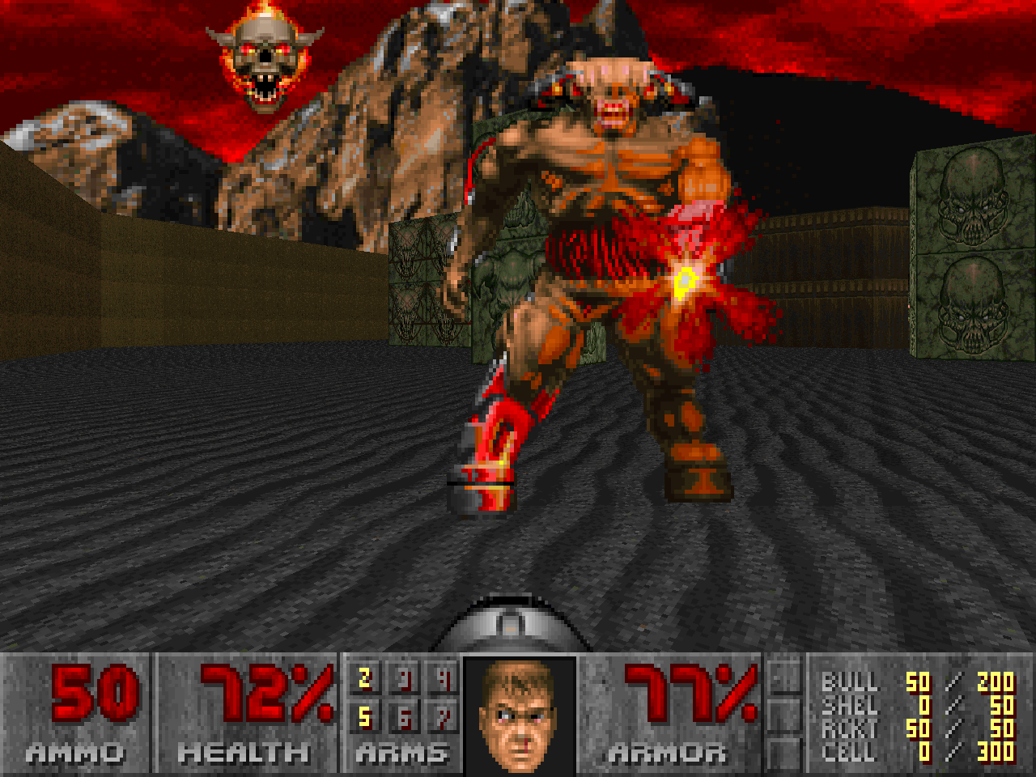
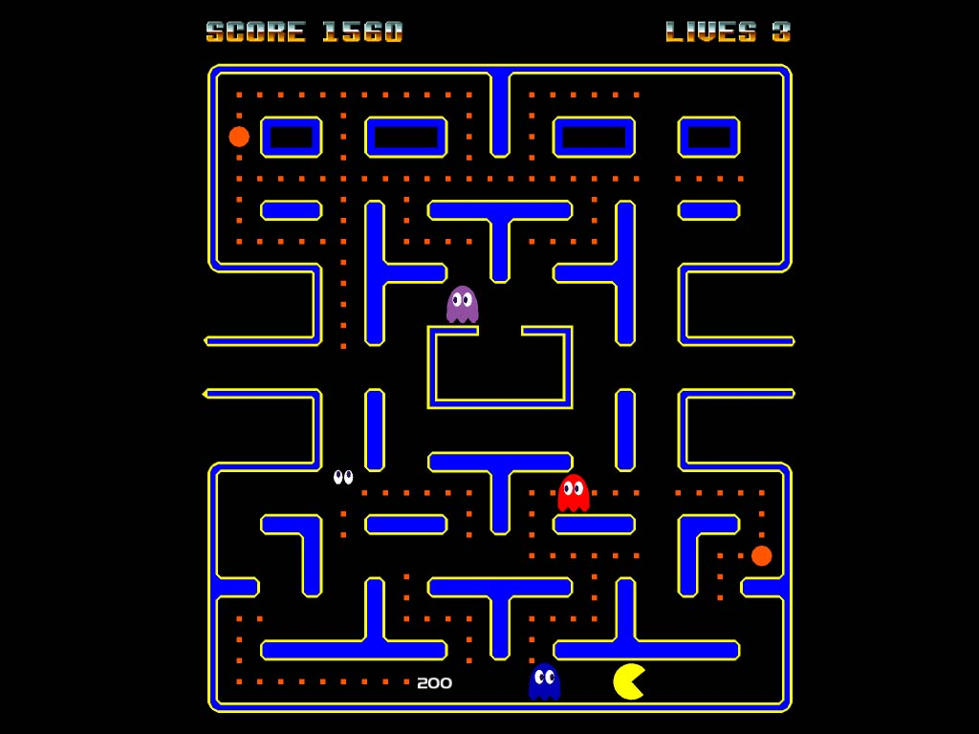
Objective
Build a small retro arcade to play old games
Learn about integration between raspberry pi and potentially Arduino libraries using button and joystick controllers

Slide 3
Materials
1x Raspberry Pi with Retro pie installed
1x SD card (16GB)
1x Arudino
8x buttons
1 joystick
1x tiny screen (480 or 720 p)
various cables preferably male to female cables
A surge protector or physical outlet (make sure to check if the devices are compatible with 120 or 240 volts or various other plug configurations)

Slide 4
Links for extra materials
https://www.amazon.com/Case-Official-Raspberry-Touchscreen-Display/dp/B01HV97F64/ref=sr_1_4?s=pc&ie=UTF8&qid=1515616875&sr=1-4&keywords=raspberry+pi+monitor
https://www.amazon.com/WGCD-Button-Microswitch-Jamma-Mame-Arcade/dp/B072R1H185/ref=pd_sbs_200_1?_encoding=UTF8&pd_rd_i=B072R1H185&pd_rd_r=KBSS1CBS2CQ4DVPM13YR&pd_rd_w=IdnCj&pd_rd_wg=lNd7Y&psc=1&refRID=KBSS1CBS2CQ4DVPM13YR

Slide 5
Milestones
Feb 1: working with retropie, ensuring all of the libraries are set up with roms or games running from a external hard drive
Feb 15: configuring the controllers to communicate between raspberry pi and Arduino
Feb 28: continue working with the controllers to ensure that they are working properly.
March 1: begin to map the controls to the buttons from the controllers
March 15: using spare parts build a box or something like that to hold the parts

Slide 6
Milestones continued
March 30: map a layout for the inside of the box
April 4: being to put the components into the box and wire them to a central power unit
April 15: being running tests on various components to ensure they work and debug if necessary
April 30: finalize the project be ready to present
All milestones are subject to modification depending on what happens during the process*

