Slide 1
Procedural Mesh Generation
Christopher Eicher
Jason Murray
12/6/17

Slide 2

Procedural Mesh Generation
Fun pictures
Code Conventions
Math
Make Money!
Get bought out

Slide 3
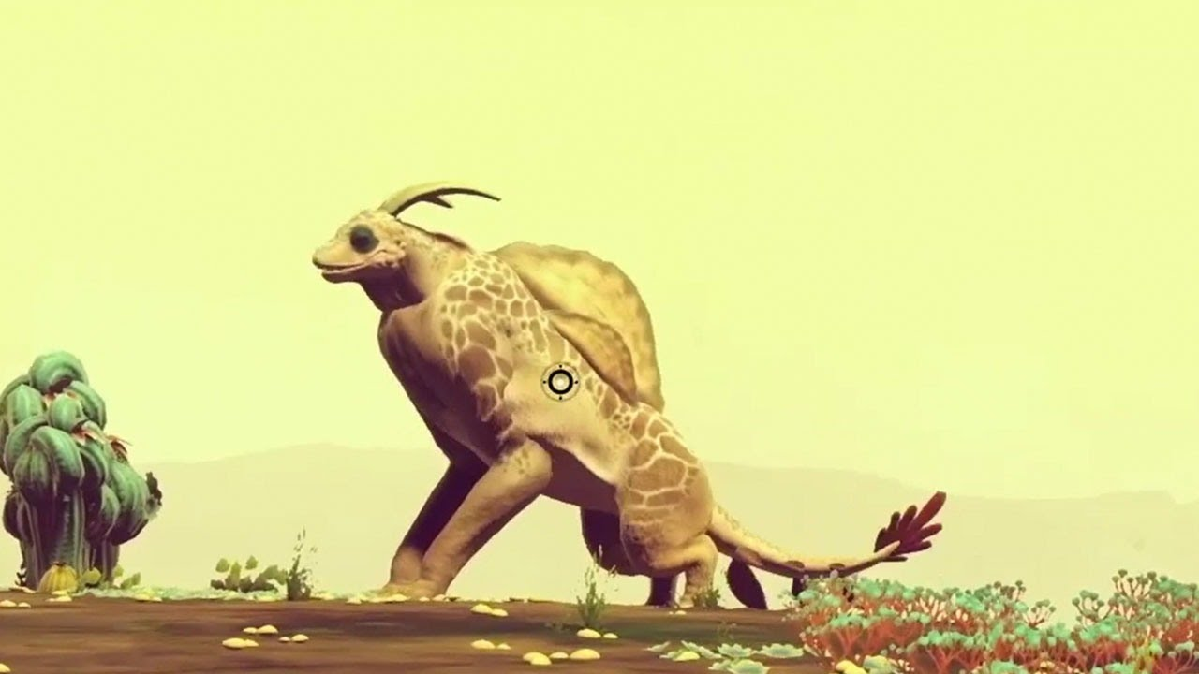
Lego block approach only gets you so far
Lets make better bricks
Notes:
We want to do more than make content that looks like mashed together parts

Slide 4
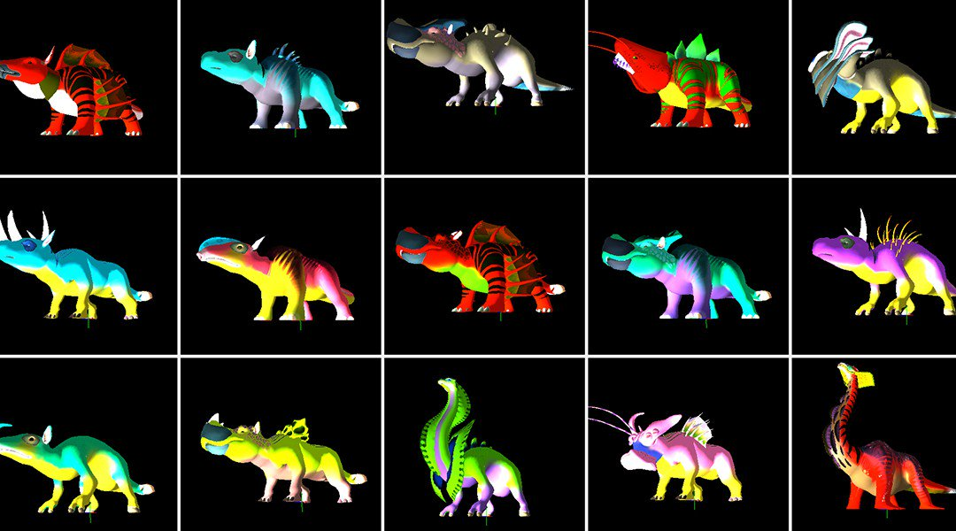
We are good at seeing patterns

Slide 5
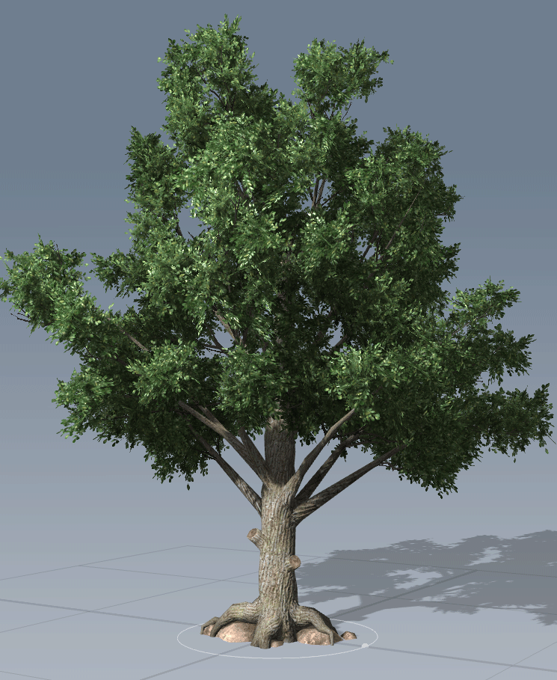
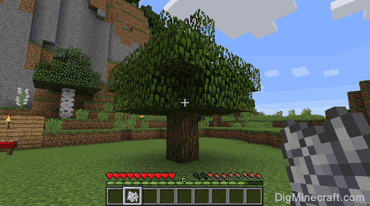
Procedural content generation ≠ blended copy-paste
We can do better
Notes:
We want to do more than make content that looks like mashed together parts

Slide 6
Why Procedural Mesh Genration
More uniquness

Slide 7
Procedural mesh generation can add that final touch
There are many New Slide drop down versions
Section (optional footer)

Slide 8
Conventions I will assume
for (int i = 0; i < iterations; i++)
{
// [0,1] increasing
float t = (float)i / iterations;
// compliment of t, [0,1] decreasing
float tc = 1 - t;
}
Notes:
We want to do more than make content that looks like mashed together parts

Slide 9
Linear Transformation Refresher
vec3 pos = vec3(0, 0, 0);
vec3 dir = vec3(0, 1, 0);
vec3 scale = vec3(1, 1, 1);
/* Translate <- Rotate <- Scale */
mat4x4 trans =
Trans(pos) *
Quaternion.LookAt(dir, vec3(0, 1, 0)) *
Scale(scale);

Slide 10
Mesh Structure
Std::vector<vec3> verts;
Std:;vector

Slide 11
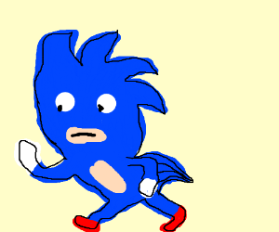
Lets make rings!
void MakeRing(mat4x4 localToModel, int subdivisions, ...)
{
for (int i = 0; i < subdivisions; i++)
{
float r = t * 2 * PI; // radians
vec4 vert = vec4(cos(r), sin(r), 0, 1);
verts.push_back(localToModel * vert);
uvs.push_back(vec2(t, v));
}
}

Slide 12
Lets make Bands
int topEdge = 100;
int bottomEdge = 200;
100 + 1
100
200 + 1
200

Slide 13
Lets make Bands
int AddBand(int topEdge, int bottomEdge, int numVerts) {...}
topEdge + i + 1
topEdge + i
bottomEdge + i + 1
bottomEdge + i

Slide 14
DUMMY
There are many New Slide drop down versions
Section (optional footer)
Indented Content (optional footer)
Content (optional footer)
Split Content (optional footer)
Blank page (optional footer)
Note: You can always hide the footer
Click on a blank part of the background
Right click and choose “Format Background”
Check the “Hide Background” checkbox

Slide 15
DUMMY
There are many New Slide drop down versions
Section (optional footer)
Indented Content (optional footer)
Content (optional footer)
Split Content (optional footer)
Blank page (optional footer)
Note: You can always hide the footer
Click on a blank part of the background
Right click and choose “Format Background”
Check the “Hide Background” checkbox

Slide 16
“Home->New Slide” drop down has choices
There are many New Slide drop down versions
Section (optional footer)
Indented Content (optional footer)
Content (optional footer)
Split Content (optional footer)
Blank page (optional footer)
Note: You can always hide the footer
Click on a blank part of the background
Right click and choose “Format Background”
Check the “Hide Background” checkbox

Slide 17
Checklist for editing slides
Is the formatting of the slides consistent?
Is the text large enough to read?
Is each slide aesthetically pleasing?
Is there too much stuff on each slide?
Is there anything annoying that should be removed?
Is there enough interesting stuff?
Are the slides adding value?

Slide 18


Get rid of noise, decoration, and chart junk
The title should explain the point of the slide
Candidate Applications
The number of candidates dropped
over the last six years
Candidate Applications Per Year
500
456
400
385
300
Applications
200
155
100
94
1985
1990
1995
2000
2005
1985
1993
1998
2008
23

Slide 19
Make your PowerPoints better
Use less ink
No chart junk
No gifs
No crowding
No walls of text
No decoration/background
Use one highlight color
Sentences as titles – So What?
Allow your slides to breathe
Fewer bullets or no bullets
Text appears as you talk about it
Interesting and relevant images
Aesthetically balance your slides
Consistency between all slides

Slide 20
Make your Delivery better
Figure out your key message
Practice, practice, practice
Adapt to your audience
Empathize with the audience
Give a performance
Involve the audience
Show up early and test
Extinguish idiosyncrasies
Use repetition to make it stick
Be a storyteller
Vary your pacing and pitch
Show your excitement
End strong – stick the landing
Tell them what to remember

Slide 21
Questions/Comments

