Slide 1
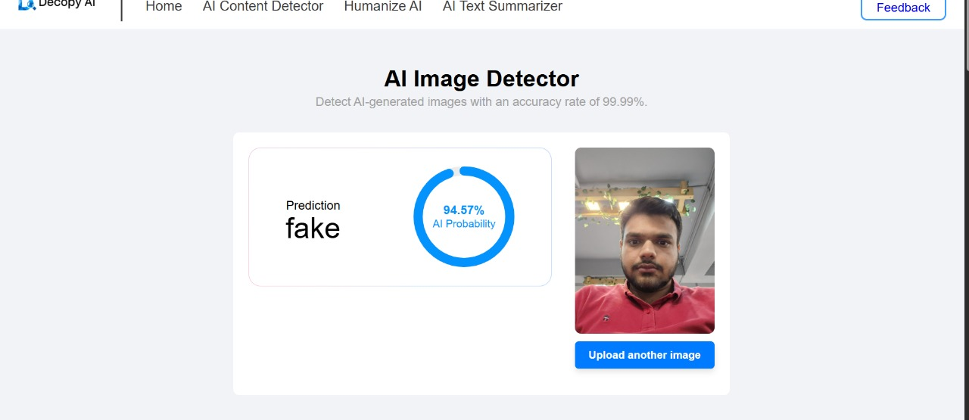
https://decopy.ai/ai-image-detector/
decopy.ai-images

Slide 2
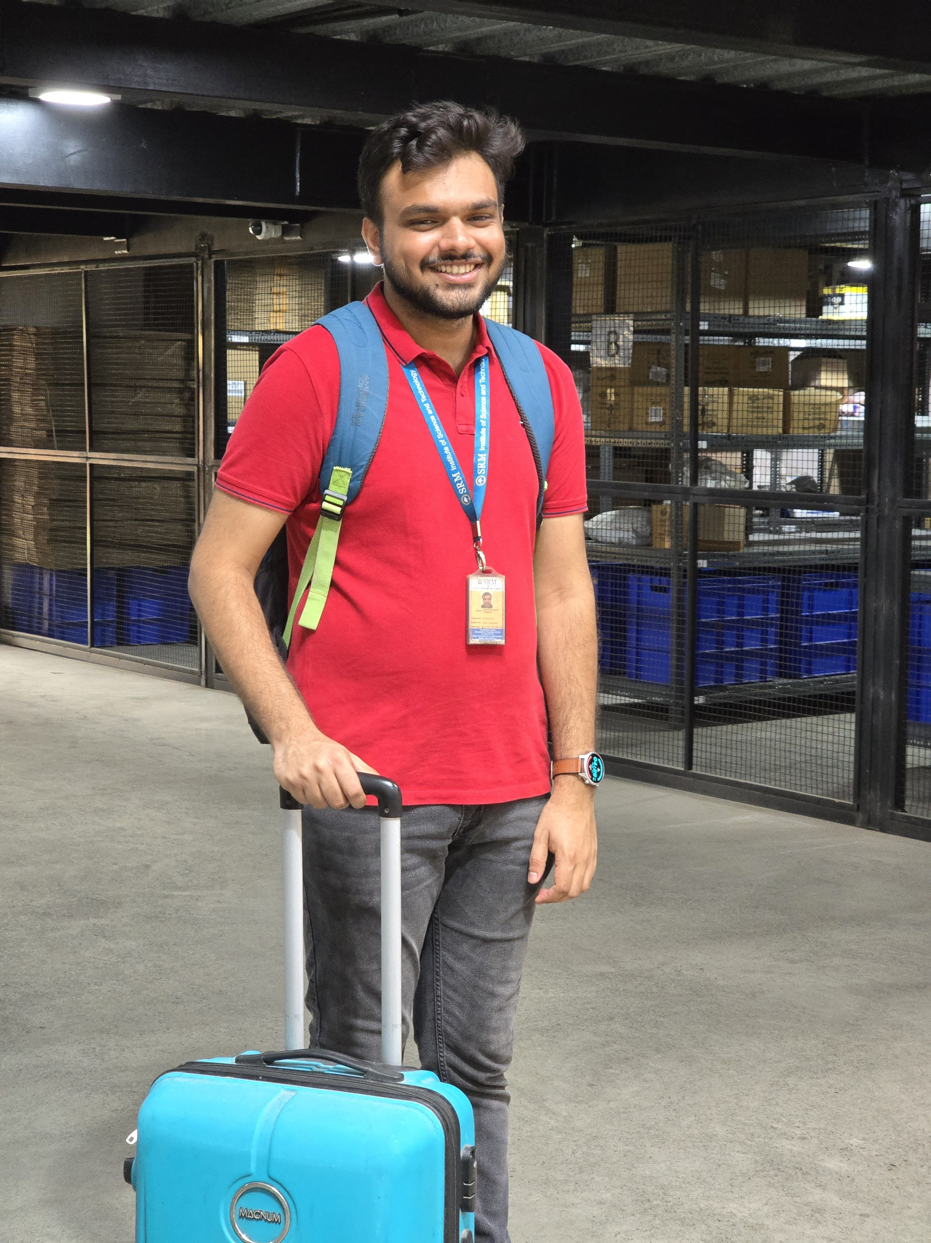
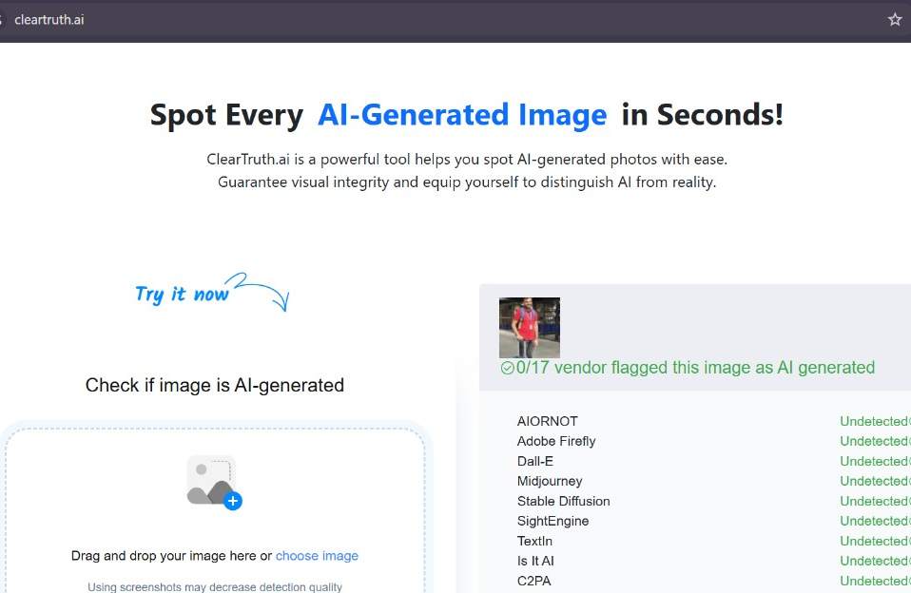
Cleartruth.ai-images https://cleartruth.ai/

Slide 3
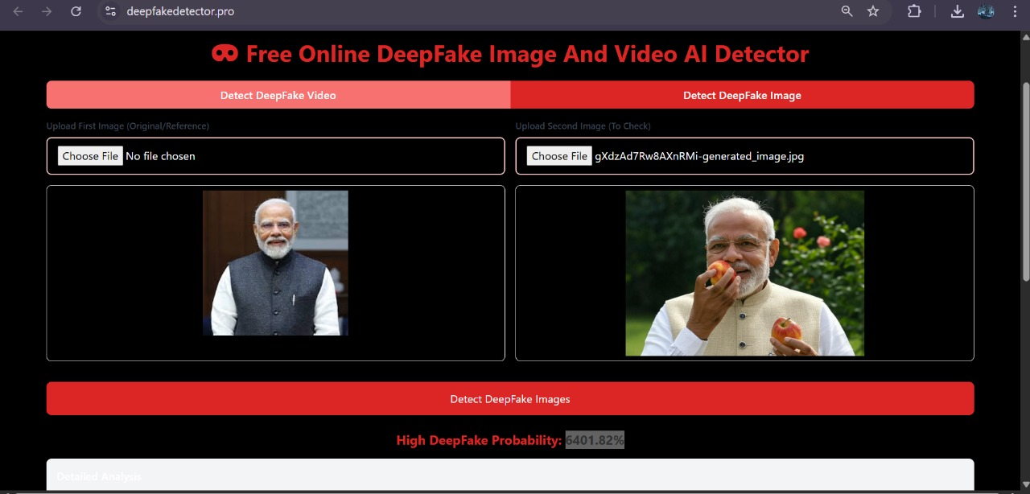
Deepfakedetector.pro-images and videos https://deepfakedetector.pro/

Slide 4
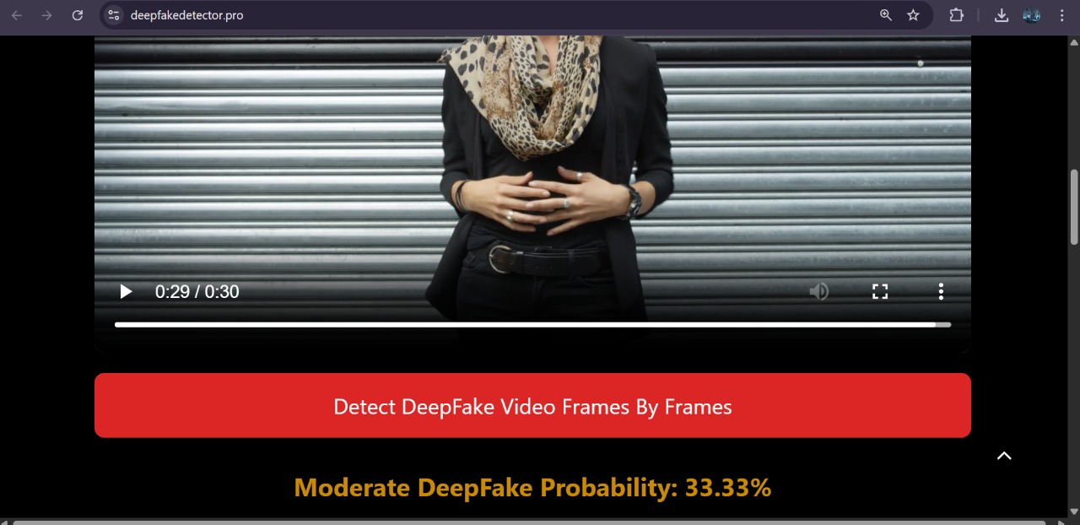

Slide 5
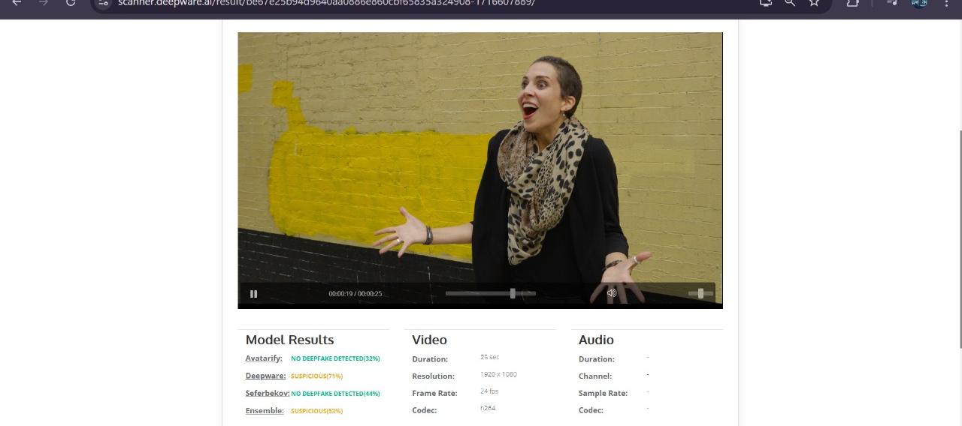
Deepware.ai-video https://scanner.deepware.ai/

Slide 6
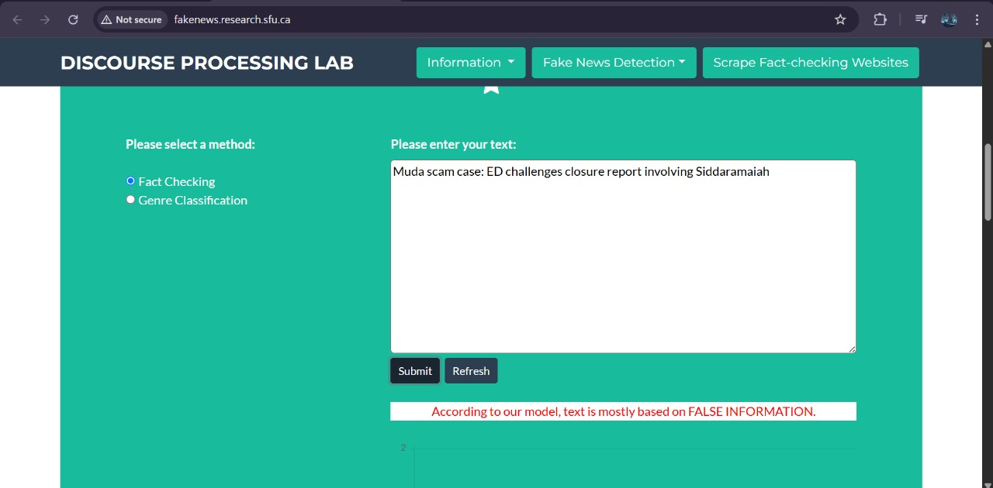
Fakenews.research.sfu.ca-news verification http://fakenews.research.sfu.ca/

