Slide 1

SIR C.R.REDDY COLLEGE OF ENGINEERING
AICTE, Permanently Affiliated to JNTU-KAKINADA accredited by the NBA, NAAC Eluru-534007 2023-2024
FashionGPT
PROJECT GUIDE
G.VIHARI
Asst Professor
PROJECT MEMBERS
1.G.Anusha(20B81A1232)
2.CH. Gruhitha(20B81A1215)
3.K. Venu Gopal(20B81A1263)
4.D.Narayana Reddy(20B81A1222)

Slide 2
Index
Abstract
Introduction
Benefits
Use Cases
Existing System
Disadvantages
Proposed System
Problem Statement
Methodology
Algorithms Usage
System Requirements
Implementation
Conclusion

Slide 3
Abstract
The Fashion GPT project aims to leverage Natural Language Processing (NLP) techniques to generate compelling and fashion-forward for various fashion-related image content. With the ever-growing influence of social media, ecommerce, and digital platforms in the fashion industry, there is a rising demand for engaging and creative textual content to accompany visual elements such as images and videos. The proposed Fashion GPT model utilizes Machine learning techniques, particularly the GPT-2 architecture, to understand and generate contextually relevant and stylistically appealing descriptions for fashion-related items, outfits, and trends. The model is trained on a diverse dataset comprising fashion articles, product descriptions, and user-generated content from reputable sources to ensure a comprehensive understanding of the language used in the fashion domain.

Slide 4
Introduction
Purpose
FashionGPT is an AI-powered fashion responsive system designed to provide personalized style suggestions and fashion advice to users.
Functionality
Using Machine learning algorithms, FashionGPT analyzes user preferences, fashion trends, and style data to generate tailored response for clothing, accessories, and outfits.

Slide 5
Benefits of FashionGPT
Personalized Response
FashionGPT utilizes Machine learning algorithms to analyze user preferences and browsing behavior, allowing it to generate personalized clothing responsive tailored to each individual.
Improved Shopping Experience
By providing accurate and relevant clothing suggestions, FashionGPT enhances the overall shopping experience for customers, making it easier for them to discover new styles and find clothing items that match their unique tastes.

Slide 6
Use Cases of FashionGPT
Fashion Styling
FashionGPT can assist users by providing stylish responsive outfits on clothing combinations, color palettes, and accessories.
Outfit Response
FashionGPT can generate personalized outfit responses based on users preferences, occasion, and current trends.

Slide 7
Existing System
The existing model is designed to understand and generate human-like text responses across a wide range of topics and contexts.
One significant limitation is that it generates only textual data, which affects its capabilities and potential applications.

Slide 8
Disadvantages
Lack of Personalization
The existing fashion responsive system lacks personalization, resulting in generic responses that do not cater to individual preferences and styles.
Limited Product Range
Another disadvantage of the existing system is its limited product range. It often fails to showcase a diverse range of fashion items, limiting the options available to users.
Inaccurate Response
The existing system also suffers from inaccurate response and it provide only textual content.

Slide 9
Proposed System and How to Overcome the Disadvantages
Introducing FashionGPT
FashionGPT is an AI-powered system designed to overcome the limitations of the existing fashion responsive systems.It leverages state-of-the-art natural language processing and machine learning techniques to provide personalized and accurate fashion responsive items.
Overcoming Limitations with FashionGPT
FashionGPT utilizes natural language processing algorithms to understand fashion context and user preferences more effectively.It generates diverse and creative outfit suggestions by learning from a vast dataset of fashion trends and styles.The system is continuously updated with real-time fashion trends, ensuring up-to-date responses.FashionGPT automates the curation process, saving time and improving efficiency.

Slide 10
Redirecting to the web-app
We Develop a Web App using flask that presents the user. The user with a web app and an option to input the text and choose a model from various inference Models that we have trained. On clicking generate Image, the request is processed in the backend in python and a resultant image using the model is created and we hit another flask endpoint where the generated Image is displayed. The following end points have been created in our existing flask application

Slide 11
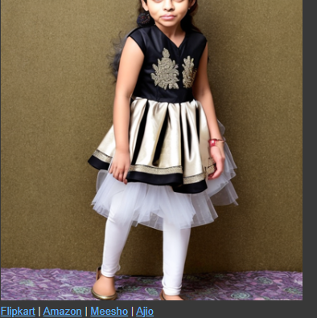
1) Home Route
2) Generate Route
3) Result Route
4) Error Route

Slide 12
Problem Statement
The Fashion GPT project seeks to address this issue by developing a sophisticated NLP model to enhance and streamline the content creation process in the dynamic and ever-evolving landscape of the fashion industry.

Slide 13
Methodology
Module 1-Text Input Module: This module is responsible for processing textual inputs, such as fashion-related queries or prompts, and converting them into a format suitable for the model's input layer. It may involve tokenization, encoding, and embedding of the input text.
Module 2 - Transformer Architecture: The core of the Fashion GPT model is based on a transformer architecture. This module comprises multiple layers of transformers with self-attention mechanisms for capturing textual dependencies and generating coherent fashion-related text.
Module 3 - Decoder Module: In the context of text generation tasks, the decoder module takes the output of the transformer layers and generates sequences of text. It may include techniques like beam search or nucleus sampling to improve the quality and diversity of the generated text.

Slide 14
Module 4 - Fine-tuning Module: To adapt the pre-trained Fashion GPT model to specific fashion-related tasks, a fine-tuning module is used. This module fine-tunes the parameters of the model on a task-specific dataset, adjusting them to better fit the task requirements.
Module 5 - Deployment Module: Once trained and evaluated, the Fashion GPT model needs to be deployed for practical use. This module involves packaging the model into an accessible format, such as an API or a deployable package, and integrating it into fashion-related applications or platforms.

Slide 15
Algorithm
Transformer Architecture: The backbone of Fashion GPT is the transformer architecture, which includes mechanisms like self-attention and multi-head attention. This architecture allows the model to capture long-range dependencies in fashion-related text and generate coherent and contextually relevant responses.

Slide 16
Models
Stabilityai/stable-diffusion-2: GPT-2 model will generate prompts that are then fed into the Stable Diffusion model (StableDiffusionPipeline) for image generation. So, the transformers library is utilized here to generate text prompts which are then used as input for the image generation process.
Hugging Face: Implement machine learning models. Users can upload machine learning models to the platform. There are models for a variety of functions, including natural language processing (NLP), computer vision, image generation and audio.Share and discover machine learning

Slide 17
System Requirements
Software
Technology:Machine Learning
Language:Python
OS: Windows 7 and above
Hardware
RAM: 4GB and above
Storage: 512 SSD (min)

Slide 18
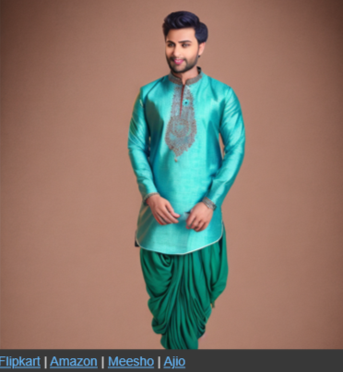
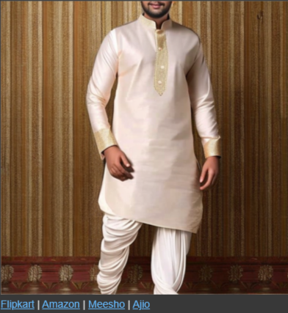
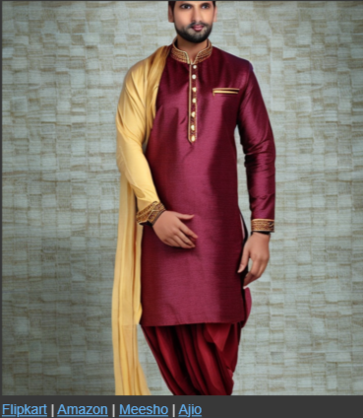
Implementation
Result:

Slide 19
Conclusion
This project enhances visual content creation by generating images related to given text inputs.
The system effectively bridges the gap between textual descriptions and visual representations, offering a seamless and innovative approach to content generation.

Slide 20
THANK YOU

