Slide 1

Prototype
Early validation of patterns/tactics
Validation of quality “performance”
Experimental prototype.
Validation of quality “Safety”:
Exploratory

Slide 2



Evaluation
ATAM or aSQA
2
Iterations
Notes:
ATAM (Architecture Trade-off Analysis Method) is heavy. aSQA (arch. software quality assurance) has iterative focus.
With aSQA. Easier to directly compare different suggstions.
We had two iterations: before and after improvement.

Slide 3
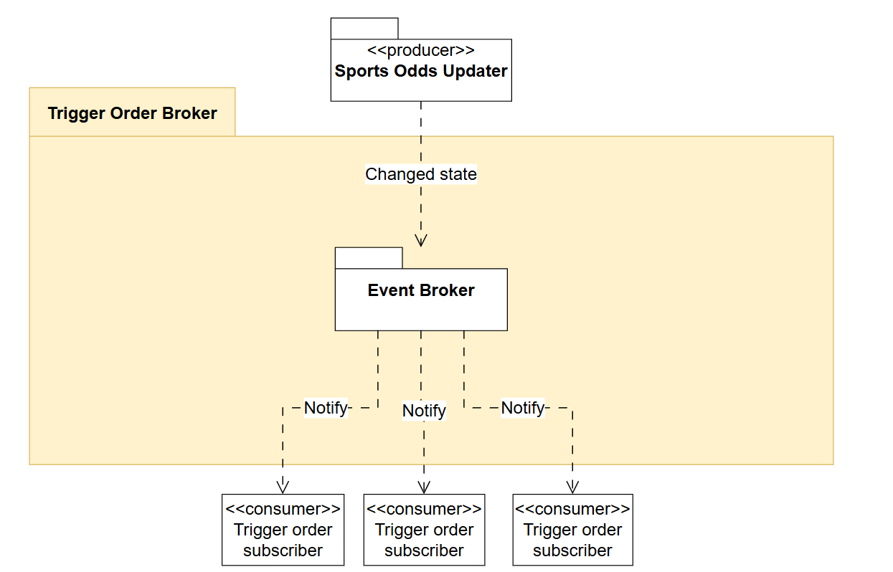
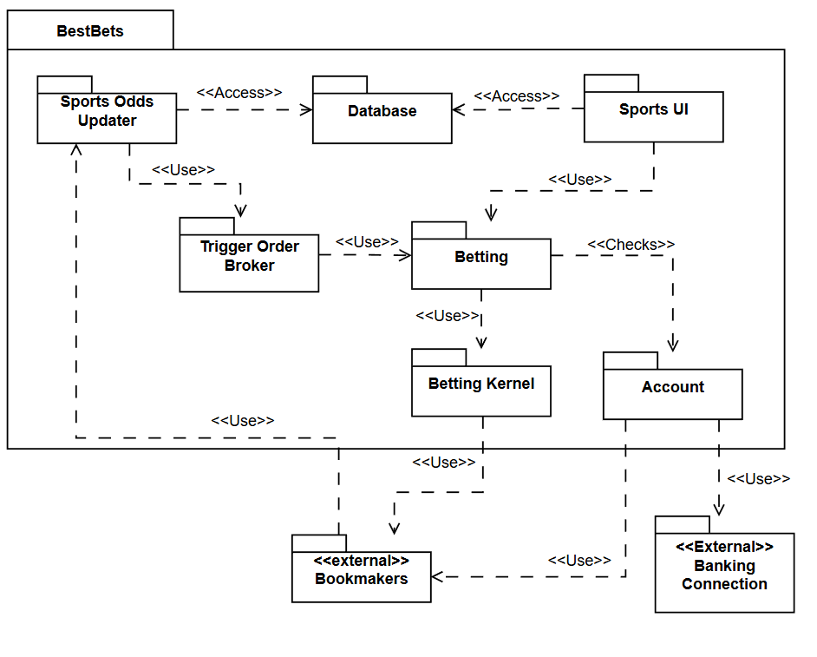
In-depth with 3+1
Notes:
Iterative process making views -> Realized project needs to be fictitious to be dersirable for stakeholders
Interesting to prototype Event Broker -> Is in backlog
Monolithic structure

Slide 4
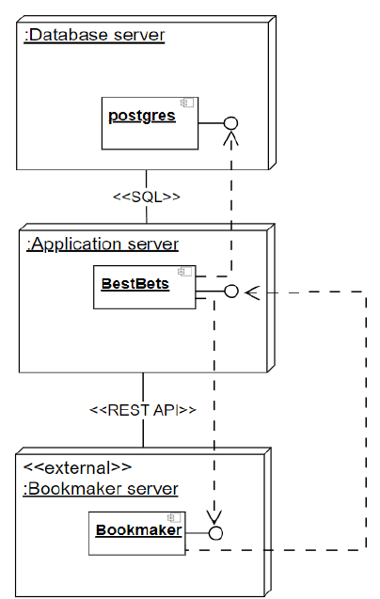

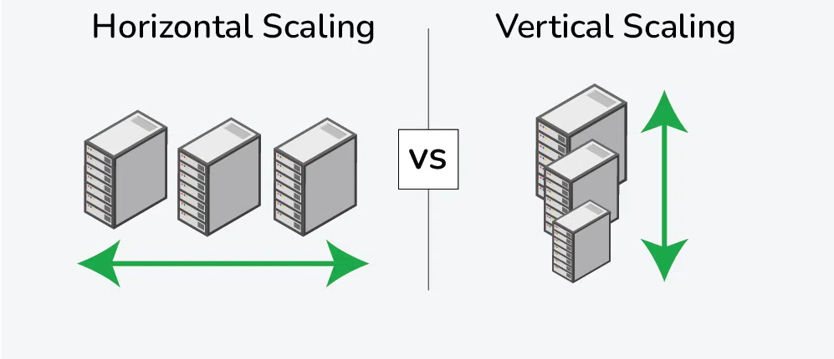
Scaling of system
Deployment view
Microservices?
Notes:
Focussed on performance and safety -> No horizontal scaling in deplyoment view
Microservice instead of monolithic structure (Good modifiability, could help solve database concerns)
- Could still be an area of interest in fututure
- Would have made more sense if Availability scores highest

