Slide 1
CSCI 4061
Lab 10

Slide 2
Overview
Critical Sections
Mutex Locks
Condition Variables
Today’s Tasks

Slide 3
Critical Sections
Code sections that access shared variables/data/state
e.g., a global sum, buffer, etc.
Only one thread should access a critical section at a time
Otherwise, there could be undefined behavior
A section is critical only if it is non-atomic
Atomic = all of the operations occur as a unit, so they cannot be interrupted midway

Slide 4
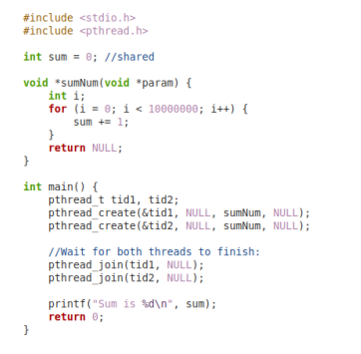
Critical Section Example
Sum is a global variable accessed by two threads
Increment of sum is NOT atomic
In the machine code, it is represented by a load, an increment, and a store
If the active thread switches in the middle of these steps, the other thread may increment the wrong value
The result has not been stored!

Slide 5
Race Conditions
Code behavior depends on when different threads reach a certain point
Race condition in the example if a thread began to increment sum before the other thread finished and stored the result
Solution: Enforce mutual exclusion within critical sections
Mutual exclusion locks (mutexes)
Condition variables
Semaphores

Slide 6
Mutex Locks
Only one thread can possess a mutex lock at a time
Other threads must wait until the lock is released
Blocked if they try to hold the lock while it is in use
Locks can be used to ensure only one thread goes through a critical section at once (mutual exclusion)
Attempt to grab the lock before entering the critical section
Release the lock once done

Slide 7
Mutex Locks
Two ways to initialize a mutex:
1. Static initializer (Best for global mutexes)
Doesn’t allow for setting of options, but ensures mutex is initialized before use
pthread_mutex_t m = PTHREAD_MUTEX_INITIALIZER;
2. Dynamic initializer (General purpose)
Allows for setting of options in the second argument (a pthread_mutexattr_t*)
pthread_mutex_t m; pthread_mutex_init(&m, NULL);

Slide 8
Mutex Locks
Special functions to lock/unlock mutex in the current thread:
pthread_mutex_lock(pthread_mutex_t *m)
Locks the mutex passed as the argument for the current thread
Blocks the current thread until the mutex is unlocked if it began locked
pthread_mutex_unlock(pthread_mutex_t *m)
Unlocks the mutex passed as an argument
Wakes up the first waiting thread to give them access to the mutex now

Slide 9
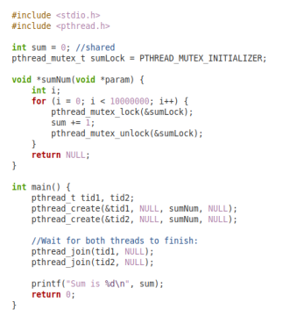
Mutex Lock Example
Adding a mutex to the earlier example ensures the current sum is maintained
Forces the full load, increment, store to occur at each step before the other thread can begin
Unlock the mutex after each use so that the other thread can continue!

Slide 10
Condition Variables
Sometimes we want to enter a critical section only when certain conditions are met
e.g., another thread has finished a task, there are new items to process, etc.
Checking a condition then locking a mutex is subject to race conditions
What if the condition changed between when we checked and when we locked the mutex?
We also don’t want to lock the mutex first, then check the condition
If the condition is false, it won’t change until we unlock the mutex

Slide 11
Condition Variables
Solution: Condition Variables
Allow for an atomic unlock and block to wait for the condition to change
Can be signaled when the condition may have changed favorably
The thread using the condition variable is atomically woken up and given the mutex
Note: you must use a condition variable in conjunction with a mutex lock
The condition variable locks/unlocks the given mutex for the relevant thread

Slide 12
Condition Variables
Two ways to initialize a condition variable (analogous to mutexes):
1. Static initializer (Best for global cond. vars)
Doesn’t allow for setting of options, but ensures cond. var is initialized before use
pthread_cond_t c = PTHREAD_COND_INITIALIZER;
2. Dynamic initializer (General purpose)
Allows for setting of options in the second argument (a pthread_condattr_t*)
pthread_cond_t c; pthread_cond_init(&c, NULL);

Slide 13
Condition Variables
Special functions to wait/signal with a condition variable:
pthread_cond_wait(pthread_cond_t *c, pthread_mutex_t *m)
Unlocks the mutex m and waits on the cond. var c
Blocks the current thread until the cond. var is signaled
pthread_cond_signal(pthread_cond_t *c)
Wakes up one thread waiting on the cond. var c to resume once mutex is unlocked
pthread_cond_broadcast(pthread_cond_t *c)
Signals ALL threads waiting on the cond. var c in order

Slide 14
Condition Variable Example
Assume each function is run by a single thread in the main program:
void *part_1(void *t) {
// grab lock for part 1 task
pthread_mutex_lock(&m);
do_part_1();
part_1_not_done = 0;
// put part 2 on the ready list
pthread_cond_signal(&c);
// unlock the mutex for part 2
pthread_mutex_unlock(&m);
return NULL;
}
void *part_2(void *t) {
// grab lock initially
pthread_mutex_lock(&m);
if (part_1_not_done) {
// block and wait for signal
pthread_cond_wait(&c, &m);
// has the mutex again here
}
do_part_2();
// finally unlock after task
pthread_mutex_unlock(&m);
return NULL;
}

Slide 15
Tasks
Quiz on Canvas: due Tuesday at 11:59 pm
Exercise:
Given some code containing 100 threads and race conditions
Add condition variables and mutexes to the code so that it is correct
Two critical sections to worry about, marked by TODO
1. a producer function run by 50 threads to add items to a buffer
2. a consumer function run by 50 threads to remove elements from the buffer
What might go wrong here without any synchronization?
Note that the buffer has a built in mutex/condition variable for you to use
See the definition of struct condBuffer for details of how they are stored
Compiling command is: gcc -pthread lab10.c -o lab10
Expected result if correctly synchronized: Total of buffer = 1275

