Slide 1
Delhi – Neighborhood Battles
A report by Aryan Agarwal

Slide 2
Problem Statemnt
Which part (area) of the city should the company open the supermarket first.
Which Neighborhood(s) would be ideal in that part (as in point 1) setting up such a supermarket in the city.

Slide 3

Summary
A retail company wants to set up supermarket stores in Delhi city but is not exactly sure about which Neighborhood(s) to open the store(s) in. The chosen locations should ideally have a considerable population so that there is more store footfall & near to work centers/residential districts for easier access to a large number of citizens.

Slide 4
Data
Geographical co-ordinates data of Neighborhoods in Delhi city by zip code from GitHub repository.
Source : https://github.com/sanand0/pincode/blob/master/data/IN.csv
Average House prices (per square feet) for each Neighborhood in Delhi city.
Source: https://www.makaan.com/price-trends/property-rates-for-buy-in-delhi
Use:
The data helps us to show real estate prices on Choropleth Maps and to identify potential Neighborhoods where stores can be opened.

Slide 5
Methodology
For the House prices, I have used web scraping to extract data from a house finder website in my project. A part of the table shown below.I have used python folium library to visualize

Slide 6
Solution
The analysis shows that although there is a great number of venues in Delhi (~1400 venues for 145 Neighborhoods), which are concentrated in western & west-central Neighborhoods.

Slide 7
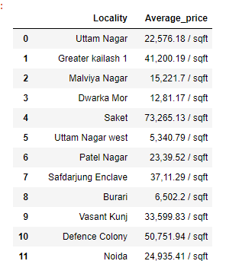
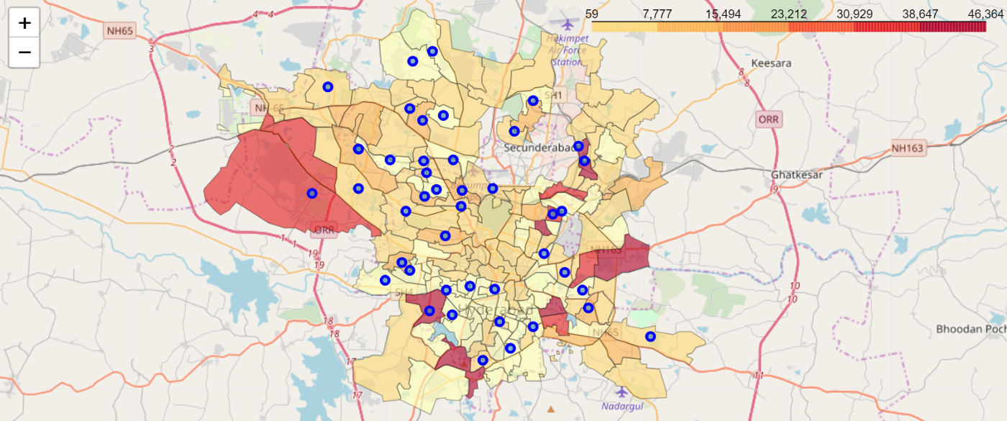
Data and graphs of analysis
geographic details of Delhi by creating a map of Delhi with Neighborhoods superimposed on top. I used latitude and longitude values to get the visual as below

Slide 8
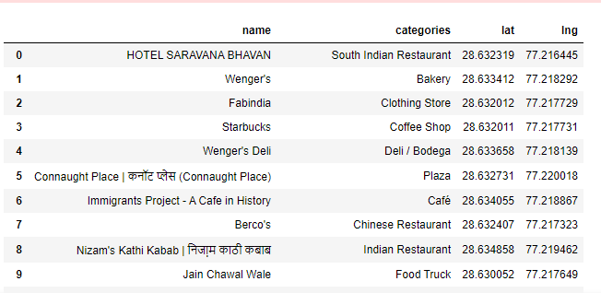
Utilized the Foursquare API to explore Neighborhoods and segment them. I kept the limit as 100 venues and the radius 1000 meters for each Neighborhood centers (calculated above) from their given latitude and longitude data. Here is a head of the list Venues name, category, latitude and longitude information from Foursquare API.

Slide 9
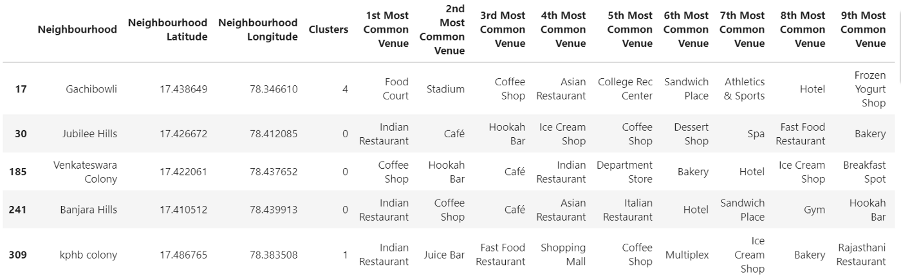
Below is the merged table with cluster labels for each Neighborhoods.

