Slide 1

Protests: how to be heard and not killed
Understanding the dynamics of protest violence and safety
Notes:
Good [morning/afternoon/evening], ladies and gentlemen. Thank you for joining me today for this presentation on "Protests: How to be Heard and Not Killed." In recent years, protests have become a significant means for people to express their grievances, demand change, and fight for justice. Today, we will explore the dynamics of protest activity, the factors influencing protest violence, and strategies to ensure the safety of protestors.

Slide 2
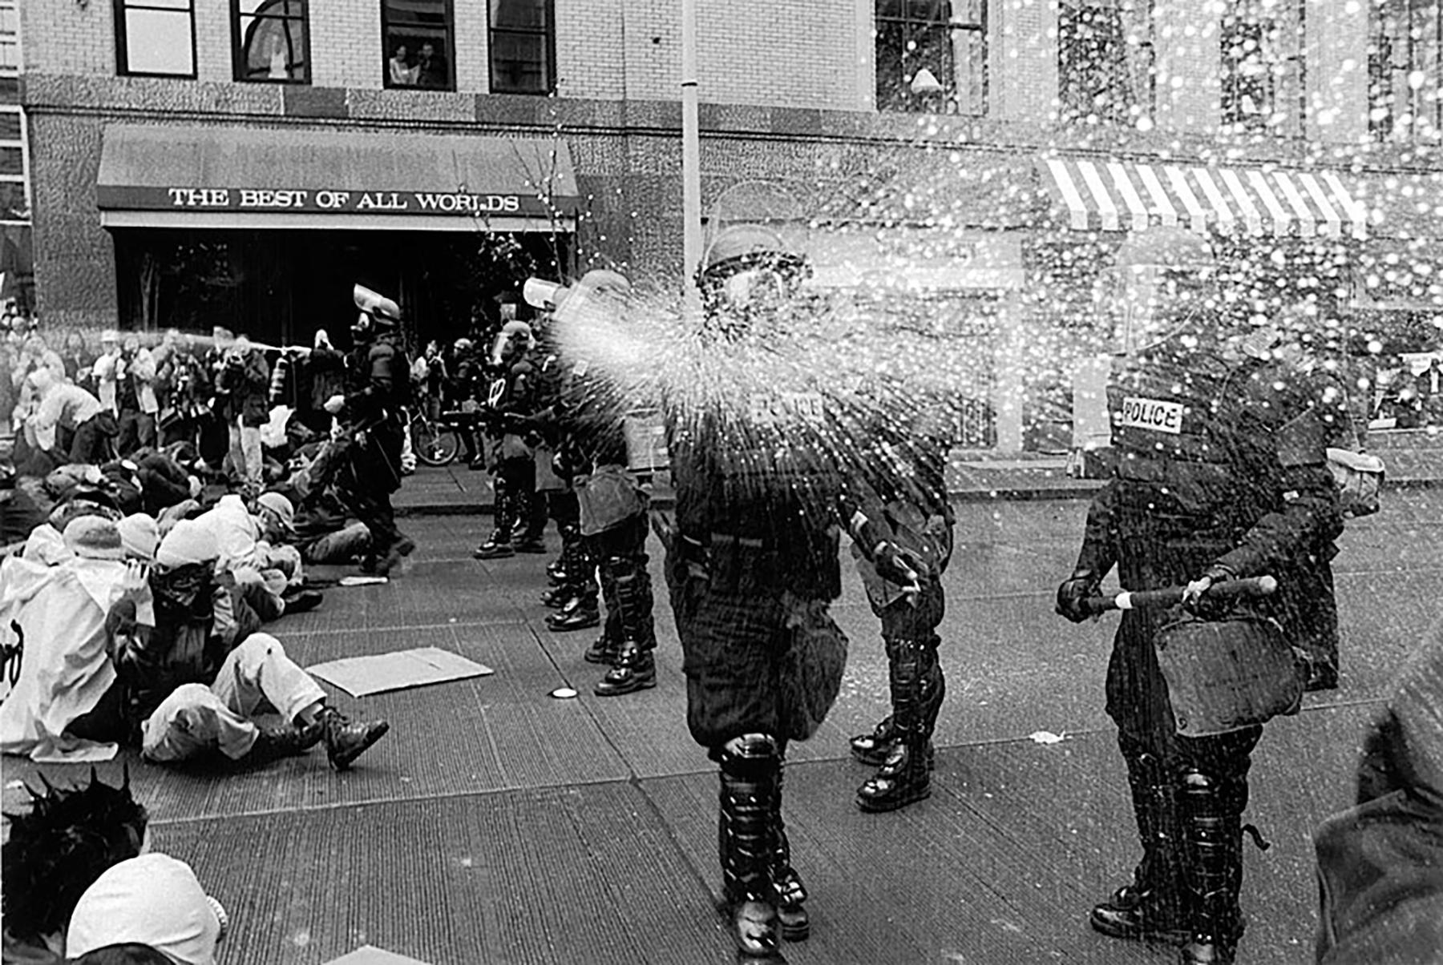
Key Insights from Analysis
Protest activity has increased in recent years, with a noticeable impact from the pandemic in 2020.
Shootings in protests have resulted in a significantly higher fatality rate compared to accommodations.
Certain protest demands are associated with a higher likelihood of violence, emphasizing the need for thoughtful engagement.
Larger protests tend to be safer, highlighting the potential protective effect of higher participation.
State responses vary based on the nature of demands, and political behavior demands receive the least accommodation.
Regional variations in protest activity and violence warrant tailored approaches to address challenges.
Notes:
[Implications for Protest Organizers]
Prioritize Participant Safety:
Emphasize Non-Violent Methods: Organize training sessions on non-violent protest tactics and peaceful conflict resolution.
Crowd Management: Implement measures to ensure the safety and well-being of participants during demonstrations.
Strategic Planning and Messaging:
Clear Objectives: Define clear and achievable protest objectives to garner support and avoid ambiguity.
Impactful Messaging: Craft persuasive messages to resonate with diverse audiences and gain broader public support.
Inclusivity and Diversity:
Amplify Voices: Foster inclusive movements that amplify diverse voices and concerns to build solidarity.
Strengthen Networks: Collaborate with community organizations and activists to broaden the impact of the protest.
Engaging with Authorities:
Constructive Engagement: Establish communication channels with authorities to express demands and concerns.
Dialogue Facilitation: Facilitate constructive dialogues with policymakers to find common ground and explore solutions.
Media Relations:
Responsible Media Coverage: Work with media outlets to ensure accurate and unbiased coverage of protests.
Highlight Peaceful Nature: Showcase the non-violent nature of the protest and intentions to promote a peaceful movement.
Monitoring and Evaluation:
Early Warning Mechanisms: Develop systems to detect potential conflicts and respond proactively.
Learn from Experience: Analyze past protests to identify lessons learned and improve future demonstrations.
By embracing these recommendations, protest organizers can create impactful and safe protests that effectively communicate their message, garner public support, and contribute to positive social change.

Slide 3
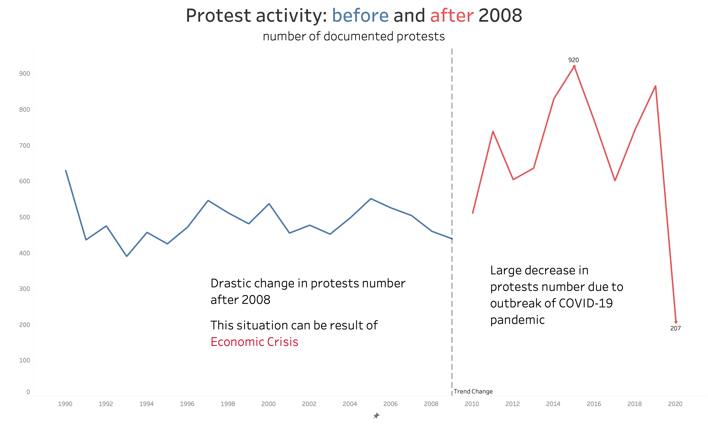
Protests: how to be heard and not killed
Notes:
As we delve into the data, one key observation stands out - the increase in protest activity over time. We can see a rising trend in protest occurrences after the year 2008. However, there is a dramatic decline in protests for the year 2020. This decline can be attributed to the outbreak of the pandemic, which severely limited social gatherings and public demonstrations.
While we acknowledge the impact of the pandemic on protest activity, it is essential to understand that the trend of increasing protests is likely to continue. Economic hardships, social inequalities, and calls for justice are driving factors behind the surge in demonstrations.
Now, let's explore how different variables impact protest violence and how we can make protests safer for everyone involved.

Slide 4
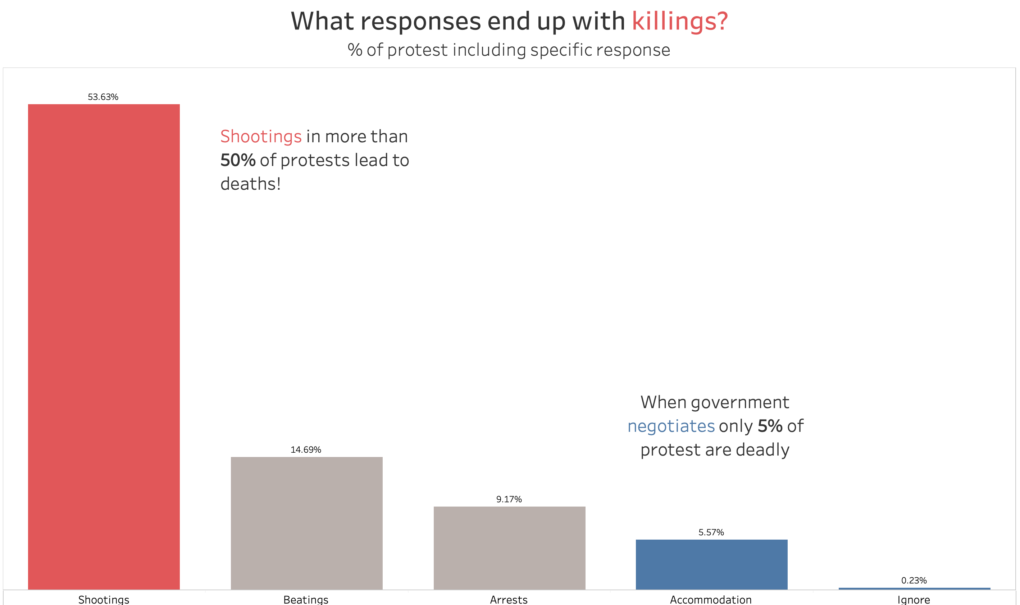
Protests: how to be heard and not killed
Notes:
Let's dive deeper into the factors that influence protest violence and the outcomes of different state responses.
Here, we have a chart that highlights the impact of shootings on protest violence. In over 53% of protests involving shootings, deaths occurred, indicating a high fatality rate associated with the use of firearms in protest contexts. The use of violence can escalate situations and lead to tragic consequences.
On the other hand, when governments engage in negotiations with protestors, the fatality rate decreases significantly to only 5%. Negotiations provide a pathway for peaceful resolutions, reducing the likelihood of violence during protests.
As we analyze these factors, it becomes evident that peaceful dialogues and negotiations play a crucial role in minimizing violence and ensuring the safety of protestors. By understanding the impact of different state responses, we can identify strategies to promote peaceful demonstrations and create an environment where protestors can be heard without facing harm.

Slide 5
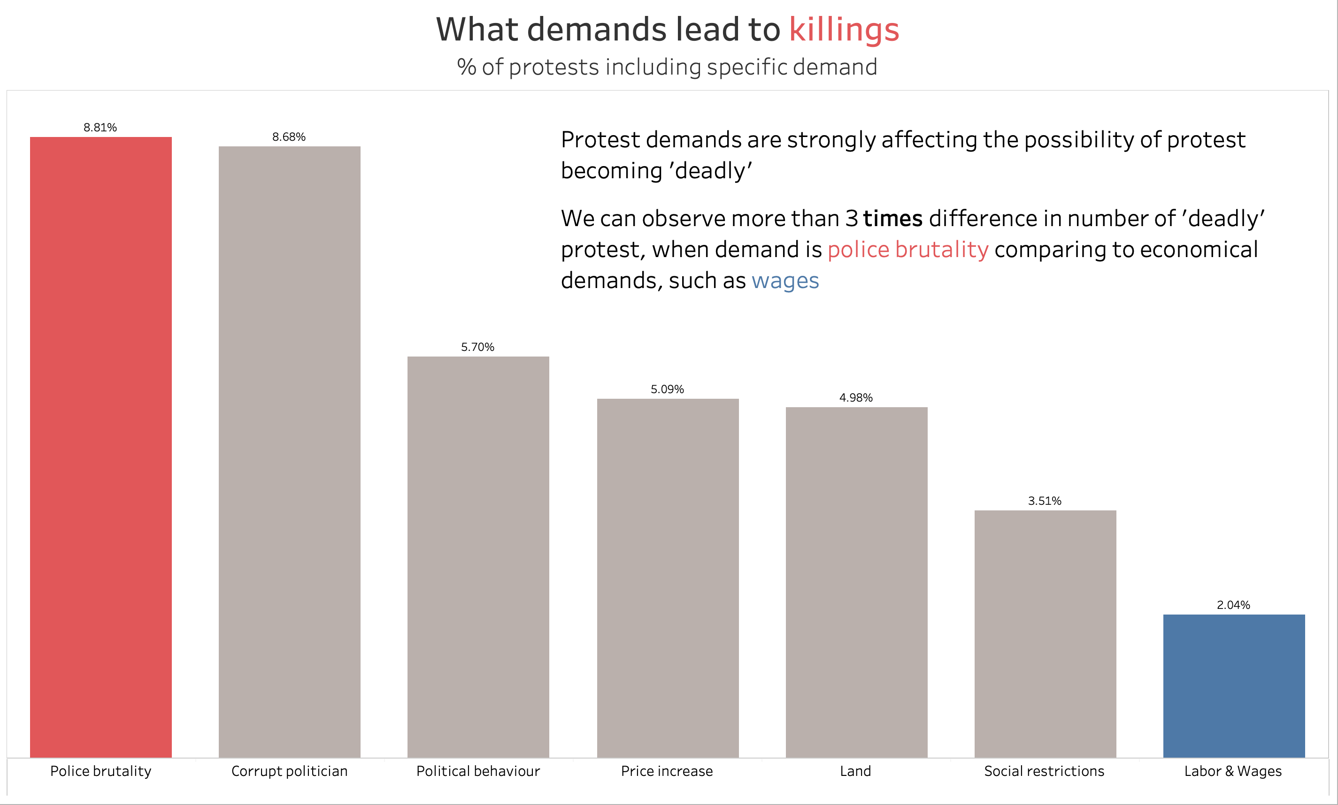
Protests: how to be heard and not killed
Notes:
Here, we have a bar chart that illustrates the frequency of different types of protest demands. Each demand category represents the key issues that protestors are advocating for during their demonstrations.
One of the striking findings from our analysis is that certain protest demands are more likely to lead to violence than others. For instance, protests demanding an end to police brutality were associated with a substantially higher number of "deadly" protests compared to protests focused on economic demands, such as wages.
Let's explore potential hypotheses for this observation. It's important to note that these hypotheses are based on the data and further research may be needed to validate them fully:
Nature of the Demand: Demands related to sensitive issues, such as human rights violations, may evoke strong emotional responses, leading to escalated tensions and violence during protests.
Government's Response: The nature of the government's response to specific demands can also influence protest outcomes. If the government takes a hardline approach or responds with force, it may increase the likelihood of violence.
Public Perception: The perception of the protest demands by the public and media coverage can also play a role. Demands that are perceived as divisive or polarizing may attract more attention and potentially lead to confrontations.
Historical Context: The historical context of a country, including its past experiences with protests and government responses, may shape the dynamics of current demonstrations.
As we delve deeper into the data, we hope to gain further insights into the complex interplay between protest demands and the occurrence of violence. Understanding these patterns can guide policymakers and protest organizers in formulating effective strategies to promote peaceful demonstrations and address protestors' concerns without resorting to violence.

Slide 6
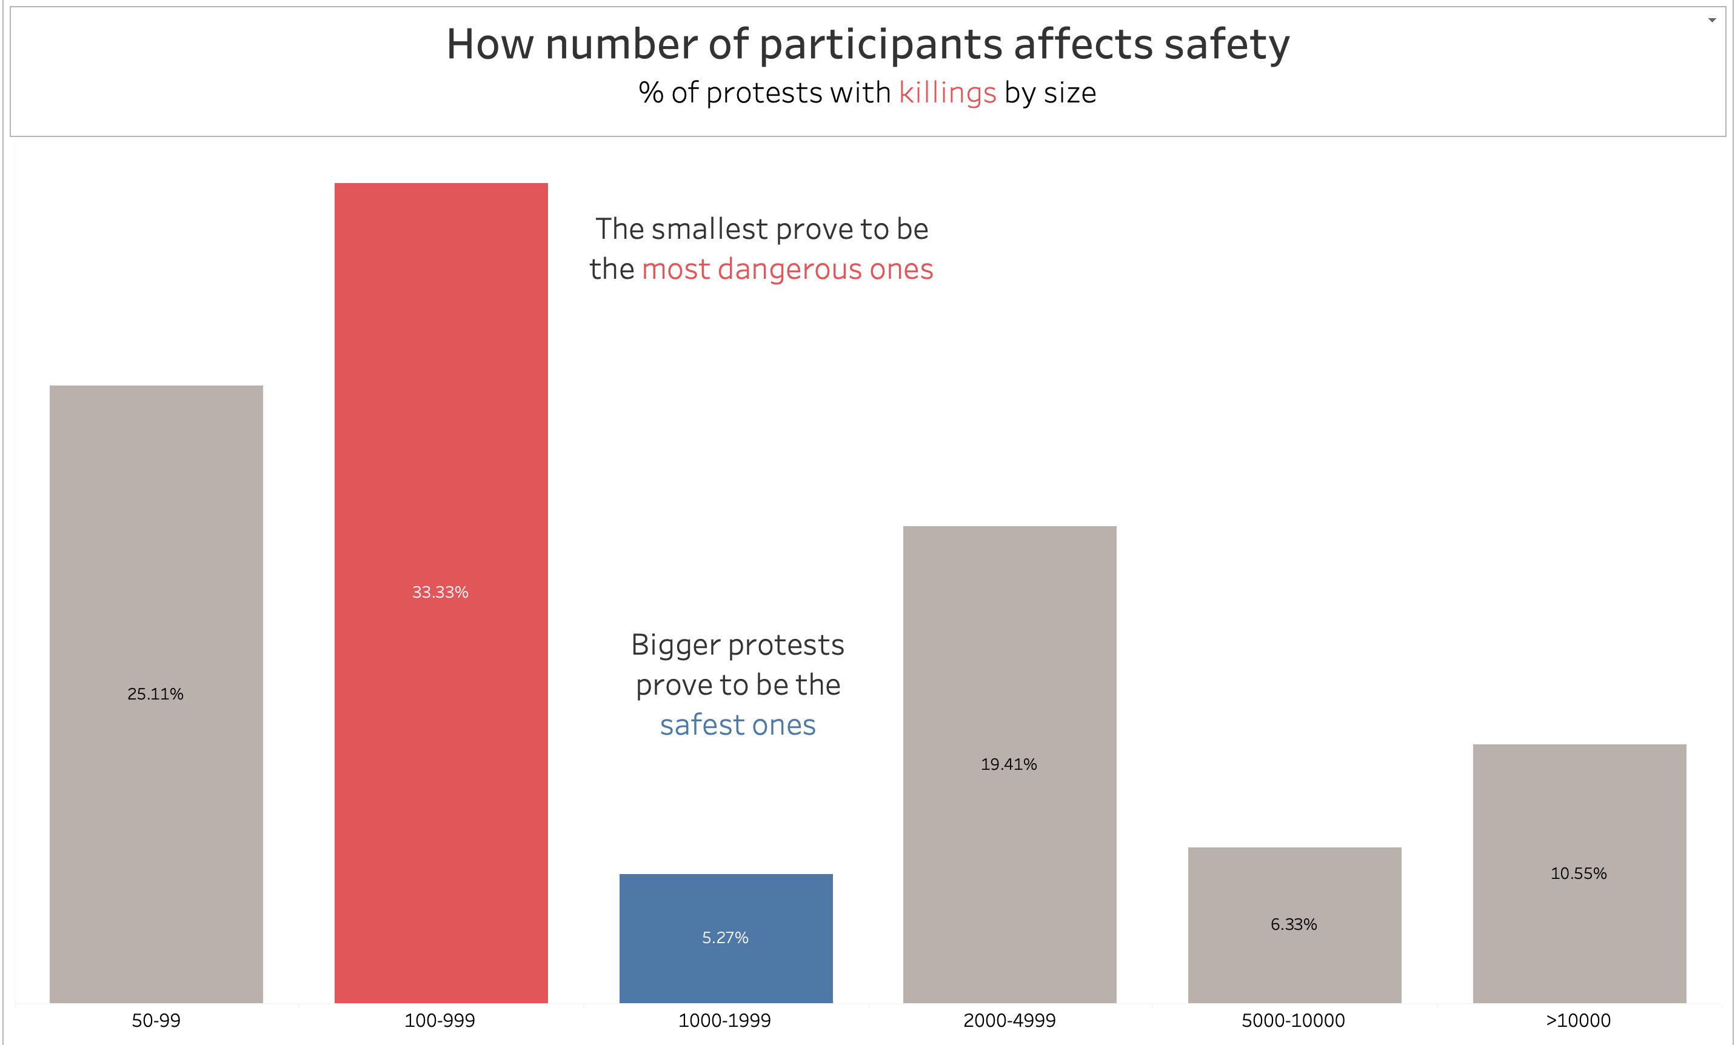
Protests: how to be heard and not killed
Notes:
Our analysis reveals a compelling insight: larger protests tend to be safer compared to medium-sized protests. We observed a lower incidence of violence in larger demonstrations, which suggests that larger crowds may provide a protective effect.
While the data does not directly provide the reasons behind this observation, we can speculate on potential factors that contribute to this trend:
Visibility and Accountability: Larger protests attract more attention, both from the public and the media. This increased visibility may hold authorities more accountable for their actions, discouraging the use of force.
Strength in Numbers: Larger crowds may make it more challenging for agitators or provocateurs to incite violence. The solidarity among participants can promote a peaceful atmosphere.
Peaceful Intentions: Organizers of larger protests may put more emphasis on maintaining non-violent demonstrations to achieve their objectives peacefully.
For protest organizers, this insight highlights the importance of encouraging larger turnouts. By mobilizing more participants, organizers can enhance the safety and effectiveness of their demonstrations. Furthermore, our findings underscore the need for effective crowd management strategies and communication to ensure that protests remain peaceful.

Slide 7
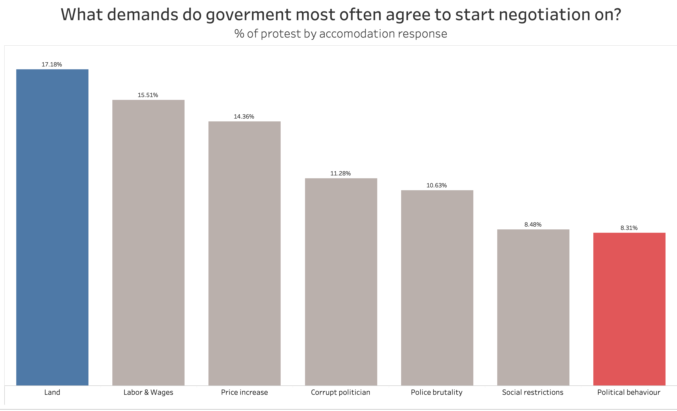
Protests: how to be heard and not killed
Notes:
In this visualization, we explore the types of protest demands that governments are more likely to agree to negotiate. The chart displays the frequency of government negotiations initiated in response to various protest demands.
It is evident from the chart that governments are more willing to accommodate certain issues during negotiations. For demands related to economic issues, such as wages or working conditions, governments tend to be more receptive to starting negotiations. On the other hand, demands concerning more controversial and divisive issues, like political behavior, show significantly fewer instances of negotiations being initiated.
The data highlights the importance of framing protest demands strategically. When organizing protests, emphasizing economic issues and workplace-related demands may lead to more fruitful negotiations with the government. However, demands related to political behavior might require alternative approaches to foster dialogue and resolution.

Slide 8
Recommendations
Prioritize Participant Safety
Emphasize non-violent methods
Crowd management
Strategic Planning and Messaging
Clear objectives
Impactful messaging
Engaging with Authorities
Constructive engagement
Dialogue facilitation
Media Relations
Responsible media coverage
Highlight peaceful nature
Monitoring and Evaluation
Early warning mechanisms
Learn from experience!
Notes:
[Implications for Protest Organizers]
Prioritize Participant Safety:
Emphasize Non-Violent Methods: Organize training sessions on non-violent protest tactics and peaceful conflict resolution.
Crowd Management: Implement measures to ensure the safety and well-being of participants during demonstrations.
Strategic Planning and Messaging:
Clear Objectives: Define clear and achievable protest objectives to garner support and avoid ambiguity.
Impactful Messaging: Craft persuasive messages to resonate with diverse audiences and gain broader public support.
Engaging with Authorities:
Constructive Engagement: Establish communication channels with authorities to express demands and concerns.
Dialogue Facilitation: Facilitate constructive dialogues with policymakers to find common ground and explore solutions.
Media Relations:
Responsible Media Coverage: Work with media outlets to ensure accurate and unbiased coverage of protests.
Highlight Peaceful Nature: Showcase the non-violent nature of the protest and intentions to promote a peaceful movement.
Monitoring and Evaluation:
Early Warning Mechanisms: Develop systems to detect potential conflicts and respond proactively.
Learn from Experience: Analyze past protests to identify lessons learned and improve future demonstrations.
By embracing these recommendations, protest organizers can create impactful and safe protests that effectively communicate their message, garner public support, and contribute to positive social change.

Slide 9
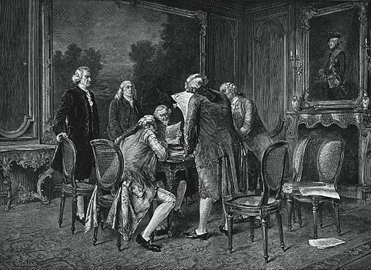
Conclusion
Key Takeaways:
Protest activity has increased in recent years, influenced by socio-political and economic factors.
The use of shootings in protests results in significantly higher fatality rates compared to negotiations.
Certain protest demands are associated with a higher likelihood of violence.
Larger protests tend to be safer, possibly due to deterrence or increased visibility.
State responses vary based on demand types, with political behavior demands receiving the least accommodation.
Regional variations in protest activity and violence highlight the need for tailored approaches.
Notes:
Protest organizers play a crucial role in shaping movements that drive positive change in our societies. By understanding the dynamics of protest violence and safety, you have the power to create more impactful and safer demonstrations. As you plan and lead protests, keep in mind the importance of prioritizing participant safety, strategic planning, inclusivity, and engaging constructively with authorities.
Your passion for social change, combined with evidence-based strategies, can pave the way for a more just and equitable world. Remember that data and research are valuable tools in your journey to create meaningful and peaceful protests.
Thank you for your attention and engagement. I invite any questions or discussions on the findings or recommendations presented today. Let's continue our commitment to making a difference through peaceful and effective protest movements.

Slide 10
Q&A and Information
Email: lucacafoncelli@gmail.com
LinkedIn: https://www.linkedin.com/in/lucacafoncelli/
Twitter: @LucaCafoncelli
Notes:
Now, I would be happy to open the floor for any questions or discussions. Please feel free to ask anything related to the data findings, recommendations, or any other topics you'd like to explore further.
If you have any additional questions or would like to discuss any aspect of today's presentation in more detail, please feel free to reach out to me:
I look forward to staying connected and collaborating with you to create impactful and peaceful protests in the future.

