Slide 1
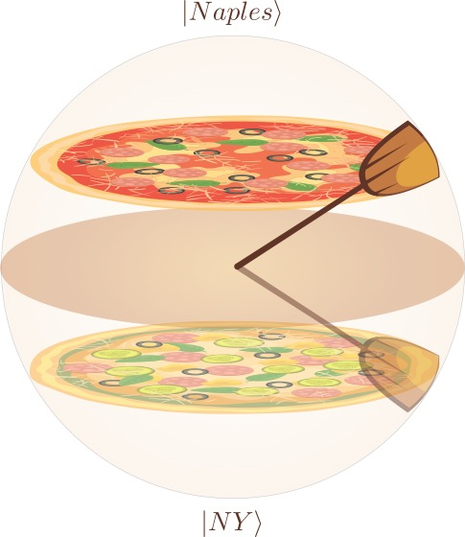
spinYpizza
A quantum secure chat among N users

Slide 2
Security assumptions
The chat between a user and the Intermediate Interface is artificial: in a real case scenario it doesn’t exist so it’s supposed to be secure
The chat between a couple of users is not secure

Slide 3
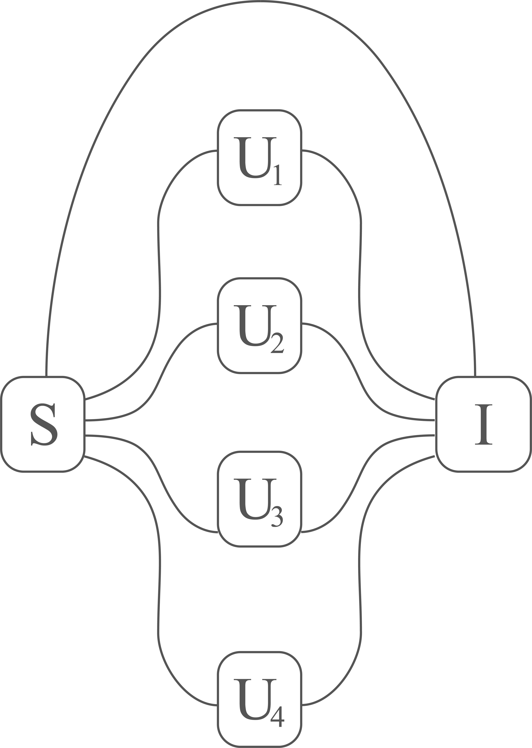
Network topology
Nodes of the network
S: Messaging server
I: Interface (authentication server)
U₁, U₂, U₃, ... : Users

Slide 4
Authentication protocol
The point of the authentication protocol is to establish a series of secure links between the server (S) and each user (U_{i}). For each user, the messaging server (S) plays the role of Alice and the user (U_{i}) plays the role of Bob. They interact with direct messages to the Interface server (I).
In this way, Alice basis are shared only between Alice the Interface, same for Bob.
The Interface server communicates with the QuTech device.

Slide 5
Authentication protocol
For each User U_{i}
S sends MESSAGE_{i} to I
S sends A_{BASIS,i} to I
U_{i} sends B_{BASIS,i} to I
I execute BB84 or E91
I sends RESULTS_{i} to U_{i}
U_{i} sends B_{BASIS,i} to S
S sends A_{BASIS,i} to U_{i}
U_{i} eliminates bits with wrong basis from RESULTS_{i} : U_{i} has key K_{i}
U_{i} sends index of bits to be eliminated to S
S eliminates the bits : S has key K_{i}

Slide 6
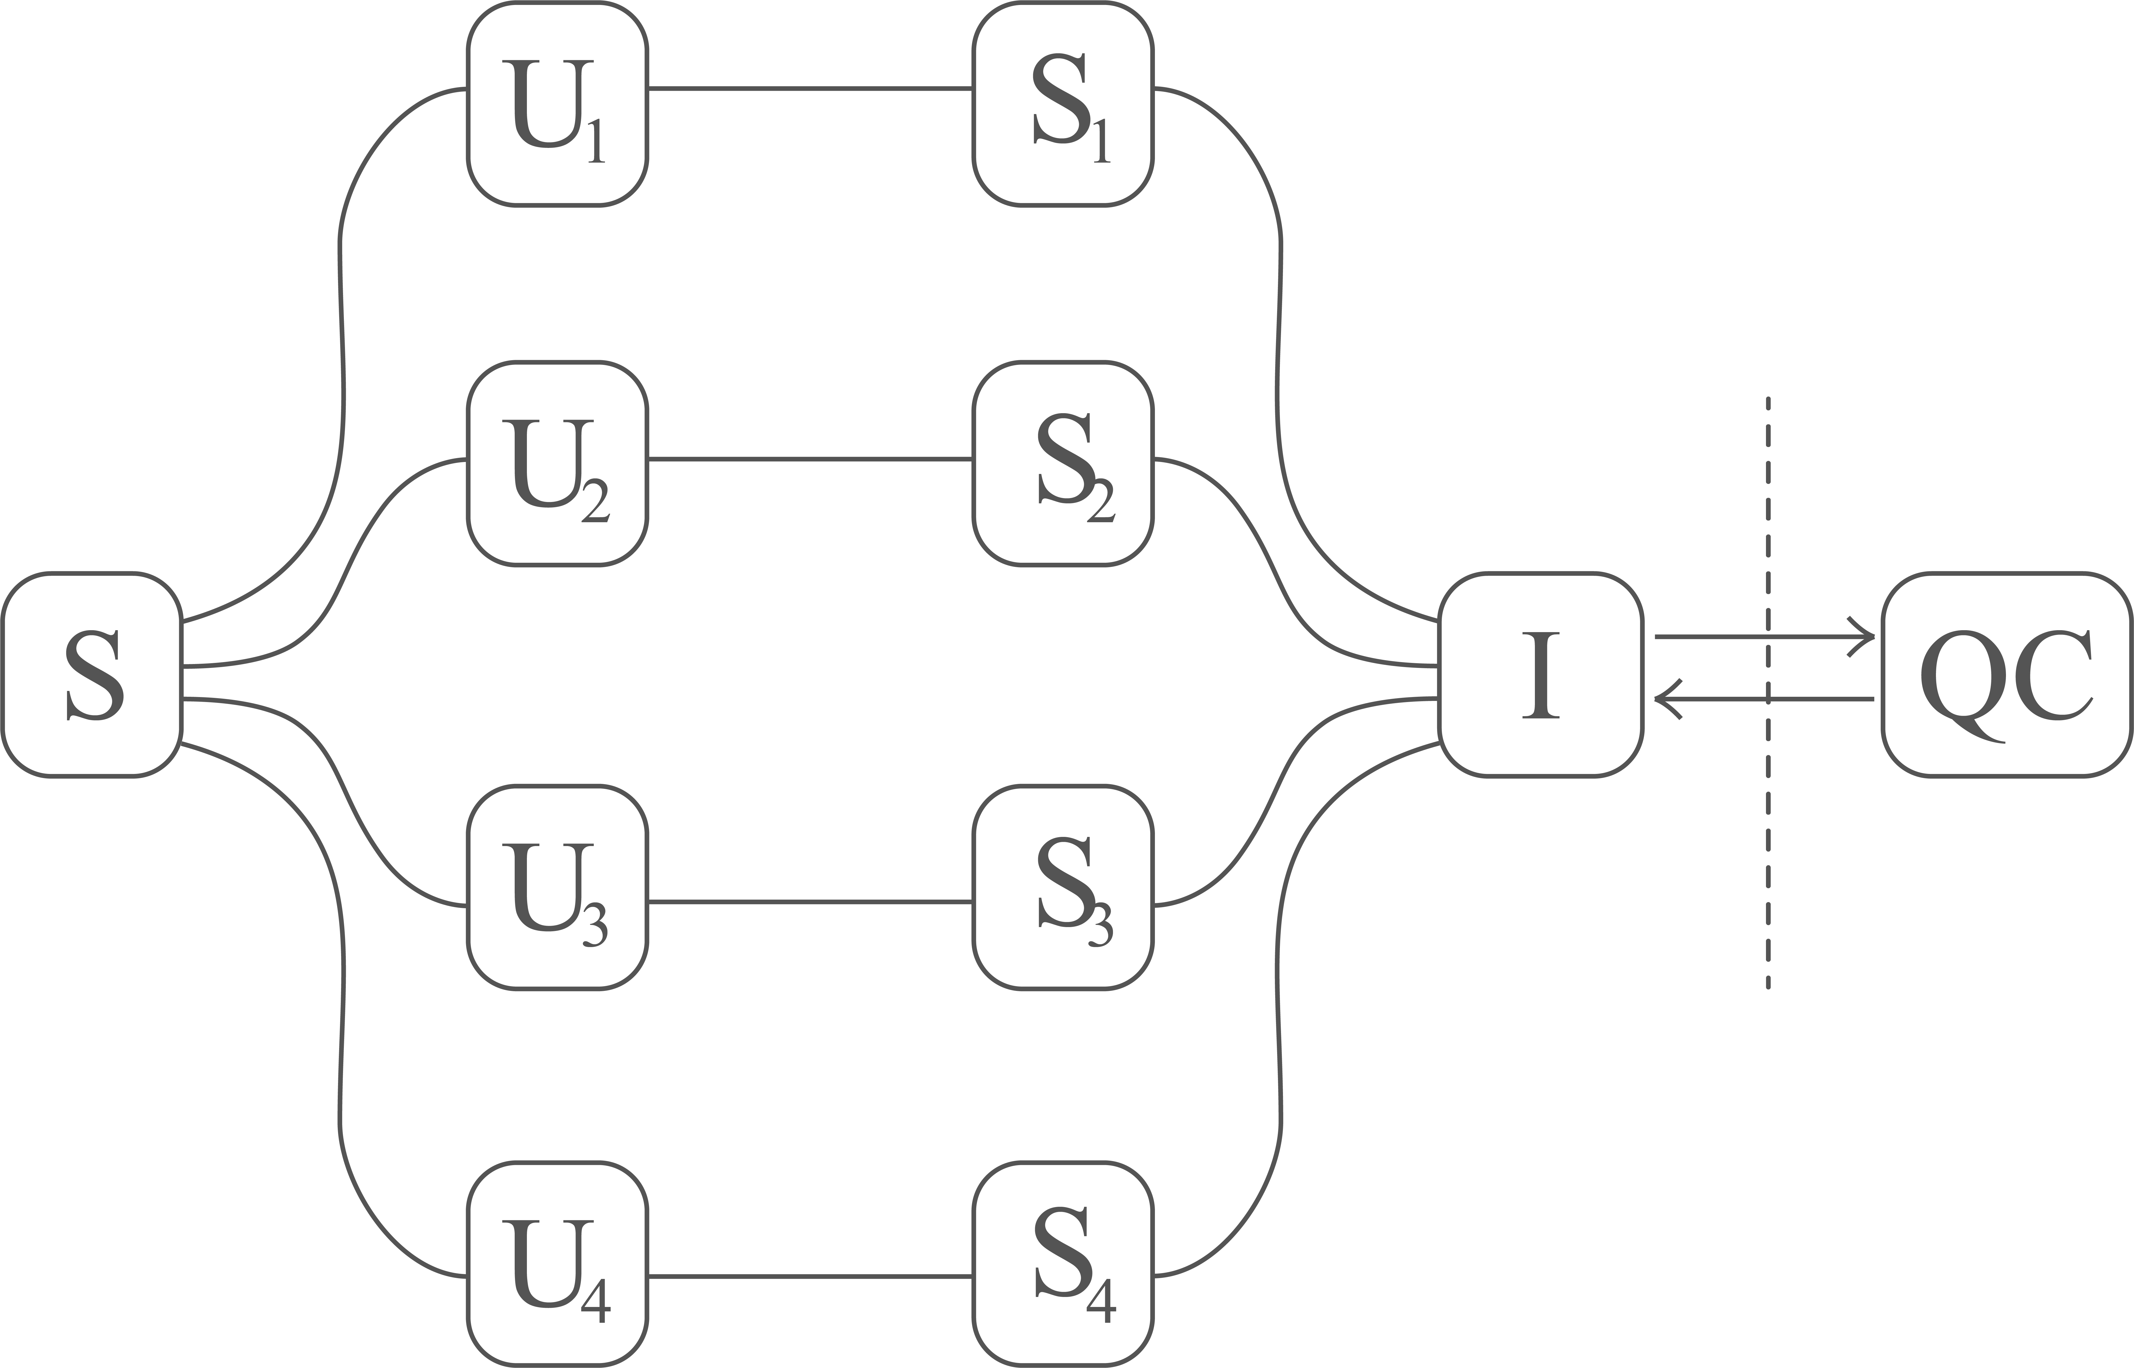
Implementation
a main server used to communicate between different users classically
the ‘quantum servers’ are used to communicate only with the Intermediate interface
The intermediate interface communicate with the Quantum Computer assembling a circuit that implements Ekert91 or BB84 depending on the input received by a couple of users
The basis used for the qkd protocol are then shared between the users passing through the main server (S)

