Slide 1

Data Management HW3
Leonardo Placidi
Negin Amininodoushan

Slide 2
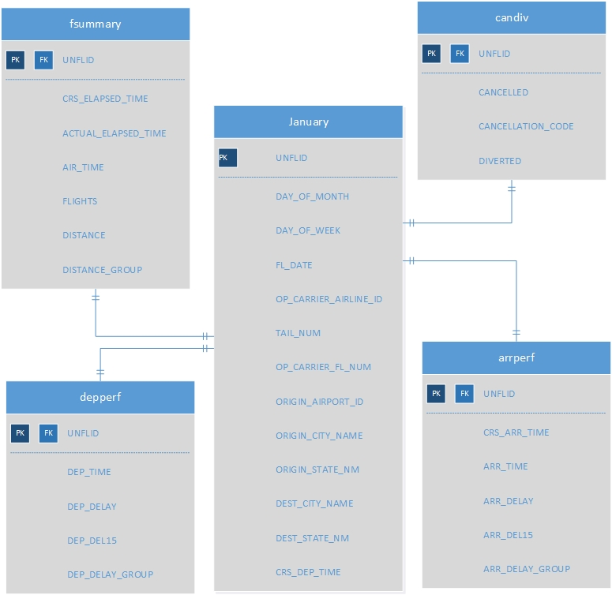
Flight database
US Flight data from 16 carriers
January 2010,2015,2020
521810 records in the main table(January)
The Unique flight ID was created by concatenating 5 attributes

Slide 3
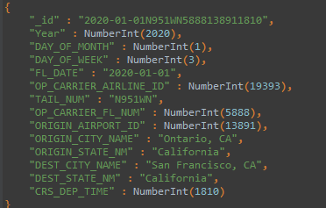
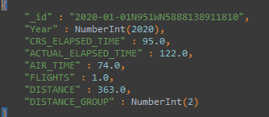
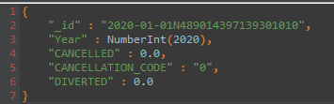
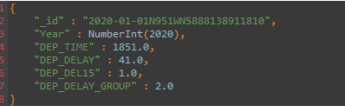
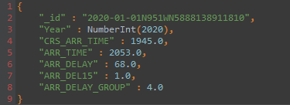
First database design
A database like we had in the first homework for SQL
5 different collections
fsumm
jan
candiv
depperf
arrperf

Slide 4
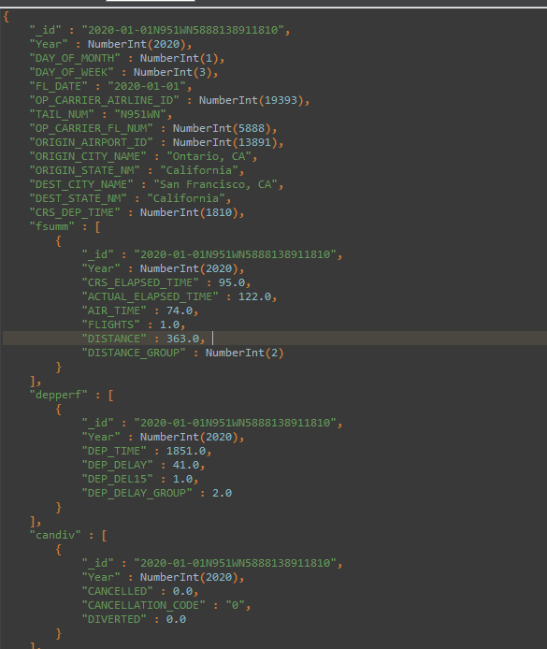
One nested collection

Slide 5
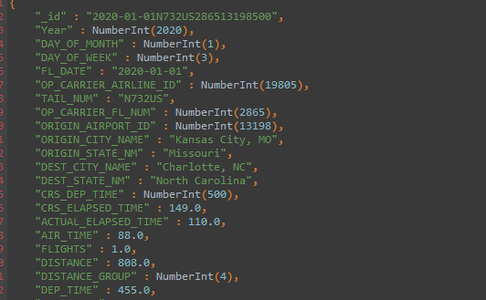

One collection schema

