Slide 1

Data Management HW1 & HW2
Leonardo Placidi
Negin Amininodoushan

Slide 2
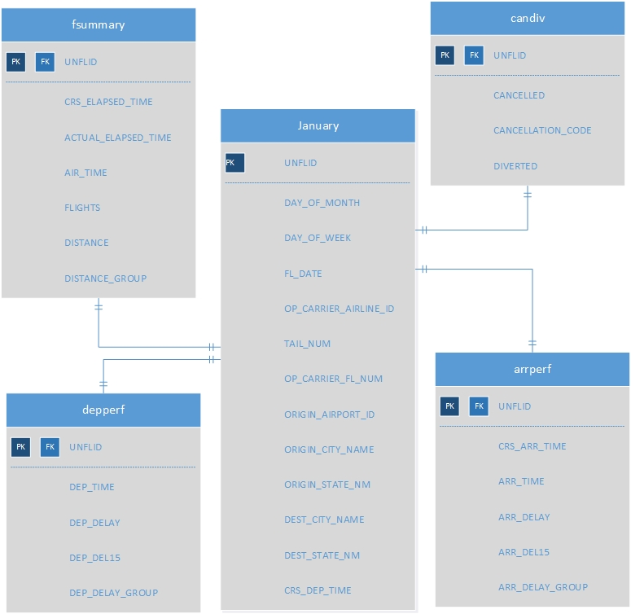
Flight database
US Flight data from 16 carriers
January 2010,2015,2020
521810 records in the main table(January)
The Unique flight ID was created by concatenating 5 attributes

Slide 3
Query performance
Query number | First execution time | Second execution time
3 | 4.259 | 1.79
5 | 6.151 | 2.09
6 | 4.42 | 0.000415
9 | >400 | 9.28
10 | 15.9 | 9.7

