Slide 1
Laser Controller

Slide 2
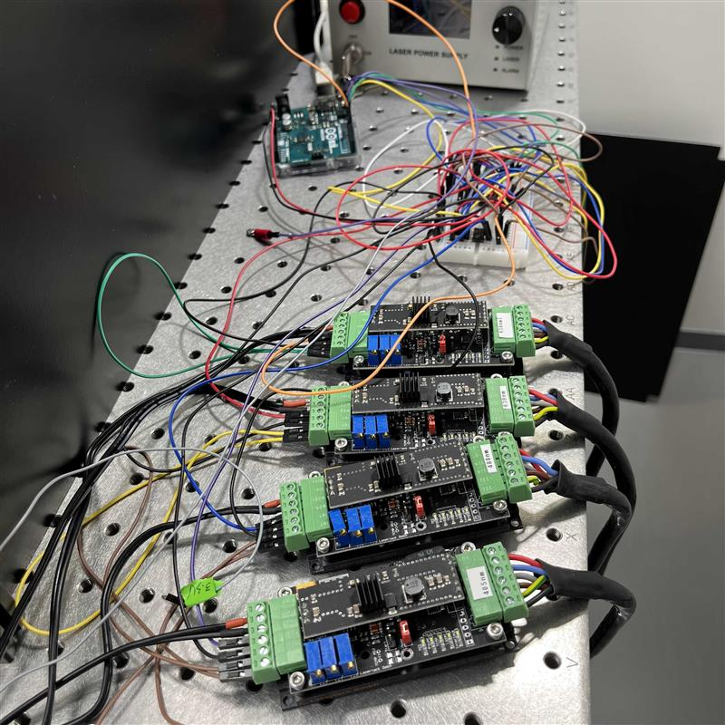
Current Solution

Slide 3
Requirements
Should be controllable in Micro-Manager
Should be easy to install (software)
Should be easy to build (hardware)
Should be inexpensive (under $100)

Slide 4
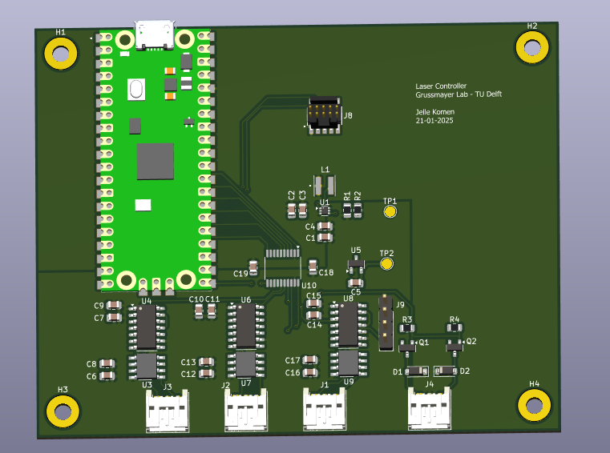
Hardware Design
Raspberry Pi Pico: firmware can easily be installed without requiring special tools.
The Board can be ordered at JLC PCB at a cost of ~$35 per board.

Slide 5
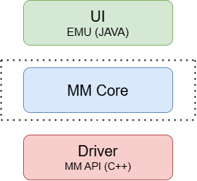
Software Design

Slide 6
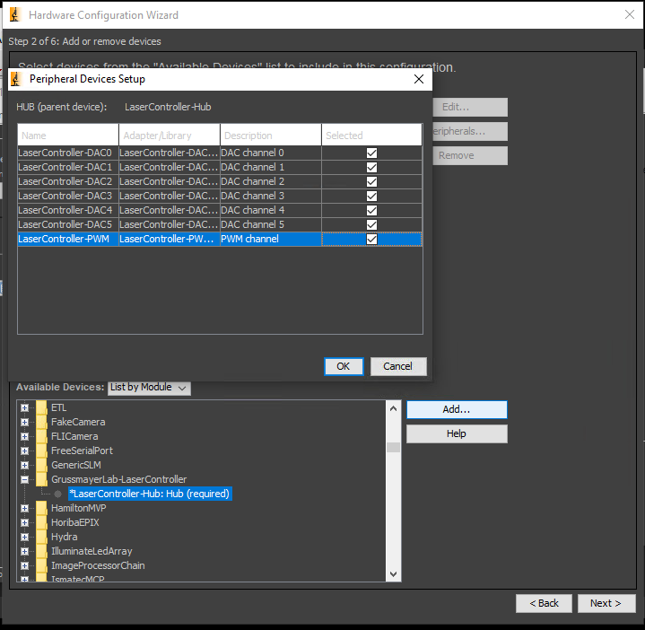
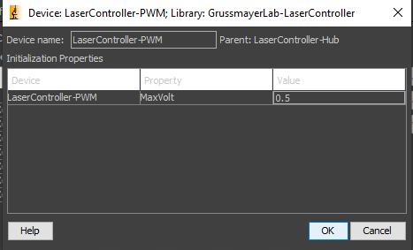
Driver Installation
Open Device Manager

Slide 7
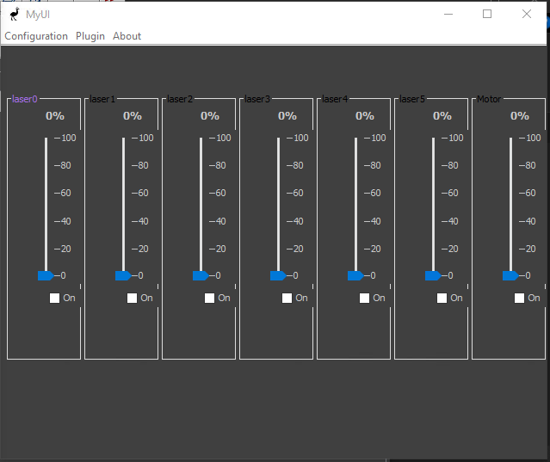
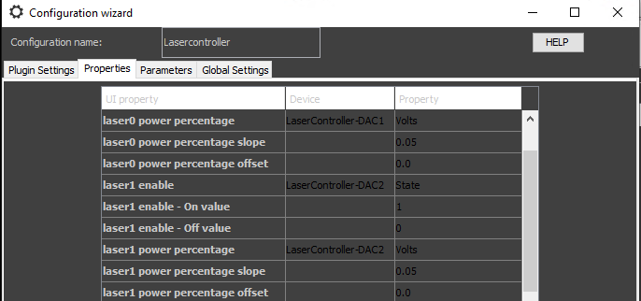
User Interface

Slide 8
Questions?
https://github.com/GrussmayerLab/LaserController

