Slide 1

Test automation course
Lesson 2

Slide 2
Table of contents
1. UML notations
2. Basic data types
3. Access modifiers
4. Non-access modifiers
5. Java constructor
6. “this” keyword in Java
7. “void” keyword in Java
8. “return” keyword in Java
9. Creation of class instances (objects)

Slide 3
UML notations
The class diagram is a static diagram. It represents the static view of an application. Class diagram is not only used for visualizing, describing and documenting different aspects of a system but also for constructing executable code of the software application.
The class diagram describes the attributes and operations of a class and also the constraints imposed on the system. The class diagrams are widely used in the modelling of object oriented systems because they are the only UML diagrams which can be mapped directly with object oriented languages.
The class diagram shows a collection of classes, interfaces, associations, collaborations and constraints. It is also known as a structural diagram.

Slide 4
UML notations
Purpose:
Analysis and design of the static view of an application.
Describe responsibilities of a system.
Base for component and deployment diagrams.
Forward and reverse engineering.

Slide 5
UML notations
Drawing Class Diagram:
The name of the class diagram should be meaningful to describe the aspect of the system.
Each element and their relationships should be identified in advance.
Responsibility (attributes and methods) of each class should be clearly identified.
For each class minimum number of properties should be specified. Because unnecessary properties will make the diagram complicated.
Use notes when ever required to describe some aspect of the diagram. Because at the end of the drawing it should be understandable to the developer/coder.
Finally, before making the final version, the diagram should be drawn on plain paper and rework as many times as possible to make it correct.

Slide 6
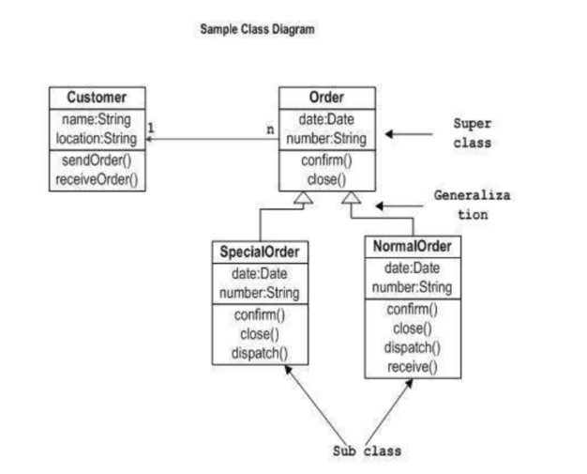
UML notations
Now the following diagram is an example of an Order System of an application. So it describes a particular aspect of the entire application.
First of all Order and Customer are identified as the two elements of the system and they have a one to many relationship because a customer can have multiple orders.
We would keep Order class is an abstract class and it has two concrete classes (inheritance relationship) SpecialOrder and NormalOrder.
The two inherited classes have all the properties as the Order class. In addition they have additional functions like dispatch () and receive ().

Slide 7
Basic data types
There are eight primitive data types supported by Java:
byte: (1 byte) /-128;127
short: (2 bytes) / -2¹⁵;2¹⁵
int: (4 bytes) / -2³¹;2³¹
long: (8 bytes) / -2⁶³;2⁶³
float: (4 bytes) / ~1,4*10⁻⁴⁵; ~3,4*10³⁸
double: (8 bytes) / ~4,9*10⁻³²⁴; ~1,8*10³⁰⁸
boolean: (1 bit) /false(0) ; true(1)
char: (2 bytes) / 0;65535 Unicode

Slide 8
Basic data types
Reference Data Types:
Reference variables are created using defined constructors of the classes. They are used to access objects. These variables are declared to be of a specific type that cannot be changed. For example, Employee, Puppy etc.
Class objects, and various type of array variables come under reference data type.
Default value of any reference variable is null.
A reference variable can be used to refer to any object of the declared type or any compatible type.
Example: Animal animal = new Animal("giraffe");

Slide 9
Access modifiers
Java provides a number of access modifiers to set access levels for classes, variables, methods and constructors. The four access levels are:
Visible to the package. the default. No modifiers are needed.
Visible to the class only (private).
Visible to the world (public).
Visible to the package and all subclasses (protected).

Slide 10
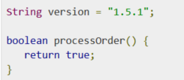
Access modifiers
Default Access Modifier - No keyword:
Default access modifier means we do not explicitly declare an access modifier for a class, field, method, etc.
A variable or method declared without any access control modifier is available to any other class in the same package. The fields in an interface are implicitly public static final and the methods in an interface are by default public.
Example:

Slide 11
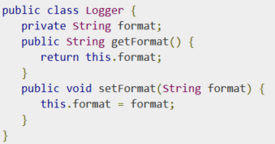
Access modifiers
Private Access Modifier - private:
Methods, Variables and Constructors that are declared private can only be accessed within the declared class itself.
Private access modifier is the most restrictive access level. Class and interfaces cannot be private.
Variables that are declared private can be accessed outside the class if public getter methods are present in the class.
Example:

Slide 12

Access modifiers
Public Access Modifier - public:
A class, method, constructor, interface etc declared public can be accessed from any other class. Therefore fields, methods, blocks declared inside a public class can be accessed from any class belonging to the Java Universe.
Example:

Slide 13
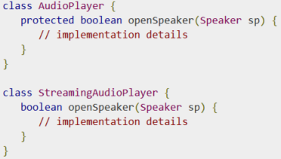
Access modifiers
Protected Access Modifier - protected:
Variables, methods and constructors which are declared protected in a superclass can be accessed only by the subclasses in other package or any class within the package of the protected members' class.
The protected access modifier cannot be applied to class and interfaces. Methods, fields can be declared protected, however methods and fields in a interface cannot be declared protected.
Protected access gives the subclass a chance to use the helper method or variable, while preventing a nonrelated class from trying to use it.
Example:
Here, if we define openSpeaker() method as private, then it would not be accessible from any other class other than AudioPlayer. If we define it as public, then it would become accessible to all the outside world. But our intension is to expose this method to its subclass only, thats why we used protected modifier.

Slide 14
Java Non Access Modifiers
Java provides a number of non-access modifiers to achieve many other functionality.
The static modifier for creating class methods and variables
The final modifier for finalizing the implementations of classes, methods, and variables.
The abstract modifier for creating abstract classes and methods.
The synchronized and volatile modifiers, which are used for threads.
More info: http://www.tutorialspoint.com/java/java_nonaccess_modifiers.htm

Slide 15
Java constructor
Constructor in a class is a special type of subroutine called to create an object. It prepares the new object for use, often accepting arguments that the constructor uses to set required member variables.
A java constructor has the same name as the name of the class to which it belongs. Constructor’s syntax does not include a return type, since constructors never return a value.
Constructors may include parameters of various types. When the constructor is invoked using the new operator, the types must match those that are specified in the constructor definition.
Java provides a default constructor which takes no arguments and performs no special actions or initializations, when no explicit constructors are provided.
The only action taken by the implicit default constructor is to call the superclass constructor using the super() call. Constructor arguments provide you with a way to provide parameters for the initialization of an object.
public class Animals {
private int age;
public String name;
Animals() {}
private void sleep() {}
}

Slide 16
Java constructor
JAVA OVERLOADED CONSTRUCTOR
Like methods, constructors can also be overloaded. Constructor overloading is way of having more than one constructor which does different-2 tasks.
public class Animals {
private int age;
public String name;
Animals() {}
Animals(int legs, String name) {}
private void sleep() {}
}

Slide 17
“this” keyword in Java
Using this with a Field:
The most common reason for using the this keyword is because a field is shadowed by a method or constructor parameter.
Using this with a Constructor:
From within a constructor, you can also use the this keyword to call another constructor in the same class. Doing so is called an explicit constructor invocation. Here's another Rectangle class, with a different implementation from the one in the Objects section.

Slide 18
“void” keyword in Java
The void type is the type for the result of a function that returns normally, but does not provide a result value to its caller. Usually such functions are called for their side effects, such as performing some task or writing to their output parameters. It is also similar to the unit type used in functional programming languages and type theory; however, there are some differences in allowable usage, in that the void type is taken to be an empty type with no values.

Slide 19
“return” keyword in Java
Return statement causes execution to leave the current subroutine and resume at the point in the code immediately after where the subroutine was called, known as its return address. The return address is saved, usually on the process's call stack, as part of the operation of making the subroutine call. Return statements in many languages allow a function to specify a return value to be passed back to the code that called the function.
The return type (or result type) defines and constrains the data type of the value returned from a subroutine or method. In many Java the return type must be explicitly specified when declaring a function.

Slide 20
Creation of class instances (objects)
Object - Objects have states and behaviors. Example: A dog has states - color, name, breed as well as behaviors -wagging, barking, eating. An object is an instance of a class.
Class - A class can be defined as a template/blue print that describes the behaviors/states that object of its type support.

Slide 21
Creation of class instances (objects)
Creating an Object:
There are three steps when creating an object from a class:
Declaration: A variable declaration with a variable name with an object type.
Instantiation: The 'new' key word is used to create the object.
Initialization: The 'new' keyword is followed by a call to a constructor. This call initializes the new object.

Slide 22
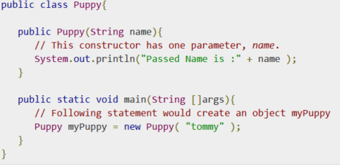
Creation of class instances (objects)
Example of creating an object:

