Slide 1
Before we start
This will be recorded, so if you missed something, you will be able to come back to it
There will be a Q&A at the end, so take note of any questions you have during the talk (or send them to me
You can ask questions both in voice chat or text chat, however, questions in voice chat will be recorded too
Repository containing the files used can be found here: https://github.com/GryPr/TT-DockerK8S
Enjoy!

Slide 2
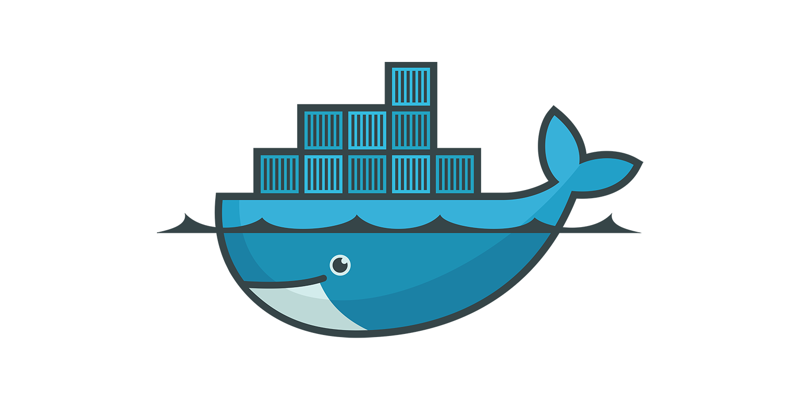
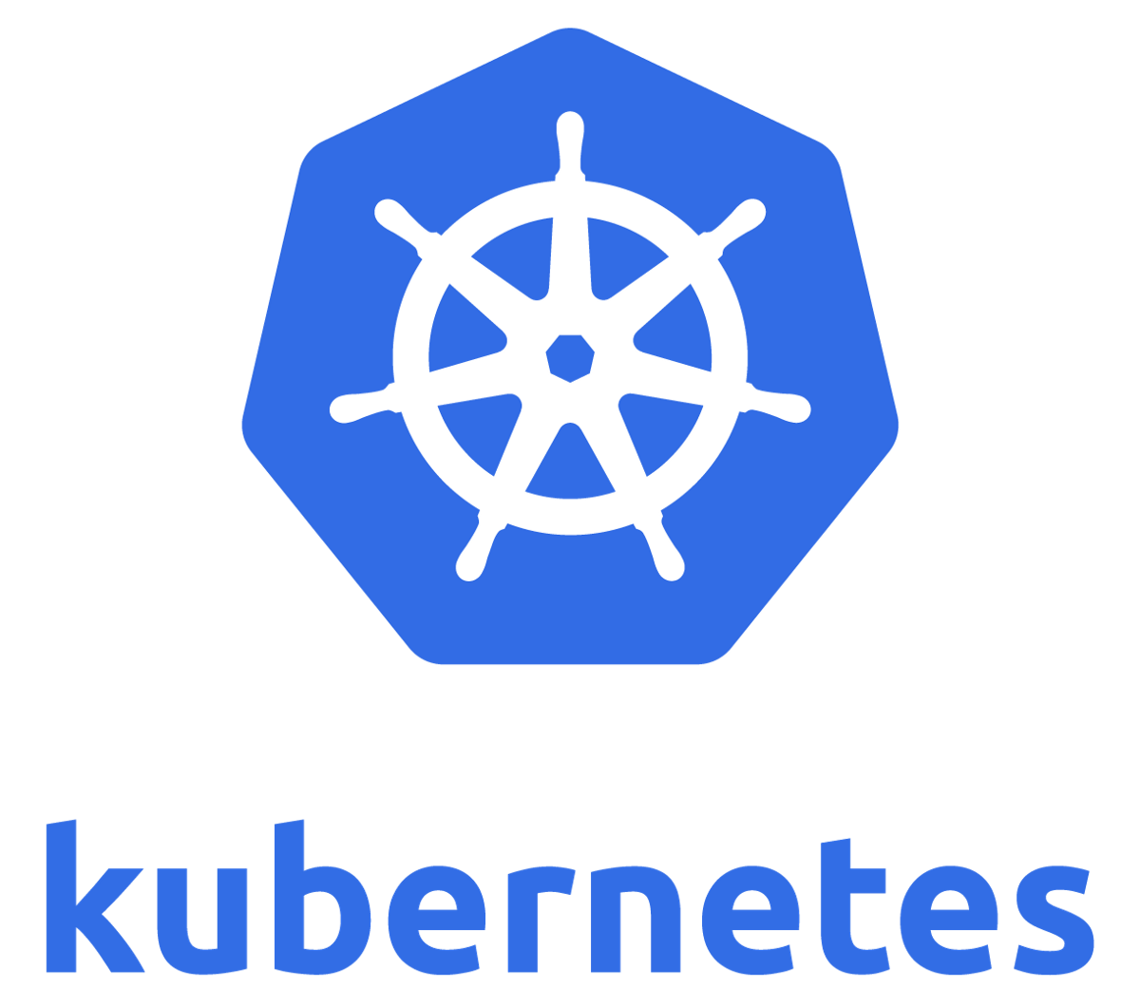
Introduction to Docker and Kubernetes

Slide 3
Who I am
Second-year Computer Engineering student at Concordia University
Interests in technology both in modern software and hardware
Web dev
Cloud
Machine Learning
Security
Virtual Reality
3D Printing

Slide 4
Part 1 - Docker
What is Docker?
Containers vs Virtual Machines

Slide 5
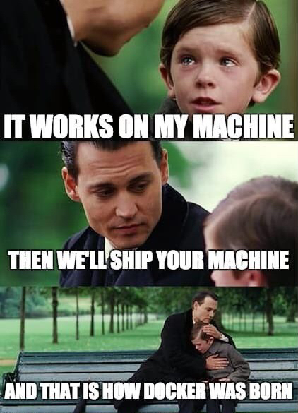

Slide 6
What is Docker?
OS-level virtualization with similarities to virtual machines
Allows delivery of software in the form of packages called ‘containers’
Containers run as a “stripped down OS” and are bundled with software, libraries and configuration files
Multiple containers can run in parallel isolated to each other

Slide 7
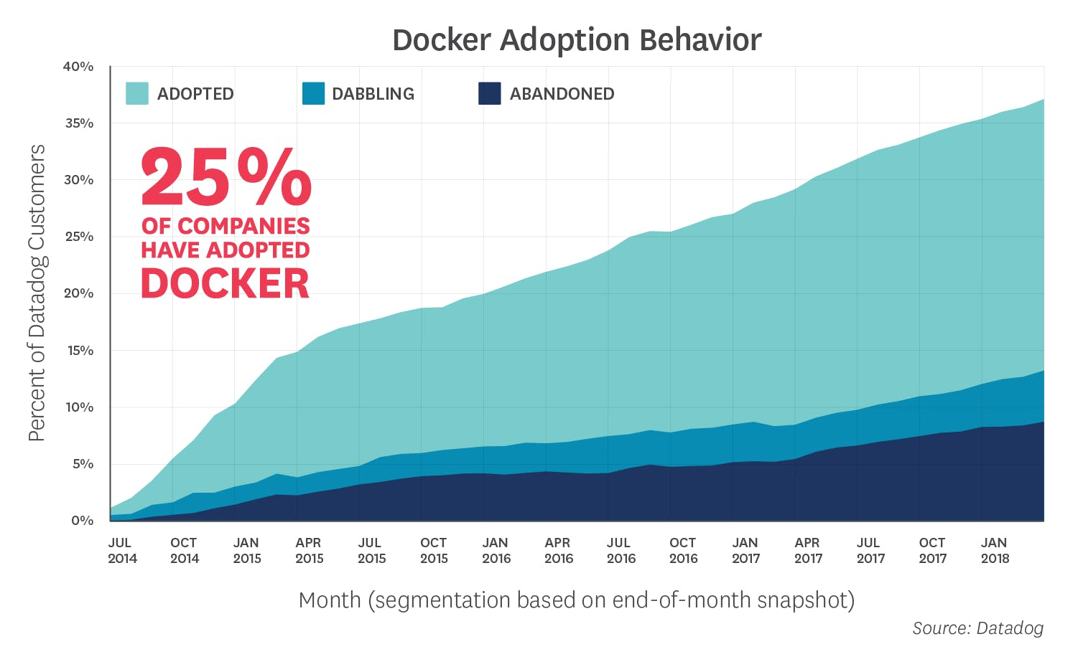
Docker Statistics
Currently the status quo in running containers
Popularity has skyrocketed over the past 6 years

Slide 8
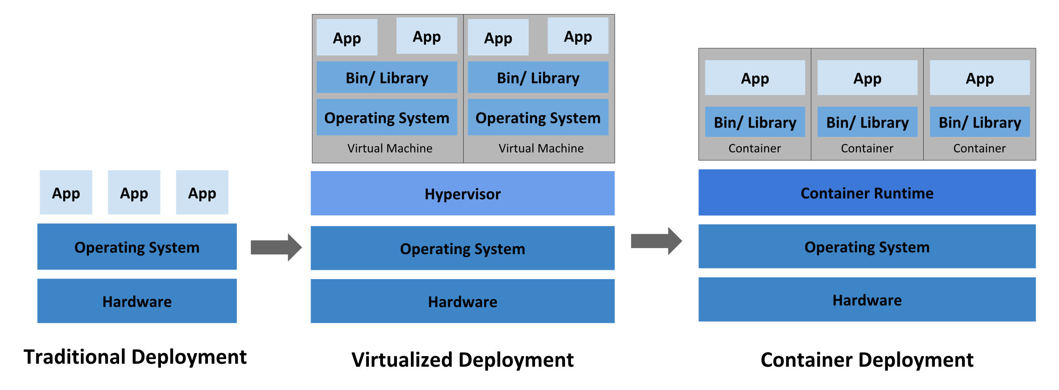
Towards Containerization
Notes:
Traditional:
Cannot define resource boundaries for applications
Causes resource allocation issues
An application could hoard resources and cause degraded
Virtualized:
Container:

Slide 9

Why Docker?
It allows for encapsulation of software
Everything needed to run the software is in the container
This container can then be run on any machine that has the Docker runtime installed
Much less time wasted on installing/configuring the proper dependencies, and dealing with conflicts
Updates can be released quickly in the form of Docker images, and rolled back easily in case issues arise
Compared to VMs, Docker uses resources more efficiently

Slide 10
Docker at home
Did you know that Docker is one of the best ways to deploy software at home?
Some examples of software you can deploy in containers on a Linux server machine:
BitTorrent client (Qbittorrent, Deluge, etc…)
Media server (Jellyfin, Emby, Plex)
Game servers (Minecraft, CSGO, etc…)
Home automation (Huginn, n8n)

Slide 11
Docker compose
Docker compose is an easy way to declaratively deploy containers
You write YAML files that declare all the parameters of the deployment
Allows for the use of version control software such as Git
Eases the deployment since all the parameters are in the YAML file, and deploying it can be simply done using docker-compose up
Very useful to deploy single containers, or small group of containers (i.e. application and database)
Other better software exist for more complex deployments of containers

Slide 12
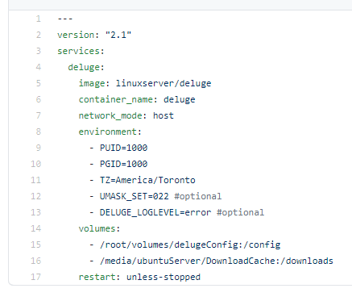
Docker-compose example
File format version
Service name
Image name from library
Environment variables
Volumes mounted into container

Slide 13
Docker Environment on Windows
Docker Desktop for Windows is used alongside a WSL 2 backend
Be aware that Docker is meant to be run on Linux
Docker Desktop virtualizes Linux to run Docker
WSL 2 allows you to select the distro you will run Docker on
Docker Desktop exposes the commands to Command Prompt and Powershell

Slide 14
Application to deploy
We are deploying an endpoint at port 8000 of localhost
The app is written in Go with a dependency on gorilla/mux
gorilla/mux is not actually necessary for this app
Dependency is there only to show how to deal with dependencies in Docker

Slide 15

Creating a Dockerfile
More information at https://docs.docker.com/engine/reference/builder/

Slide 16

Docker Deployment Demo
Let’s go an deploy our app on Docker!

Slide 17
Part 2 - Kubernetes

Slide 18
What is Kubernetes?
Container Orchestration system
Automatically deploys and manages containers
Runs health checks, and restarts bad containers
Automatic scaling based on demand
YAML declarative management allows setup to be version controlled on Git

Slide 19
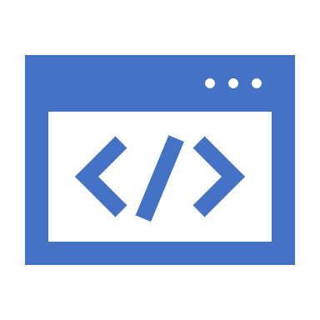
Why Kubernetes?
To move towards a microservice architecture instead of the old monolithic architecture
Each part of the application can be modified, updated and scaled independently
This allows for more efficient distribution of resources towards components that may require it
Components of an app can be run on different machines, and resources can be allocated accordingly
This is especially important when hosting an application in the cloud
Companies are billed by resource consumption
Microservices reduce overall cost

Slide 20
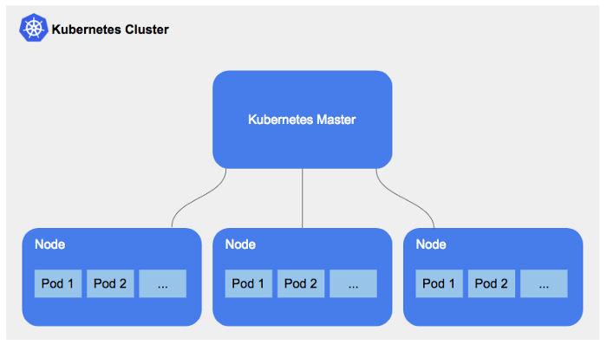
K8S Cluster
What is a cluster?
Composed of nodes running containers
These nodes can be physical or virtual machines
There is a master node that controls the worker nodes
How can we run K8S locally?
We use minikube which runs a single node cluster
Typically run on a Linux virtual machine if you have a Windows dev environment

Slide 21
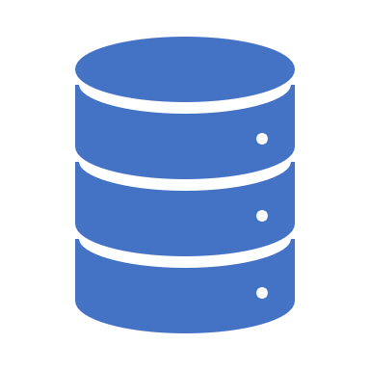
K8S Pods
Essentially a group of one or more Docker containers
Usually only one container in a pod
For horizontal scaling (getting more resources by running more instance), multiple pods are used instead
This is called replication, and can be specified in YAML
You would usually deploy pods through other K8S resources like deployments
A pod has an IP address, and all containers in a pod share it.

Slide 22
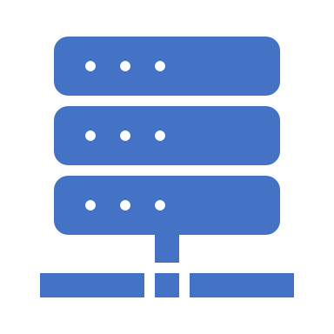
K8S Services
Pods are stateless and can be dynamically destroyed and respawned
This changes the IP address of the pods
Problem: what if a pod depends on another pod
i.e. Frontend & backend pods
How can it find a pod with an IP that always change?
Services allow for the abstraction of pods.
It defines a set of pods, and how to access them.
To access a pod, you would first pass through a service so that you can access the pod that provides you with what you need
Notes:
For example, consider a stateless image-processing backend which is running with 3 replicas. Those replicas are fungible—frontends do not care which backend they use. While the actual Pods that compose the backend set may change, the frontend clients should not need to be aware of that, nor should they need to keep track of the set of backends themselves.
The Service abstraction enables this decoupling.

Slide 23

K8S Deployment
Provides a way to declare how pods are deployed
Which image is used
How many pod replicas
How they should be updated
Allows deployment of pods to be repeatable and automated according to the YAML
Allows you to automatically update the deployment using the K8S backend instead of manually doing it with scripts

Slide 24
Namespaces
It is a virtual cluster within the physical cluster
It scopes the name of resources – the name must be unique in a given namespace, but not across multiple namespaces
Resources can only belong to one namespace
The most common use is simply as a way to organize resources in large clusters to facilitate administration
It also permits role-based access control (RBAC) where people can be granted roles specific to certain namespaces, and not to other namespaces

Slide 25

Ingress
Ingress is a Kubernetes object that manages external access to the Kubernetes cluster
It exposes HTTP and HTTPS routes from outside towards services in the cluster
It can give services an URL, and does not expose arbitrary ports. Instead, it can designate a path in the URL towards a service
i.e. example.com/service1, example.com/service2
It can also be paired with load balancing to distribute incoming requests

Slide 26

Kubernetes Environment on Windows
Kubernetes is run on minikube, a tool for local K8S development
Otherwise, the same environment is used as with Docker

Slide 27
Kubernetes Deployment Demo
Let’s go an deploy our app on Kubernetes!

Slide 28

Helm

Slide 29
Helm Demo
Let’s package our deployment with Helm!

Slide 30
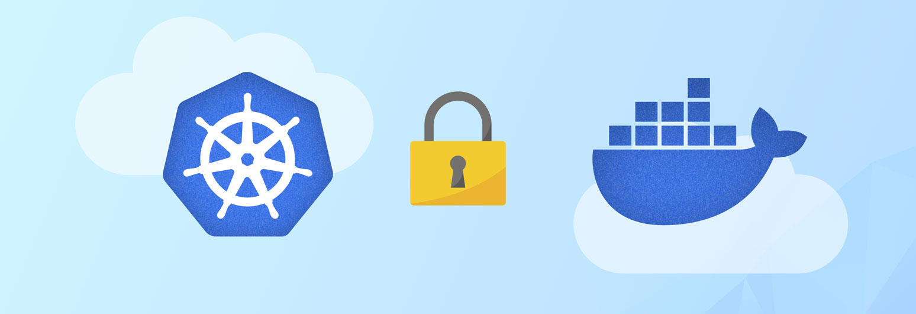
Security in Docker and Kubernetes
Notes:
In the enterprise context, applications are often targeted by attacks that seek to cause damage for monetary gain. Security is arguably the most important aspect of deploying applications on Docker and Kubernetes. Your application is useless if it’s vulnerable and can be abused by others. Having a vulnerable application will lead to poor reliability and reduced trust among users, hence making your application useless for others.

Slide 31
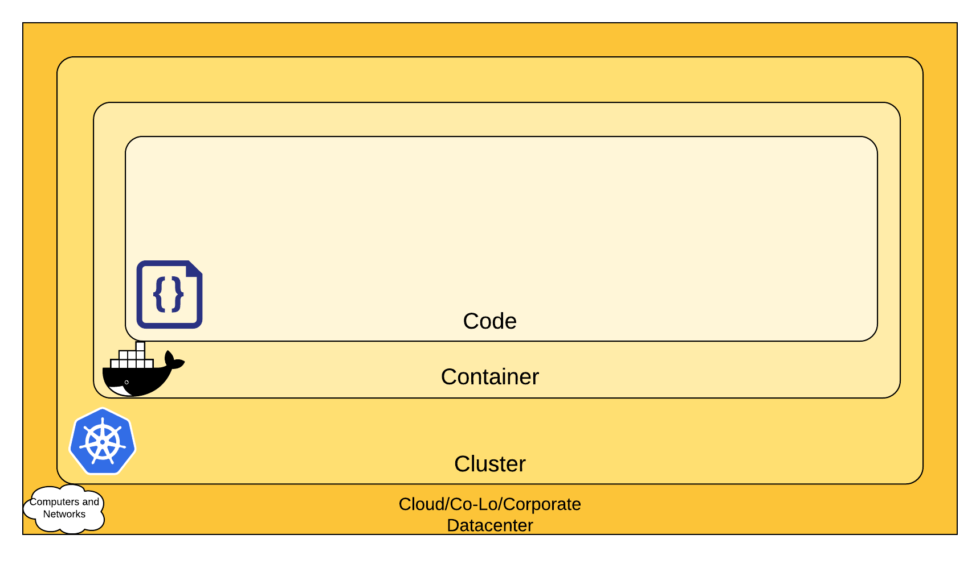
Four C’s of Cloud Native Security
Defense in depth by having more layers of security to penetrate
The inner layers’ security is complemented by the outer layers’ security
Each layer must implement proper security practices to reinforce the security of the whole software system
Notes:
In the context of a cloud application, there are four layers that must implement proper security practices. I will only focus on the container and cluster aspects for now, but be aware that the two other

Slide 32

Docker Content Trust
Transport of images often cannot be trusted
How do we know if an image wasn’t tampered in transit from a trusted source?
Solution: attaching digital signatures to tags of images when sending/receiving images to/from remote Docker registries.
These signatures can be used to verify on the receiving side to confirm the integrity and authenticity of the image

Slide 33
How does signing images work?
First, the publisher generates a pair of public/private cryptographic keys
These are used to decrypt/encrypt data
Data encrypted with the private key can only be decrypted by the public key, and vice-versa
The private key is used to sign the tag of an image
What is a tag?
Alias tied to an image ID
What is an image ID?
Unique to the image’s JSON configuration object
SHA256 hash of the JSON
Hash is completely different if even a single bit of the JSON config is changed

Slide 34
Basics of signature cryptography
How does the image publisher sign an image?
We encrypt the image ID (SHA256 hash) of the image
We then publish the public key for others to verify the image
How do users validate an image?
Users verify the integrity of the image by verifying the hash
The hash is unique to the image, and cannot be replicated with a modified image
The user hashes the JSON config in SHA256, and checks if it matches the provided image ID
If the hash matches, then the integrity is verified
Users verify the origin of the image by verifying the signature
The user decrypts the hash with the public key provided by the publisher
If the public key decrypts the private key, then the identity of the publisher is validated

Slide 35
Docker Content Trust Demo
Let’s sign our image, and publish it on Docker Hub

Slide 36
Docker Security Practices
If you pull a 3rd party image, make sure that the contents of the image are trustworthy
Control access to the Docker daemon
By default, only root users can access it
Attackers with access to the daemon can start a container that shares the / directory of the host, and can read/write with no restriction
Avoid exposing the Docker API over HTTP (use HTTPS and certificates)
As previously stated, enable and use Docker Content Trust to avoid receiving tampered images

Slide 37
Kubernetes Security
Kubernetes introduces a new attack surface
Proper Kubernetes security practices must be used on top of the previously mentioned Docker security practices
Kubernetes has very powerful features which can be a double-edged blade

Slide 38
Controlling Access to the Kubernetes API
Goal: prevent unauthorized users from gaining access to the API
Authentication – verify the identity of users
Client certificate (X509)
Bearer Token
Static Token File
In HTTP request header
Bootstrap Token
Service Account Token
Static Password File
OpenID Connect
Authorization – tightly controlling user access to resources
Role-based access control (RBAC)
Attribute-based access control (ABAC)
Node
Notes:
Authentication – we need to know who you are to know what you have access to
Client certificate: key pair associated with an identifier and signed by a trusted authority
Bearer token: a string that you pass to get access which identifies you, but there are many ways to pass it
Static password file: you use a password to gain access
OpenID Connect: a modification of Oauth 2.0 which redirects you to a third party service to log in, and then passes a token
Authorization – select which resources a specified user has access to
RBAC: each role has access to a set of resources, and you can give that role to users. The user than inherits the role’s access permissions
ABAC: more granular control based on user, resource and environmental attributes.
User: name, role, security clearance, location of user
Resource: creation date, resource owner, data sensitivity
Environmental attributes: time of day, location of data

Slide 39

Q&A

