Slide 1
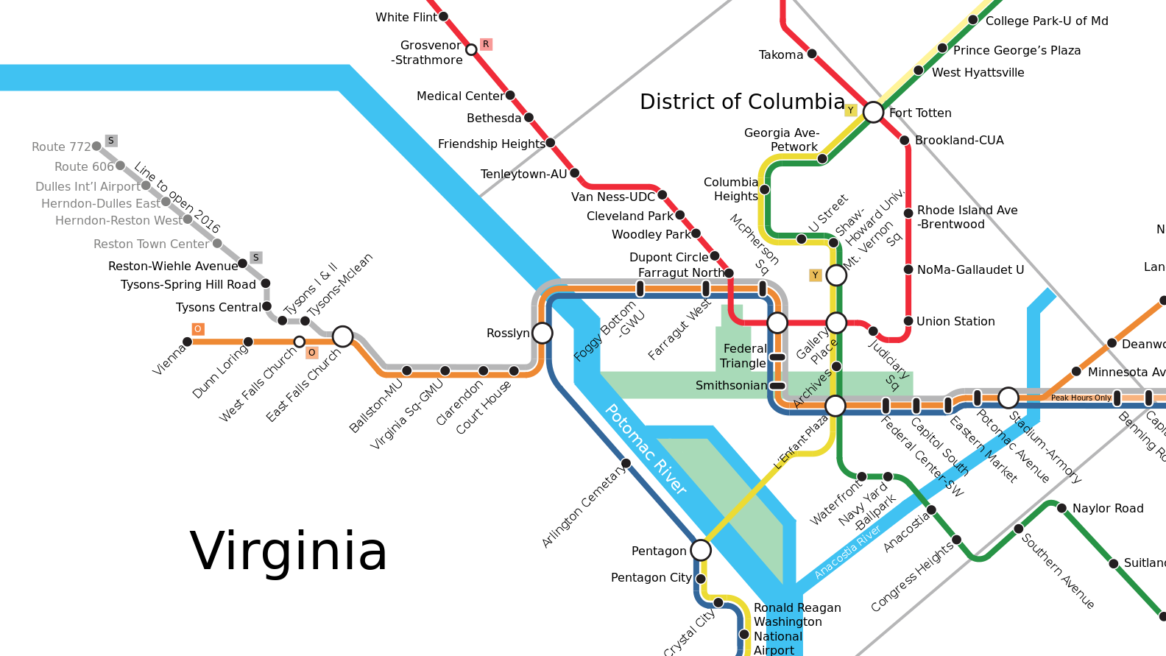
Washington Metro Area Transportation Analysis
project 3
Team:
Abubeker Mohammed
Yegor Kryukov
Sonya Smirnova
Marc Pitarys
Presentation Date: 21 APR 2018

Slide 2
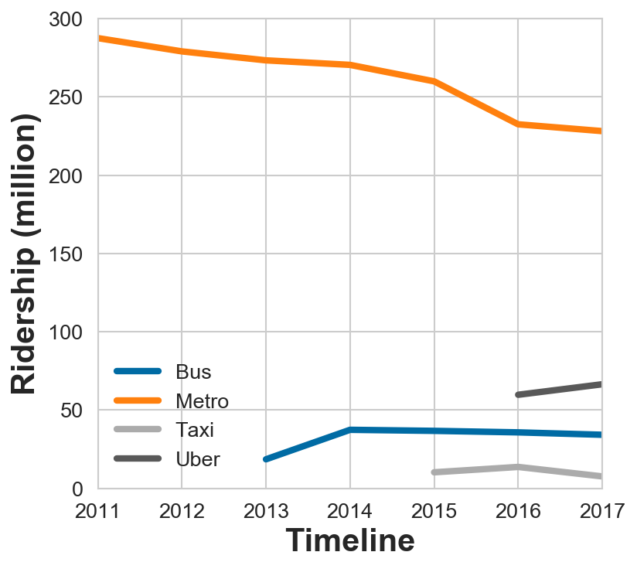
Motivation & Summary
What
The Washington Metropolitan Transit Authority (WMATA) provides bus and rail transit to the Washington region
Why
Transporting over 300,000,000 passengers a year WMATA is facing many challenges concerning safety, ridership, and funding
Bottomline
What factors impact Metro performance and does Metro impact other transportation resources?
Is metro getting better or other ways of transportation are taking over its customers?
Notes:
Define the core message or hypothesis of your project.
Describe the questions you asked, and why you asked them
Describe whether you were able to answer these questions to your satisfication, and briefly summarize your findings

Slide 3
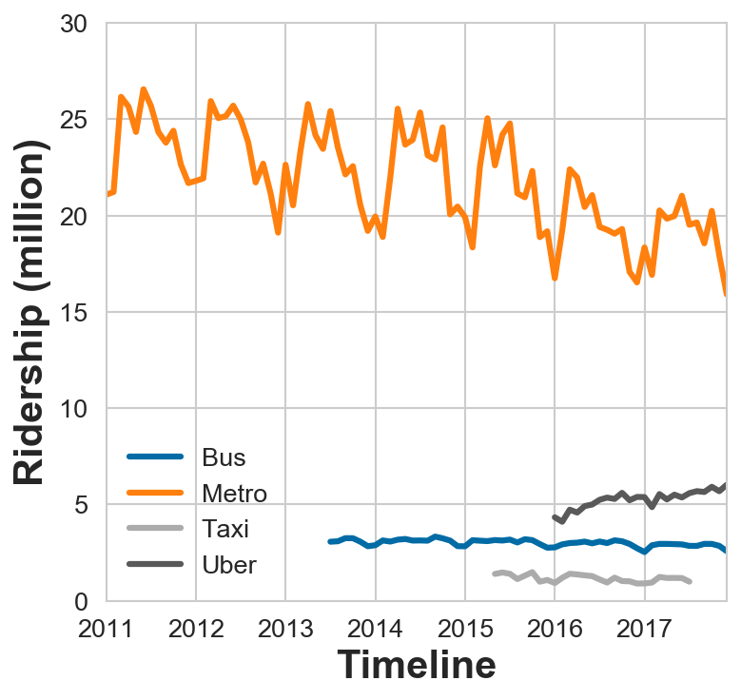
Questions & Data
Questions
Does time of year impact demand for transportation resources?
Does Metro performance impact the demand for other transportation resources?
Can one predict the availability of transportation resources based on metro past performance?
Data
Use DC area transportation data from WMATA, Taxi and Uber to understand relationships between metro performance and the use of other modes of transportation
Gather monthly ridership data for determining time of year impacts
Sources: Metro and US Government Data: Various reports for years 2012-2017: Vital Signs, Metro’s Key Performance Indicators (KPI), annual and Metro Performance Reports, Federal Transit Administration Monthly Module Raw Data Release, Bureau of Economic Analysis, Census Bureau, DC Government: Department of For-Hire Vehicles, Uber
Notes:
Elaborate on the questions you asked, describing what kinds of data you needed to answer them, and where you found it

Slide 4


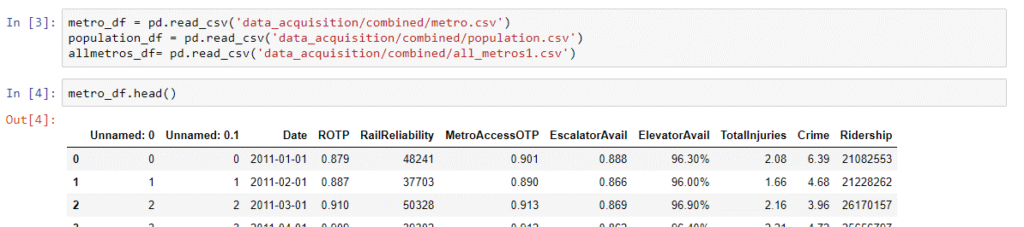


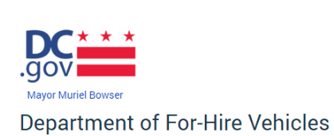
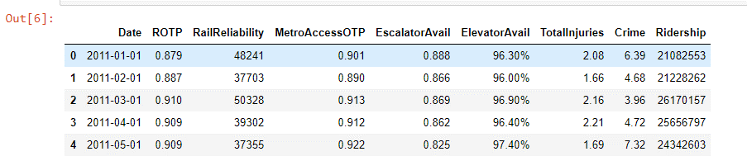
Raw Data from Web Sites
Data Exploration and Clean Up Process
Reports (PDF Files)
Paste into CSV Files
Uber
CSV Files
Read CSV Files into Pandas DataFrame
Clean Data
Convert Dates to DateTime
Delete unneeded columns
Key Performance Indicators (KPIs)
ROTP: Rail On Time Performance (% of Time)
Rail Reliability: Number of miles between railcar failure causing a delay of service greater than 3 minutes
Escalator Availability
Elevator Availability
Total Injuries: Injury rate per million passengers
Crime: Crime rate per million passengers
Ridership: Unlinked Passenger Trips (Count each time a person boards a train)

Slide 5
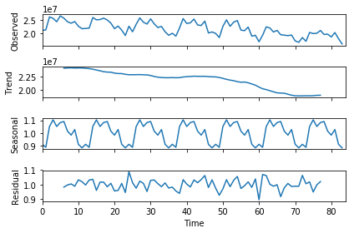

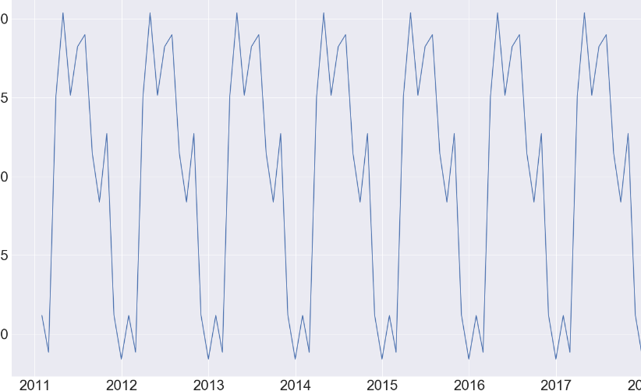
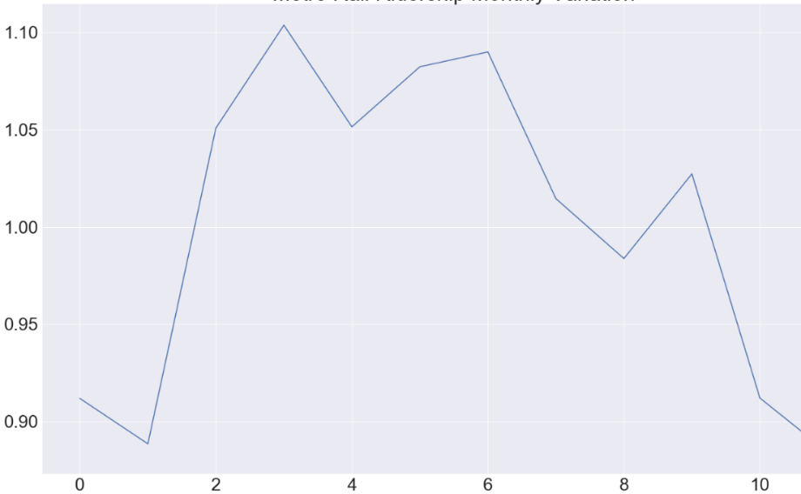
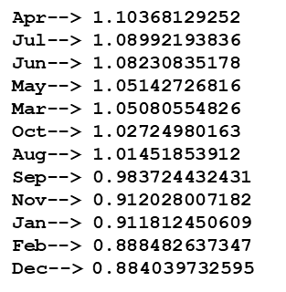
Analysis Process: Find Seasonal Index for Question 1
Ridership Data
Y
T
Y = T x C x S x I = TCSI
S
Y: Time Series Variable
T: Trend C : Cyclical Movement
S : Seasonal Variation I : Irregular Movement
CI
The ridership data is characteristic of a time series
Long Term Trend or Movement
Seasonal Movement
Long-Term Cyclical Movement
Irregular Movement:
Seasonal Variation Found by the Average Percentage Method.
Each month ridership data expressed as a percentages for the whole year ridership.
Percentages from corresponding months of different years are averaged.
The resulting twelve percentages are the seasonal index.
Seasonal Index

Slide 6
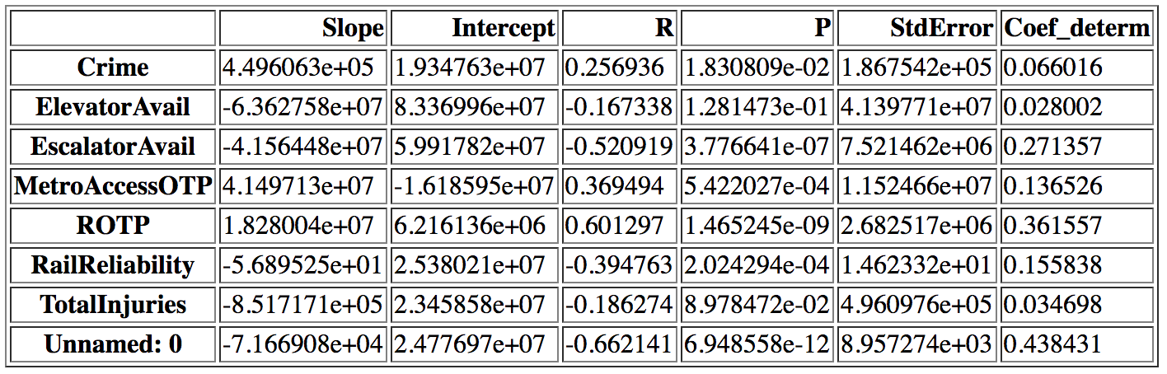
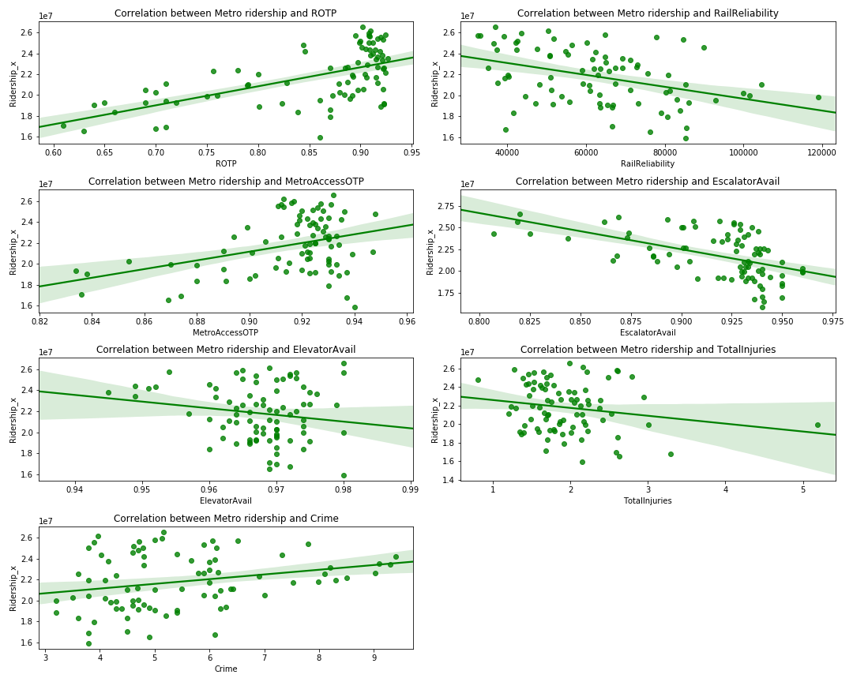
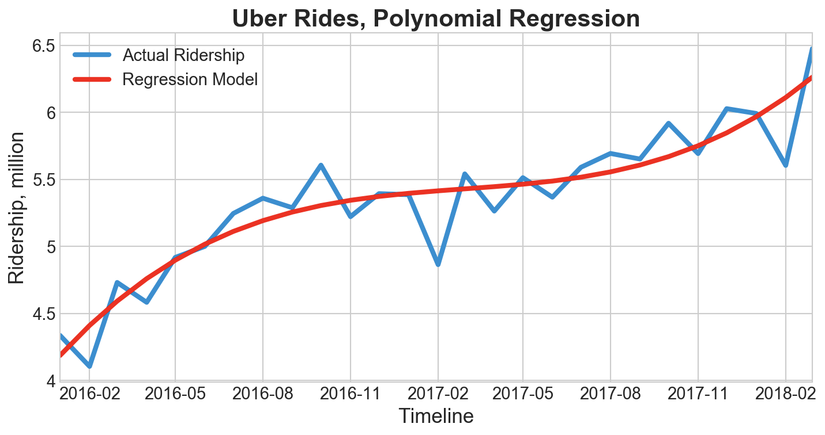




Analysis Process: Use Regression Analysis to Answer Questions 2 and 3
Linear Regression
$$B1$$
$$Bo$$
$$e$$
R²
$$y=Bo+B1x+e$$
Evaluate R
Create Scatter Plots
Observe Patterns
Assess trend of plot
Polynomial Regression
$$y=Bo+B1x+B2x2+…+Bkxk+ e$$

Slide 7
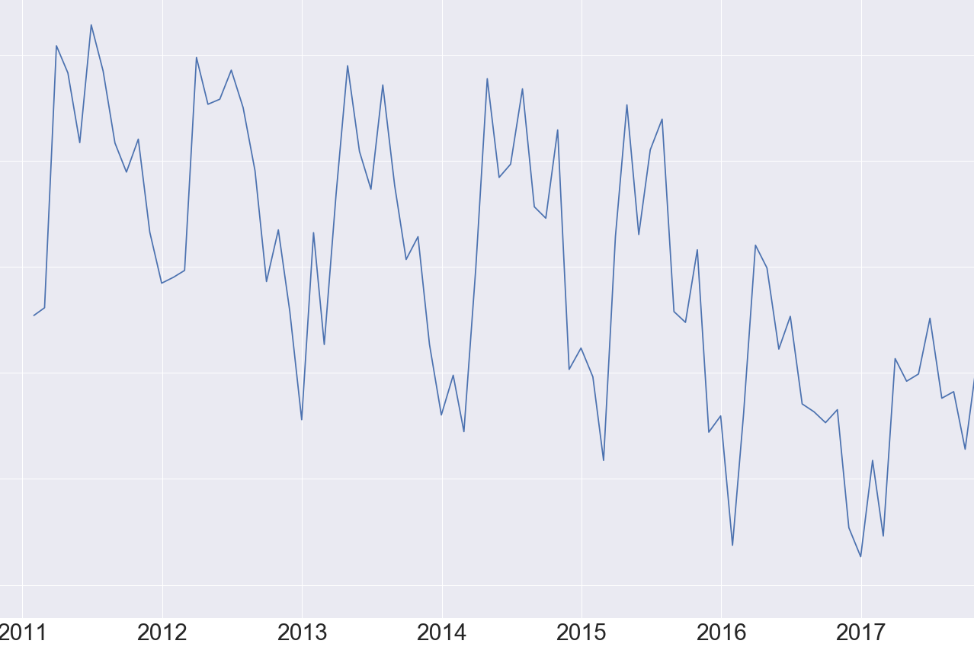

Question #1: Does time of year impact demand for transportation resources?
Seasonal Variation Found by the Average Percentage Method.
Each month ridership data expressed as a percentages for the whole year ridership.
Percentages from corresponding months of different years are averaged.
The resulting twelve percentages are the seasonal index.
On average, ridership is the lowest in December and highest in April
The graph of the ridership data is characteristic of a time series.
Long Term Trend or Movement
Seasonal Movement
Long-Term Cyclical Movement
Irregular Movement:
Answer: Yes

Slide 8

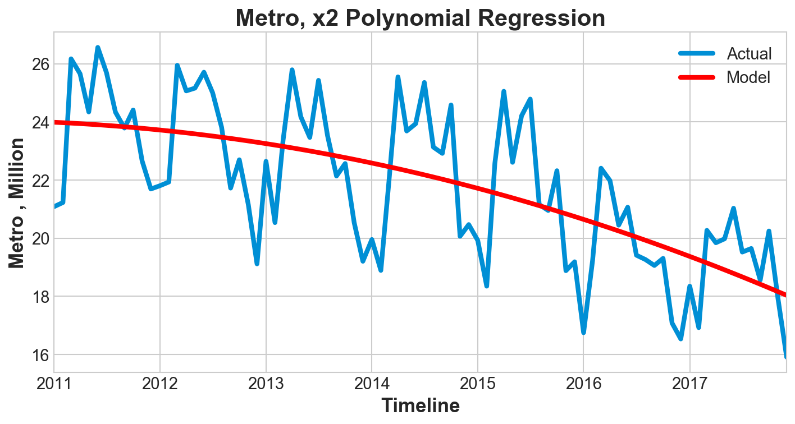

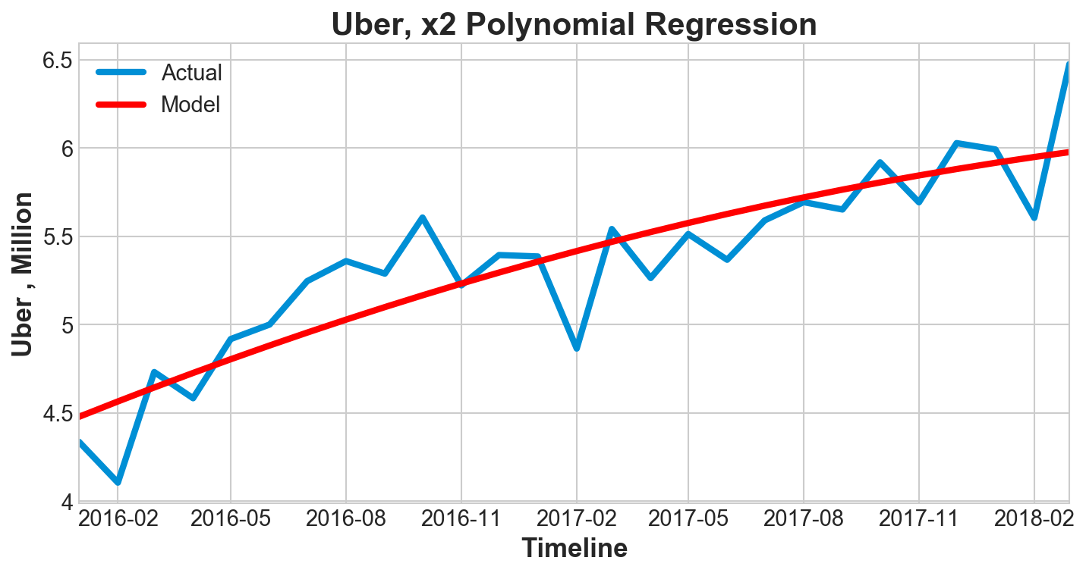
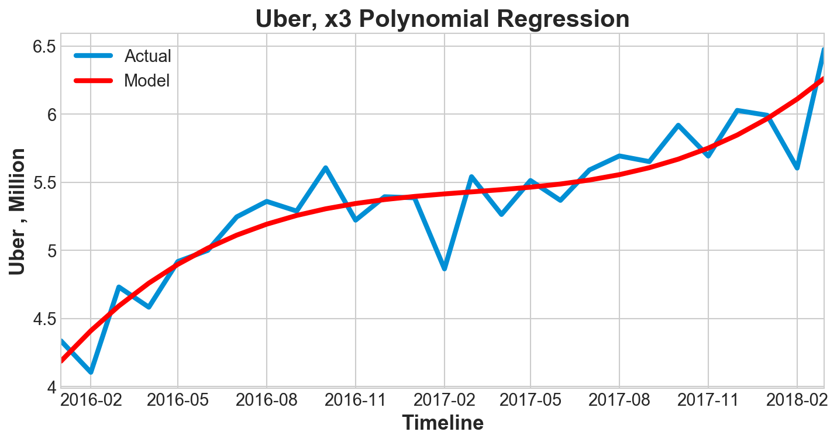

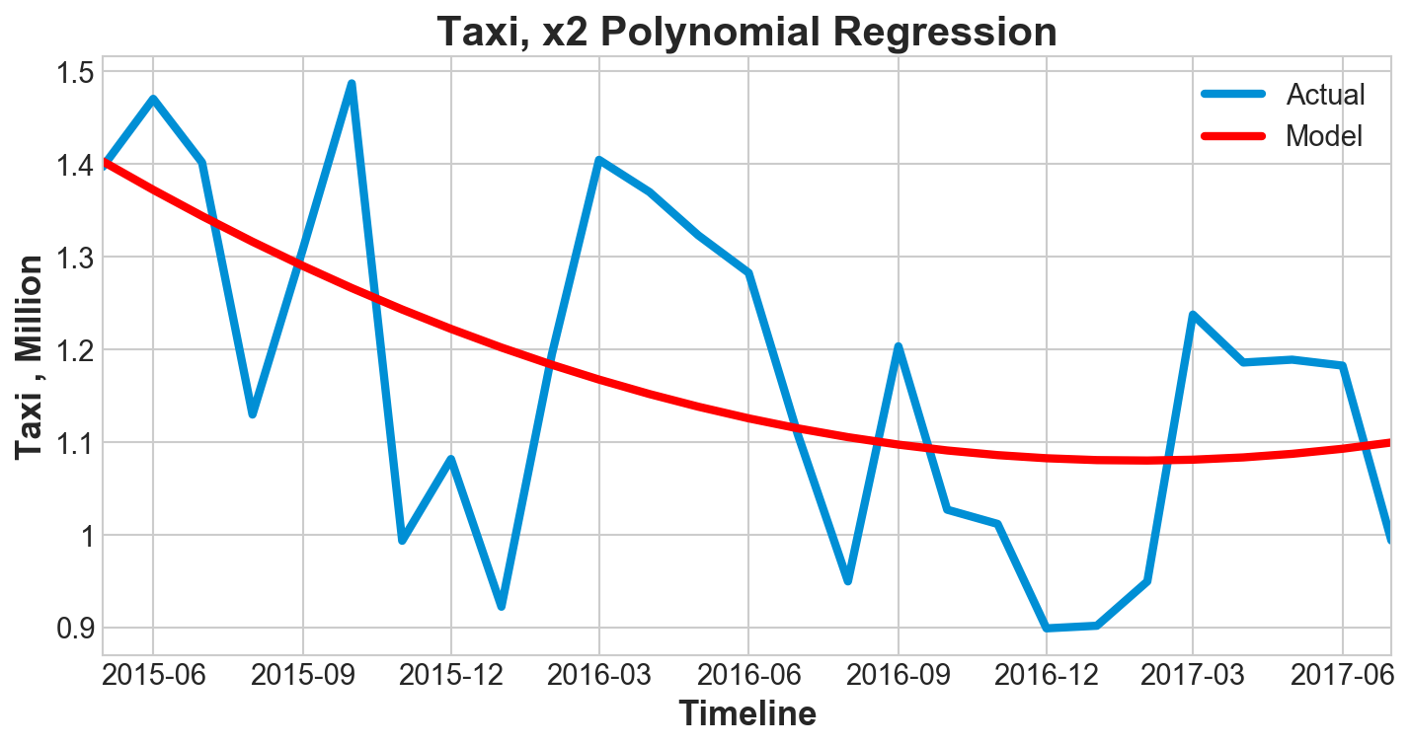
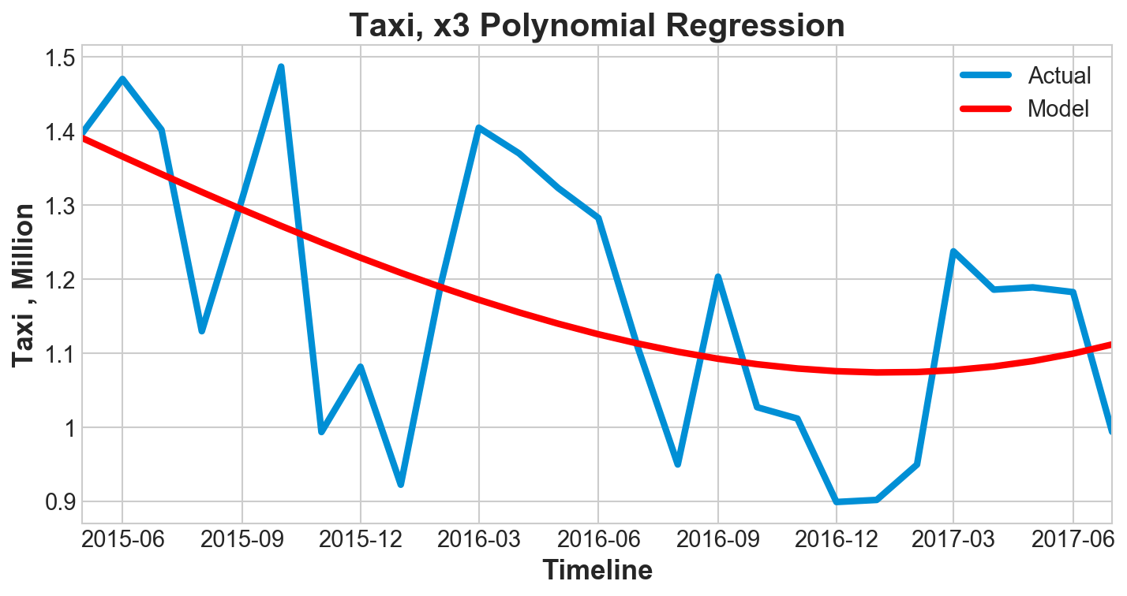
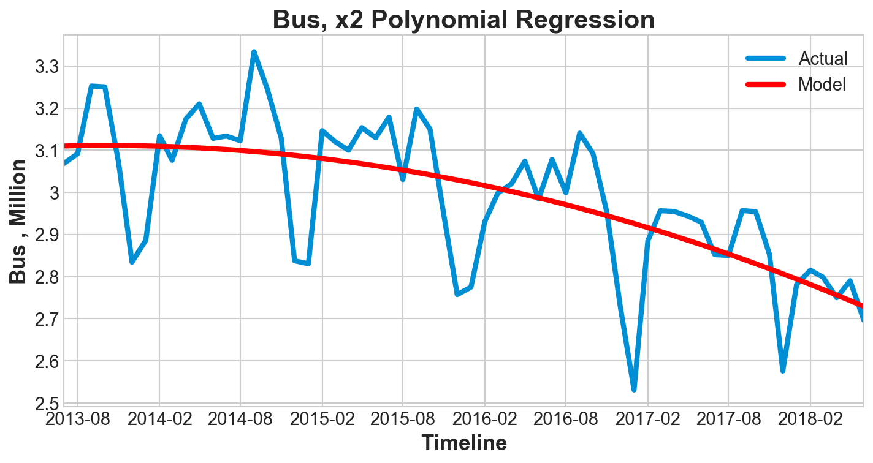
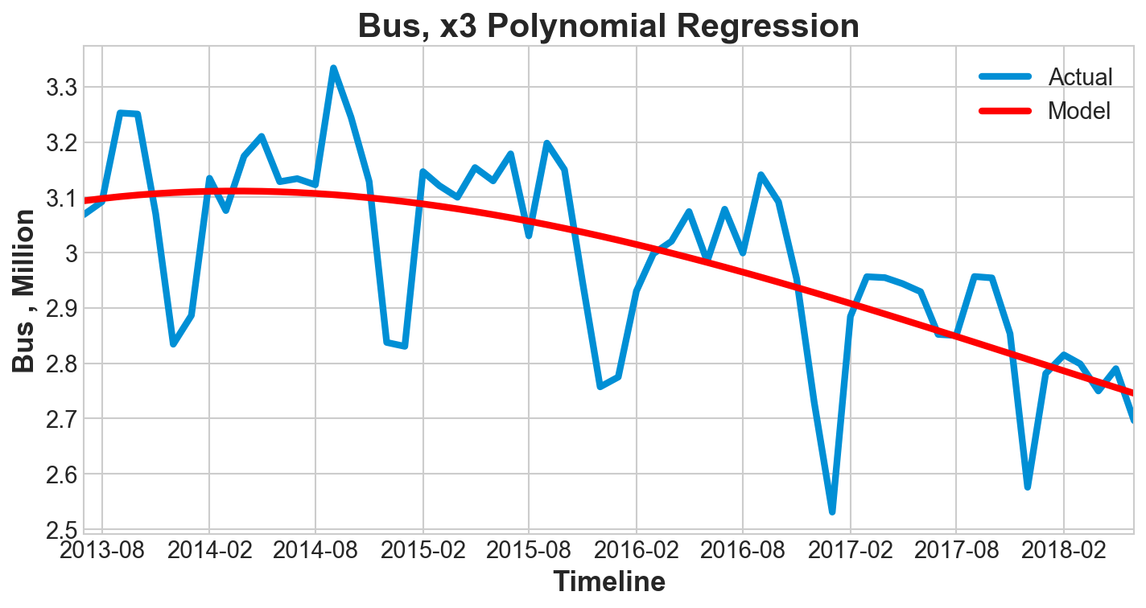
Question #2: Does Metro performance impact the demand for other transportation resources?
Polynomial Regression
y = B₀ + B₁x + B₂x²
Polynomial Regression
y = B₀ + B₁x + B₂x²+ B₃x³
Monthly Ridership
Conclusion: Analysis indicates Metro is losing passengers to Uber and some other mode of transportation other than taxi or bus. Perhaps then number of drivers are increasing.
All observations
Annual Ridership
Trend
6M Decrease
2.5M Increase

Slide 9
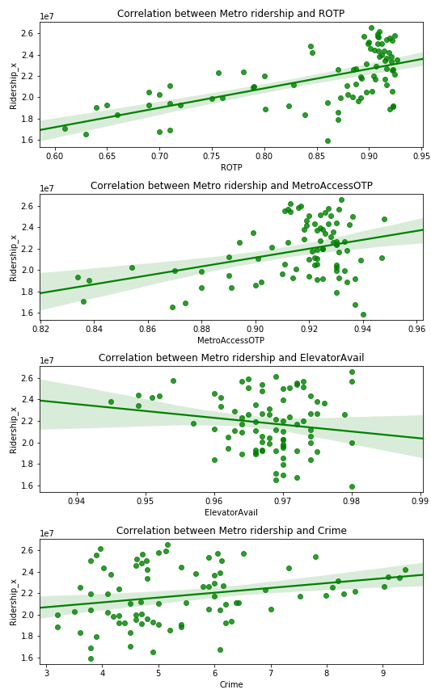
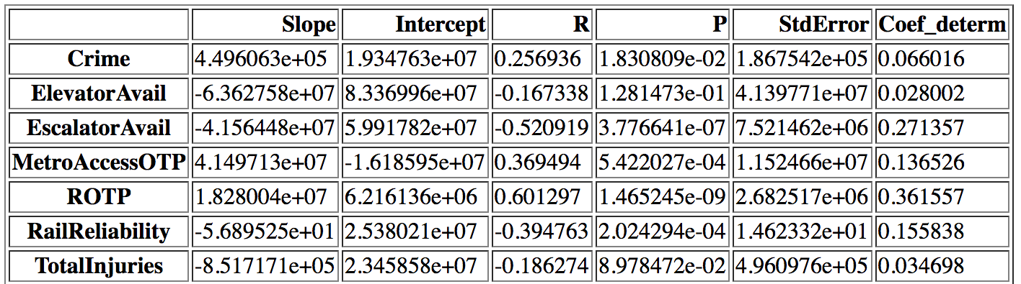
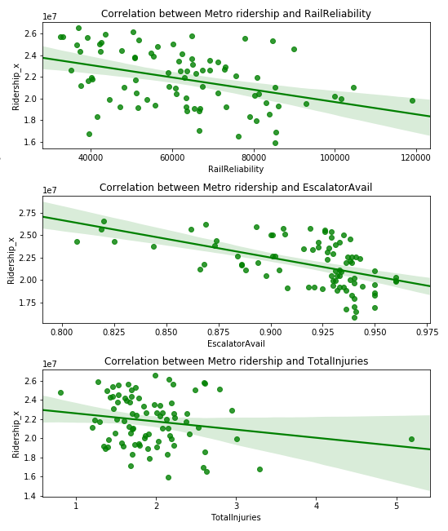
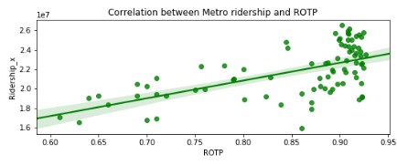
Question #3: Can one predict the availability of transportation resources based on metro past performance?
(Metro)
No strong relationships between KPIs and Ridership
Metro Performance Characterized by KPIs?
R² much less than 0.85
Rail Ridership most influenced by
Rail on Time Performance

Slide 10
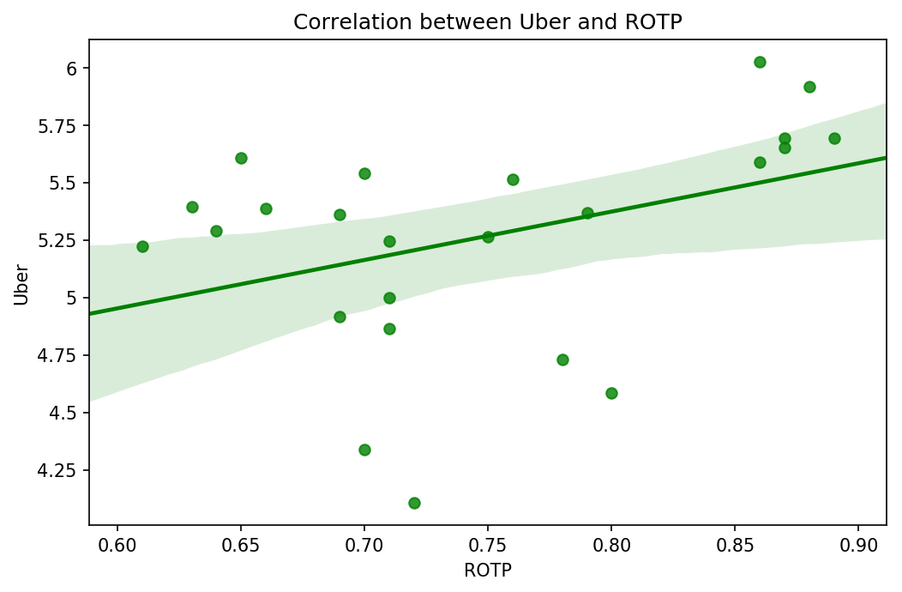
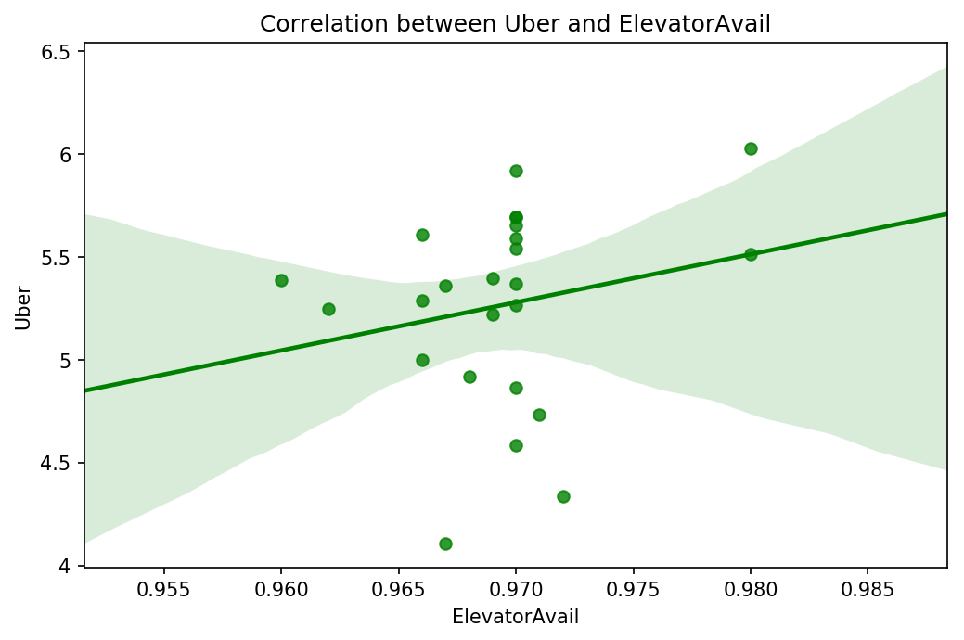
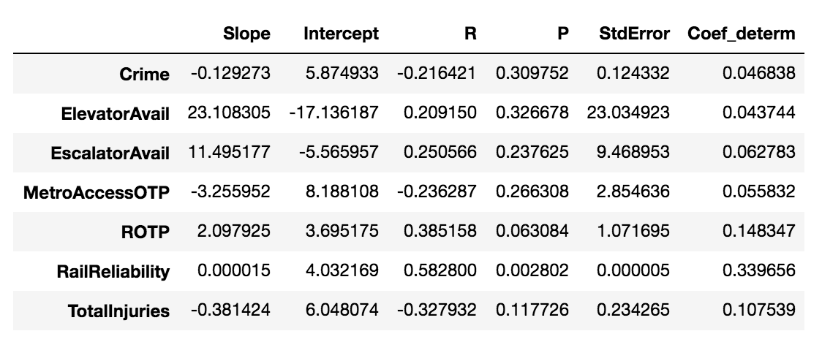
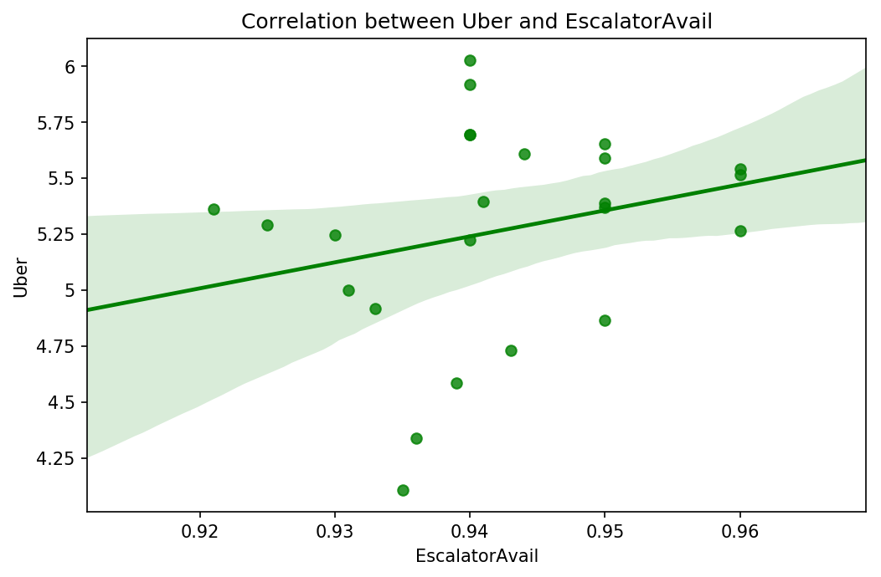
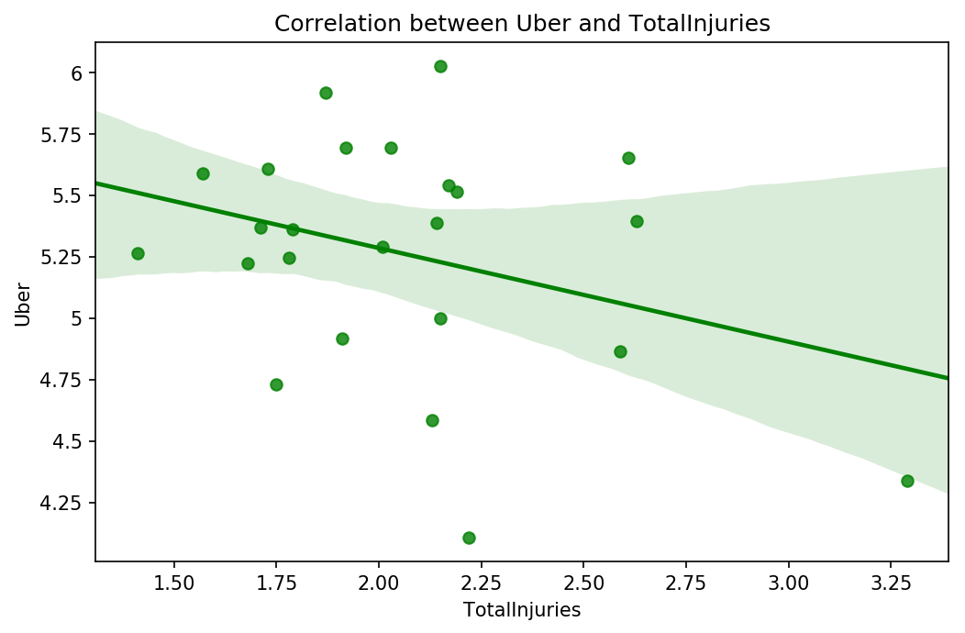
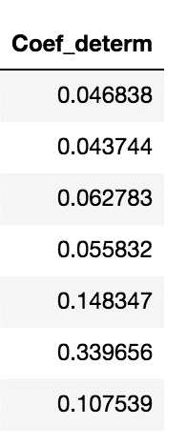
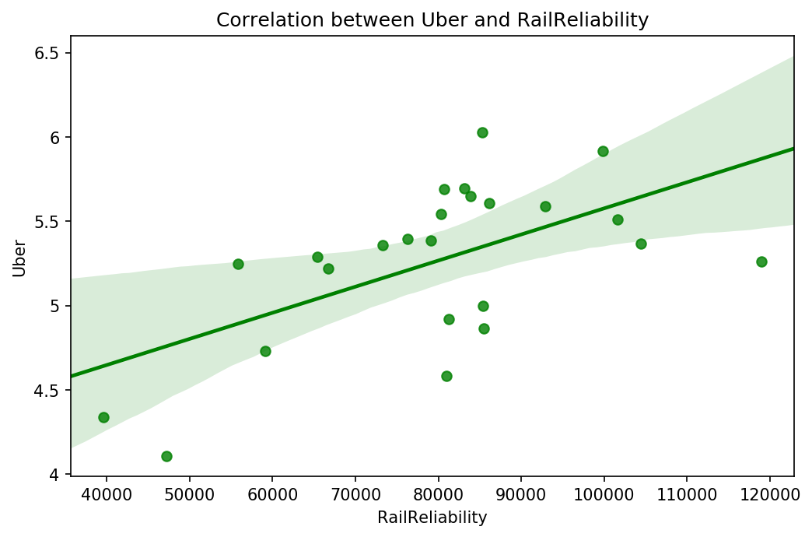
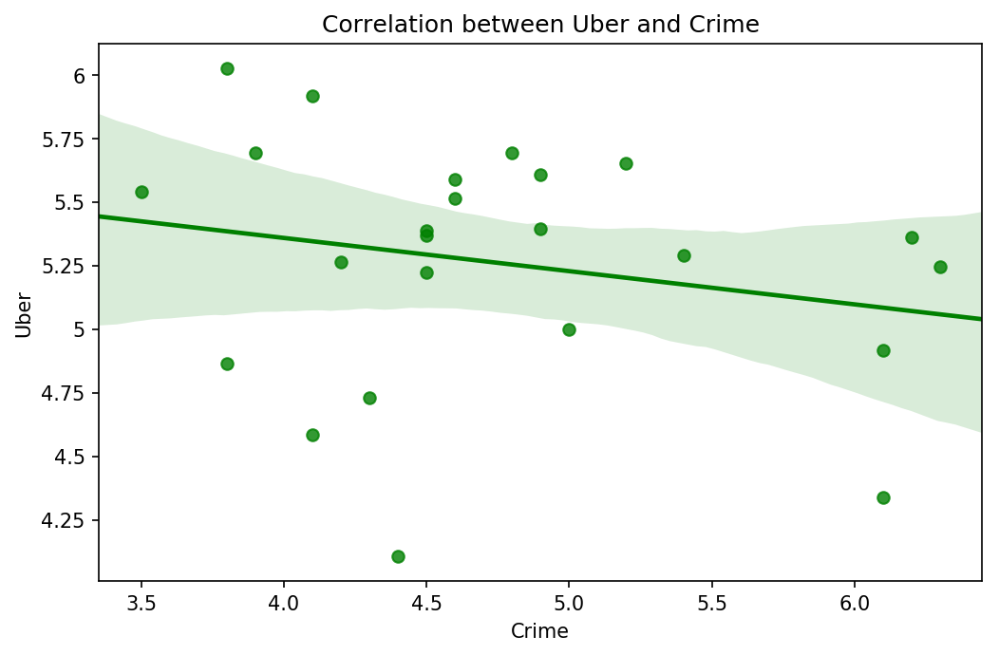
Question #3: Can one predict the availability of transportation resources based on metro past performance?
(Uber)
No strong relationships between KPIs and Ridership
R²
R² much less than 0.85
Uber most influenced by
Rail on Time Performance

Slide 11
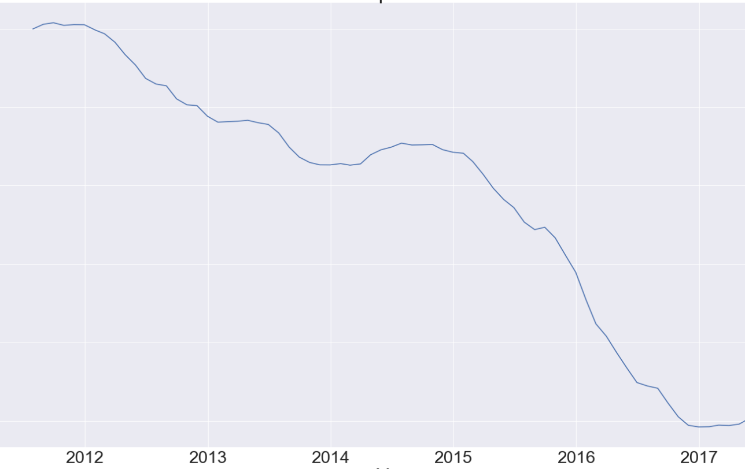
Implications from the findings: There’s is an overall downward trend in ridership on metro?
Time series variable: Y describes the observations.
Y = T x C x S x I = TCSI
T : Trend
C : Cyclical Movement
S : Seasonal Variation
I : Irregular Movement
The graph of the ridership data is characteristic of a time series.
Long Term Trend or Movement
Seasonal Movement
Long-Term Cyclical Movement
Irregular Movement:

Slide 12
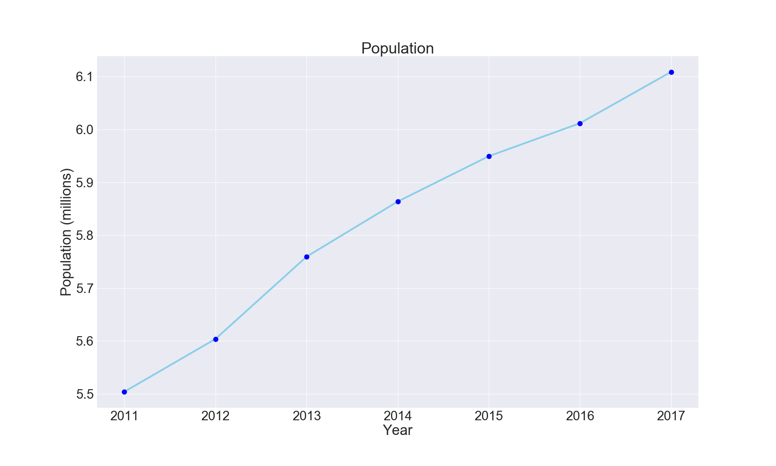
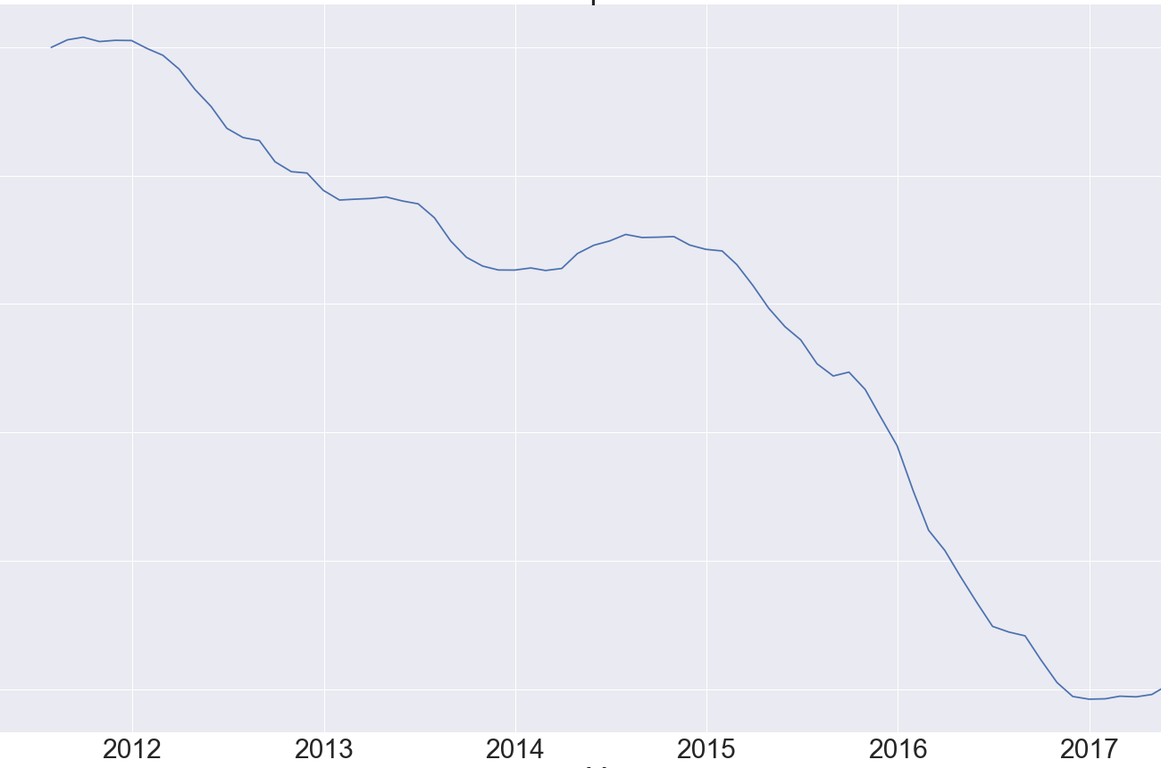
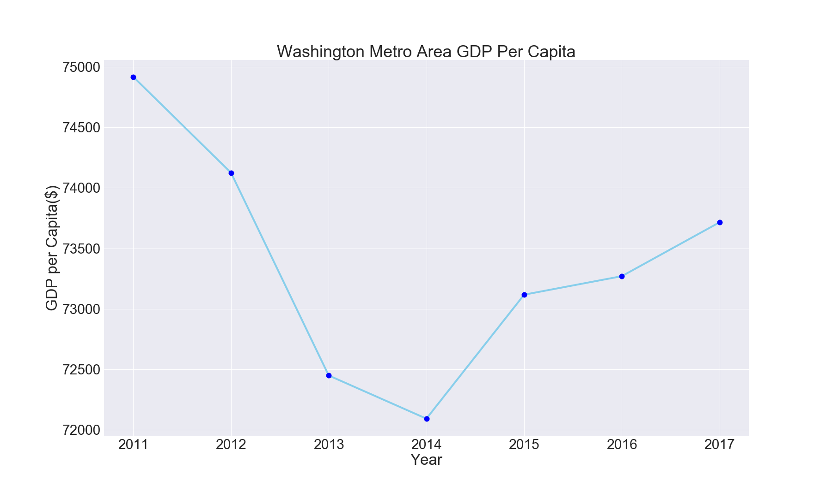
Could Population or the Economy are not factors in the decline of ridership.
11% Increase
20.1% Decrease
1.6 % Decrease
Population Increased during the interval ridership declined.
Population is ruled out.
Economic conditions in terms of GDP per Capita declined during the interval ridership declined. However, GDP per Capita increased from 2014 to 2017 by 2.25% while ridership experienced its greatest decline (15.5%) during this same time period.
Economic Conditions ruled out.

Slide 13
Summary
Time of year impacts Metro demand
Metro ridership performance (decline) is the inverse of Uber Ridership (increase)
KPIs are not significant factors in ridership numbers, however the Rail On Time Performance KPI has the strongest impact on Metro Ridership

