Slide 1
Washington Metro Area Transportation Analysis
Team 3
Abubeker Mohammed
Yegor Kryukov
Sonya Smirnova
Marc Pitarys
Presentation Date: 21 APR 2018

Slide 2
Presentation Overview
Motivation
Research Questions
Analysis Process
Data
Observations
Summary

Slide 3
Motivation
The Washington Metropolitan Transit Authority (WMATA) provides bus and rail transit to the Washington region
WMATA Metro is facing many challenges concerning safety, ridership, and funding
Specific Questions to be answered in this analysis:
Does time of year impact demand for transportation resources?
Does Metro performance impact the demand for other transportation resources?
Can one predict the availability of transportation resources based on metro past performance?
Bottomline: What factors impact metro performance and does metro impact other transportation resources?

Slide 4
How to answer the research questions
Monthly ridership data for determining time of year impacts
Metro
Vital Signs Report. A Scorecard of Metro’s Key Performance Indicators (KPI). 2012: A Year in Review
Vital Signs Report. A Scorecard of Metro’s Key Performance Indicators (KPI). 2013: A Year in Review
A Scorecard of Metro’s Key Performance Indicators (KPI). 2014: A Year in Review
Vital Signs. January – December 2015 Annual Report
Vital Signs. January – December 2016 Annual Report
Q2 FY2018 Metro Performance Report. Fiscal-Year-To-Date Jul 2016-Dec 2017
US Government
Federal Transit Administration Monthly Module Raw Data Release. Provides ridership data on all urban transit agencies.
Bureau of Economic Analysis
Census Bureau
DC Government: Department of For-Hire Vehicles
Uber
Use statistical analysis tools for answering the questions
Time Series Analysis
Linear Regression (Single Variable and Multi-Variable)
Polynomial Regression

Slide 5
Research Questions
Does time of year impact demand for transportation resources?
Does metro performance impact the demand for other transportation resources?
Can one predict the availability of transportation resources based on metro past performance?

Slide 6
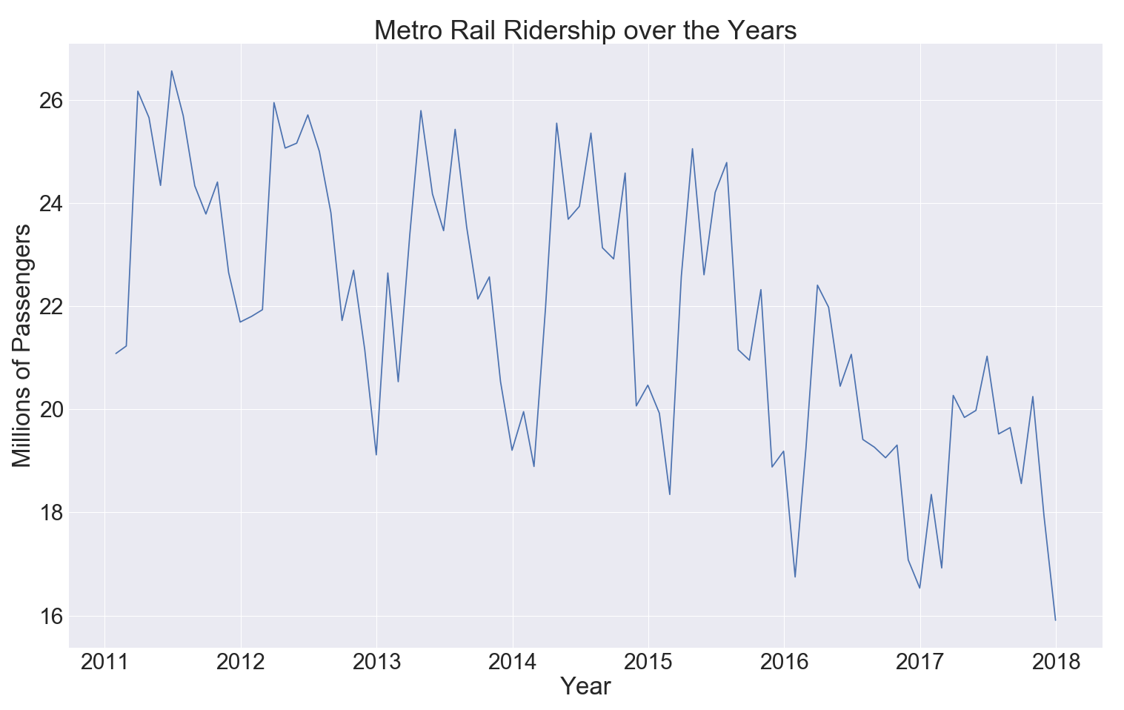
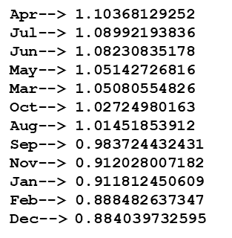
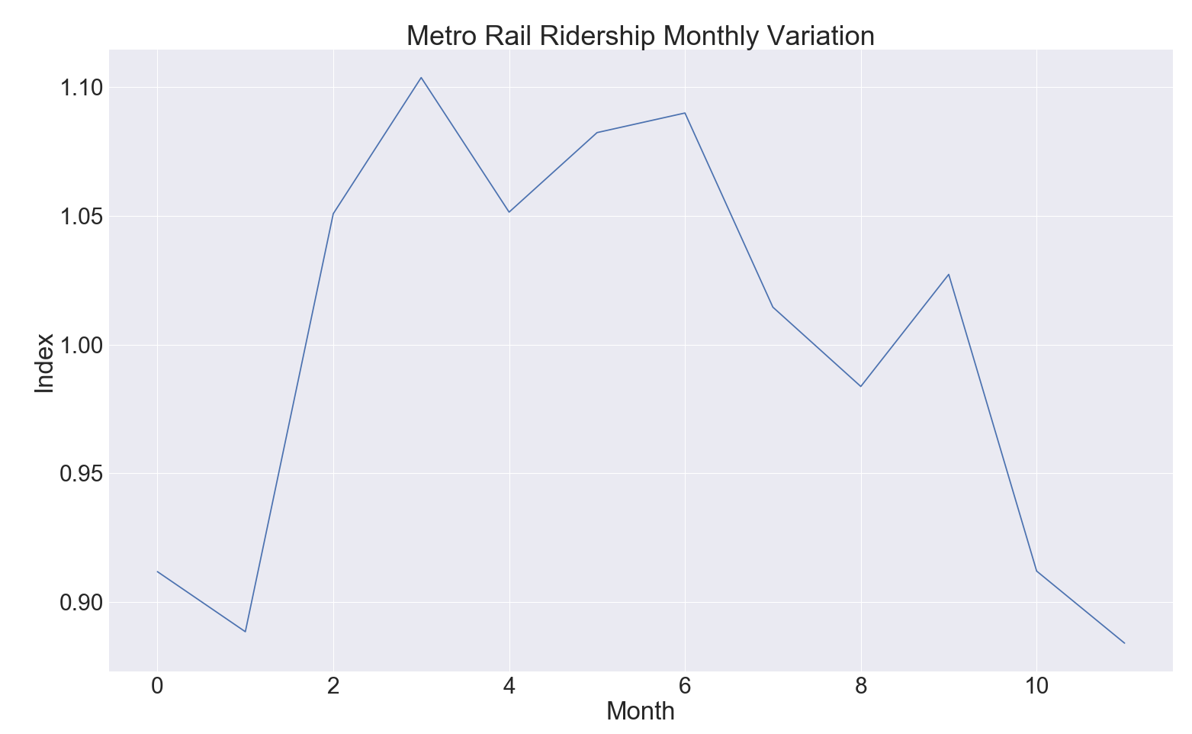
Question: Does time of year impact demand for transportation resources?
Seasonal Variation Found by the Average Percentage Method.
Each month ridership data expressed as a percentages for the whole year ridership.
Percentages from corresponding months of different years are averaged.
The resulting twelve percentages are the seasonal index.
On average, ridership is the lowest in December and highest in April
The graph of the ridership data is characteristic of a time series.
Long Term Trend or Movement
Seasonal Movement
Long-Term Cyclical Movement
Irregular Movement:
Answer: Yes

Slide 7
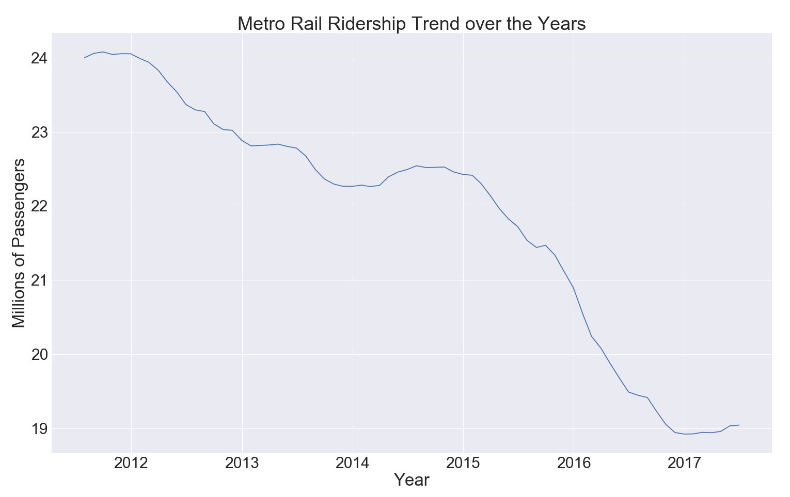
Question: Is there an overall trend in ridership on metro?
Time series variable: Y describes the observations.
Y = T x C x S x I = TCSI
T : Trend
C : Cyclical Movement
S : Seasonal Variation
I : Irregular Movement
Answer: Yes (Down)
The graph of the ridership data is characteristic of a time series.
Long Term Trend or Movement
Seasonal Movement
Long-Term Cyclical Movement
Irregular Movement:

Slide 8
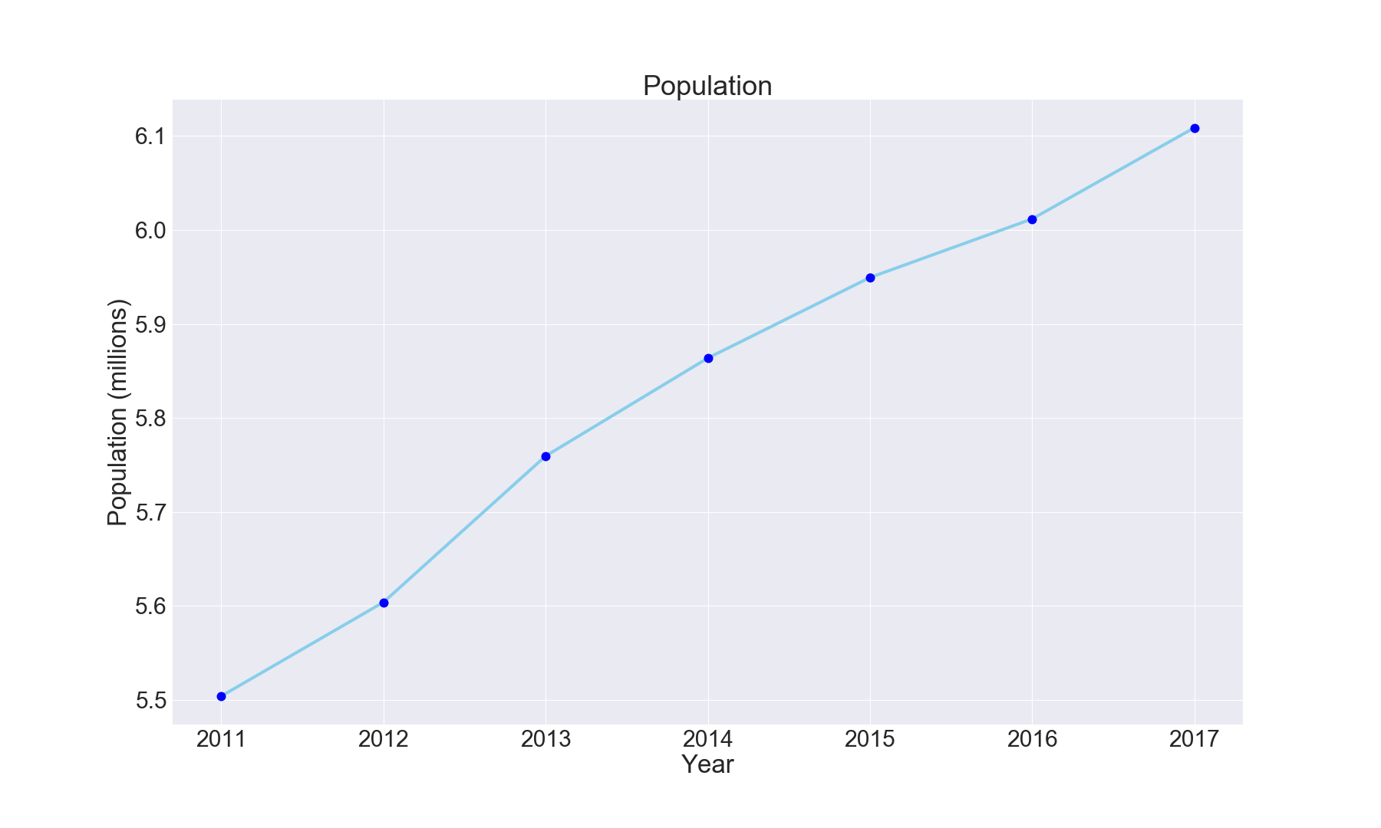
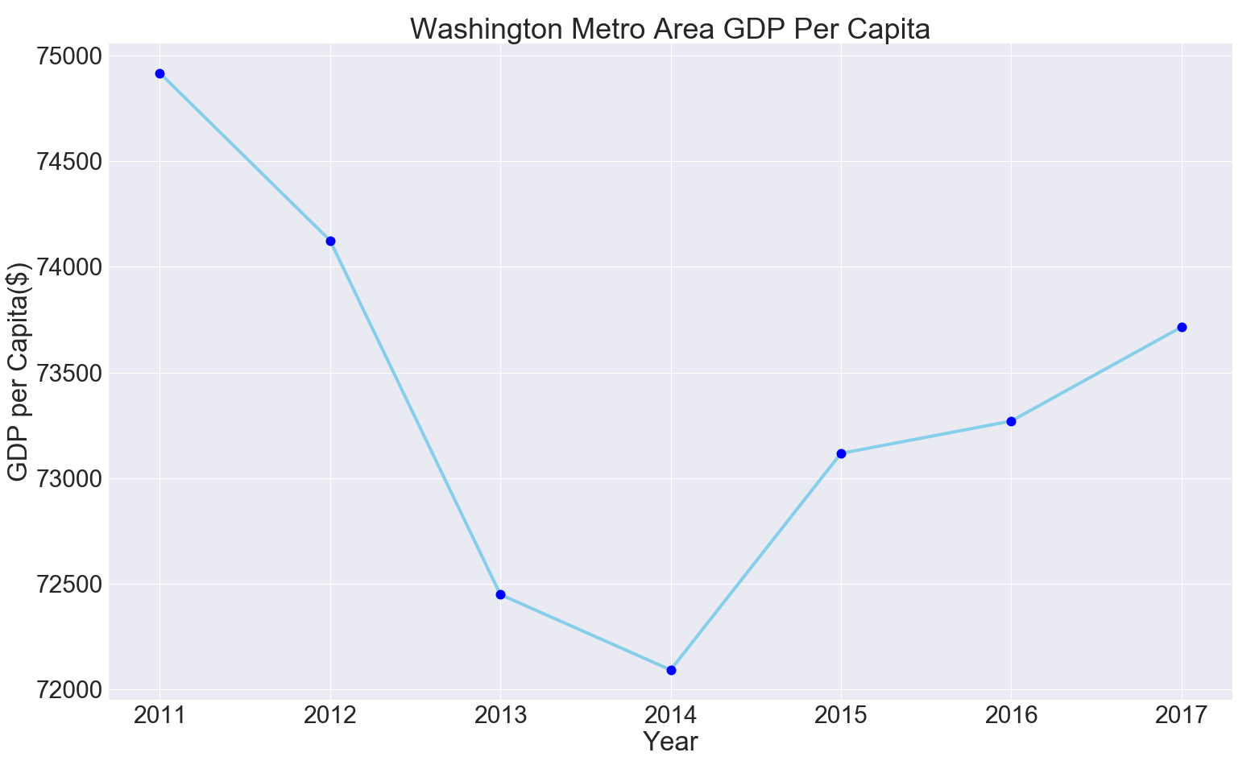
Could External Factors Impact Ridership?
11% Increase
20.1% Decrease
1.6 % Decrease
Population Increased during the interval ridership declined.
Population is ruled out.
Economic conditions in terms of GDP per Capita declined during the interval ridership declined. However, GDP per Capita increased from 2014 to 2017 by 2.25% while ridership experienced its greatest decline (15.5%) during this same time period.
Economic Conditions ruled out.

Slide 9
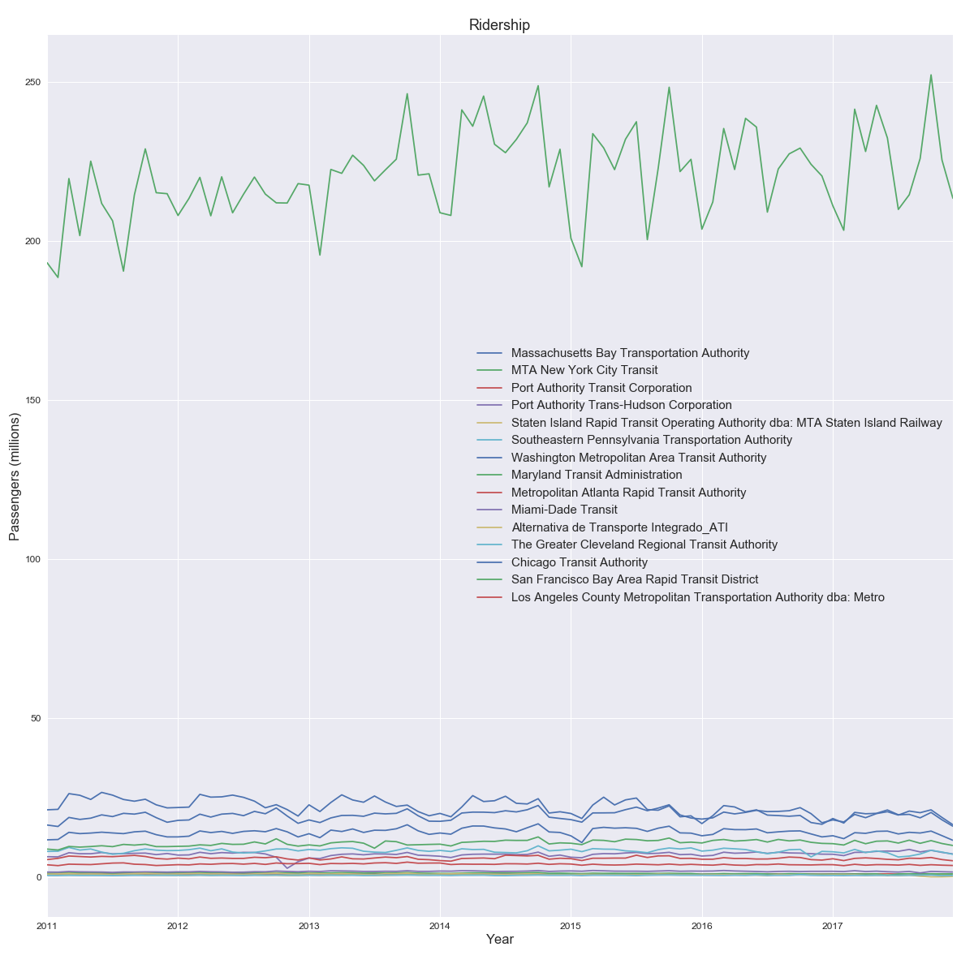
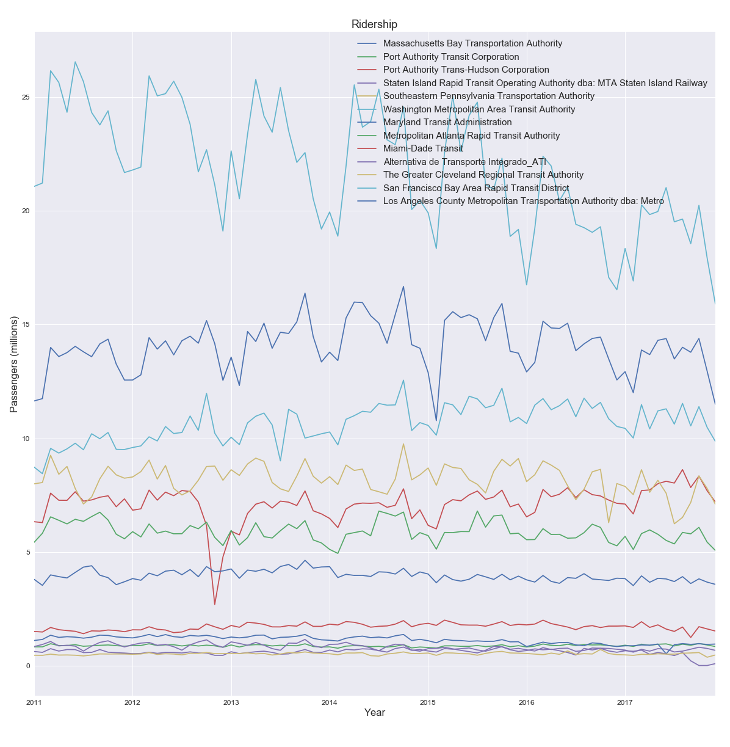
What is causing Washington Metro ridership to decline?
Washington
Washington

