Slide 1
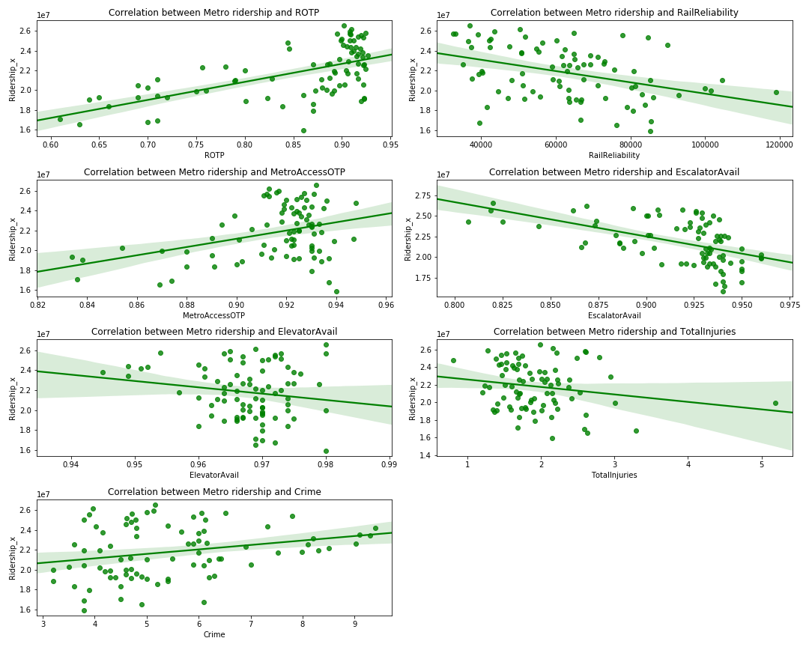
Question: Does metro performance impact the demand for other transportation resources?
In order to determine if there is a correlation between Metro KPIs and its ridership, Linear regression analysis was performed. According to the results, none of the KPIs is a significant predictor for the Metro ridership.

Slide 2
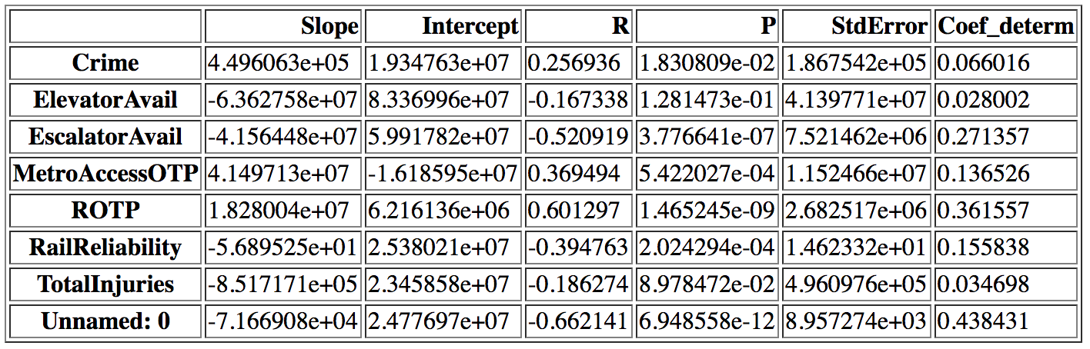
Question: Does metro performance impact the demand for other transportation resources?
Linear regression coefficients

Slide 3
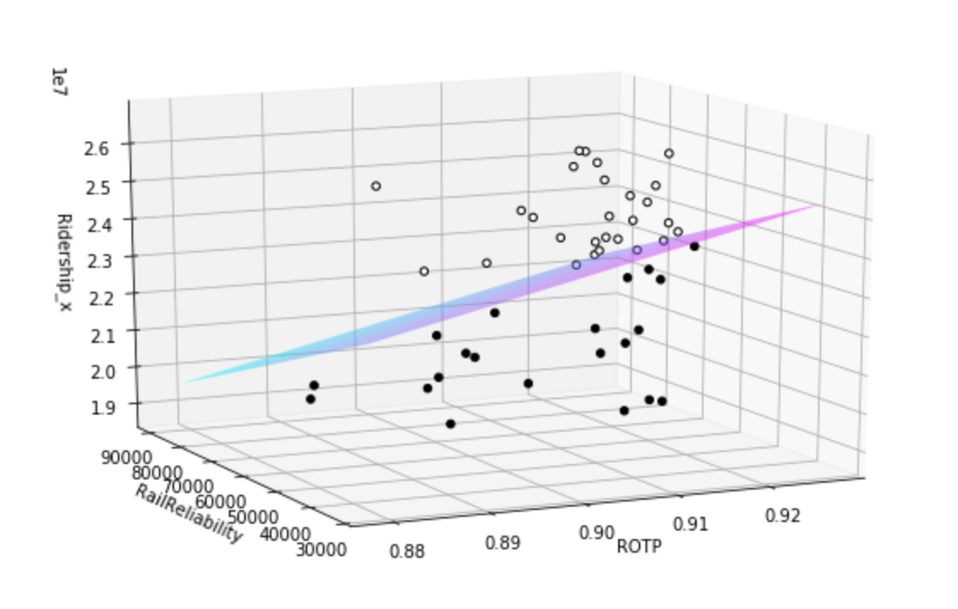
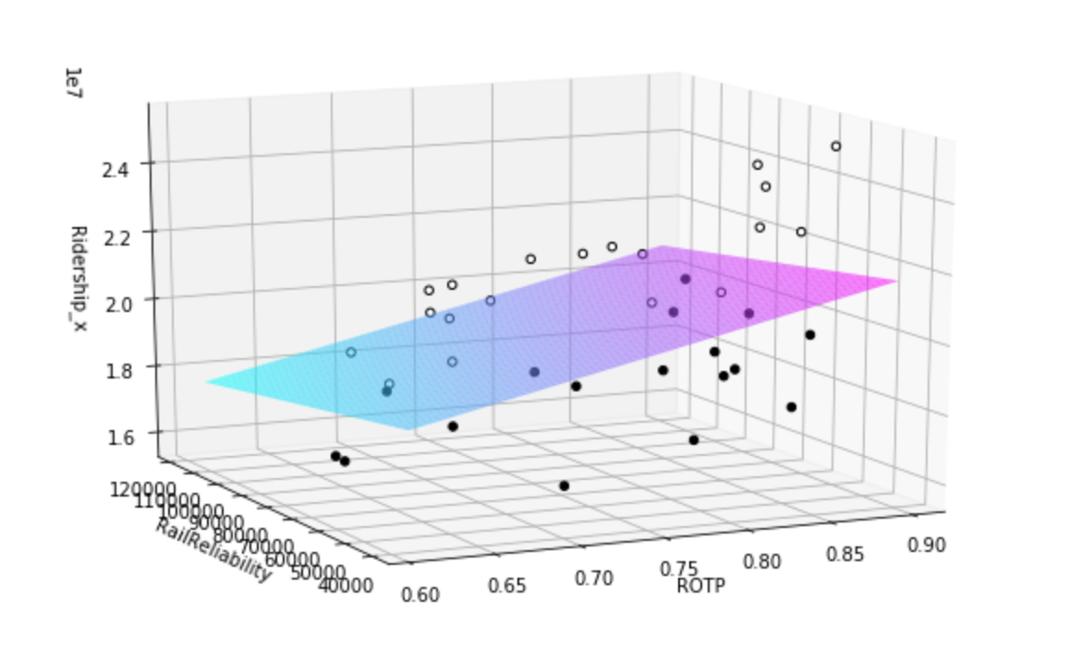
Question: Does metro performance impact the demand for other transportation resources?
In 2015 after a few incidents Metro introduced a Safe Track program, that affected ROTP. The graphs below show the multivariable regression between two most significant KPIs ROTP and Rail Reliability and ridership correlation before and after the Safe Track implementation (2015):
Correlation before 2015, R2 = 0.124
Correlation after 2015, R2 = 0.188

Slide 4
Question: Does metro performance impact the demand for other transportation resources?
This information may indicate the following:
1. KPIs are not exactly correct, but there is no additional information to check it.
2. KPI is an internal organizational criteria that is used to measure its success or failure. Whereas the KPIs do not impact the ridership, it can be concluded that the number of passengers is not the “Metro goal (Mark I need your help here)”.
Also it means that KPI’s can’t be used to determine if metro performance impact the demand for other transportation resources.

Slide 5
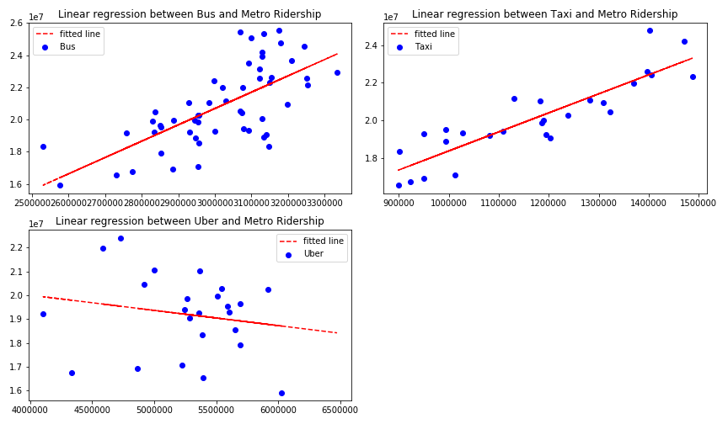
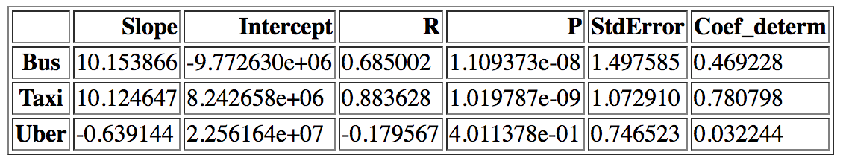
Question: Does metro performance impact the demand for other transportation resources?
Below performed a linear regression between Metro ridership and each type of transportation

Slide 6
Question: Does metro performance impact the demand for other transportation resources?
The most significant relation is between Taxi and Metro ridership R2 = 0.78.
The more people use Metro, the more they ride a taxi. Why??

