Slide 1

GovHack 2023 Measuring Emissions
EARTHLY – A Next Gen AI and ML based Tracking , Monitoring and Reporting
Solution by Team Gryffindor
Disclaimer: Icons/Images used from free and Creative Commons license http://creativecommons.org/licenses/by-nc-sa/3.0

Slide 2
Measuring Emissions
Challenge
Climate change is forcing governments and regulators to enforce stringent norms for businesses to reduce emissions and address environmental risks. There is no standard framework for reporting ESG and climate related risks, leading to non-uniform data. How can this issue be addressed to help organisations better report on their emissions?
Data collected is not standardised in a specific format, and there is no consistent taxonomy for the various data points across the business. This makes data collection, ensuring data quality, and reporting extremely difficult. The other major challenge is integrating this data into financial risk calculations.
Eligibility: Environment, Social and Governance dataset from data.gov.au
Entry: Challenge entry is available to all teams in Australia.
Our Solution elements
API Based data collection
Data conversion utility to standardize data format
Loading of data into a Observability tool
Standardized Dashboards to display data
Consistency on data points and reporting strategy
Help teams need to make smart choices at each step of the life cycle
Data quality and ease of reporting
GenAI and ML to provide predictive calculations for futuristic purposes
Integrated layer for different management risk calculations e.g. finance, planning, etc.
Data Sets – Available and Used
Environmental, Social and Governance Data
Data Governance Maturity Indicators
Digital Governance Project Database

Slide 3

Causes and Actions
Pollution because of Greenhouse Gases.
Climate Change - Change of Earth’s average weather patterns including temperature, precipitation and weather patterns.
Global Warning
Burning Fossil Fuels
Extreme Weather Events – Bushfires, etc
Ocean level increase impacting lives.
Social and economic impacts
Importance to disclose sustainability Practices and performances.
Contribution towards ESG initiatives.
No standard reporting framework and processes tied to the financial risks
ISO and Sustainable Developments Goals framework
Unified methodology to combine data and provide a reporting framework

Slide 4
Approach to Net Zero
NetZero
Effective and Efficient process
Transformation and Planning
Renewal Energy Supply
Value and AI Led approach
Climate Risk Modelling
Access to Financing
Product and Process Innovation

Slide 5




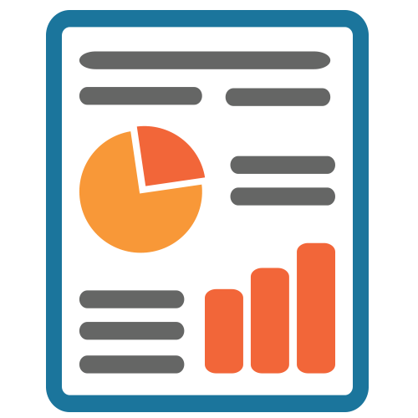
Our solution – AI Based Emission Tracking and Reporting System
We have built a GenAI and ML based prototype (Earthly) to efficiently collect, track, monitor and report emissions data.
AI enabled sensor’s to collect data.
Incentive(hPts) system to provide credits to industry sectors to achieve carbon neutrality.
API’s to pull data from Sensors and load to a Observability tool.
Automated data cleansing job to process and convert data in a standardized manner.
Dashboards and alerting for reporting and deviations.
AI and ML framework to predict and forecast carbon emissions.
Report’s based on Sector / Industries.

Slide 6
Reporting and Tracking Administration
Governance
Data Classification
Strategy
Global Recognized Standards
Risk Management
Identification
Metrics and Objectives
Data Collection and Validation
Data Collection
Conversion Factors
Emission Factors
Verification and Validation
Remote Sensing
Standardization
Data classification and Management Systems
Quality Assurance
Transparency
Stakeholder Engagement
Assessment
Collaborate to Mitigate
Continuous Improvement and Training
Financial and Sector based assessment
Conversion and Standardization
Define Emission metrics
Baseline
SMART Approach (Specific, Measurable, Achievable, Relevant and Time Bound)
Review and Adjust

Slide 7
High Level Solution Flow
Sensor based emission tracking
API to pull data and send to database
Framework to convert data to Standard format
AI Based Alerting on deviations and risk management
ML Based Prediction and alignment to standards
Chatbot based response solution
Standardized dashboard’s

Slide 8
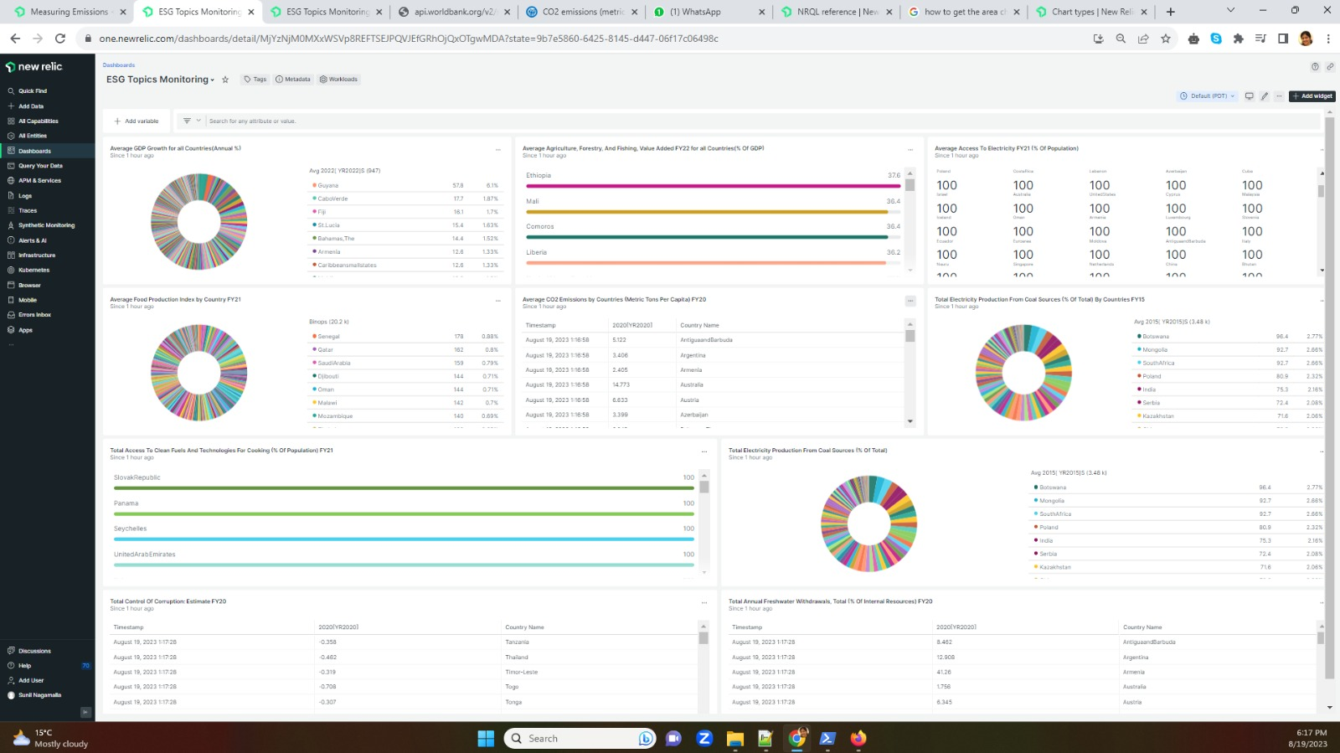
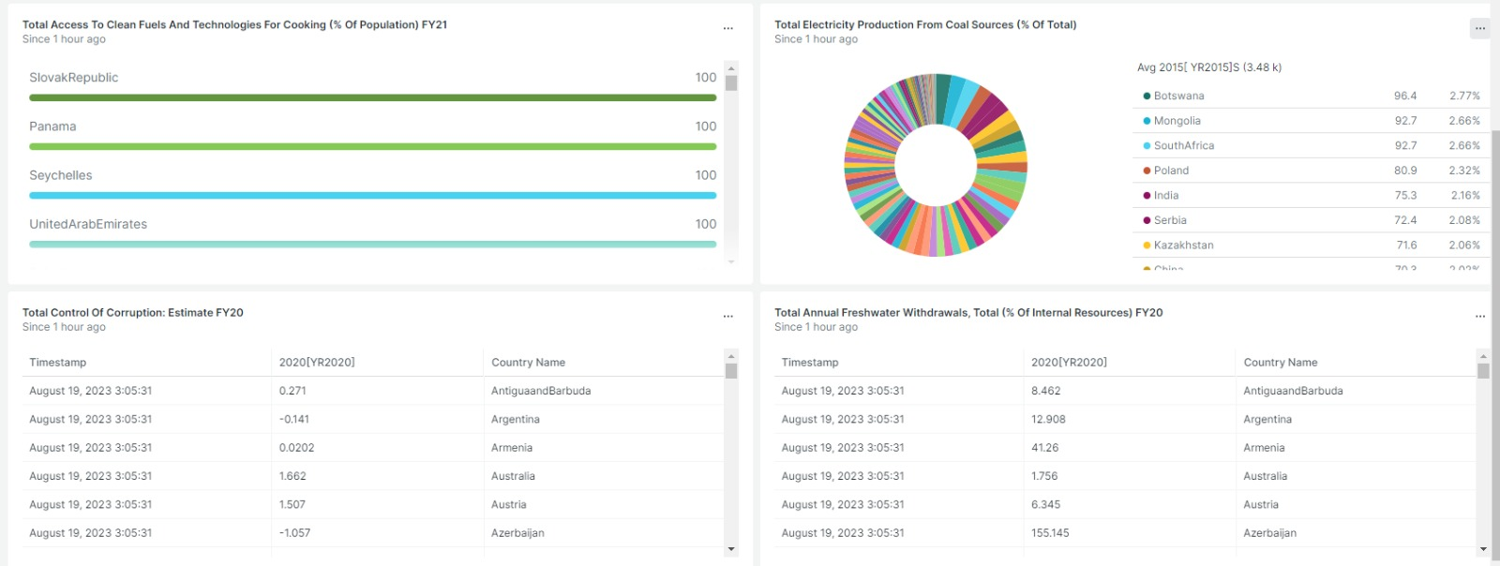
Dashboards and Reports – A sample
Processed data and dashboards associated with it – Standardized reporting format for any sectors / data

Slide 9
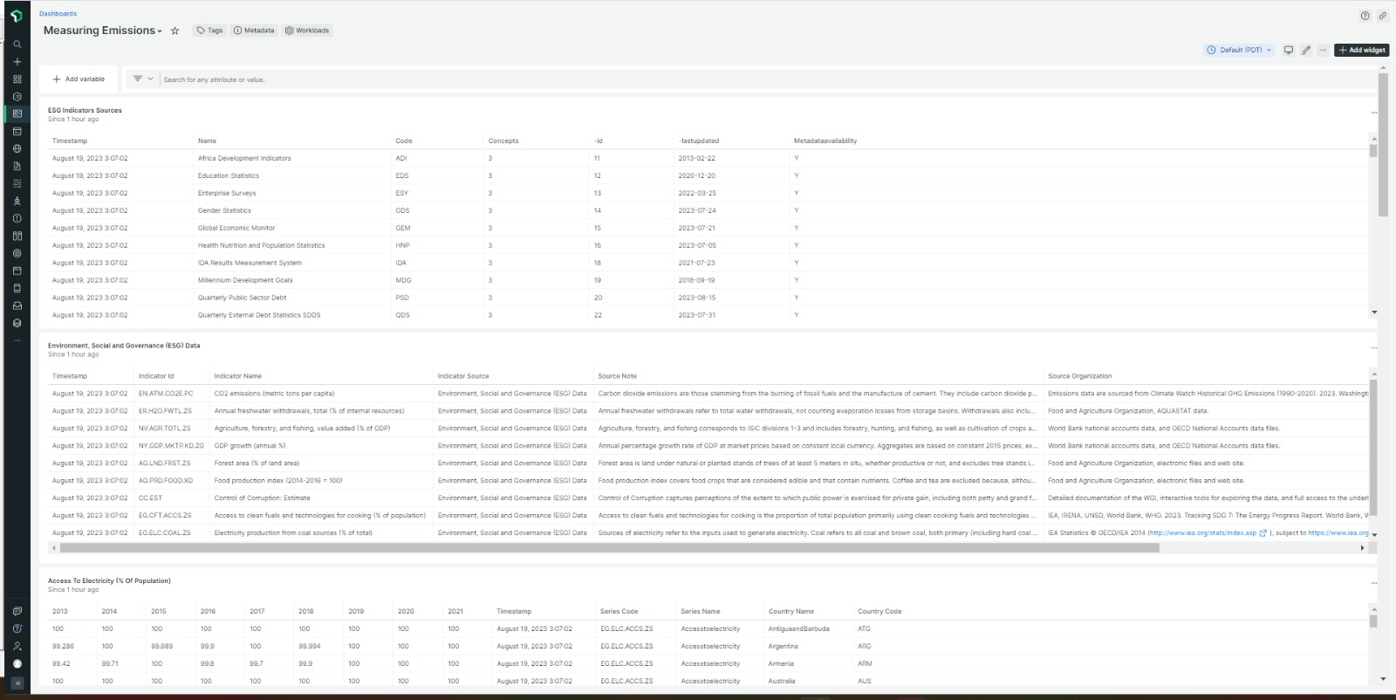
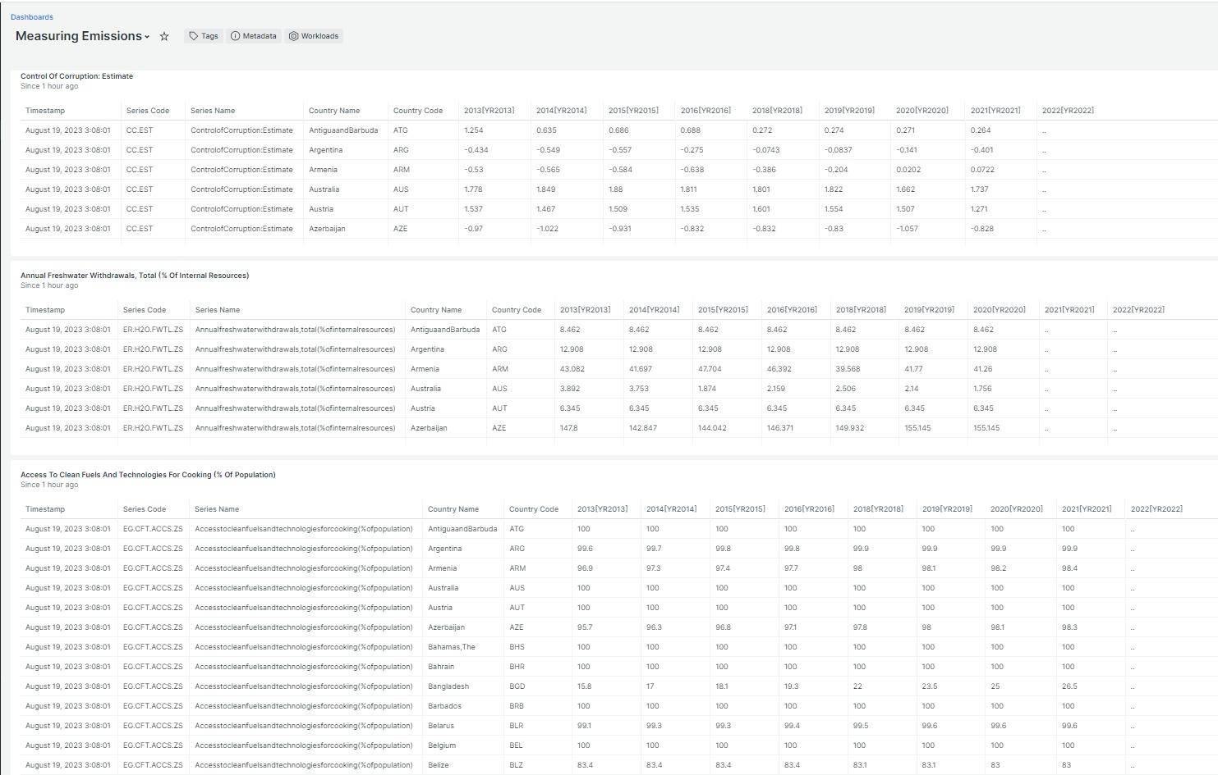
Dashboards and Reports – A sample

Slide 10

Thank You
Team Gryffindor

