Slide 1

Deno
Deno is a simple, modern and secure runtime for JavaScript and TypeScript that uses V8 and is built in Rust.

Slide 2
So what is Deno?
Deno is a simple, modern and secure runtime for JavaScript and TypeScript
What is a “secure runtime”?
Well a runtime is an environment in which your code runs in, you can think of it like a wrapper almost, these runtime environments like Deno or Node provide helpful methods and functionality to make executing and building your code easier to do.
Deno is more secure since it requires permission for any code in it to access your network unlike node.

Slide 3
How do I install Deno?
How you install Deno will depend on your operating system, the most recent install instructions can be found at https://deno.land/
As of this presentation you can use the following commands:
Windows:
PowerShell: iwr https://deno.land/x/install/install.ps1 -useb | iex
Chocolatey: choco install deno
Mac:
Homebrew: brew install deno
Shell: curl -fsSL https://deno.land/x/install/install.sh | sh
Linux:
Shell: curl -fsSL https://deno.land/x/install/install.sh | sh
Cargo (Rust Package Manager)
cargo install deno

Slide 4
A note about install
If you are using WSL you may run into difficulties with the ‘deno’ command.
If it doesn’t work, you can still interact with deno without the deno command. It will tell you after the install to use a help command to get started, for example: /home/michael/.deno/bin/deno --help
So anywhere you would use the deno command put /home/michael/.deno/bin/deno (your own username of course)

Slide 5
Now what?

Slide 6
Executing code with Deno
To run code with Deno you use `deno run`
For example:
deno run --allow-net ./server.jsx
Or for WSL users: /home/michael/.deno/bin/deno run --allow-net ./server.jsx
Since the program ‘server.jsx’ accepts connections we need the
--allow-net flag.
For security reasons Deno does not allow programs to access the network without permission!

Slide 7
Importing modules instead of using packages
Modules work very much like the packages you are used to with NPM only you do not store them in a node_modules folder.
Instead the code can live anywhere on your computer, or on the web. You can import modules directly off of GitHub, deno’s website or I believe basically anywhere…
It is like the script tag and require had a super baby

Slide 8
Putting it all together!
So we are going to make a website in deno!
First, we will create our project directory
Then make three files:
app.jsx
server.jsx
dependencies.js

Slide 9
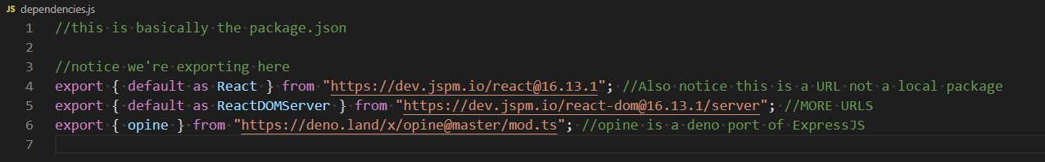
dependencies.js

Slide 10
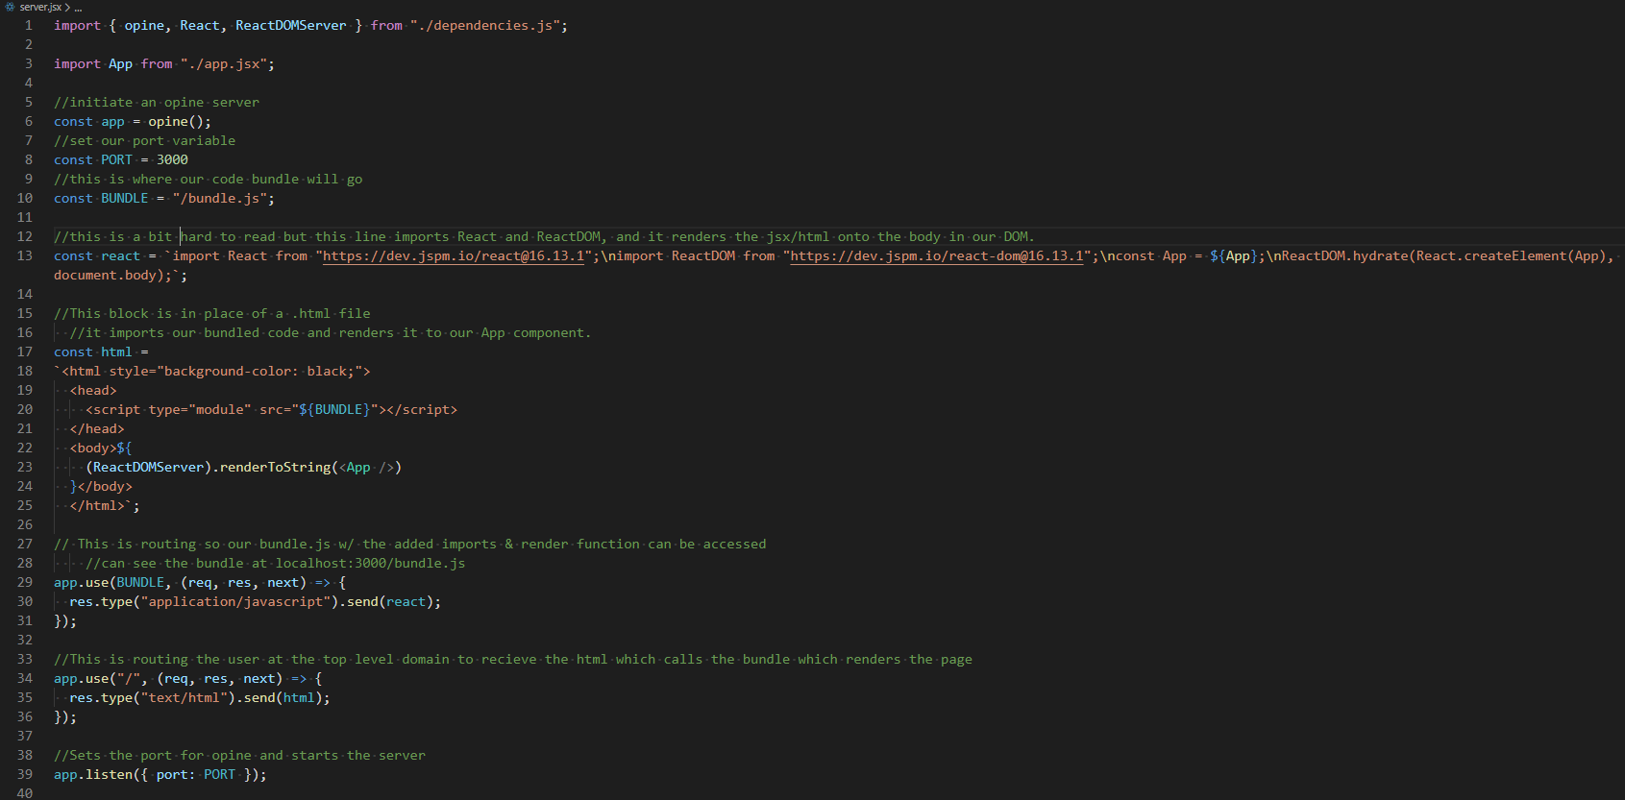

Slide 11
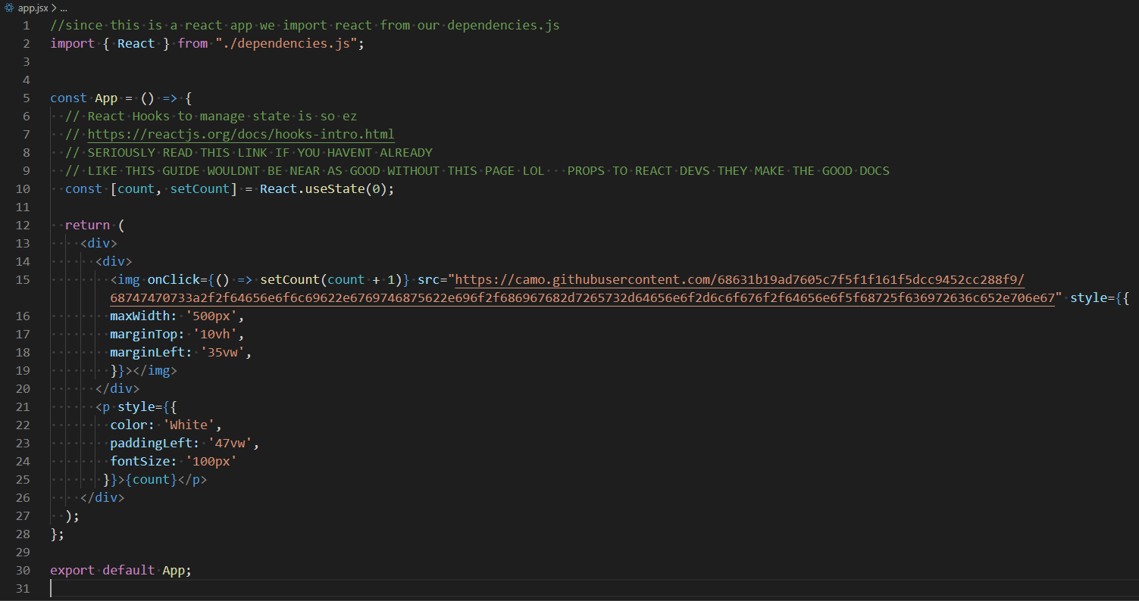

Slide 12
SHOW WEBSITE NOW

Slide 13
Documentation and Useful Links
https://deno.land/
https://deno.land/manual
https://deno.land/manual/getting_started/permissions
https://doc.deno.land/https/github.com/denoland/deno/releases/latest/download/lib.deno.d.ts
https://doc.deno.land/https/deno.land/x/opine@master/mod.ts#request
https://reactjs.org/docs/hooks-intro.html

