Slide 1
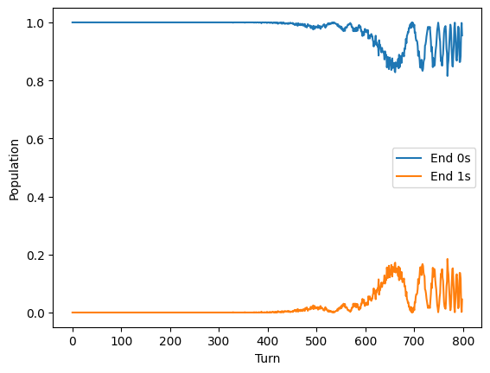
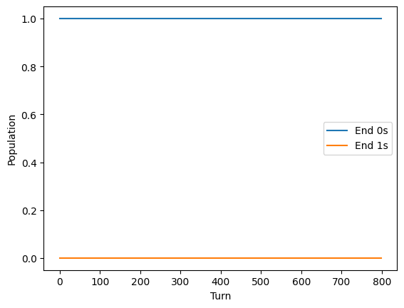
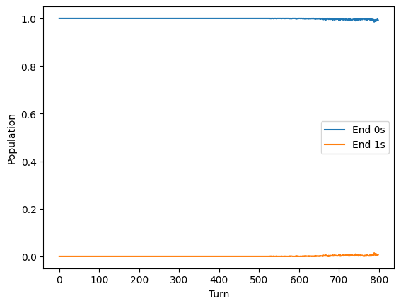
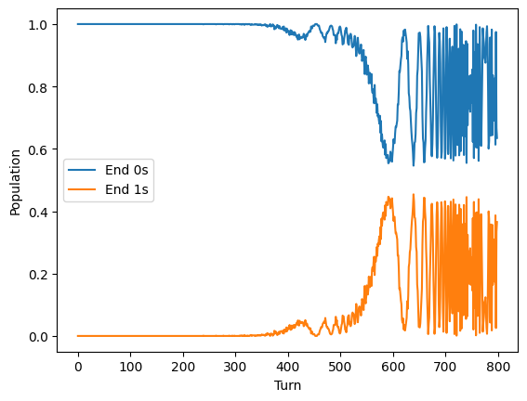
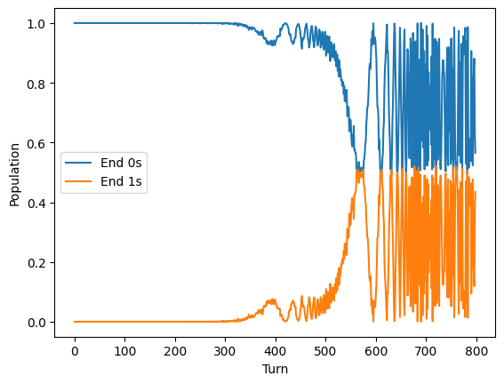
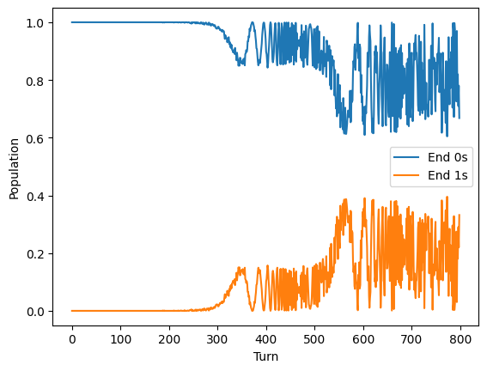
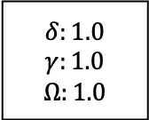
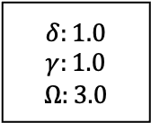
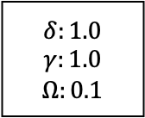
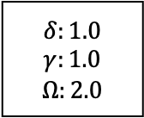
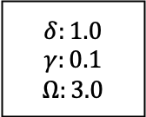
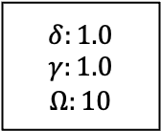
$$δ:1.0$$
$$γ:1.0$$
$$Ω:1.0$$
$$δ:1.0$$
$$γ:0.1$$
$$Ω:3.0$$
$$δ:1.0$$
$$γ:1.0$$
$$Ω:2.0$$
$$δ:1.0$$
$$γ:1.0$$
$$Ω:0.1$$
$$δ:1.0$$
$$γ:1.0$$
$$Ω:3.0$$
$$δ:1.0$$
$$γ:1.0$$
$$Ω:10$$
Notes:
Parameter investigations
Delta, gamma, omega
1,2,1 does not work
1,2,3 does not work – gamma cant be 2?

Slide 2
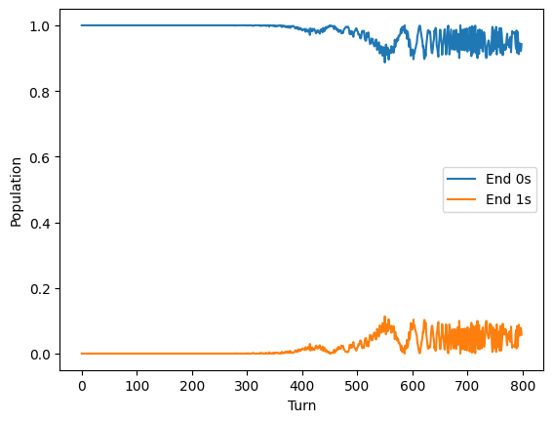
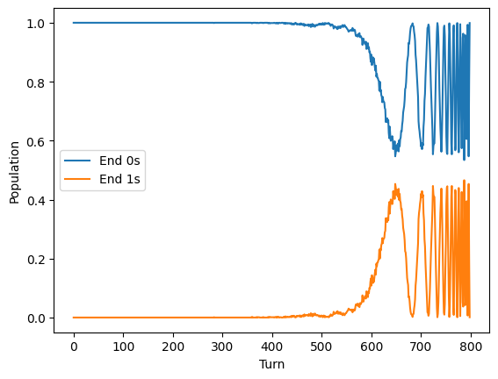
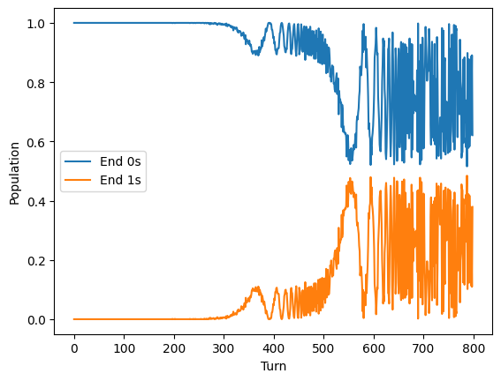
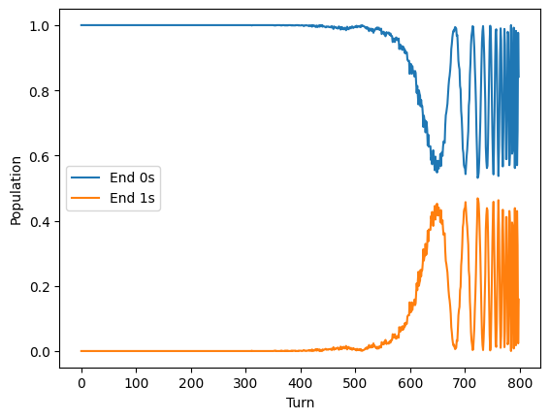
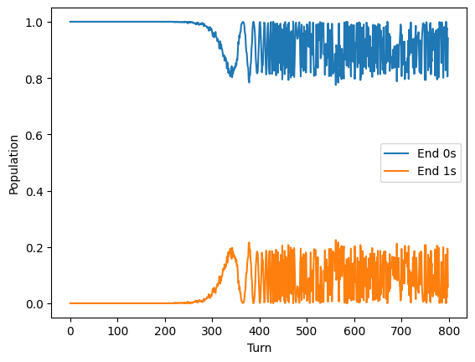
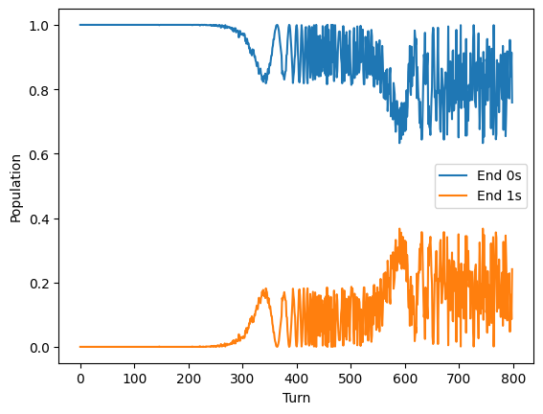
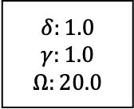
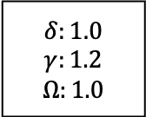
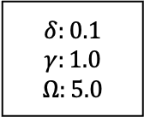
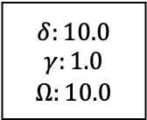
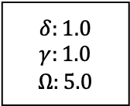
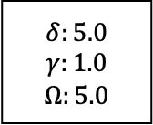
$$δ:1.0$$
$$γ:1.2$$
$$Ω:1.0$$
$$δ:5.0$$
$$γ:1.0$$
$$Ω:5.0$$
$$δ:1.0$$
$$γ:1.0$$
$$Ω:5.0$$
$$δ:10.0$$
$$γ:1.0$$
$$Ω:10.0$$
$$δ:0.1$$
$$γ:1.0$$
$$Ω:5.0$$
$$δ:1.0$$
$$γ:1.0$$
$$Ω:20.0$$

Slide 3
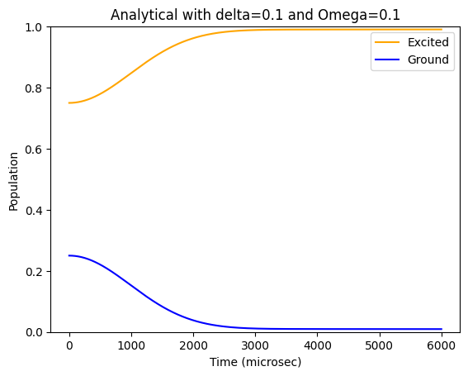
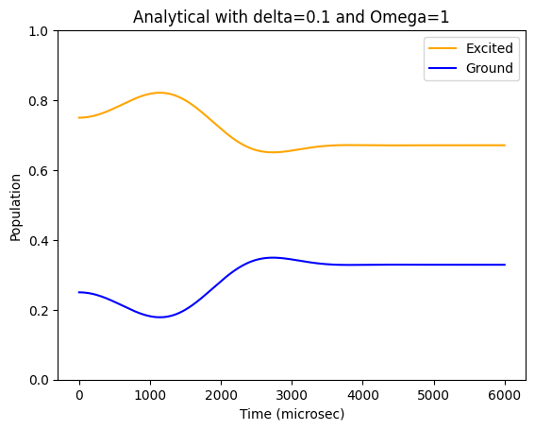
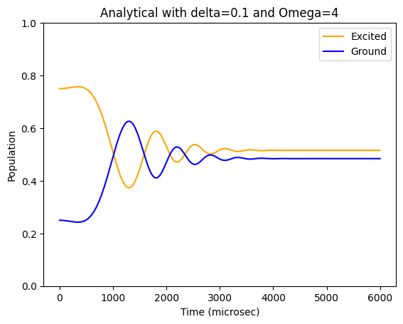
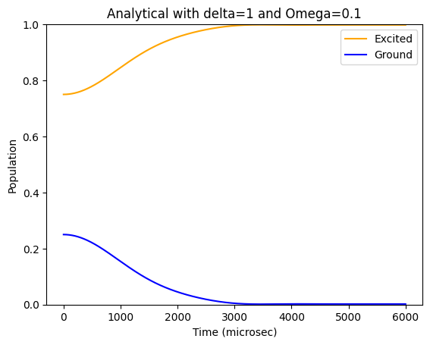
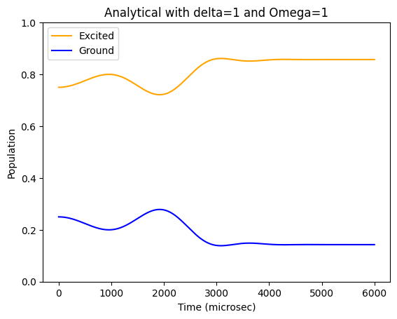
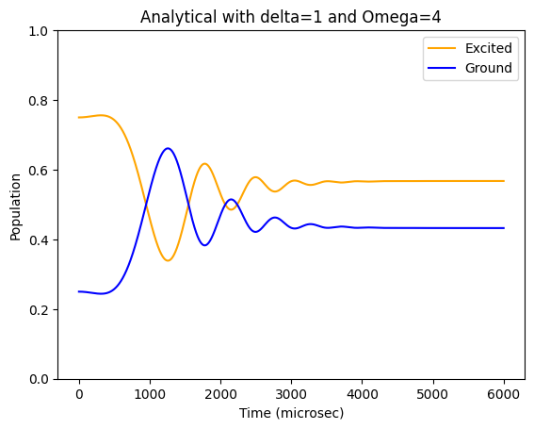
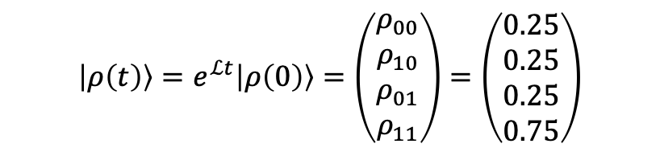
$$\left|ρ\left(t\right)\right\rangle =e^{ℒt}\left|ρ\left(0\right)\right\rangle =\left(\begin{aligned}ρ_{00} \\ ρ_{10} \\ ρ_{01} \\ ρ_{11}\end{aligned}\right)=\left(\begin{aligned}0.25 \\ 0.25 \\ 0.25 \\ 0.75\end{aligned}\right)$$
Notes:
Gamma parameter set as 2.0 here (at top of code)

Slide 4
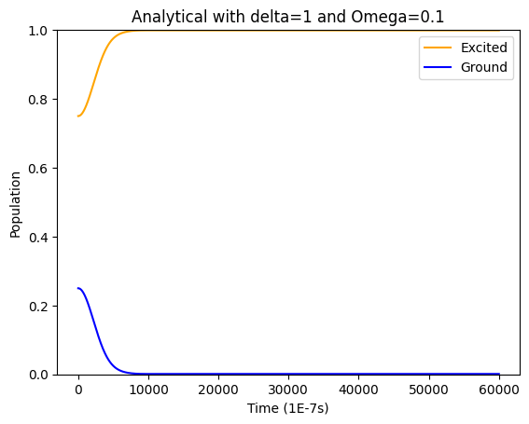
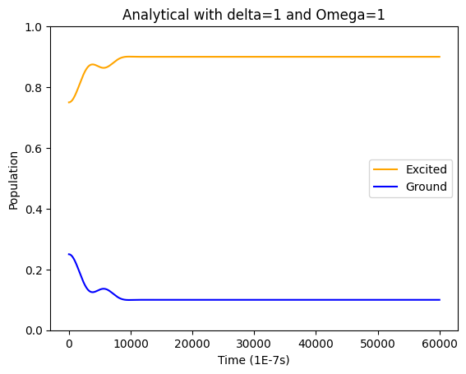
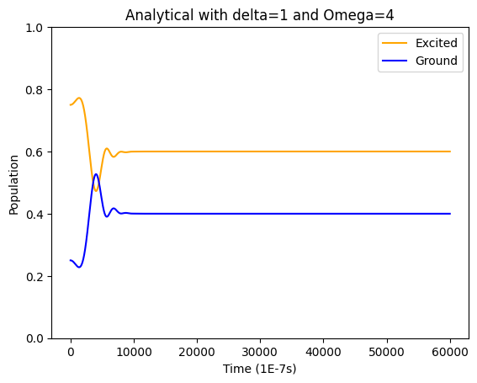
Timestep: 1E-6 s (1 microsec)
Timestep: 1E-7 s
Observations: under the basic forward time march, timestep does have an impact → better to use Runge-Kutta 4 .etc package
Notes:
20 April
Try smaller time steps to see if any different.
Install and run QuTiP examples to debug my analytical
Align values of delta, gamma and initial values
Use small delta for quantum to match my analytical results

Slide 5

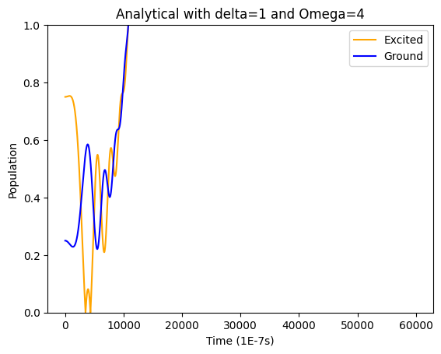
Alignment issues
Initial values: ground state 0.25, excited state 0.75 from density matrix (see the left most data points)
Quantum and analytical don’t match! The I should be interpreted as identity matrix in make Lindbladian. When I tried it as ones,
Delta, gamma, Omega at 1.0, 1.0, 1.0
With ones matrix
Timestep at 1E-7 s

Slide 6
QuTip installation and examples
https://qutip.org/docs/latest/guide/dynamics/dynamics-master.html

