Slide 1

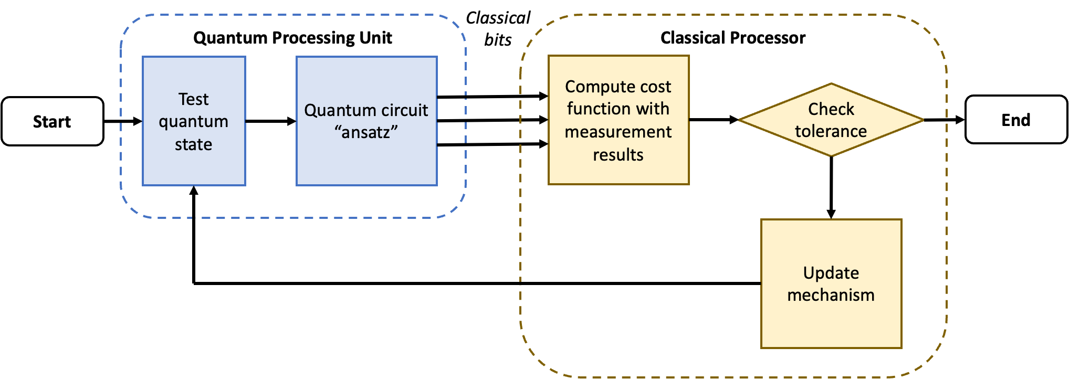
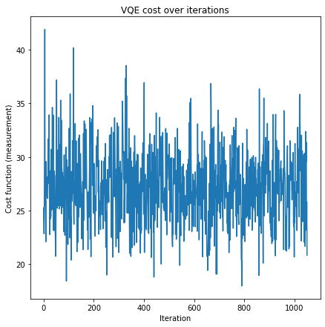
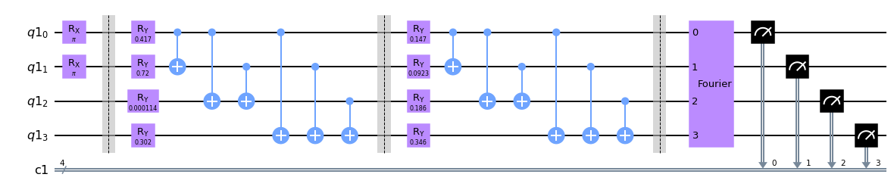
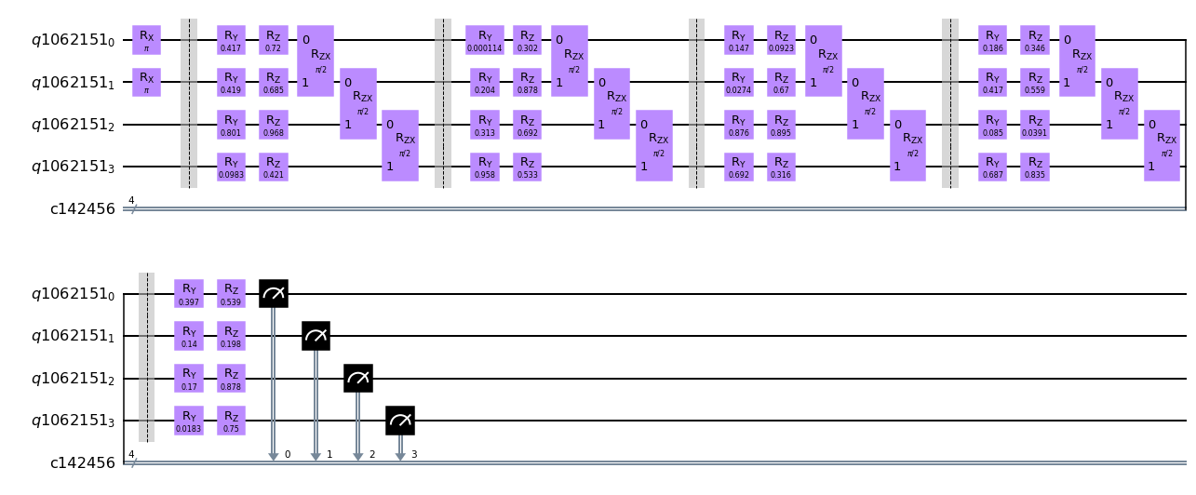

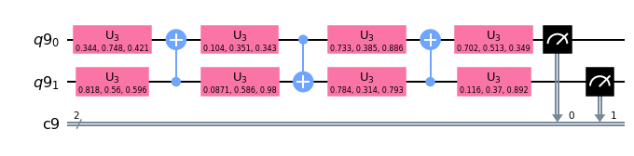
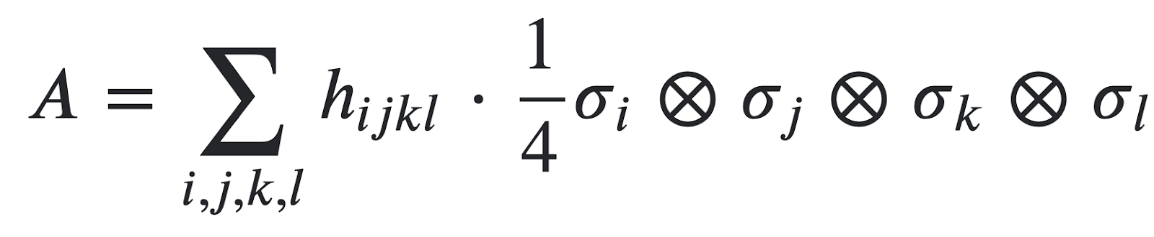
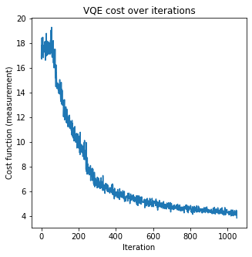
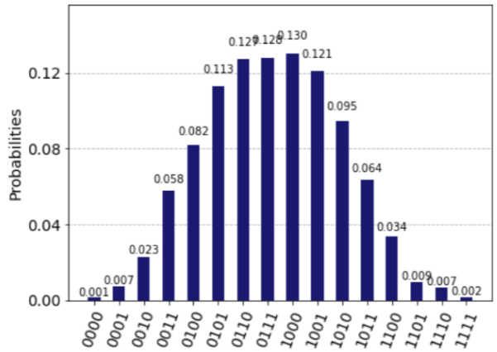
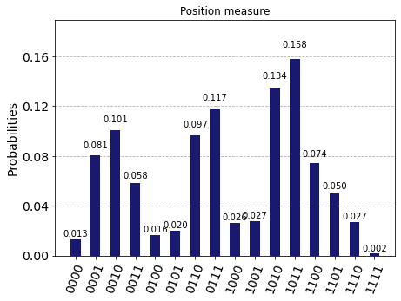
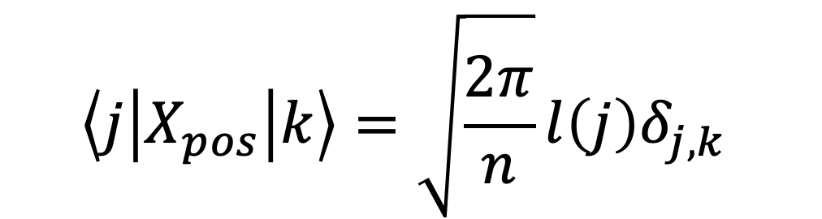
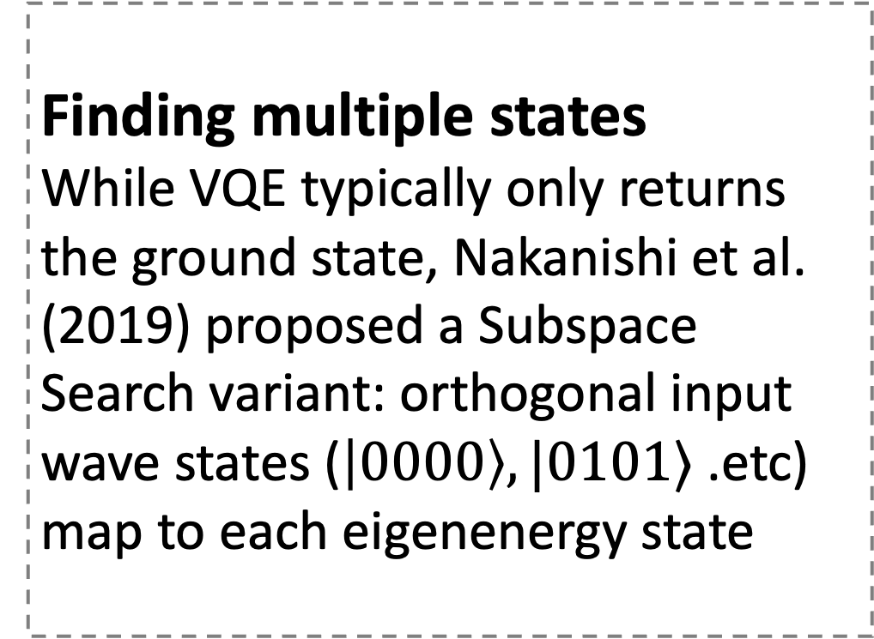
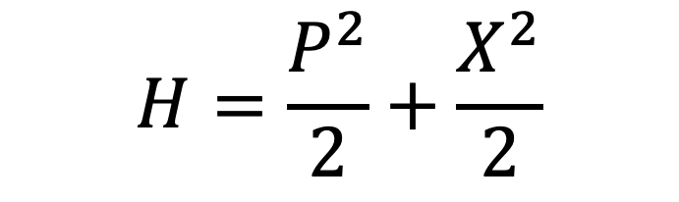
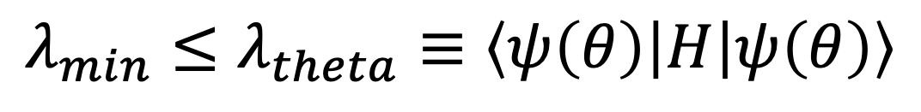
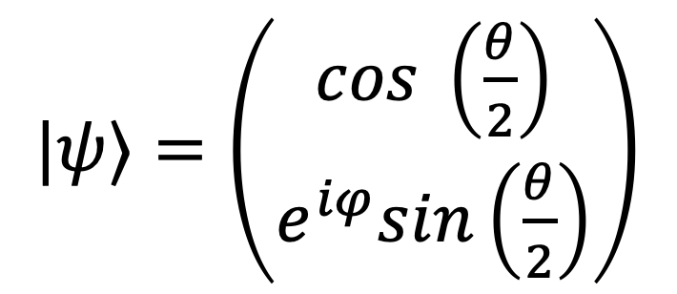

Quantum Implementation of a Quantum-Cognitive Model of Decision-Making
Yu Jun Shen (yujun.shen@yale.edu)
Mentored by Prof. Bhattacharjee Abhishek and Dr. Raghavendra Pothukuchi
Introduction
Quantum computers may solve certain computations much faster than classical electronic computers
Quantum computers process information using ”quantum bits” (qubits) that can be in superposition
We are presently in the Near Term Intermediate Scale quantum era with noisy and depth-limited quantum computers → use hybrid, variational algorithms
Application to cognitive science
Human decision making can be modelled as a multiple potential wells problem
Probability of finding a particle in a well corresponds to likelihood of taking that decision
Solve for lowest few energy states corresponding to decision probabilities
Results and discussion
Standard VQE allows us to find ground state eigenstate and wave function in the position basis
With more steps and complexity, the lowest four eigenstates can be found by SSVQE
Simultaneous Perturbation Stochastic Approximation algorithm worked best; have to use stable parameters for convergence
Finding multiple states
While VQE typically only returns the ground state, Nakanishi et al. (2019) proposed a Subspace Search variant: orthogonal input wave states ($\left|0000\right\rangle , |0101⟩$ .etc) map to each eigenenergy state
$$H=\frac{P^{2}}{2}+\frac{X^{2}}{2}$$
SPSA settings could not be adjusted too aggressively
Fig. 4. An instance of “Ry-style” ansatz using two layers and four qubits, with CNOT entangling gates.
Fig. 7. A more aggressive classical optimizer tuning led to improved results for a low dimension problem but did not work as well with multiple qubits.
Fig. 1. The VQE uses both quantum (blue) and classical (yellow) parts connected in feedback to minimize the measured value of a quantum wave state.
VQE algorithm design factors
Ansatz choice
Hardware Optimized vs Ry style
Method of entanglement
Subspace Search VQE
Convergence results of different ansatz types
Variational Quantum Eigensolvers (VQE)
Solve for the lowest eigenenergy state by making a parameterized circuit, in Python Qiskit (compatible with IBM quantum hardware)
$|ψ⟩=\left(\begin{aligned}cos \left(\frac{θ}{2}\right) \\ e^{iφ}sin\left(\frac{θ}{2}\right)\end{aligned}\right)$
Fig. 5. An instance of “Hardware optimized” ansatz with four qubits.
1 qubit
Classical Optimizer
Simultaneous Perturbation Stochastic Approximation (SPSA)
Constrained Optimization by Linear Approximation (COBYLA)
Fig. 2. A basic one qubit quantum circuit has just two angles to optimize over.
Fig. 8. Cost functions for various optimizers had similar trends overall.
Conclusion
Variational quantum eigensolver can be implemented for Hamiltonian cost estimation on near term quantum machines
Different circuit gate arrangements possible
Large cost of optimization steps in basic approach
2 qubit
Measuring the Hamiltonian
Can do measurement in position basis, and then momentum basis via a Fourier Transform
Or decompose Hamiltonian into tensor products
Fig. 3. At two qubits and beyond, quantum entanglement must be considered and circuit complexity increases.
$$λ_{min}≤λ_{theta}≡\left\langle ψ\left(θ\right)\left|H\right|ψ\left(θ\right)\right\rangle$$
References
Nakanishi K. M., Mitarai K. and Fujii K. (2019) Subspace-search variational quantum eigensolver for excited states. Phys. Rev. Research, 1.
Rosendahl M., Bizyaeva A. and Cohen J. (2020) A novel quantum approach to the dynamics of decision making. Cognitive Science.
Apanavicius J., Feng Y., Flores Y., Hassan M., McGuigan M. (2021) Morse potential on a quantum computer for molecules and supersymmetric quantum mechanics.
Spall J. C. (1998) Implementation of the simultaneous perturbation algorithm for stochastic optimization. IEEE Transactions on Aerospace and Electronic Systems, 34.
Wang H., Ding Y., Gu J., Lin Y., Pan D. Z., Chong F. T., Han S. (2021) QuantunNAS: Noise-Adaptive Search for robust quantum circuits. HPCA 2022.
Difficult to use “universal” ansatzes for larger circuits
Consider heuristics-based designs
Trotterized potential well; quantum Fourier transform between position and momentum basis
$$\left\langle j\left|X_{pos}\right|k\right\rangle =\sqrt{\frac{2π}{n}}l\left(j\right)δ_{j,k}$$
$$P_{pos}=F^{\text{†}}X_{pos}F$$
Fig. 6. (L to R) Example cost function with full ansatz, the resultant ground and third energy states found (using SSVQE).
Yale STARS II Fellowship (2021 – 2023) funded by the Yale College Dean’s Office
Notes:
Edited 12 April after Allison and STARS session feedback
Project Mentors: Prof. Bhattacharjee Abhishek, Dr. Raghavendra Pothukuchi
Subtitle 40 bold left aligned, main text 36. Captions in Times 32 italic.
Equations: 36

