Slide 1
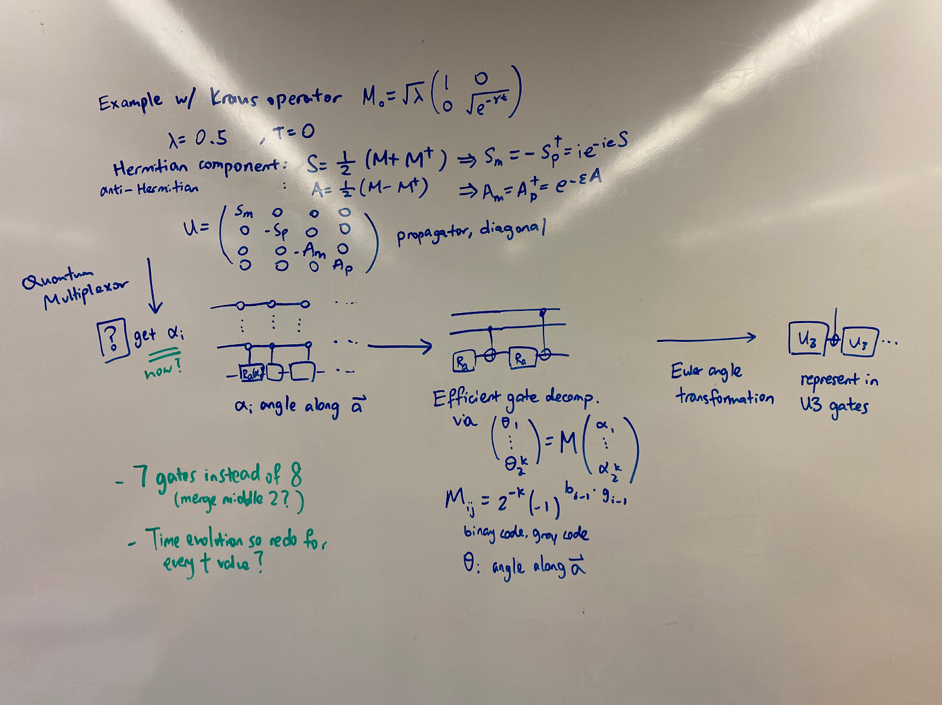

















Quantum multiplexor
Efficient gate decomposition
Euler angle transformation
$$…$$
$$…$$
$$…$$
$$…$$
$$…$$
$$…$$
$$…$$
$$…$$
$$…$$
$$…$$
$$…$$
$$…$$
Target operator (matrix)
$$R_{a}(α_{1})$$
$$R_{a}(α_{2})$$
$$R_{a}(α_{3})$$
$$R_{θ1}$$
$$R_{θ1}$$
$$U_{3}$$
$$U_{3}$$

