Slide 1
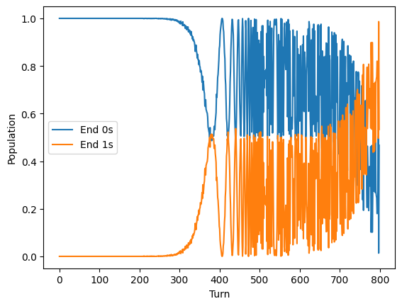
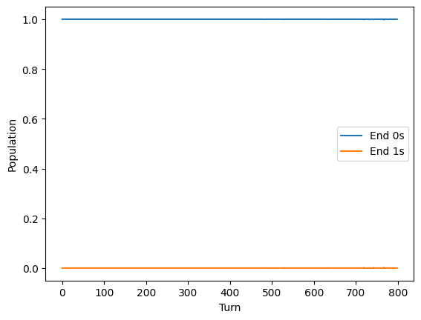
Probabilities Pj set as [0.15, 0.35, 0.35, 0.15] using Kvam et al. paper Lindbladian (cognitive science)
Same model with uniform probabilities Pj set as [0.25, 0.25, 0.25, 0.25] → no change?
https://github.com/GryphonTorch/Quantum/blob/master/Open%20system%20Lindbladian%20simulation.ipynb
Notes:
7 April – new model
Used Gunnar’s function to generate Gamma matrix and the Pj suggestions
4 number of states

Slide 2
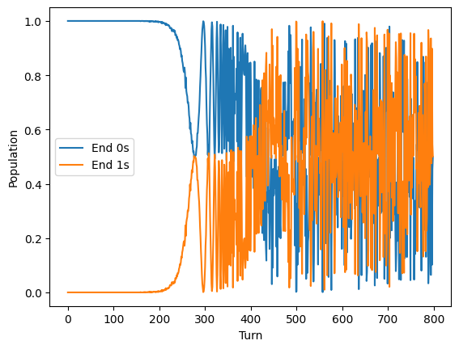
Probabilities Pj set as [0.1, 0.4, 0.4, 0.1] using Kvam et al. paper Lindbladian. Looks like a faster inversion?

