Slide 1
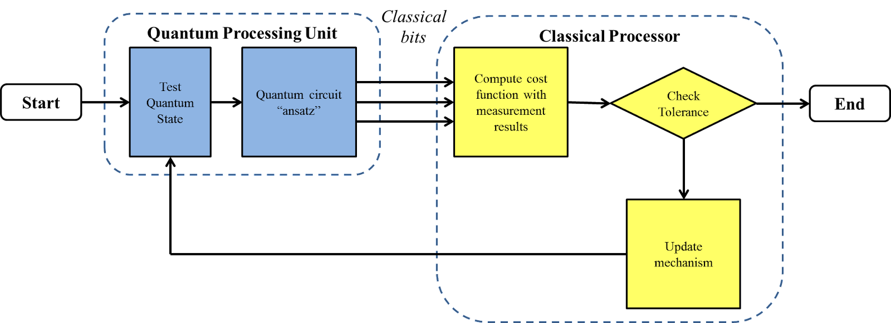
Classical bits
Quantum Processing Unit
Classical Processor
Test quantum state
Quantum circuit “ansatz”
Compute cost function with measurement results
Check tolerance
Start
End
Update mechanism

