Slide 1
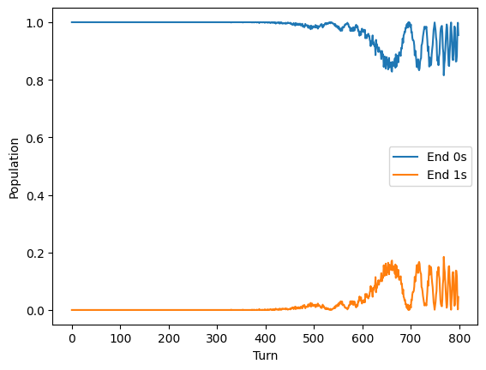
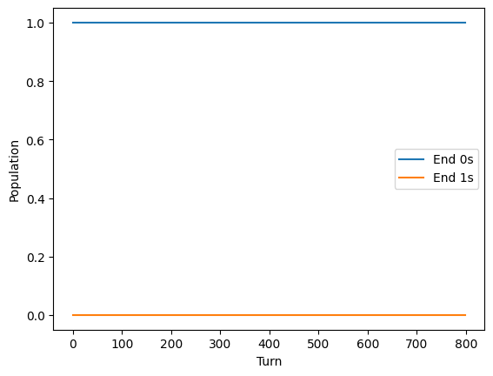
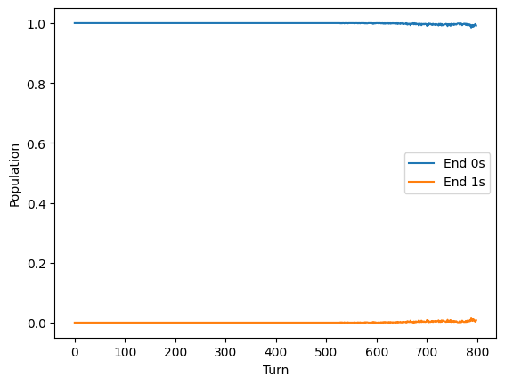
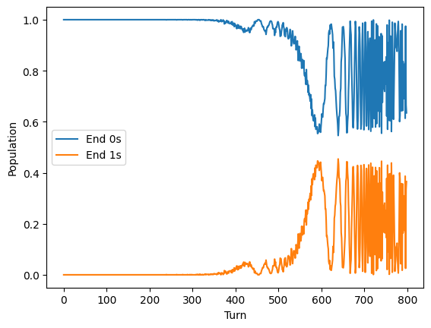
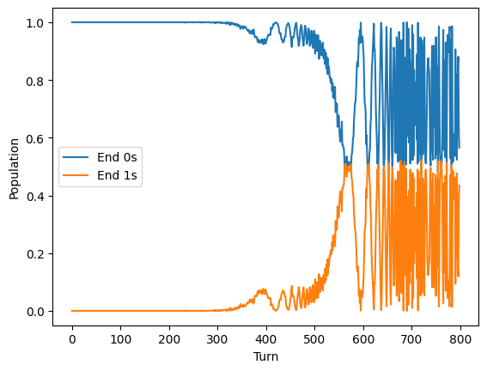
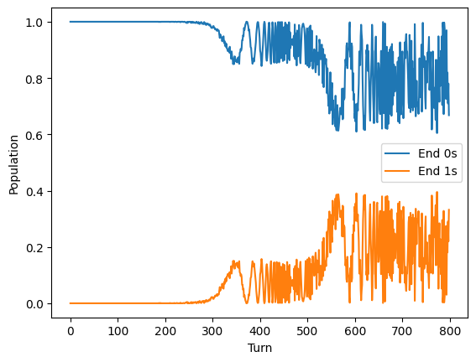
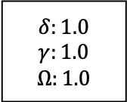
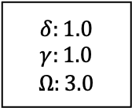
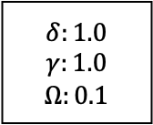
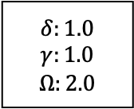
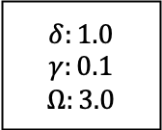
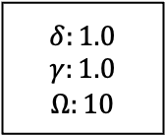
$$δ:1.0$$
$$γ:1.0$$
$$Ω:1.0$$
$$δ:1.0$$
$$γ:0.1$$
$$Ω:3.0$$
$$δ:1.0$$
$$γ:1.0$$
$$Ω:2.0$$
$$δ:1.0$$
$$γ:1.0$$
$$Ω:0.1$$
$$δ:1.0$$
$$γ:1.0$$
$$Ω:3.0$$
$$δ:1.0$$
$$γ:1.0$$
$$Ω:10$$
Notes:
Parameter investigations
Delta, gamma, omega
1,2,1 does not work
1,2,3 does not work – gamma cant be 2?

Slide 2
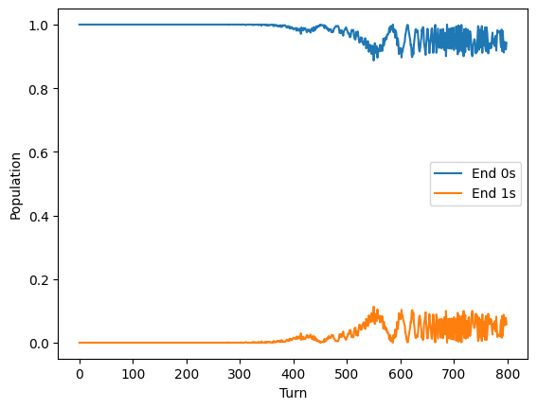
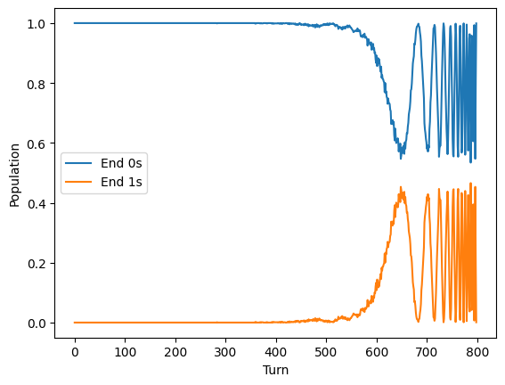
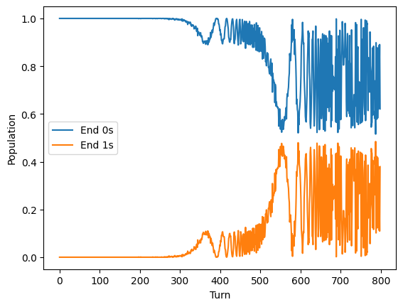
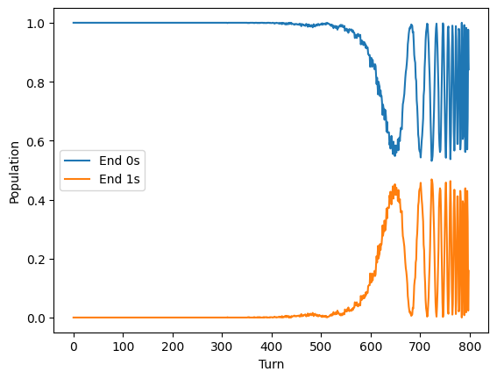
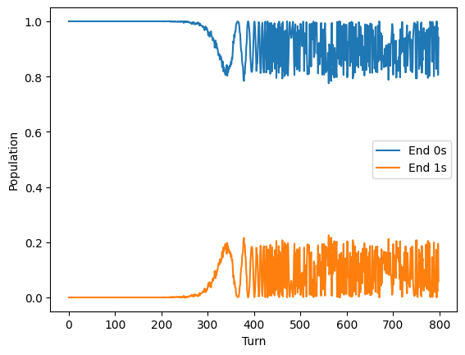
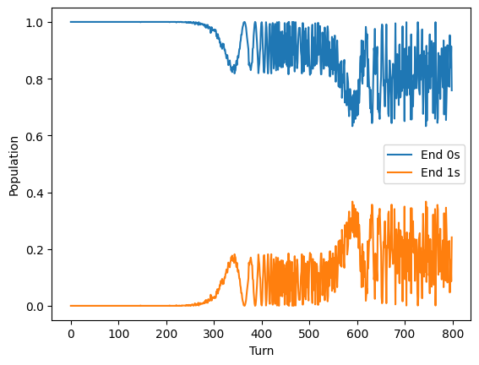
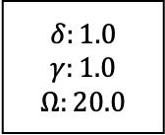
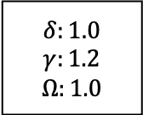
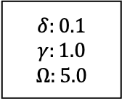
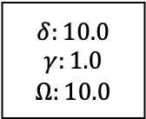
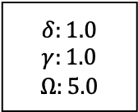
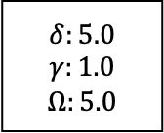
$$δ:1.0$$
$$γ:1.2$$
$$Ω:1.0$$
$$δ:5.0$$
$$γ:1.0$$
$$Ω:5.0$$
$$δ:1.0$$
$$γ:1.0$$
$$Ω:5.0$$
$$δ:10.0$$
$$γ:1.0$$
$$Ω:10.0$$
$$δ:0.1$$
$$γ:1.0$$
$$Ω:5.0$$
$$δ:1.0$$
$$γ:1.0$$
$$Ω:20.0$$

Slide 3
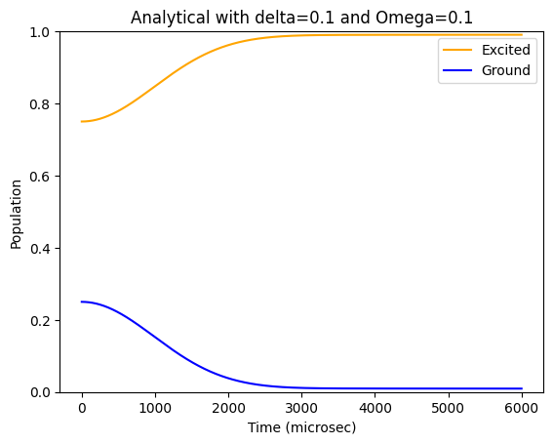
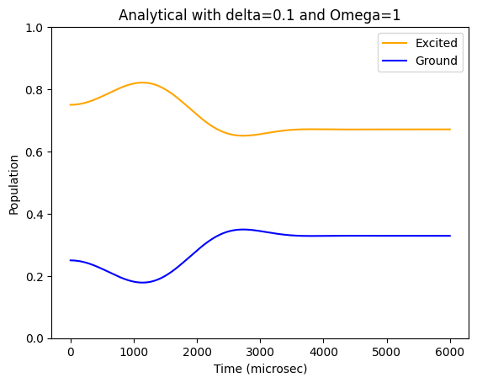
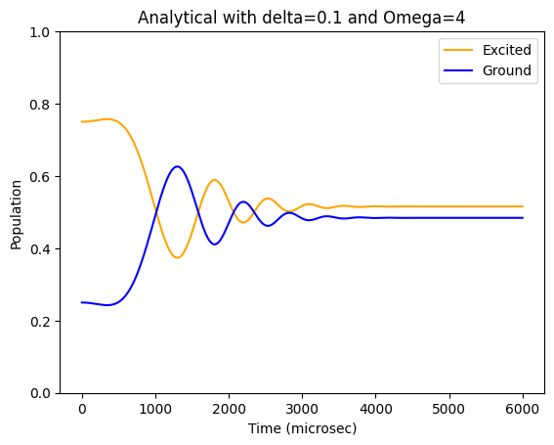
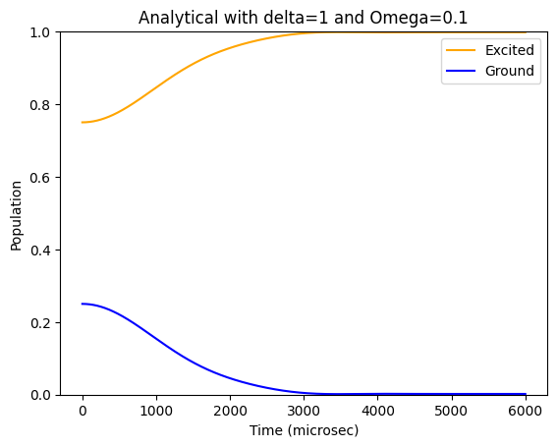
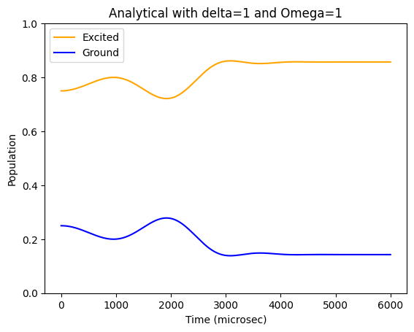
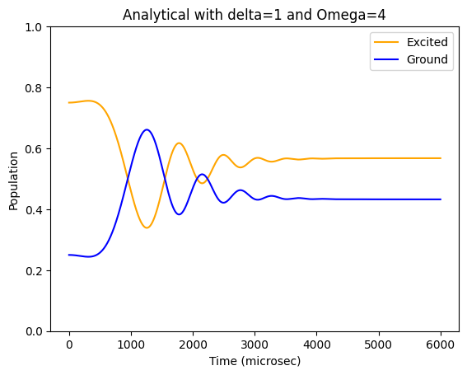
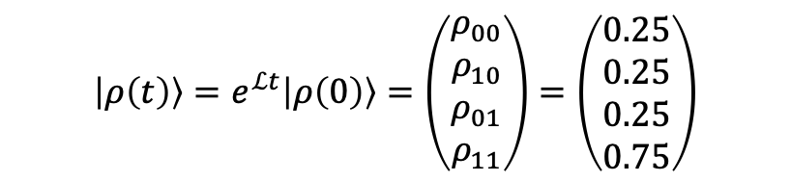
$$\left|ρ\left(t\right)\right\rangle =e^{ℒt}\left|ρ\left(0\right)\right\rangle =\left(\begin{aligned}ρ_{00} \\ ρ_{10} \\ ρ_{01} \\ ρ_{11}\end{aligned}\right)=\left(\begin{aligned}0.25 \\ 0.25 \\ 0.25 \\ 0.75\end{aligned}\right)$$

