Slide 1
istio
vikas

Slide 2
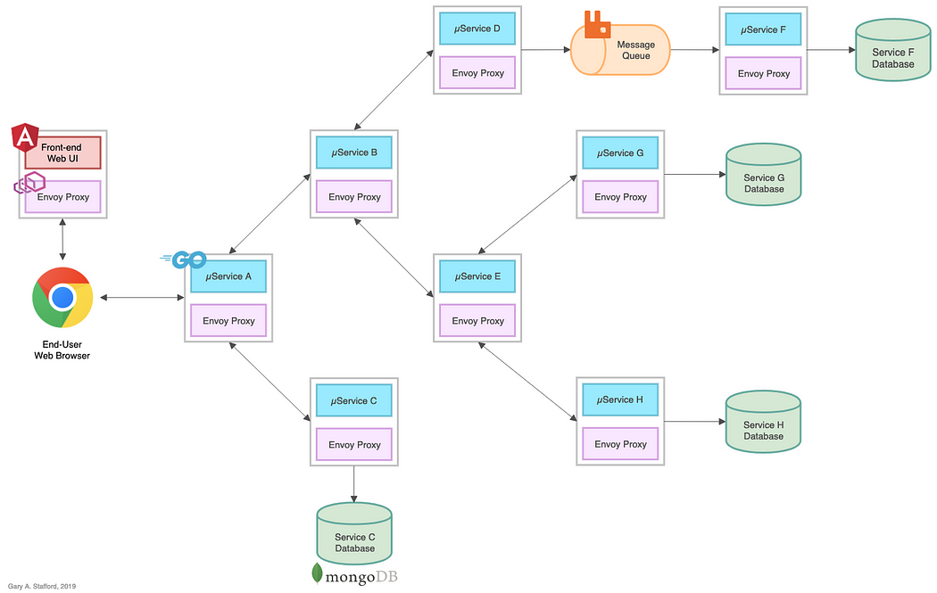
Notes:
Challenges with Microservices:
====================
No Encryption
No Load Balancing
No Failover / Auto Retries
Routing Decisions Load Metrics/ Logs
Access Control to Services

Slide 3
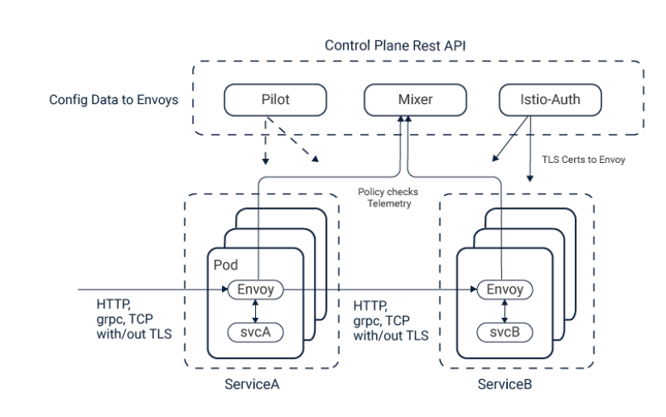
Notes:
Istio service mesh provides several capabilities for traffic monitoring, access control, discovery, security, resiliency, and other useful things to a bundle of services.
Istio deployed for Micro Services without any change in the code of Micro Service.
To make this possible, Istio deploys an Istio proxy (called an Istio sidecar) next to each service. All of the traffic meant for assistance is directed to the proxy, which uses policies to decide how, when, or if that traffic should be deployed to the service.
Istio service mesh, as suggested, uses a sidecar container implementation of the features and functions required mainly for microservice

