Slide 1

GKE
VIKAS

Slide 2
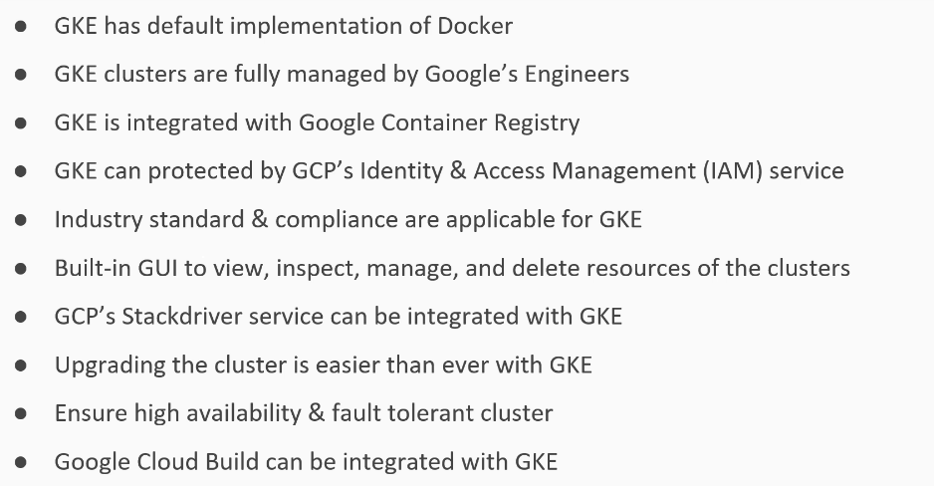
Notes:
Project – Organize cloud resources & billing.
gcloud auth list
gcloud projects list
gcloud config set compute/zone us-central1-a
gcloud projects create sample-project-2342 --name sample-project
gcloud config set project sample-project-2342

Slide 3
Notes:
Create k8s cluster:
k8s-Engine -- > cluster -- > Enable Billing -- > create cluster – name it -- >
gcloud container clusters create my-second-cluster
gcloud container clusters list
gcloud container clusters get-credentials <cluster-name >
kubectl create deployment webserver –image nginx:latest
kubectl expose deployment webserver --port 80 --type LoadBalancer
gcloud container clusters delete my-cluster

Slide 4
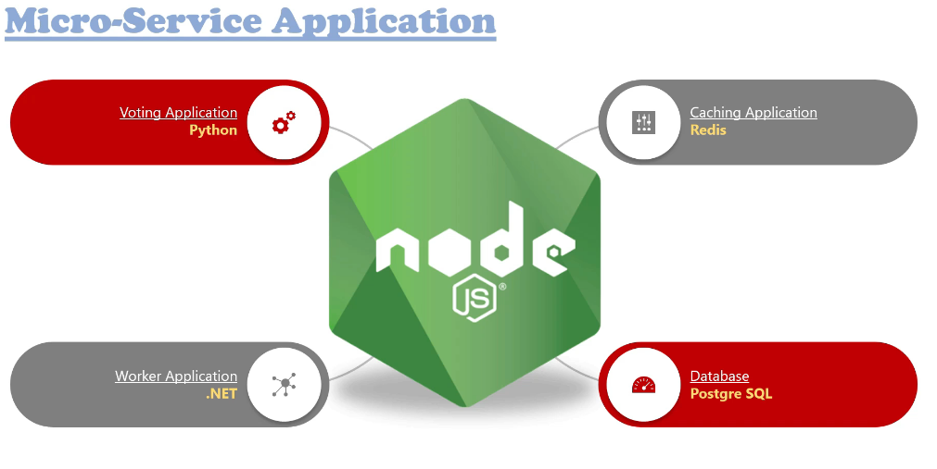
Notes:
https://github.com/vikas99341/k8s-masterclass/tree/main/microservices

